Slide 1
FRAUD TRANSACTION
DETECTION
A Machine Learning Pipeline for Binary Fraud Classification
Presenter: Emeron Marcelle
Date: June 18, 2026

Slide 2
OVERVIEW
Agenda
• Business Problem & Dataset Overview
• Data Cleaning & Missing Value Strategy
• Feature Engineering & Encoding
• Exploratory Data Analysis — Key Findings (with charts)
• Class Imbalance & Why It Matters
• Model Selection & Bayesian Hyperparameter Search
• Results: Classification Reports, PR Curve & Feature Importance
• Honest Assessment: Perfect Scores & Synthetic Data
• Deployed Inference App — Threshold Tuning & SHAP Explanations
• Limitations & Next Steps

Slide 3
CONTEXT
Business Problem
• Financial fraud costs institutions billions annually — detection must be fast and accurate
• Challenge: Fraudulent transactions are rare (~8% of all transactions)
• Goal: Build a binary classifier to flag fraudulent transactions at inference time
• Constraint: Model must be explainable to both technical and business audiences
•
• Dataset: 15,000 transactions · 18 features · domains: device, location, auth, behavioural
– Target: is_fraudulent_transaction (1 = fraud, 0 = legitimate)
– Class split: 13,800 legitimate vs 1,200 fraud

Slide 4
DATA
Dataset Feature Overview
Numeric Features
Categorical & Binary Features
• transaction_amount — USD value
• device_type — desktop / mobile / tablet
• transaction_hour — time of day (0–23)
• card_type — credit / debit / prepaid / virtual
• velocity_last_1hr — txns in last hour
• merchant_category — 8 categories
• failed_auth_attempts — prior failures
• transaction_channel — online / POS / ATM
• previous_fraud_flags — account history
• location_mismatch — binary flag
• distance_from_home_km — geo signal
• ip_country_match — binary flag
• amount_deviation_ratio — vs. avg spend
• cvv_match — binary flag
• account_age_days — account maturity
• is_weekend — binary flag

Slide 5
DATA CLEANING
Missing Data — Scale & Strategy
• Heavy missingness (~24–25%): transaction_amount, velocity_last_1hr, account_age_days,
– failed_auth_attempts, amount_deviation_ratio, distance_from_home_km, cvv_match
•
• Moderate missingness (~9–10%): transaction_hour, device_type, location_mismatch,
– previous_fraud_flags, merchant_category, card_type, ip_country_match, is_weekend
•
• Strategy chosen based on 3 factors: data type · distribution shape · fraud relevance
– MICE — continuous interrelated fraud signals (preserves correlation structure)
– Median — skewed numerics & binary flags (robust to outliers)
– Mode — low-variance binary & categorical columns

Slide 6
DATA CLEANING
Why MICE for Continuous Features?
• MICE = Multiple Imputation by Chained Equations
• Models each missing column as a function of all other columns — iterates until stable
•
• Key insight: fraud-signal features are interrelated:
– High velocity_last_1hr often co-occurs with high failed_auth_attempts
– High previous_fraud_flags correlates with distance_from_home_km
•
• Simple median imputation would break these correlations — MICE preserves them
• Applied to: velocity_last_1hr · account_age_days · failed_auth_attempts ·
– amount_deviation_ratio · previous_fraud_flags · distance_from_home_km

Slide 7
FEATURE ENGINEERING
Missingness as a Fraud Signal
• Key insight: the absence of certain values may itself indicate fraud
•
• cvv_match missing → CVV was never provided — suspicious behaviour
• transaction_amount missing → incomplete transaction record — unusual
• ip_country_match missing → IP was masked or unavailable — red flag
•
• Solution: created binary indicator columns BEFORE imputation:
– cvv_match_missing · transaction_amount_missing · ip_country_match_missing
•
• These indicators are kept as features — the model can learn from the fact
– that a value was missing, even after the missing value is filled
⚠ Indicator columns must always be created before imputation — doing it after results in all zeros.

Slide 8
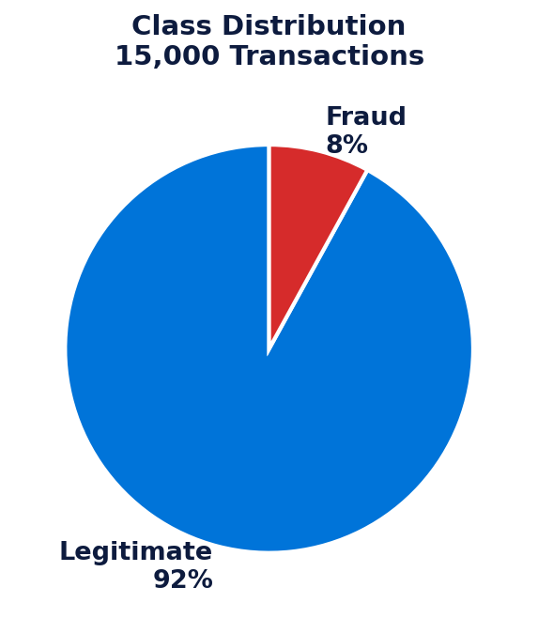
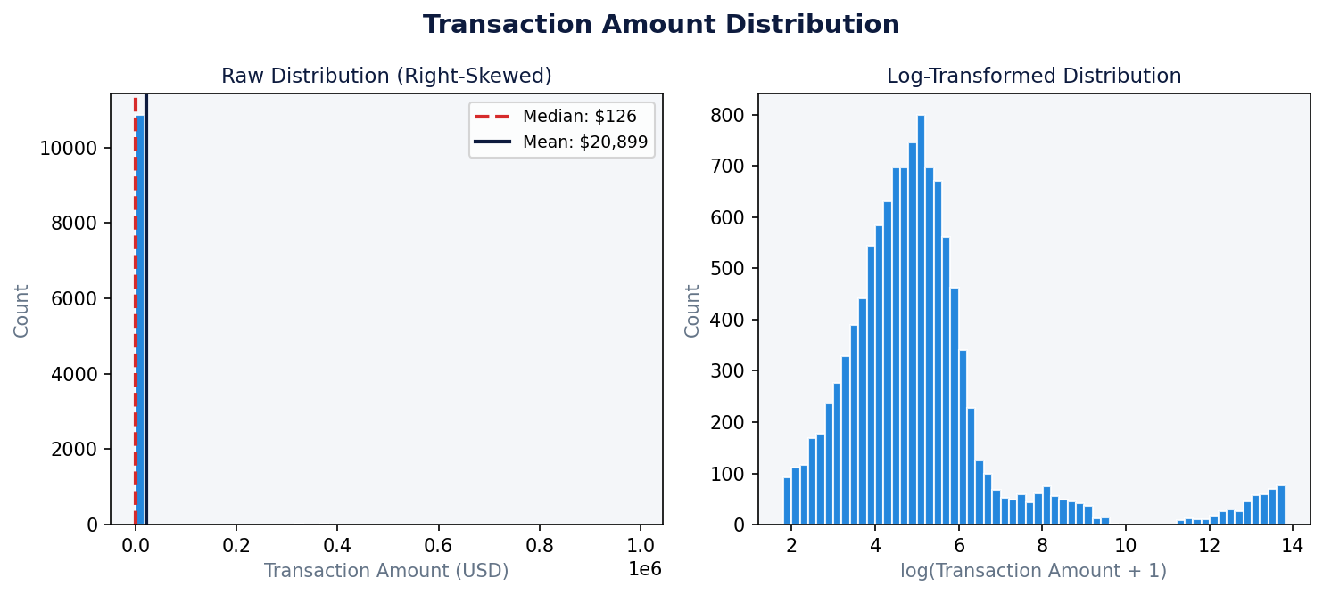
EDA
Class Imbalance & Transaction Amount Distribution
• 92% legitimate vs 8% fraud — accuracy alone would be misleading (predicting all-legit = 92%) • transaction_amount is heavily right-skewed: mean $20,898 vs median $126, max $995K • Log-transform normalises the distribution — recommended before production deployment

Slide 9
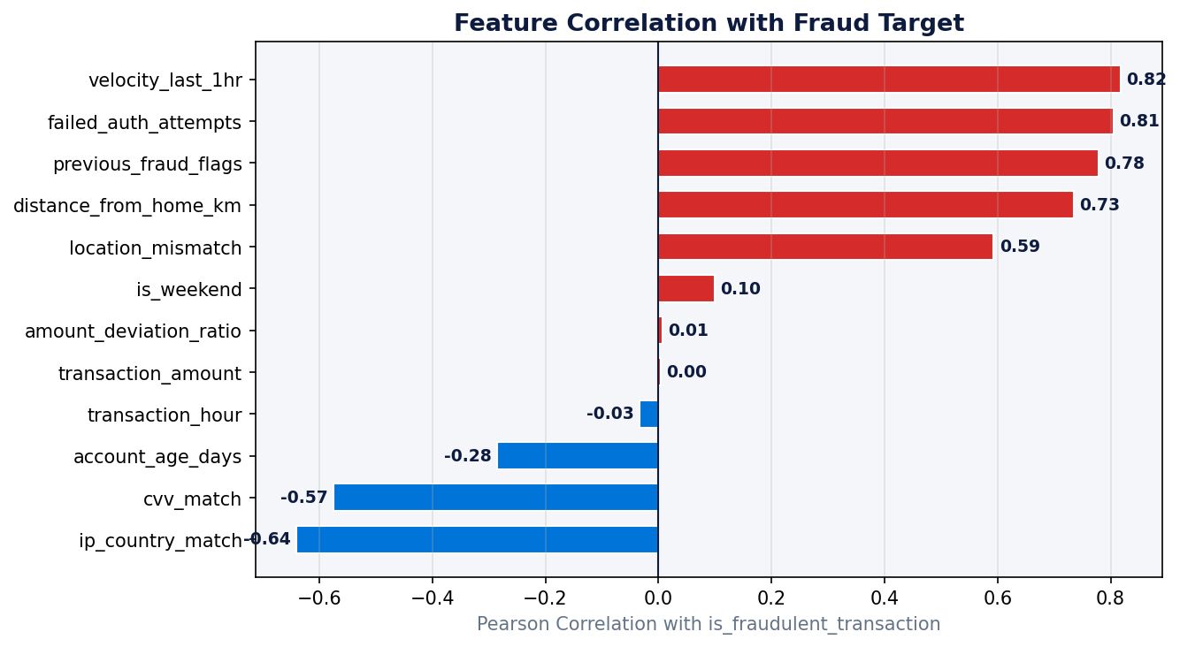
EDA
Feature Correlation with Fraud Target
Top Fraud Signals
• velocity_last_1hr
r = 0.82
• failed_auth_attempts
r = 0.81
• previous_fraud_flags
r = 0.78
• distance_from_home_km
r = 0.73
• ip_country_match
r = 0.64
• location_mismatch
r = 0.59
Behavioural signals dominate. No multicollinearity detected (all inter-feature r < 0.8)

Slide 10
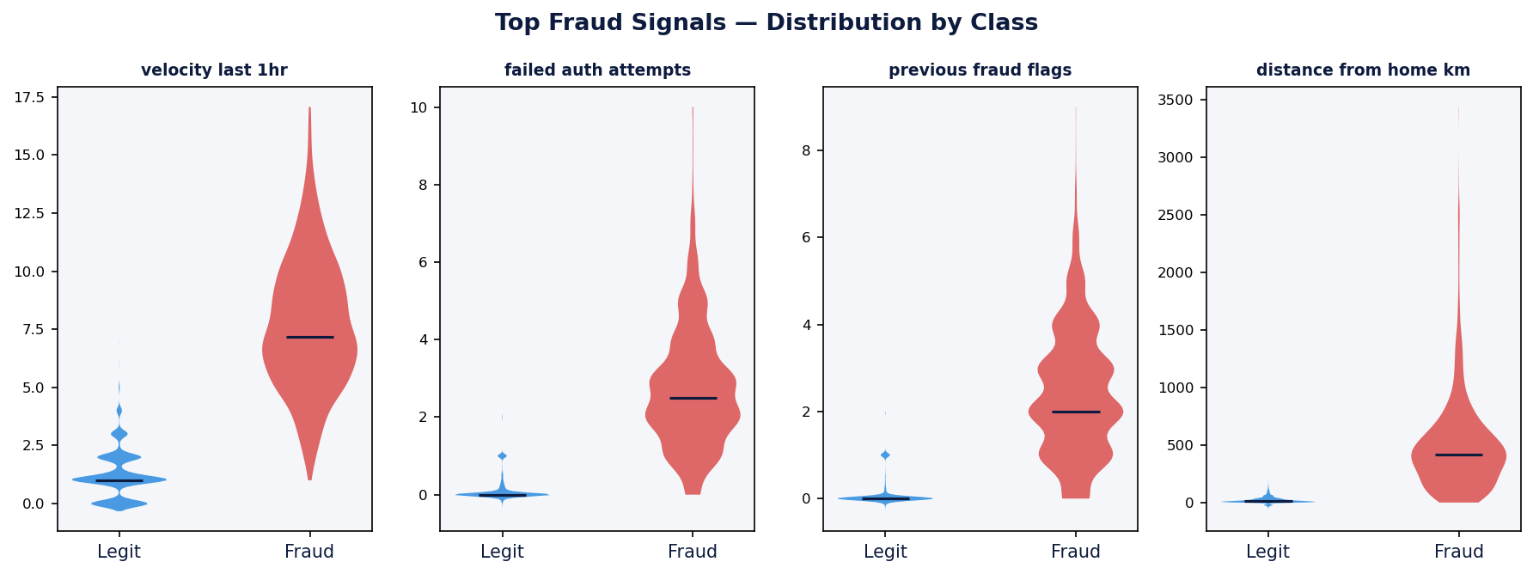
EDA
Top Fraud Signals — Distribution by Class
• Fraud transactions cluster at HIGH values for all four signals — clean separation in synthetic data • Legitimate transactions stay near zero — confirms these are the most discriminative features

Slide 11
MODELLING
Class Imbalance — Why It Matters
• Dataset: 13,800 legitimate (92%) vs 1,200 fraud (8%)
•
• A naive model predicting "not fraud" every time achieves 92% accuracy
– — but catches zero fraud cases. Accuracy is the wrong metric here.
•
• Solution: SMOTE (Synthetic Minority Oversampling Technique)
– Generates synthetic fraud samples by interpolating between real fraud cases
– After SMOTE: 11,040 legitimate vs 11,040 fraud in training set
•
• Critical rule: SMOTE applied to training set ONLY — never before splitting
– SMOTE placed inside the pipeline so it runs fresh per CV fold
– Prevents synthetic samples from leaking into validation or test sets
⚠ Metrics used: Precision · Recall · F1 · PR-AUC — not accuracy.

Slide 12
MODELLING
Model Selection — Simple to Complex
Algorithms Tested
Optimisation Strategy
• Logistic Regression — baseline
• XGBoost — high-performance benchmark
• Linear decision boundary
• Sequential error correction
• Fully interpretable coefficients
• scale_pos_weight for imbalance
• StandardScaler for feature normalisation
• Best performer on tabular fraud data
• Fast — establishes performance floor
•
•
• Bayesian Hyperparameter Search
• Random Forest — robust middle ground
• Smarter than Grid / Random search
• Ensemble of decision trees
• Learns from each trial — 30 iterations
• Handles outliers & mixed features
• SMOTE baked into each pipeline

Slide 13
RESULTS
Model Performance — All Three Models
Model
CV AUC
ROC-AUC
PR-AUC
F1 (Fraud)
Logistic Regression
1.0000
1.0000
1.0000
1.00
Random Forest
1.0000
1.0000
1.0000
1.00
XGBoost
1.0000
1.0000
1.0000
1.00
⚠ Perfect scores (1.0000) across all models warrant scrutiny. This dataset is synthetic — fraud patterns are too clean and consistent compared to real-world data. The model architecture and pipeline are sound; results should be validated on a real-world dataset before production deployment.

Slide 14
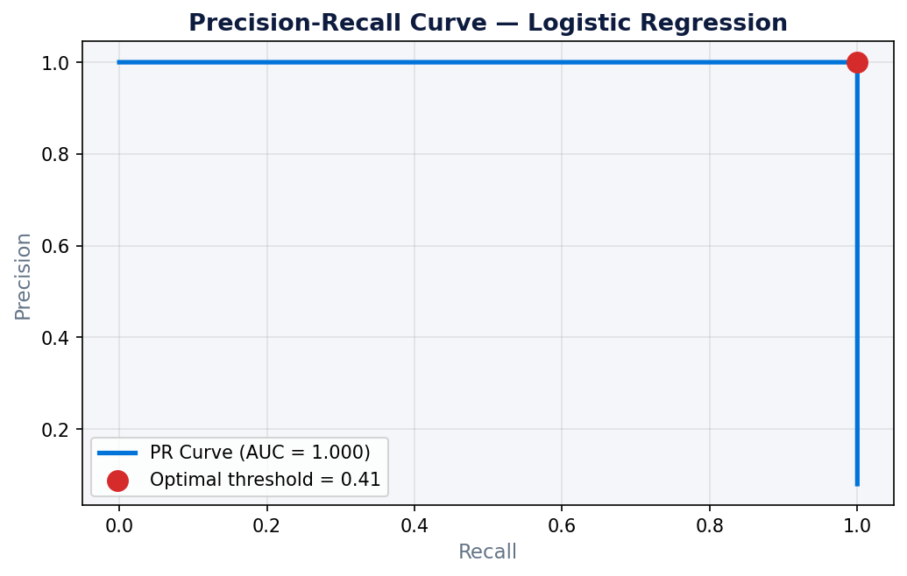
RESULTS
Precision-Recall Curve & Threshold Tuning
Why Tune the Threshold?
Default threshold = 0.5 is arbitrary
Optimal threshold maximises F1:
balances precision vs recall
Tuned threshold = 0.41
→ catches more fraud (higher recall)
→ accepts slightly more false positives
In fraud detection, missing a fraud case
is more costly than a false alarm
→ tuning toward recall is deliberate

Slide 15
RESULTS
Honest Assessment — Perfect Scores
• All three models achieved 1.0 AUC, F1, Precision and Recall on the test set
•
• This is NOT data leakage — confirmed by single-feature AUC analysis:
– Leakage would mean a feature encodes the answer (e.g. fraud confirmed after the fact)
– Our top features (velocity, failed_auth, previous_flags) are available at inference time
•
• Root cause: the dataset is synthetic
– Synthetic fraud datasets are designed with clean, consistent fraud patterns
– Real fraudsters adapt — legitimate users sometimes behave suspiciously
– Real datasets produce AUC in the 0.85–0.95 range, not 1.0
•
• Conclusion: pipeline and methodology are correct — on realistic data,
⚠ Recommendation: test on a real financial fraud dataset (e.g. IEEE-CIS or PaySim) before production.
– the performance will reflect true model capability

Slide 16
RESULTS
Feature Importance — Key Fraud Signals
• Top predictors consistent across all three models:
•
– 1. velocity_last_1hr r = 0.82 — rapid transactions = fraud signal
– 2. failed_auth_attempts r = 0.81 — repeated authentication failures
– 3. previous_fraud_flags r = 0.78 — account history is highly predictive
– 4. distance_from_home_km r = 0.73 — geographic anomaly detection
– 5. ip_country_match r = 0.64 — IP origin mismatch
– 6. location_mismatch r = 0.59 — registered address vs transaction location
– 7. cvv_match r = 0.57 — failed CVV verification
•
• Business insight: behavioural signals (velocity, auth failures) outperform
– static account signals (account age, card type) for fraud detection

Slide 17
DEPLOYMENT
Why Logistic Regression for Deployment?
• All three models performed identically on this synthetic dataset
• Logistic Regression chosen for deployment for three reasons:
•
– Interpretability: coefficients directly map features to fraud probability
– Business stakeholders can understand and audit the decision logic
•
– Speed: inference in microseconds — critical for real-time transaction scoring
– XGBoost and Random Forest are 10–100x slower at inference time
•
– Regulatory compliance: explainable models preferred in financial services
– Easier to justify decisions to regulators (e.g. GDPR, SR 11-7)
•
• On a real-world dataset with more noise, XGBoost would likely outperform LR
– and should be re-evaluated before production

Slide 18
DEPLOYMENT
Deployed Inference App — Streamlit
• Real-time inference web app — user enters 16 raw transaction fields via form
• Loads saved LR pipeline (fraud_lr_model.pkl) + tuned threshold (model_threshold.pkl)
•
• App applies the same preprocessing pipeline as the notebook:
– Creates indicator columns → one-hot encodes → aligns to 31-column model input
– StandardScaler applied before prediction (same scaler used in training)
•
• Output 1 — Risk Assessment:
– Fraud probability % · Decision threshold (0.41) · LEGITIMATE / FRAUD DETECTED verdict
•
• Output 2 — SHAP-style Explanation:
– Top 10 feature contributions (coef × scaled value) shown as colour-coded bar chart
– Red bars pushed toward fraud · Green bars pushed toward legitimate
– Key Drivers section lists top 3 features in each direction with input values

Slide 19
SUMMARY
End-to-End Pipeline
1
2
3
4
5
6
7
Raw Data
Cleaning
Feature Eng.
EDA
Modelling
Evaluation
Deployment
15K rows · 18 features · 8% fraud
▶
Drop ID · MICE · Median · Mode imputation
▶
Missingness indicators · One-hot encoding
▶
Skewness · Correlation · Class imbalance charts
▶
SMOTE in pipeline · Bayesian search · 3 models
▶
Classification report · PR curve · Threshold tuning
▶
LR + Scaler · Streamlit app · SHAP explanations

Slide 20
NEXT STEPS
Limitations & Next Steps
Remaining Limitations
Recommended Next Steps
• Synthetic dataset — fraud patterns are too clean
• Validate on real dataset (IEEE-CIS / PaySim)
• Perfect scores not representative of production
• Add LightGBM to model comparison
• Single model saved — no A/B infrastructure
• Set up model monitoring for drift detection
• No model drift monitoring in production
• Build proper A/B model testing infrastructure
• SHAP approximated via coef × value (not full SHAP)
• Add full SHAP background data for global explanations
• Containerise app with Docker for cloud deployment
✓ Already Resolved in This Project
• Add authentication layer to Streamlit app
✓ StandardScaler added to LR pipeline
✓ Classification threshold tuned via PR curve (0.41)
✓ Feature contributions (SHAP-style) shown in Streamlit app

Slide 21
CONCLUSIONS
Key Takeaways
Pipeline
Full end-to-end ML pipeline built: cleaning → imputation → encoding → modelling → deployment
Imbalance
SMOTE inside the pipeline correctly handles 8% fraud rate without data leakage
Signals
velocity_last_1hr, failed_auth_attempts, and previous_fraud_flags are the strongest fraud predictors
Improvements
StandardScaler, threshold tuning (0.41) and SHAP-style explanations all implemented and deployed
Deployment
LR pipeline deployed as a real-time Streamlit app with probability, threshold, and feature explanations
Honesty
Perfect 1.0 scores reflect a synthetic dataset — methodology is sound, not the scores

