Slide 1

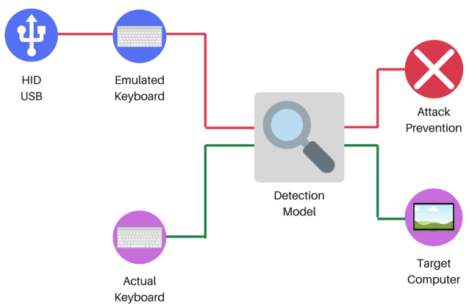
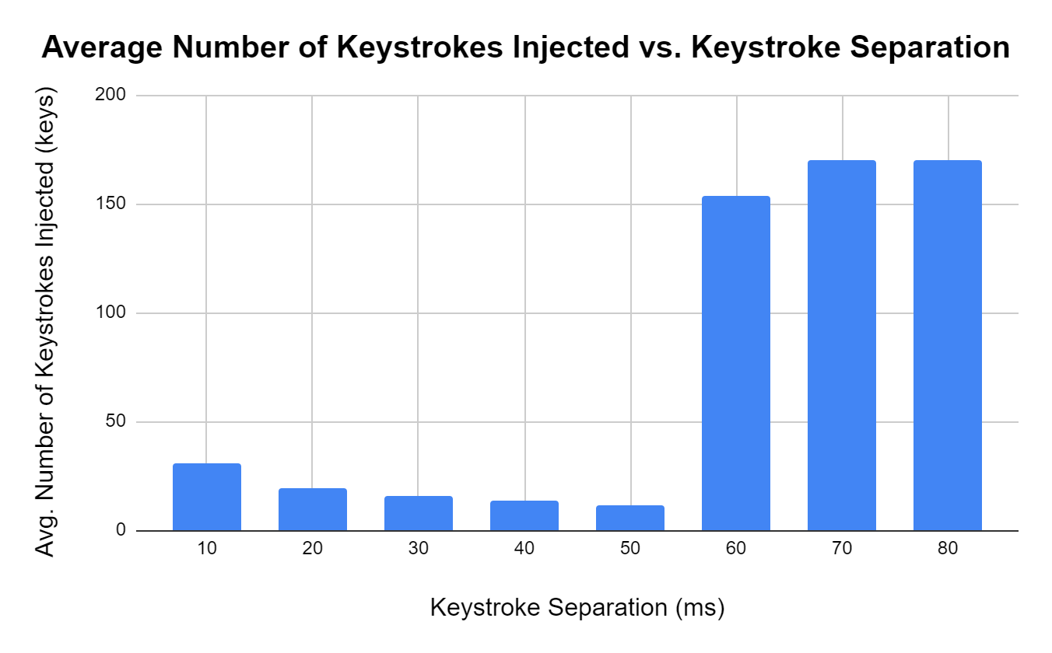
Keystroke Injection Detection and Mitigation
Emory Lindsey
Department of Computer Science and Information Systems
Georgia College & State University
Introduction
Keystroke injection is a hardware attack by which a USB device is used to type a sequence of keystrokes at inhuman speeds. Upon connection, a typical OS views such a device as a USB HID keyboard device. Since the USB protocol does not provide a standard for device authentication, USB buses and, by extension, operating systems often blindly trust connected devices regarding their advertised capabilities. The purpose of this research is to devise a simple detection mechanism that is capable of detecting and stopping a keystroke injection attack.
Methods
For primary testing, the Raspberry Pi Zero W was used to test a range of keystroke separation timings, denoted as s, where
s ≈ 10 ms, 20 ms, 30 ms, … 80 ms. For secondary testing, the Bash Bunny was used and was found to have a fixed value of s ≈ 10 ms.
Ten test runs were conducted for each distinct value of s and for each injection device used, recording the average number of keystrokes allowed for each value of s, denoted as k.
Conclusion
In order to effectively analyze the primary and secondary test results, a few factors must be taken into consideration. First, as mentioned in the Methods and Results section, the values for s are approximate values. This is the case due to the fact that the monitoring software occasionally calculated values slightly above/below the variable value for s. This fact coupled with how the detection model uses s_{avg} calculated over four keystroke events helps to explain the prevalence of false negatives as the value of s becomes close to the threshold of 80 ms. Secondly, a value of k ≈ 30.9 might be alarming; however, this maximum value includes the whitespace characters found within the payload and any keystrokes needed to launch a terminal environment within a given operating system. In addition, many malicious Linux-based keystroke injection payloads are themselves longer than 30 characters. Finally, an attacker is more likely to choose a Bash Bunny for a social engineering engagement due to its inconspicuous nature. Therefore, due to practical points mentioned above and the promising results found in secondary testing, the detection/prevention model was discovered to be effective in a practical sense.
Figure 1. Visual Overview of Detection/Prevention Model
Figure 2. Primary test results (P4wnP1 A.L.O.A.)
Materials
Keystroke Injection Devices:
1. Raspberry Pi Zero W (P4wnP1 A.L.O.A. image)
2. Bash Bunny
Host/Victim Machine:
Raspberry Pi 3 Model B+ (Raspbian image)
Results
During primary testing, the value of s and k were found to be inversely proportional for values of s ≈ 10 ms, 20 ms, …, 50 ms with the maximum value of k ≈ 30.9 and the minimum value being k ≈ 11.5. There was a significant number of false negatives for values of s ≈ 60 ms, 70ms, and 80 ms. During secondary testing, the detection model allowed an average number of 10.8 keystrokes.
References
Neuner, S., Voyiatzis, A. G., Fotopoulos, S., Mulliner, C., & Weippl, E. R.: USBlock: Blocking USB-based Keypress Injection Attacks.(2018, July 10).
Umphress, D., Williams, G.: Identity verification through keyboard characteristics.International journal of man-machine studies 23(3), 263–273 (1985)
S. (2020, November 14). Reverse Shell Cheat Sheet. Retrieved December 16, 2020, from https://github.com/swisskyrepo/PayloadsAllTheThings/blob/master/Methodology%20and%20Resources/Reverse%20Shell%20Cheatsheet.md

