Slide 1
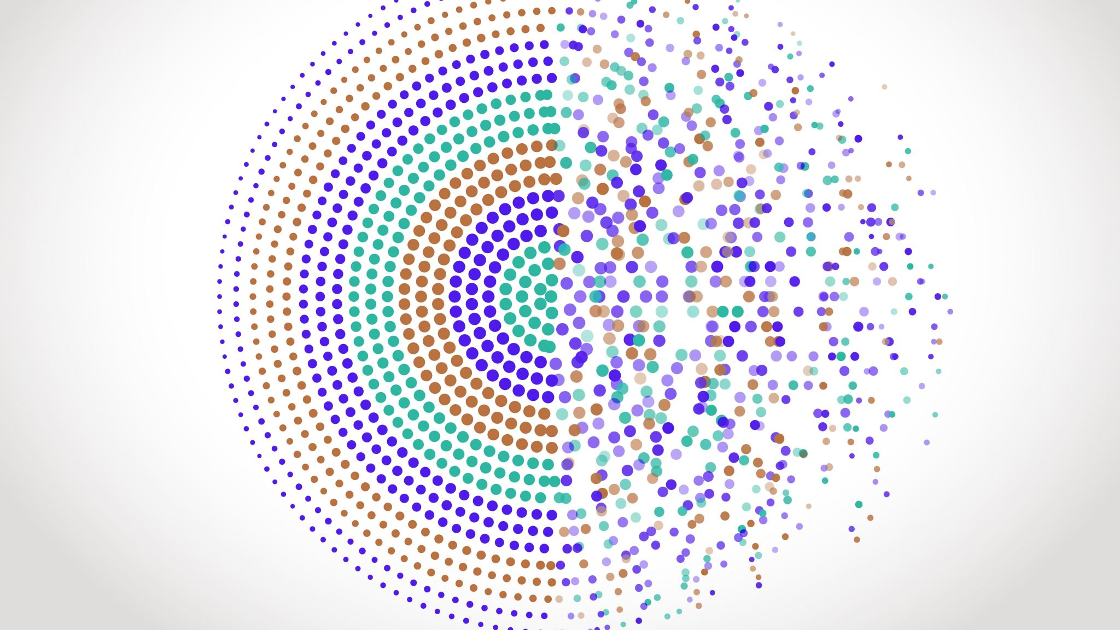
Hate Speech Detection
Emerson Cardoso
Sameer Hans

Slide 2
What is TikTok??
2017
It is a recreational app, launched in 2017
Aug. 2020
Became extremely popular with 2 billion downloads in August 2020

Slide 3
Problem Statement
1. A lot of content on TikTok includes abusive language
2. They contain Hate speech, Swear and racist words
3. Sometimes there is indecent behaviour also

Slide 4
Overview of Solution
Software Engineering
Developed an API to download the content and translate it into sentences
Sentiment Analysis
Reading the translated sentences and then classifying if it is a hate speech or not

Slide 5

Software Engineering

Slide 6
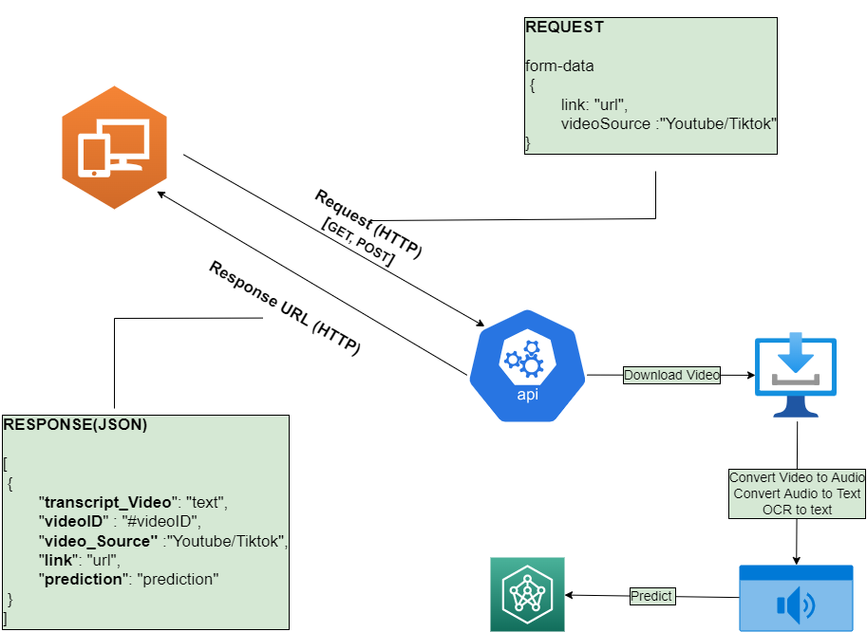
Architecture of Product

Slide 7
Tool used to Design
User Interface
Rest API
Vanilla JavaScript
HTML
CSS
Python
Gunicorn
Bottle

Slide 8
Performance
 | Time in Seconds
 | Test1 |  | Test2 |  | Test3
 | Normal | Threads | Normal | Threads | Normal | Threads
Download Video | - | - | - | - | - | -
Convert Video to Audio | - | - | - | - | - | -
Convert Audio to Text | 22.69 | 11.29 | 21.32 | 12.55 | 24.65 | 13.06
Convert OCR to Text | 47.27 | 8.6 | 45.12 | 10.35 | 52.18 | 7.15
Prediction | - | - | - | - | - | -
Total | 69.96 | 19.89 | 66.44 | 22.9 | 76.83 | 22.36

Slide 9
Performance

Slide 10

Sentiment Analysis

Slide 11
Introduction
Natural Language processing is widely used for this scenario
NLP uses preprocessing steps and machine learning algorithm
ML models classify the text as Hate Speech or Offensive Language or Neither.

Slide 12
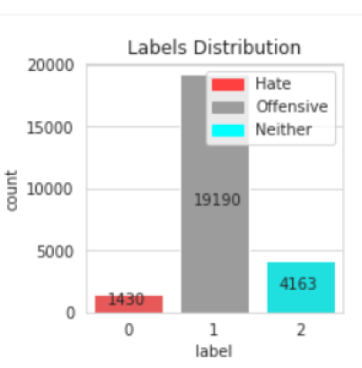
Dataset
Require 3 labels in the dataset (positive, negative or neutral) to avoid false positives
Used twitter labelled data for training the model
The dataset has three labels that is Hate, Offensive or Neither
Below is the label distribution of dataset

Slide 13
Pre-Processing
Data Cleaning: removing garbage noise such as punctuations, symbols etc.
Performed tokenization: breaking down a piece of text (the tweet) into smaller pieces (words)
Replaced Chat words: After tokens were obtained replaced few words like ppl to people
Implemented Lemmatization: It removes the grammar tense and restores the original form of each word like books will be considered as book only.

Slide 14
Modeling
Tried various ML models like SVM and Decision tree but they did not perform well
Implemented LSTM and Transformer(Bert).
Bert model was giving us the best results, so this was selected
Feature Extraction was done with Bert pre trained model

Slide 15
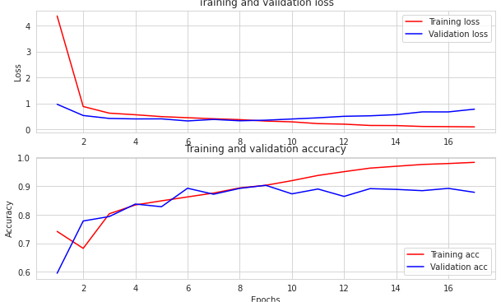
Evaluation and Performance
We got the accuracy of 0.98 and 0.88 for the training and validation datasets respectively.
We stop training our model after 25 epochs because the model started to overfit.
For the hyperparameters, we considered the learning rate to be 3e-5 and the optimizer as adamw.

Slide 16
Conclusion
Successfully created an API to download the videos and extract the sentences
Effectively designed a solution with Transformer Bert to classify hate Speech

Slide 17
Future Work
Solve
Solve the overfitting problem
Model
Model Bert for multi-Language like French, German, Hindi etc.
Enhance
Enhance API to send the analysis to Annotator website
Deploy
Deploy the website

Slide 18



Simulation

Slide 19


Thank You

