Slide 1
Hunting the Higgs with Machine Learning
What the ATLAS Higgs ML Challenge teaches us about finding a needle in a very large haystack
Emerson | DATA 400 Mini-Project
Notes:
About 30 seconds. Welcome everyone. In the next 20 minutes: what the Higgs boson is, why finding it in data is hard, how I used machine learning on the ATLAS Higgs Challenge dataset, and why physicists score models with AMS instead of just AUC.

Slide 2
What is the Higgs boson?
1
A particle with a job
Proposed almost 50 years ago to explain why other elementary particles have mass.
125 GeV
2
The last Standard Model piece
The Higgs mass. A proton is about 1 GeV, so that is roughly 125 protons' worth of energy packed into one particle.
Every other ingredient had been found; the Higgs was the holdout.
3
Found at CERN in 2012
ATLAS and CMS announced it; Englert and Higgs won the 2013 Nobel Prize in physics.
Notes:
About 1.5 minutes. Keep this light for freshmen. The Higgs was proposed almost 50 years ago as the particle tied to how other elementary particles get mass. It was the final missing ingredient of the Standard Model. ATLAS and CMS at CERN announced the discovery in 2012; Englert and Higgs got the Nobel Prize in 2013. Analogy for the 125 GeV: a proton weighs about 1 GeV, so a Higgs is roughly 125 protons' worth of mass-energy.

Slide 3
Where the data comes from
20,000,000
400
events per second reach the trigger
events per second saved to disk
trigger
1 in 50,000
~3 PB
~10
events survive the trigger
of raw data saved per year
particles of interest per event
Notes:
About 1.5 minutes. At the Large Hadron Collider, proton bunches cross inside the ATLAS detector. A trigger system, which is itself a cascade classifier, throws away almost everything. The paper says the rate drops from 20 million to about 400 events per second, so we keep about 1 in 50,000. Even after that, most saved events are known background, which sets up the next slide.

Slide 4
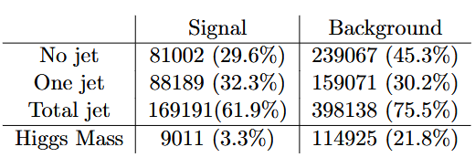
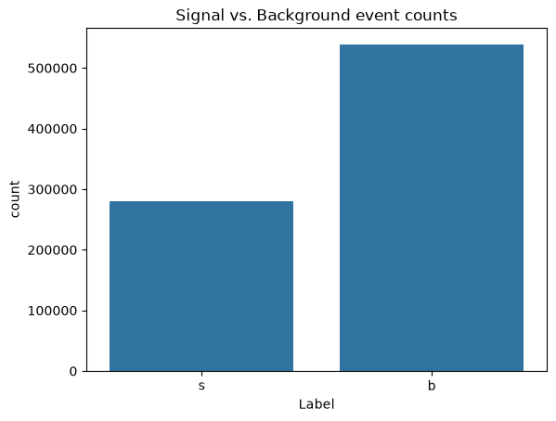
A needle in a haystack
Signal
A Higgs boson decaying into two tau particles.
Background
Known processes that leave a similar fingerprint in the detector.
Signal is much rarer than background.
Notes:
About 1.5 minutes. This is the slide for your signal versus background graph. The paper does not include a chart of this, so insert your own: for example, a bar chart of the summed event weights for signal versus background from your dataset (df.groupby('Label')['Weight'].sum()). Use a log scale if the signal bar is too small to see, which is the whole point. The paper says signal probability is several orders of magnitude lower than background, which is why the training samples get rebalanced.

Slide 5
The signal and its look-alikes
Z boson to two taus
THE SIGNAL
1
H → ττ
Mass 91.2 GeV, close to the Higgs and far more common. The toughest look-alike.
A Higgs (125 GeV) decays into two tau leptons.
Top quark pairs
2
Their decays can also leave a lepton and a hadronic tau.
Neutrinos escape the detector, so we can't weigh each Higgs directly.
W boson decays
3
Only mimic the signal when the detector misidentifies a particle.
Notes:
About 1.5 minutes. The signal is a Higgs decaying into two taus, where one tau becomes an electron or muon plus neutrinos and the other becomes a hadronic tau plus a neutrino. The Z boson also decays into two taus, happens much more often, and has a mass of 91.2 GeV, close enough to 125 GeV that the two are hard to separate. Neutrinos escape undetected, so the mass cannot be measured directly. Top quark pairs and W boson decays are the other two background processes in the Challenge.

Slide 6
The Challenge dataset
818,238
30
2
simulated events
features per event
classes: signal and background
PRI features
DER features
Weights and -999
Raw measurements: momenta and angles of the lepton, tau, jets, and missing energy.
Derived quantities that ATLAS physicists built, like the invariant mass of a particle pair.
Each event carries a weight (its share of real 2012 data). A value of -999.0 means undefined.
Notes:
About 1.5 minutes. The opendata.cern.ch version has 818,238 simulated events, merged from the original Kaggle training, public and private sets plus a withheld set. There are 30 features. PRI features are raw measurements; DER features are quantities ATLAS physicists computed from them. A value of -999.0 means the feature is undefined for that event. Weights are not features: each event's weight is its share of the expected number of real events during 2012, and the weight distributions would give away the label. EventId, Weight, Label, KaggleSet and KaggleWeight must not be fed to the classifier.

Slide 7
My approach
1
2
3
4
5
Load data with a DataLoader class
Split into train and validation
Train a LightGBM model
Check ranking with ROC and AUC
Pick a cut and measure AMS
Why gradient boosted trees? They are fast on 800K rows, strong on tabular data, and the Challenge's top entries leaned on boosted trees too.
Notes:
About 1.5 minutes. Walk through the pipeline left to right. I used LightGBM, a gradient boosted decision tree library, after first planning around XGBoost. Both are fast and strong on tabular data. I evaluated with ROC and AUC first, then moved to the physics metric (AMS) by choosing a cut on the model's output score. The code lives in a GitHub repo with a DataLoader class in src/ and a notebook that calls it.

Slide 8
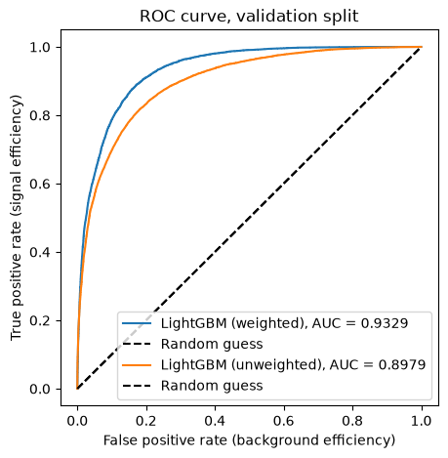
My ROC curve
[ Insert ROC curve here ]
0.9329
weighted AUC
0.8979
unweighted AUC
Notes:
About 2 minutes. Drop your ROC curve image into the placeholder. Explain the axes: true positive rate on the y-axis (how much real signal we catch), false positive rate on the x-axis (how much background we wrongly flag). The diagonal is a coin flip. AUC is the area under the curve: 0.5 is random, 1.0 is perfect. Weighted AUC uses the event weights, so it reflects the physics proportions; unweighted AUC treats every simulated event equally. Update the numbers on the right if your final run differs.

Slide 9
Why AUC is not the whole story
What AUC measures
What physicists need
Ranking quality across every possible threshold
Treats every event and every mistake equally
0.5 is a coin flip; 1.0 is perfect
One fixed selection region (a single cut)
Lots of signal inside it, very little background
Weights matter: a few stray background events can swamp the signal
vs
AUC asks: does it rank well? AMS asks: would we claim a discovery?
Notes:
About 2 minutes. AUC asks how well the model ranks signal above background across every possible threshold, and it treats every event and every mistake the same. But a physicist picks one selection region and asks whether the events inside it would convince us of a discovery. That means lots of signal and very little background in that region. Because background is so abundant, a few stray background events can swamp the signal. Analogy: AUC grades a smoke detector on how well it ranks rooms by fire risk; AMS asks how it performs once you set the alarm level and count real fires against false alarms.

Slide 10
AMS: the score physicists use
AMS = s / √b
s = signal
b = background
Bigger is better
Weighted count of true Higgs collisions that my model selects.
Weighted count of look-alike collisions that sneak into the selection.
A higher AMS means stronger evidence. 5 sigma counts as a discovery.
Challenge version: AMS = √( 2 ( (s + b + b_reg) ln(1 + s / (b + b_reg)) − s ) ), with b_reg = 10. It matches s/√b when s is much smaller than b.
Notes:
About 2 minutes. AMS stands for approximate median significance. In its simplest form it is s divided by the square root of b. Here s is the weighted number of true signal events (real Higgs collisions) that my model selects, and b is the weighted number of background events that sneak into the selection. The square root comes from Poisson statistics: random background fluctuates by about sqrt(b), so we compare the excess to that noise. Physicists call the result sigma; 5 sigma counts as a discovery. The Challenge used the fuller formula with a regularization term b_reg = 10 so the score does not get noisy when the selected region is tiny. The paper says the two agree when s is much smaller than b.

Slide 11
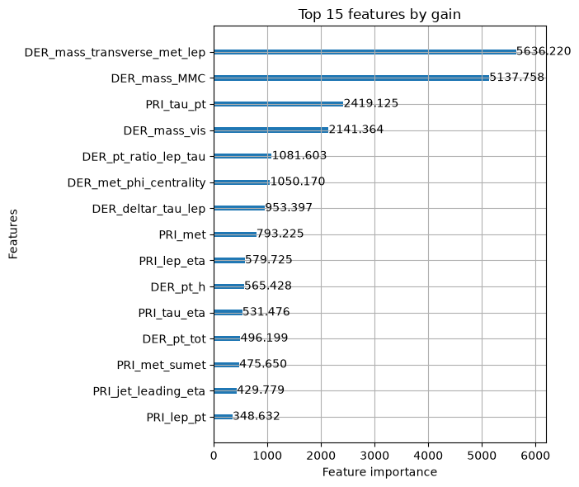
How the features were split:

Slide 12
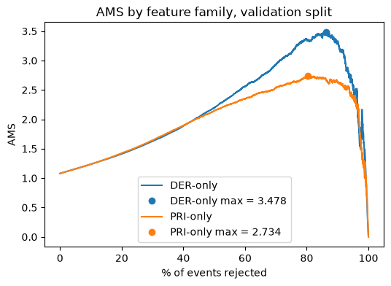
Difference in AMS by split

Slide 13
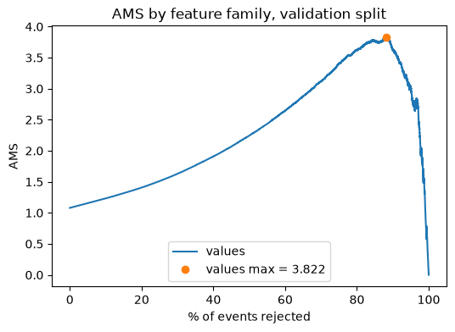
My AMS curve
[ Insert my AMS curve here ]
How to read it
x-axis: how strict my cut is
y-axis: AMS at that cut
The peak is my best selection region
My Best AMS: 3.822
Threshold: 3.85
Notes:
About 1.5 minutes. Drop in your AMS-versus-threshold curve. Explain that as the cut gets stricter, s and b both shrink, and AMS rises and then falls once too little signal is left. The peak is the best selection region for my model. Fill in the best AMS and its threshold in the card on the right.

Slide 14
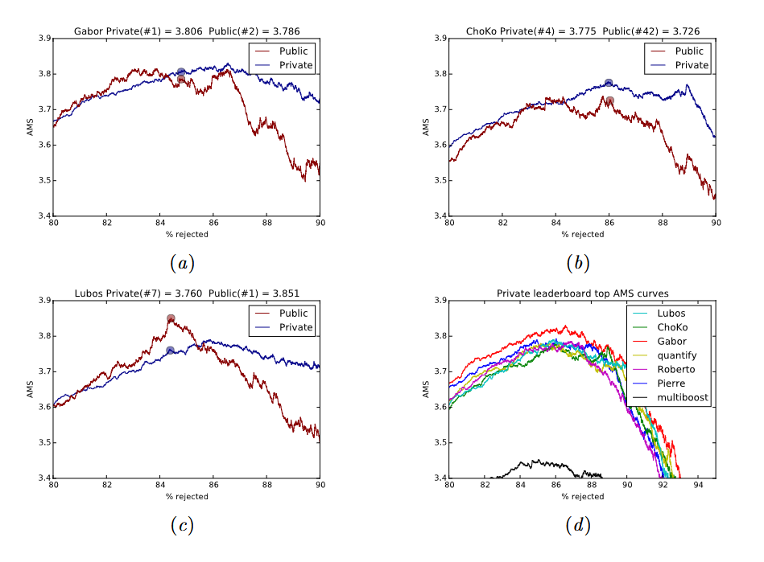
Previous graphs
Notes:
About 2 minutes. Show your AMS curve on the left and the reference result from the paper on the right. Point out three things: how high the peak is, where along the threshold axis it sits, and how close you get to the reference. Be upfront that the Challenge paper (the PDF) does not publish leaderboard scores, so the reference needs to come from the source you are comparing against.

Slide 15
Takeaways
1
Higgs searches are needle-in-a-haystack problems: the signal is far rarer than the background.
2
AUC checks ranking. AMS (s / √b) checks whether a selection could support a discovery.
3
Next: tune the threshold to push AMS higher and check it against published results.
Questions?
Notes:
About 1 minute plus questions. Three points: the problem is a needle in a haystack, AUC and AMS answer different questions, and the next step is tuning the cut and checking against published results. Then open for questions.

