Slide 1

C S
Control Interface Switching

Slide 2
Loading…

Slide 3
Conecting to server…

Slide 4
C S
Done…

Slide 5




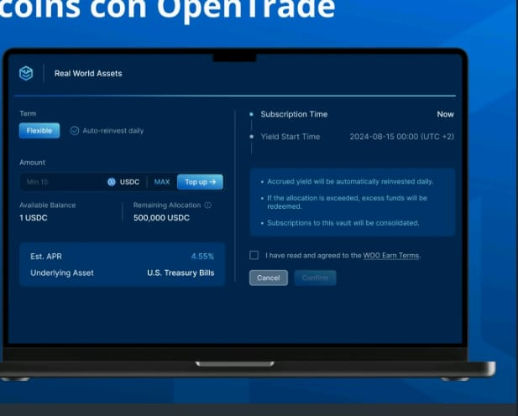
C S
C S
Control Interface Switching
Control Interface Switching
User Name (Nombre)
Password (Contraseña)
Admin (Administrador)
LOGIN

Slide 6


Slide 7



Slide 8

#01244A
BG
#1F4E79
BG
#5597D3
FG

Slide 9
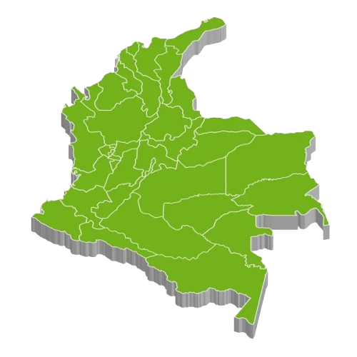
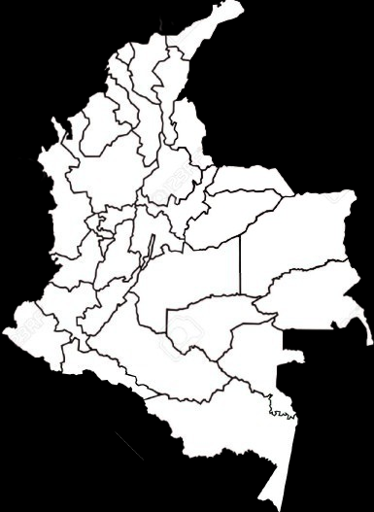
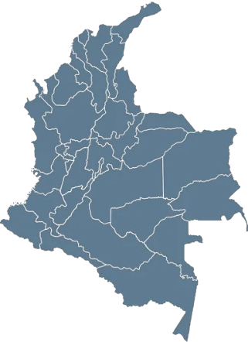

Slide 10
