Slide 1
Web Básico 1 y 2
Emerson Perales - CETI

Slide 2
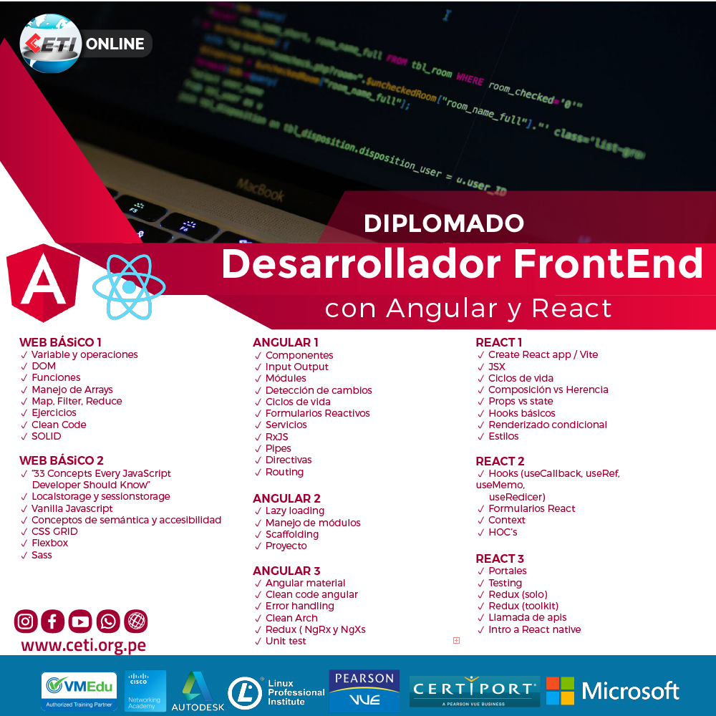
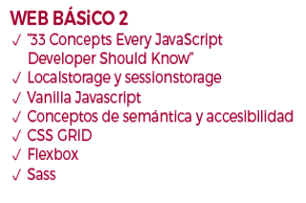
Temario

Slide 3



Requisitos Instalaciones
Editor de código
Servidor web
Live server
Cliente web

Slide 4
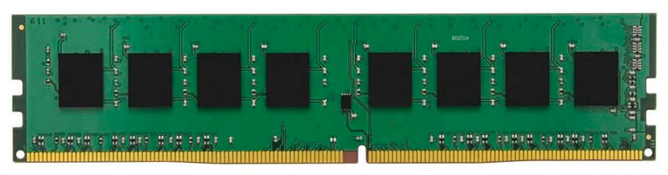
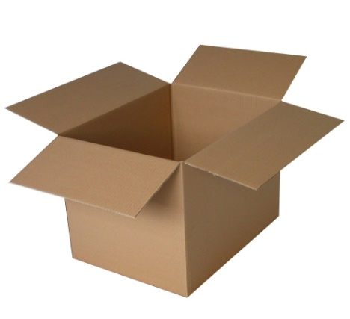

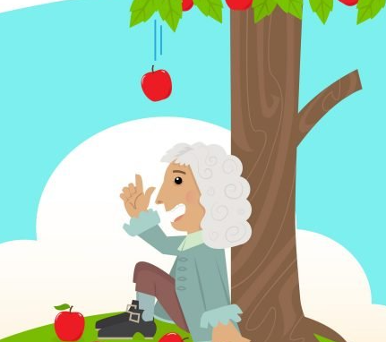
Variables
Variable
RAM
Naming Conventions
PascalCase
camelCase
snake_case
UPPER_CASE
lowercase

Slide 5
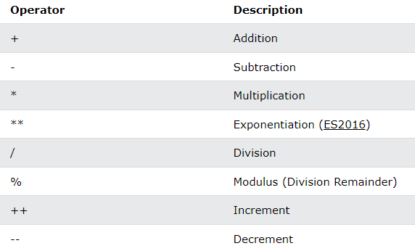
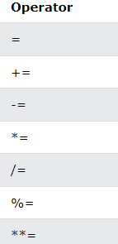
Operaciones
Arithmetic
Assignment

Slide 6
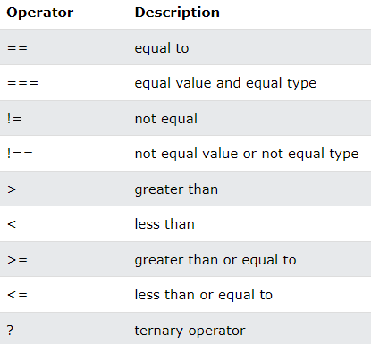
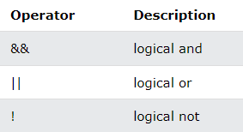
Operaciones
Comparison
Logical

Slide 7

Context
Is an international community that develops open standards to ensure the long-term growth of the Web.
W3C(Worl Wide Consortium)
DOM
Object (Html elements)
Properties
Methods
Events
Standar
(Document Object Model)
Object model
Programming
Interface

Slide 8
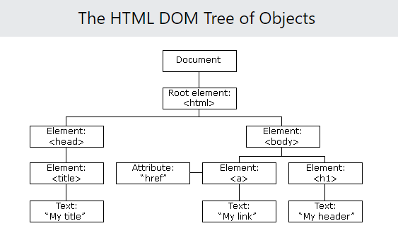

Slide 9

Funciones
Syntax
Declaration
Scope
Invocation
It promotes DRY pattern

Slide 10

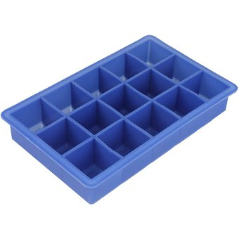
Manejo de arrays
It’s a variable used to stack many variables in one place.

Slide 11


Map, Filter and Reduce
Map gives you a new array transformed by a function
Filter gives you a new array with just ítems satified a condition by a function
Reduce gives you a value got by a reduction function

Slide 12
Vanilla Javascript
Vanilla JS is a fast, lightweight, cross-platform framework for building incredible, powerful JavaScript applications.
Enterprises:
Other frameworks;
JS jQuery, Prototype JS, MoonTools, YUI, others.

Slide 13
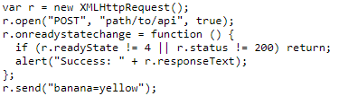
Vanilla Javascript
Examples:
Fade an element out and then remove it
Making an AJAX call

Slide 14
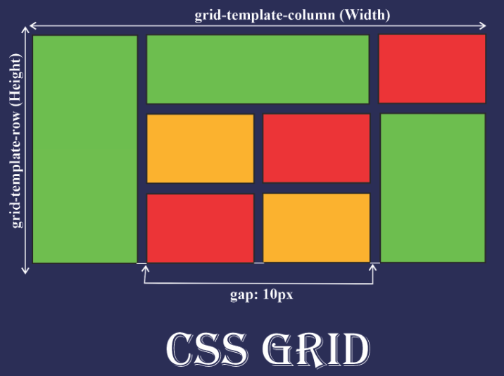
Css Grid
Bidimensional Layout : columns and rows

Slide 15
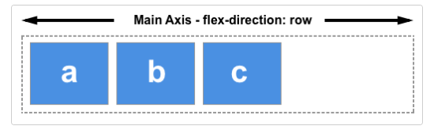
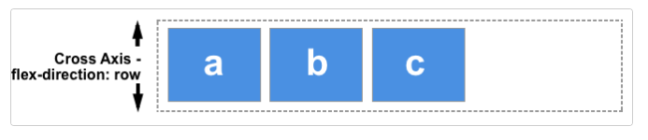
Flex box
Unidimensional Layout: 2 axis

Slide 16
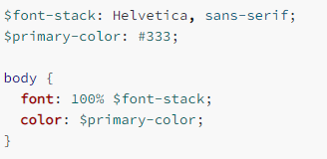
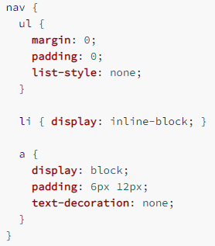
Sass
It’s a stylesheet language that’s compiled to CSS
Variables
Nesting

Slide 17
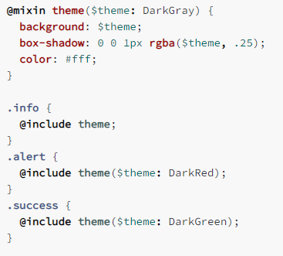
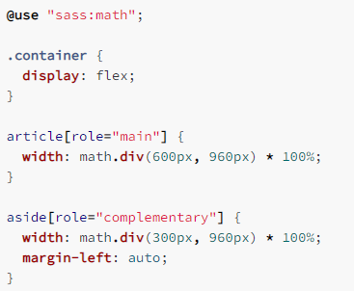
Sass
Functions
Operators

Slide 18
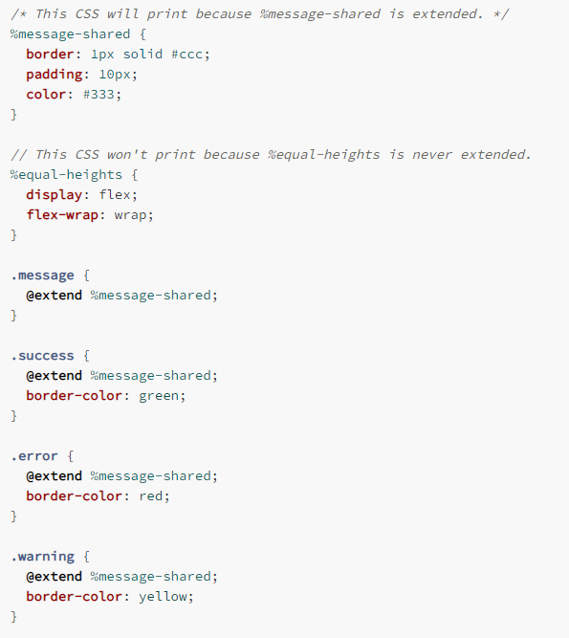
Sass
Extend/Inheritance

Slide 19
Ejercicios
Ejercicios
Conceptos
Variables
Operadores
Funciones
DOM
Vanilla JS
Sass
Css Grid
Flexbox
Calculator app

Slide 20
Ejercicios
Ejercicios
Conceptos
Array
Métodos Array
DOM
Vanilla JS
Sass
Css Grid
Flexbox
Landing page (portfolio)

Slide 21
Conceptos de Semántica y Accesibilidad
<p class="contactinfo">
My name is Jo Smith. I'm a distinguished web engineer at
<a href="http://example.org">Example.org</a>.
You can contact me
<a href="mailto:jo@example.org">via email</a>.
</p>
<p class="contactinfo" about="http://example.org/staff/jo">
My name is
<span property="contact:fn">Jo Smith</span>
. I'm a
<span property="contact:title"> distinguished web engineer </span>
at
<a rel="contact:org" href="http://example.org"> Example.org </a>
. You can contact me
<a rel="contact:email" href="mailto:jo@example.org"> via email </a>.
</p>
Accesibility Attributes: tabindex, aria-label(screen reader), role (kind of element you’re using)
Notes:
https://www.youtube.com/watch?v=-4y3vb0IHgw&t=377s
https://www.youtube.com/watch?v=Th-nv-SCj4Q&t=7s
https://www.standards-schmandards.com/2007/rdfa-and-accessibility/
https://www.w3.org/TR/xhtml-rdfa-primer/
https://www.w3.org/TR/xhtml-rdfa-primer/#bib-rdfa-lite

Slide 22
33 Concepts Every JavaScript Developer Should Know
https://github.com/leonardomso/33-js-concepts
Notes:
Puede ir arriba

Slide 23
Clean code
https://www.freecodecamp.org/news/clean-coding-for-beginners/

Slide 24
Local Storage y Sesion Storage
Objeto Storage
Acceden
Local Storage
Sesion Storage
Permanece de manera indefinida
Permanece mientras que no se cierre la pestaña
Ejemplos: https://ed.team/blog/que-es-y-como-utilizar-localstorage-y-sessionstorage
Notes:
https://ed.team/blog/que-es-y-como-utilizar-localstorage-y-sessionstorage

Slide 25
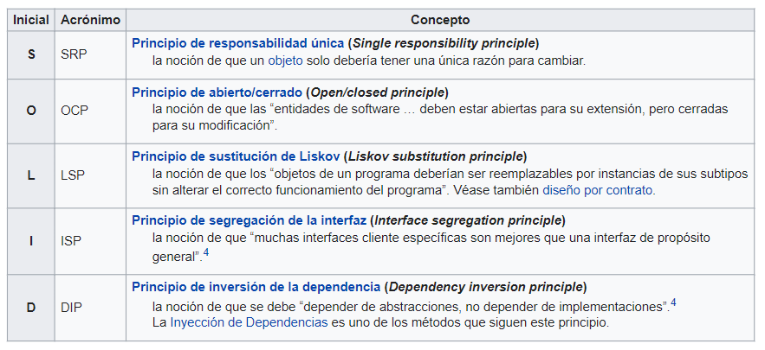
SOLID
Notes:
https://es.wikipedia.org/wiki/SOLID

Slide 26
Fuentes
https://developer.mozilla.org/en-US/
https://www.w3schools.com/default.asp
https://www.w3.org/
http://vanilla-js.com/

Slide 27

¿Dudas y consultas?

Slide 28
Sass
https://latteandcode.medium.com/c%C3%B3mo-organizar-los-archivos-sass-de-tu-proyecto-c8b02242d95#:~:text=Tambi%C3%A9n%20conocida%20como%20patr%C3%B3n%207,gestionar%20todos%20los%20imports%20necesarios.
https://webdesign.tutsplus.com/es/tutorials/como-usar-sass-para-construir-un-proyecto-con-multiples-temas--cms-22104
https://medium.com/@sir.different/easy-css-themes-with-sass-d91d054799be

