Slide 1
Linux Internals & Networking System programming using Kernel interfaces

Slide 2
Threads

Slide 3
Threads
Threads, like processes, are a mechanism to allow a program to do more than one thing at a time
As with processes, threads appear to run concurrently
The Linux kernel schedules them asynchronously, interrupting each thread from time to time to give others a chance to execute
Threads are a finer-grained unit of execution than processes
That thread can create additional threads; all these threads run the same program in the same process
But each thread may be executing a different part of the program at any given time

Slide 4
Threads Advantages
Takes less time to create a new thread in an existing process than to create a brand new process
Switching between threads is faster than a normal context switch
Threads enhance efficiency in communication between different executing programs
No kernel involved

Slide 5
Threads Compilation
Use the following command to compile the programs using thread libraries
$ gcc -o <output_file> <input_file.c> -lpthread

Slide 6
Threads Creation
The pthread_create function creates a new thread
Function | Meaning
int pthread_create( pthread_t *thread, const pthread_attr_t *attr, void *(*start_routine) (void *), void *arg) | A pointer to a pthread_t variable, in which the thread ID of the new thread is stored A pointer to a thread attribute object. If you pass NULL as the thread attribute, a thread will be created with the default thread attributes A pointer to the thread function. This is an ordinary function pointer, of this type: void* (*) (void*) A thread argument value of type void *. Whatever you pass is simply passed as the argument to the thread function when thread begins executing

Slide 7
Threads Creation
A call to pthread_create returns immediately, and the original thread continues executing the instructions following the call
Meanwhile, the new thread begins executing the thread function
Linux schedules both threads asynchronously
Programs must not rely on the relative order in which instructions are executed in the two threads

Slide 8
Threads Joining
It is quite possible that output created by a thread needs to be integrated for creating final result
So the main program may need to wait for threads to complete actions
The pthread_join() function helps to achieve this purpose
Function | Meaning
int pthread_join( pthread_t thread, void **value_ptr) | Thread ID of the thread to wait Pointer to a void* variable that will receive thread finished value If you don’t care about the thread return value, pass NULL as the second argument.

Slide 9
Threads Passing Data
The thread argument provides a convenient method of passing data to threads
Because the type of the argument is void*, though, you can’t pass a lot of data directly via the argument
Instead, use the thread argument to pass a pointer to some structure or array of data
Define a structure for each thread function, which contains the “parameters” that the thread function expects
Using the thread argument, it’s easy to reuse the same thread function for many threads. All these threads execute the same code, but on different data

Slide 10
Threads Return Values
If the second argument you pass to pthread_join is non-null, the thread’s return value will be placed in the location pointed to by that argument
The thread return value, like the thread argument, is of type void*
If you want to pass back a single int or other small number, you can do this easily by casting the value to void* and then casting back to the appropriate type after calling pthread_join

Slide 11
Threads Attributes
Thread attributes provide a mechanism for fine-tuning the behaviour of individual threads
Recall that pthread_create accepts an argument that is a pointer to a thread attribute object
If you pass a null pointer, the default thread attributes are used to configure the new thread
However, you may create and customize a thread attribute object to specify other values for the attributes

Slide 12
Threads Attributes
There are multiple attributes related to a
particular thread, that can be set during creation
Some of the attributes are mentioned as follows:
Detach state
Priority
Stack size
Name
Thread group
Scheduling policy
Inherit scheduling

Slide 13
Threads Joinable and Detached
A thread may be created as a joinable thread (the default) or as a detached thread
A joinable thread, like a process, is not automatically cleaned up by GNU/Linux when it terminates
Thread’s exit state hangs around in the system (kind of like a zombie process) until another thread calls pthread_join to obtain its return value. Only then are its resources released
A detached thread, in contrast, is cleaned up automatically when it terminates
Because a detached thread is immediately cleaned up, another thread may not synchronize on its completion by using pthread_join or obtain its return value

Slide 14
Threads Creating a Detached Thread
In order to create a detached thread, the thread attribute needs to be set during creation
Two functions help to achieve this
Function | Meaning
int pthread_attr_init( pthread_attr_t *attr) | Initializing thread attribute Pass pointer to pthread_attr_t type Reurns integer as pass or fail
int pthread_attr_setdetachstate (pthread_attr_t *attr, int detachstate); | Pass the attribute variable Pass detach state, which can take PTHREAD_CREATE_JOINABLE PTHREAD_CREATE_DETACHED

Slide 15
Threads ID
Occasionally, it is useful for a sequence of code to determine which thread is executing it.
Also sometimes we may need to compare one thread with another thread using their IDs
Some of the utility functions help us to do that
Function | Meaning
pthread_t pthread_self() | Get self ID
int pthread_equal( pthread_t threadID1, pthread_t threadID2); | Compare threadID1 with threadID2 If equal return non-zero value, otherwise return zero

Slide 16
Synchronization - Concepts

Slide 17
Synchronization why?
In a multi-tasking system the most critical resource is CPU. This is shared between multiple tasks / processes with the help of ‘scheduling’ algorithm
When multiple tasks are running simultaneously:
Either on a single processor, or on
A set of multiple processors
They give an appearance that:
For each process, it is the only task in the system.
At a higher level, all these processes are executing efficiently.
Process sometimes exchange information:
They are sometimes blocked for input or output (I/O).
Whereas multiple processes run concurrently in a system by communicating, exchanging information with others all the time. They also have very close dependency with various I/O devices and peripherals.

Slide 18
Synchronization why?
Considering resources are lesser and processes are more, there is a contention going between multiple processes
Hence resource needs to be shared between multiple processes. This is called as ‘Critical section’
Access / Entry to critical section is determined by scheduling, however exit from critical section needs to be done when activity is completed properly
Otherwise it will lead to a situation called ‘Race condition’
P2
P1
P3
Shared
Resource
(Critical Section)

Slide 19
Synchronization why?
Synchronization is defined as a mechanism which ensures that two or more concurrent processes do not simultaneously execute some particular program segment known as critical section
When one process starts executing the critical section (serialized segment of the program) the other process should wait until the first process finishes
If not handled properly, it may cause a race condition where, the values of variables may be unpredictable and vary depending on the timings of context switches of the processes
If any critical decision to be made based on variable values (ex: real time actions – like medical system), synchronization problem will create a disaster as it might trigger totally opposite action than what was expected

Slide 20
Synchronization Race Condition in Embedded Systems
Embedded systems are typically lesser in terms of resources, but having multiple processes running. Hence they are more prone to synchronization issues, thereby creating race conditions
Most of the challenges are due to shared data condition. Same pathway to access common resources creates issues
Debugging race condition and solving them is a very difficult activity because you cannot always easily re-create the problem as they occur only in a particular timing sequence
Asynchronous nature of tasks makes race condition simulation and debugging as a challenging task, often spend weeks to debug and fix them

Slide 21

Synchronization Critical Section
The way to solve race condition is to have the critical section access in such a way that only one process can execute at a time
If multiple process try to enter a critical section, only one can run and the others will sleep (means getting into blocked / waiting state)
Critical Section

Slide 22

Synchronization Critical Section
Only one process can enter the critical section; the other two have to sleep. When a process sleeps, its execution is paused and the OS will run some other task
Critical Section

Slide 23
Synchronization Critical Section
Once the process in the critical section exits, another process is woken up and allowed to enter the critical section. This is done based on the existing scheduling algorithm
It is important to keep the code / instructions inside a critical section as small as possible (say similar to ISR) to handle race conditions effectively
Critical Section

Slide 24
Synchronization Priority Inversion
One of the most important aspect of critical section is to ensure whichever process is inside it, has to complete the activities at one go. They should not be done across multiple context switches. This is called Atomicity
Assume a scenario where a lower priority process is inside the critical section and higher priority process tries to enter
Considering atomicity the higher priority process will be pushed into blocking state. This creates some issue with regular priority algorithm
In this juncture if a medium priority tasks gets scheduled, it will enter into the critical section with higher priority task is made to wait. This scenario is further creating a change in priority algorithm
This is called as ‘Priority Inversion’ which alters the priority schema

Slide 25
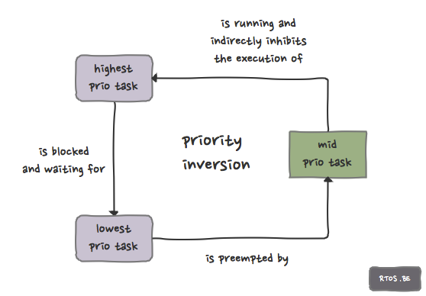
Synchronization Priority Inversion

Slide 26
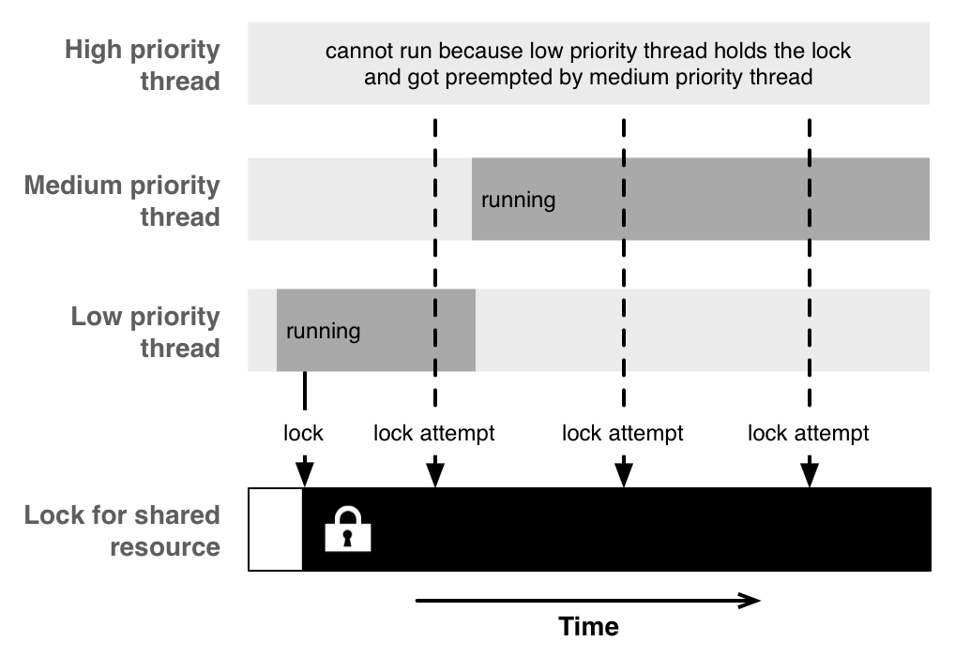
Synchronization Priority Inversion

Slide 27
Quick refresher
Before moving onto exploring various solutions for critical section problem, ensure we understand these terminologies / definitions really well.
Difference between scheduling & Synchronization
Shared data problem
Critical section
Race condition
Atomicity
Priority inversion

Slide 28
Critical Section Solutions
Solution to critical section should have following three aspects into it:
Mutual Exclusion: If process P is executing in its critical section, then no other processes can be executing in their critical sections
Progress: If no process is executing in its critical section and there exist some processes that wish to enter their critical section, then the selection of the processes that will enter the critical section next cannot be postponed indefinitely
Bounded Waiting: A bound must exist on the number of times that other processes are allowed to enter their critical sections after a process has made a request to enter its critical section and before that request is granted

Slide 29
Critical Section Solutions
There are multiple algorithms (ex: Dekker’s algorithm) to implement solutions that is satisfying all three conditions. From a programmers point of view they are offered as multiple solutions as follows:
Locks / Mutex
Readers–writer locks
Recursive locks
Semaphores
Monitors
Message passing
Tuple space
Each of them are quite detailed in nature, in our course two varieties of solutions are covered they are Mutex and Semaphores
Let us look into them in detail!

Slide 30

Critical Section Solutions - Mutual Exclusion
A Mutex works in a critical section while granting access
You can think of a Mutex as a token that must be grabbed before execution can continue.
open
Mutex
Protected Resource

Slide 31

Critical Section Solutions - Mutual Exclusion
During the time that a task holds the mutex, all other tasks waiting on the mutex sleep.
Mutex
Protected Resource
lock

Slide 32
Critical Section Solutions - Mutual Exclusion
Once a task has finished using the shared resource, it releases the mutex. Another task can then wake up and grab the mutex.
Mutex
release
Protected Resource

Slide 33
Critical Section Solutions - Mutual Exclusion – Locking / Blocking
A process may attempt to get a Mutex by calling a lock method. If the Mutex was unlocked (means already available), it becomes locked (unavailable) and the function returns immediately
If the Mutex was locked by another process, the locking function blocks execution and returns only eventually when the Mutex is unlocked by the other process
More than one process may be blocked on a locked Mutex at one time
When the Mutex is unlocked, only one of the blocked process is unblocked and allowed to lock the Mutex. Other tasks stay blocked.

Slide 34
Critical Section Semaphores
A semaphore is a counter that can be used to synchronize multiple processes. Typically semaphores are used where multiple units of a particular resources are available
Each semaphore has a counter value, which is a non-negative integer. It can take any value depending on number of resources available
The ‘lock’ and ‘unlock’ mechanism is implemented via ‘wait’ and ‘post’ functionality in semaphore. Where the wait will decrement the counter and post will increment the counter
When the counter value becomes zero that means the resources are no longer available hence remaining processes will get into blocked state

Slide 35
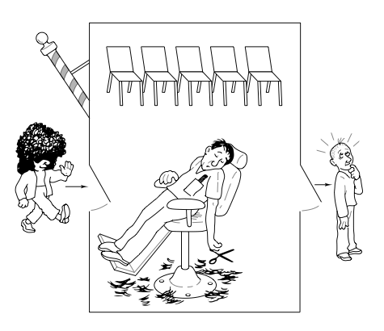
Critical Section Semaphores - Sleeping barber problem
A lazy barber who sleeps and gets up on his own will :)

Slide 36
Critical Section Semaphores – 2 basic operations
Wait operation:
Decrements the value of the semaphore by 1
If the value is already zero, the operation blocks until the value of the semaphore becomes positive
When the semaphore’s value becomes positive, it is decremented by 1 and the wait operation returns
Post operation:
Increments the value of the semaphore by 1
If the semaphore was previously zero and other threads are blocked in a wait operation on that semaphore
One of those threads is unblocked and its wait operation completes (which brings the semaphore’s value back to zero)

Slide 37
Critical Section Mutex & Semaphores
Semaphores which allow an arbitrary resource count (say 25) are called counting semaphores
Semaphores which are restricted to the values 0 and 1 (or locked/unlocked, unavailable/available) are called binary semaphores
A Mutex is essentially the same thing as a binary semaphore, however the differences between them are in how they are used
While a binary semaphore may be used as a Mutex, a Mutex is a more specific use-case, in that only the process that locked the Mutex is supposed to unlock it
This constraint makes it possible to implement some additional features in Mutexes

Slide 38
Critical Section Practical Implementation
The problem is critical section / race condition is common in multi-threading and multi-processing environment. Since both of them offer concurrency & common resource facility, it will raise to race conditions
However the common resource can be different. In case of multiple threads a common resource can be a data segment / global variable which is a shared resource between multiple threads
In case of multiple processes a common resource can be a shared memory
Global Variable
Head Space
Environmental Strings
Thread
stack
Thread
stack
Thread
stack
thread
thre`ad
thread
P1
P2
P3
Pn
Shared Memory

Slide 39
Synchronization Treads - Mutex
pthread library offers multiple Mutex related library functions
These functions help to synchronize between multiple threads
Function | Meaning
int pthread_mutex_init( pthread_mutex_t *mutex const pthread_mutexattr_t *attribute) | Initialize mutex variable mutex: Actual mutex variable attribute: Mutex attributes RETUR: Success (0)/Failure (Non zero)
int pthread_mutex_lock( pthread_mutex_t *mutex) | Lock the mutex mutex: Mutex variable RETURN: Success (0)/Failure (Non-zero)
int pthread_mutex_unlock( pthread_mutex_t *mutex) | Unlock the mutex Mutex: Mutex variable RETURN: Success (0)/Failure (Non-zero)
int pthread_mutex_destroy( pthread_mutex_t *mutex) | Destroy the mutex variable Mutex: Mutex variable RETURN: Success (0)/Failure (Non-zero)

Slide 40
Synchronization Treads – Semaphores – 2 basic operations
Wait operation:
Decrements the value of the semaphore by 1
If the value is already zero, the operation blocks until the value of the semaphore becomes positive
When the semaphore’s value becomes positive, it is decremented by 1 and the wait operation returns
Post operation:
Increments the value of the semaphore by 1
If the semaphore was previously zero and other threads are blocked in a wait operation on that semaphore
One of those threads is unblocked and its wait operation completes (which brings the semaphore’s value back to zero)

Slide 41
Synchronization Treads - Semaphores
pthread library offers multiple Semaphore related library functions
These functions help to synchronize between multiple threads
Function | Meaning
int sem_init ( sem_t *sem, int pshared, unsigned int value) | sem: Points to a semaphore object pshared: Flag, make it zero for threads value: Initial value to set the semaphore RETURN: Success (0)/Failure (Non zero)
int sem_wait(sem_t *sem) | Wait on the semaphore (Decrements count) sem: Semaphore variable RETURN: Success (0)/Failure (Non-zero)
int sem_post(sem_t *sem) | Post on the semaphore (Increments count) sem: Semaphore variable RETURN: Success (0)/Failure (Non-zero)
int sem_destroy(sem_t *sem) | Destroy the semaphore No thread should be waiting on this semaphore RETURN: Success (0)/Failure (Non-zero)

Slide 42
Thank You

