Slide 1

Muhammad Abdul-Qayyum
Joel Katako Anansambi
Herman HO
October 28, 2016

Slide 2
Motivation
SpotMe is a web application that has two goals:
Simplify the everyday hassle of finding parking
Generate revenue from unused parking spaces
SpotMe allows homeowners to place their vacant garage and/or driveway spaces up for rent, and allows drivers to find these parking spaces in the absence of available street parking.
The obvious need for this application stems from congested city streets, where parking is often limited or simply unavailable. With SpotMe, drivers will have access to more parking options, and homeowners can turn their otherwise unused parking spaces into income.

Slide 3
Competitors
parklee – a Williamsburg-based company offering a similar service of connecting drivers seeking parking, with owners of available parking.
parklee operates on a fixed pricing model - $5 per hour or $30 per day.
Owners have little flexibility in terms of how much revenue they can generate
Drivers have little incentive to use the service in areas where street parking is considerably cheaper (e.g. Brooklyn, Queens, Bronx, Staten Island)
SpotMe operates on a owner-driven pricing model, where owners can dictate how much they want to charge.
Owners can maximize their earnings during peak times (e.g. events nearby, dinner hours, etc.)
Drivers will see lower prices during times of less demand

Slide 4
Design Strategy
Slack is our collaboration tool of choice, along with face-to-face meetings, and Google Hangouts meetings when we cannot meet physically.
The workload is split as follows:
Muhammad – Data modeling and implementation
Joel – Route modeling and implementation
Herman – UI/UX design and implementation
Each member also acts as an advisor to the other two on their strongest subject(s) – suggestions are made individually and decided upon as a group.

Slide 5
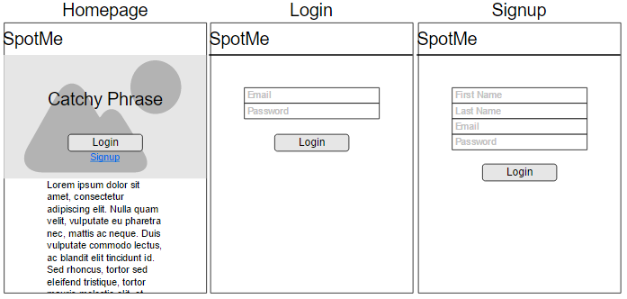
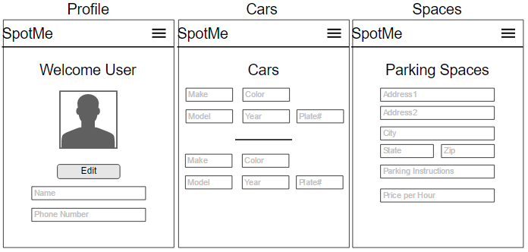
Design Strategy – UI/UX
Preliminary mockups of homepage, profile, and basic user properties:

Slide 6
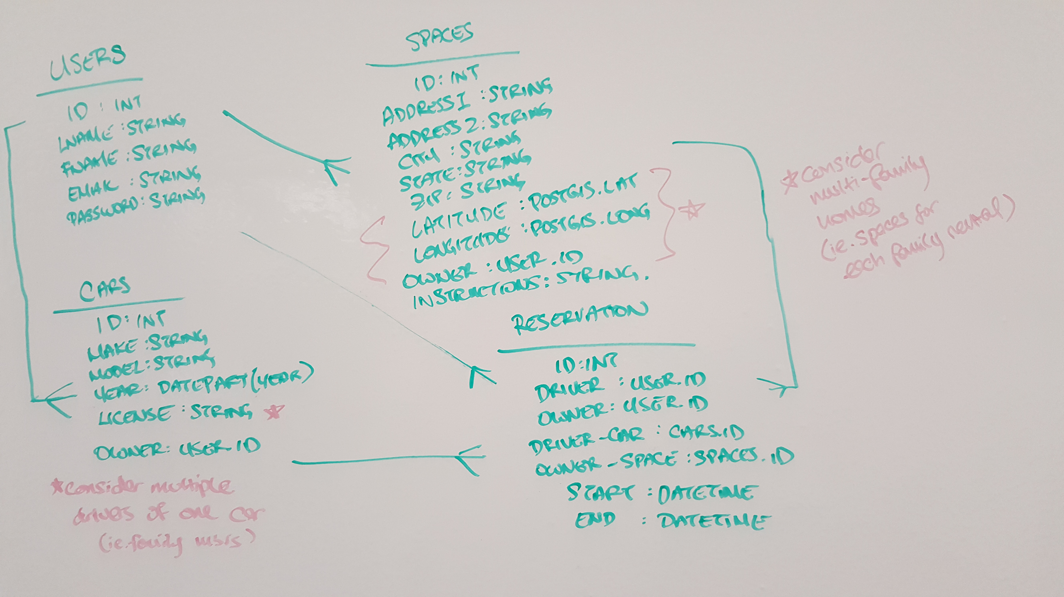
Design Strategy - Models
Preliminary models:

Slide 7
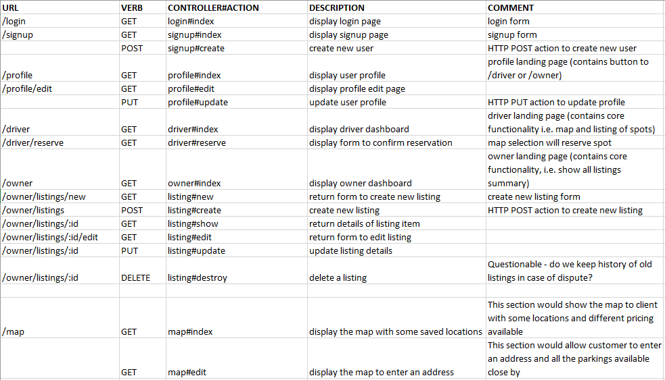
Design Strategy - Routes
Preliminary routes:

Slide 8
Technical Overview
Tech Stack:
Runtime Environment: Node.js
Frontend Rendering: Bootstrap + Handlebars.js
Application Logic & Routing: Express.js + Google Maps API
Database: Sequelize ORM + PostgreSQL + PostGIS
Resources:
npm & Node.js documentation
Google Maps API documentation
CTP Microblog code

Slide 9
Technical Overview - continued
Testing:
We currently have not implemented any test cases, but plan on for the following:
Creating a user object
Updating a user profile
Creating a car object
Creating a parking space object
Creating a reservation object

Slide 10
What’s Next?
Continued implementation of routes
Implementation of driver and owner dashboards
Finalize data models
Create and implement test cases
Incorporate Google Maps into application
Since our application relies heavily on the Google Maps API for much of the functionality, we will need to familiarize ourselves with the API, and possibly PostGIS if Google Maps lacks a desired functionality.

Slide 11
Questions?

