Slide 1

Ten most Suitable counties for Mobile Broadband Technology in the U.S
Cesar Mosquera
Emi Babu
Jacqueline McBean-Blake
Pratikchhya Upadhyay

Slide 2

Introduction:
To analyze in which US county areas it would be worth investing in Mobile Internet Technology.
Analysis is based on location, population, income, etc.
From the data we would want to extrapolate which additional County areas could be selected to investing in new Mobile Internet Technologies.
Notes:
Jacquie

Slide 3

Hypothesis
Which county would be a good selection for building out infrastructure for accessing internet through mobile devices?
Why would a county be a good selection for building out infrastructure for the same?
Notes:
Jacquie

Slide 4
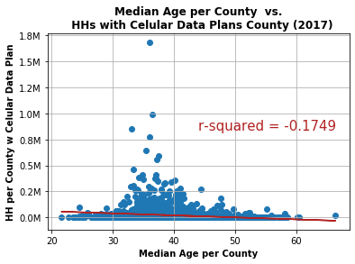
Affect of Median Age on the Usage of Cellular data
Number of households with cellular data plan decreases as the median age in each county increases.
Notes:
Jacquie

Slide 5
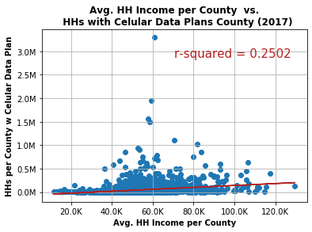
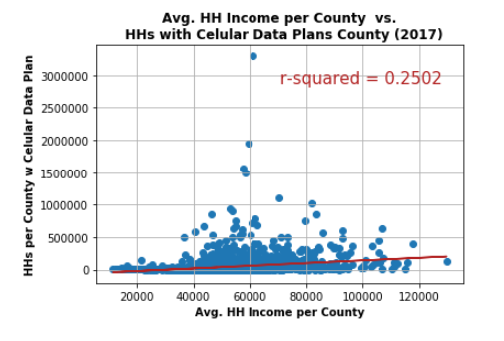
How does income affects the usage of cellular data?
Linear correlation between number of households having cellular data plan and their income is positive but weak.
Notes:
Emi

Slide 6
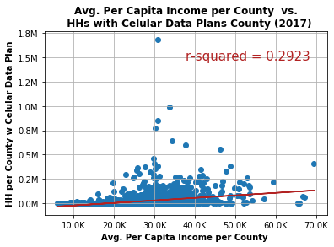
How does per capita income affects the usage of cellular data?
Linear correlation is poor which means an increase in per capita income is not correlated with an increase in number of households with cellular data plans.
Notes:
Emi

Slide 7
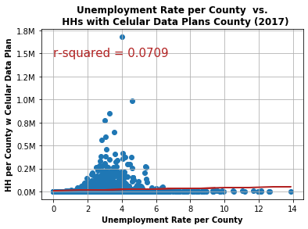
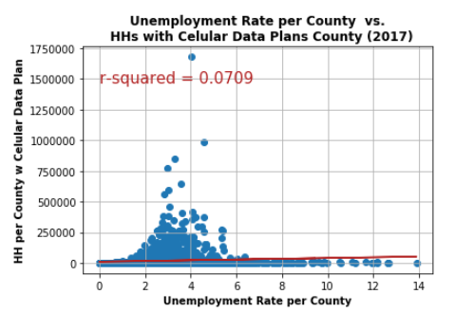
Unemployment Rate vs Households with Cellular Data
Unemployment rate in a given county has no relation with the number of households with cellular data plan.
Notes:
Emi

Slide 8
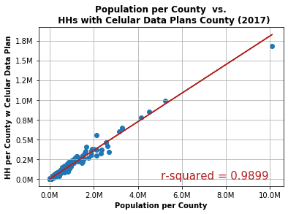
How does population affects the usage of cellular data?
Correlation between number of households having cellular data plan and population is very strong.
Counties with high density have strong cellular data usage.
Notes:
Cesar

Slide 9
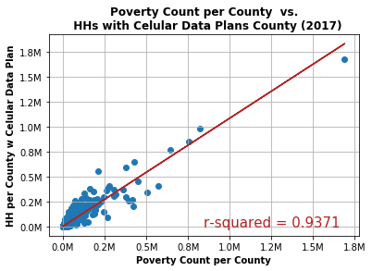
Is there any relation between Poverty and Usage of Cellular Data?
The demand for cellular data is inelastic to the poverty count.
As poverty increases in a given county the number of households with cellular data plan proportionally increases.
Notes:
Pratikchhya

Slide 10
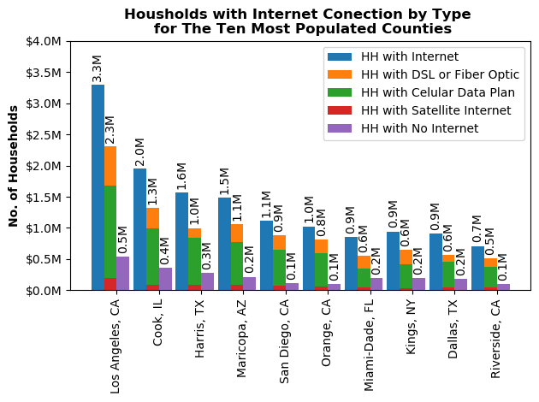
Most Populated Cities with Internet Connection Type
Cellular data plan is the most common technology used to access internet
Notes:
Pratikchhya

Slide 11
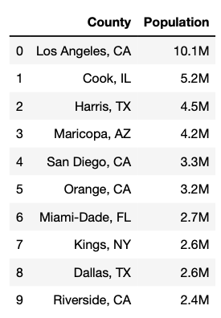
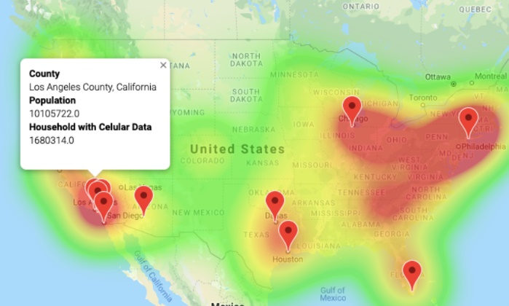
Conclusion
Population is the most significant variable influencing access to the internet through mobile devices.
Using heat map weighted on population with markers, top 10 counties were selected.
These counties would be the places we suggest to invest in infrastructure to access internet through mobile devices.
Notes:
Cesar

Slide 12

Reference:
Source: U.S. Bureau of Labor Statistics
https://www.bls.gov/web/metro/laummtrk.htm
Source: U.S. Bureau of Labor Statistics
https://www.bls.gov/web/metro/metro_oty_change.htm
Source: U.S. Bureau of Labor Statistics
https://www.bea.gov/news/2018/gross-domestic-product-metropolitan-area-2017
Source: U.S. Census Bureau
https://factfinder.census.gov/faces/tableservices/jsf/pages/productview.xhtml?src=bkmk
Source: Goberning.com
https://www.governing.com/gov-data/city-internet-connection-household-adoption-rates-data.html
Source: U.S. Bureau of Labor Statistics https://data.bls.gov/cew/apps/table_maker/v4/table_maker.htm#type=3&year=2018&qtr=3&own=0&ind=10&supp=0
Source: Google API, Census API

Slide 13


Slide 14


