Slide 1
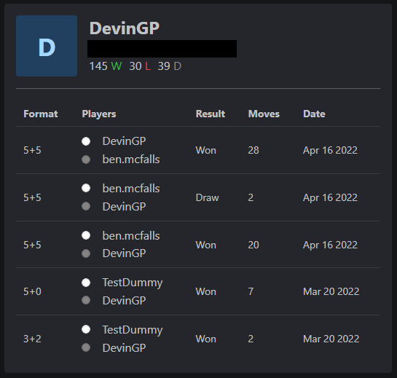
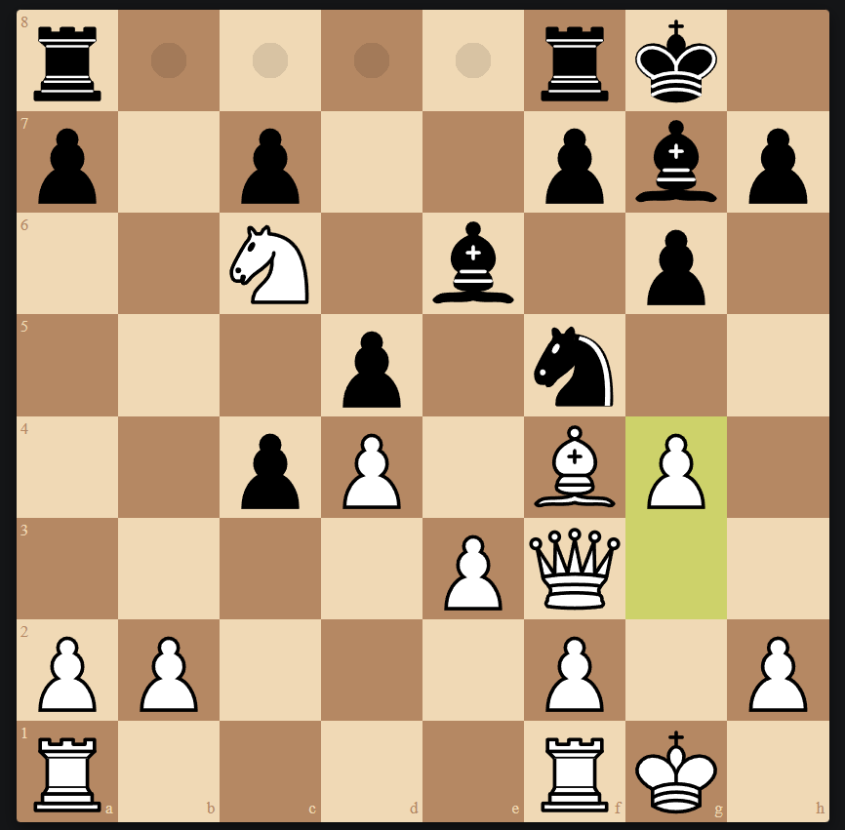
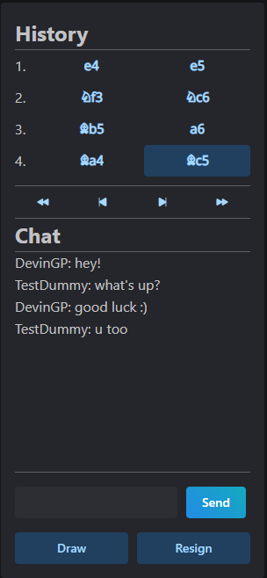
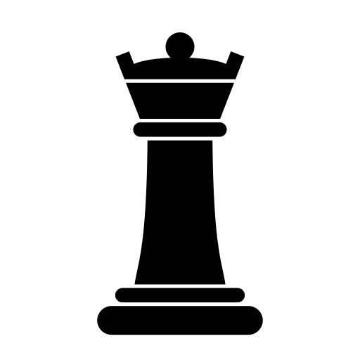




Chess Game
Kevin Jusino
Hilary Lumeh
Benjamin McFalls
Devin Parentice
Emilia Quintana
https://github.com/bam1098/JuLuMcPaQu-468
This project allows users to play chess and chat in real time with one another.
The site also features a chess computer with five different difficulties available to test your skill against. There are multiple time controls as well so the user can choose their preferred game type.
The user’s match history is saved, and users can view their stats and past games on their profile page. The user can view each game and go replay each move step by step in a visual replay.
The React frontend is containerized with Docker alongside the Node backend and the MongoDB database. Our team have set up a deployment pipeline with Jenkins and Kubernetes.
Kubernetes System with CI/CD Pipeline via Jenkins
Socket.io:
Handles sending chess moves between players in real time
Docker Container
React frontend
Client 1
(Port 3000)
Database: MongoDB
Stores user information
Node Backend
(Port 5000)
React frontend
Client 2
Express Server:
Handles DB queries and connecting frontend to backend
Docker Container
React frontend
Client N
Docker Container

