Slide 1
SortisOntology

Slide 2
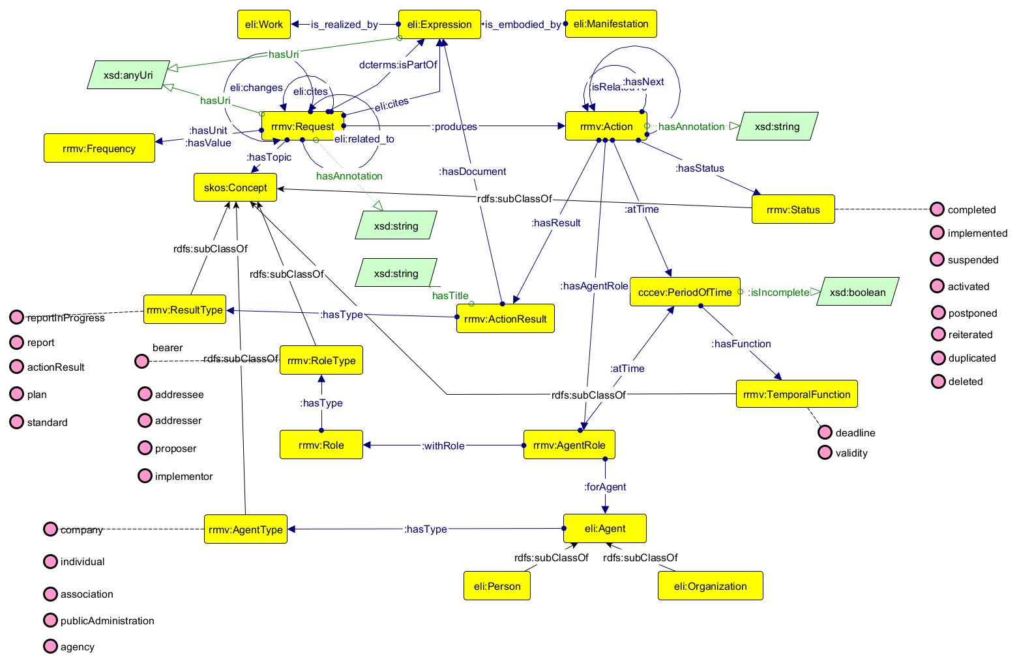
Original model

Slide 3
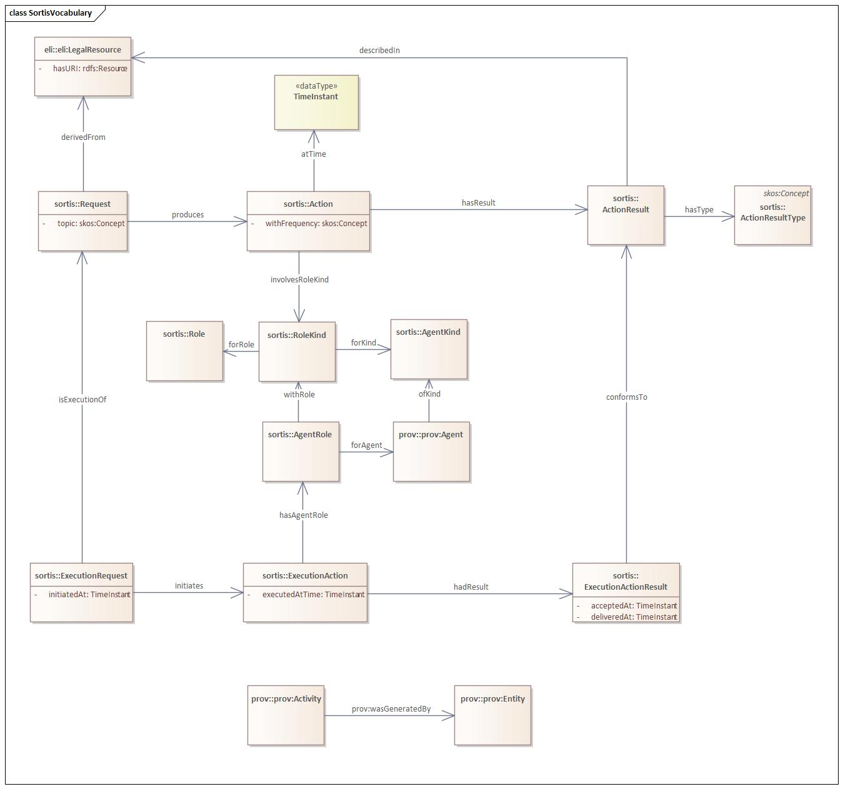
Updated proposal

Slide 4
Updated proposal
Legal text
Legal text in structured format
Execution in structured format

Slide 5
Example HVD-IR (https://eur-lex.europa.eu/legal-content/EN/TXT/?uri=CELEX:32023R0138)
HVD-IR
Celex: 32023R0138
Dct:part of (or better ELI variant)
HVD-IR – article 5
<Commission>
<consumption data>
<hvd-ir-reporting-request>
<providing data>
<HVD-IR report>
inForce
<MS>
Every 2 years

Slide 6
Example HVD-IR (https://eur-lex.europa.eu/legal-content/EN/TXT/?uri=CELEX:32023R0138)
HVD-IR
Celex: 32023R0138
Dct:part of (or better ELI variant)
HVD-IR – article 5
<Commission>
<consumption data>
<hvd-ir-reporting-request>
<providing data>
<HVD-IR report>
inForce
<MS>
Every 2 years

Slide 7
Example HVD-IR (https://eur-lex.europa.eu/legal-content/EN/TXT/?uri=CELEX:32023R0138)
HVD-IR
Celex: 32023R0138
Dct:part of (or better ELI variant)
HVD-IR – article 5
<Commission>
<consumption data>
<hvd-ir-reporting-request>
<providing data>
<HVD-IR report>
inForce
<MS>
Every 2 years

