Slide 1
EMPAPER
The selling site,
page by page.
Their papers. Without the chase.
Build Home first. Then Product, For companies, Pricing, and Demo.

Slide 2
Colours
Use these on every page.
Ink
Paper
Card
#1C2333
#F4F1EA
#FFFCF8
Text, sidebar, logo
Page background
Payslip and letter cards
Seal
Gold
Muted
#1F6B5A
#C4A46A
#6E675F
Book a demo, active item
Dividers, logo accent
Hints and labels
EMPAPER · WEBSITE LAYOUT
02

Slide 3
Same header on every page
Empaper
Product For companies Pricing
Book a demo
One green button
Book a demo is the only filled button. Talk to us stays outlined.
Footer
Short line, Powered by Empaper, and the same four links.
Do not add yet
No blog, no login, no long about page until these five are live.
EMPAPER · WEBSITE LAYOUT
03

Slide 4
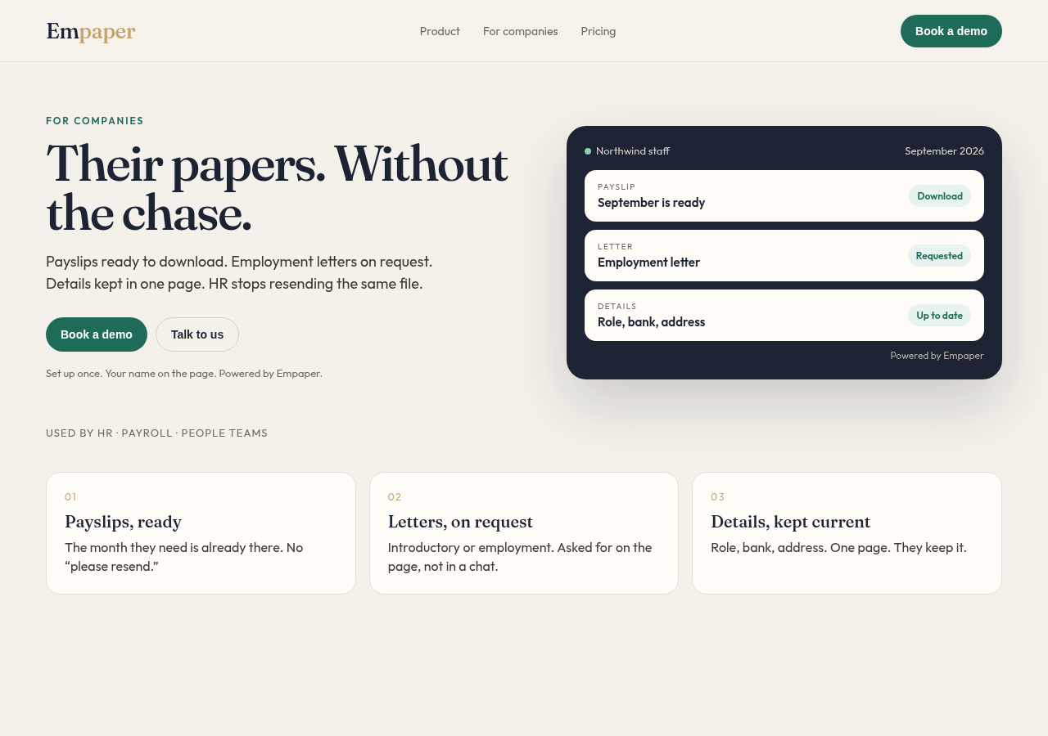
Page 1 · Home
Left: the offer.
Right: a staff page with their name.
Bottom: three cards.
Their papers. Without the chase.
EMPAPER · WEBSITE LAYOUT
04

Slide 5
Home, block by block
1 Hero, left
2 Buttons
Eyebrow: For companies. Headline: Their papers. Without the chase. Line: Payslips ready to download. Employment letters on request. Details kept in one page. HR stops resending the same file.
Book a demo. Talk to us. Small line: Set up once. Your name on the page. Powered by Empaper.
3 Hero, right
4 Three cards
Dark staff card. Company name. September payslip, Download. Employment letter, Requested. Details: role, bank, address.
Payslips, ready. Letters, on request. Details, kept current.
5 Start
6 Close
Book a demo. Add your people. They open their page.
Repeat the headline in one line. One button: Book a demo.
EMPAPER · WEBSITE LAYOUT
05

Slide 6
Page 2 · Product
What staff open. One screen each.
01
02
03
Payslip
Letter
Details
A list of months. Download sits on the latest. Nothing else on that screen.
Two choices: introductory or employment. Status moves from requested to ready.
Role, bank, address, phone. The employee edits. HR sees the same page.
EMPAPER · WEBSITE LAYOUT
06

Slide 7
Pages 3, 4, and 5
For companies
Pricing
Demo
HR stops resending payslips and letters.
One plan. Price per company.
Name.
Owners get one staff page, not a shared folder.
Payslip, letter, and details included.
Company.
Their name in front. Empaper only at the bottom.
More people is not a second product.
Work email.
Button: Book a demo.
No buy-now button yet.
Number of people.
Button: Book a demo.
After send: We’ll write back.
EMPAPER · WEBSITE LAYOUT
07

Slide 8
Build in this order
1
Home
2
Product
Same header.
One green button.
3
For companies
4
Pricing
5
Demo

