Slide 1
Distribution Channels
Elliott Maw, Edgar Williams, Cole Neves, Emil Gruenwald

Slide 2
Introduction (Emil)
Physical Media:
This is cartridges, CDs, UMDs, Blu-ray discs and much more. Physical media was the primary way through which games were distributed early on in video game history, but now physical media is mostly used by consoles.
Digital Downloads:
This is any way to buy and access games from the internet. Digital downloads is the more popular option for distributing games because of the ease of access and wide availability.
Streaming Services:
This is any way that games are distributed to the public without buying the game. This includes things like game trailers, and gameplay footage of other people playing.

Slide 3
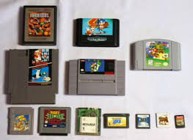
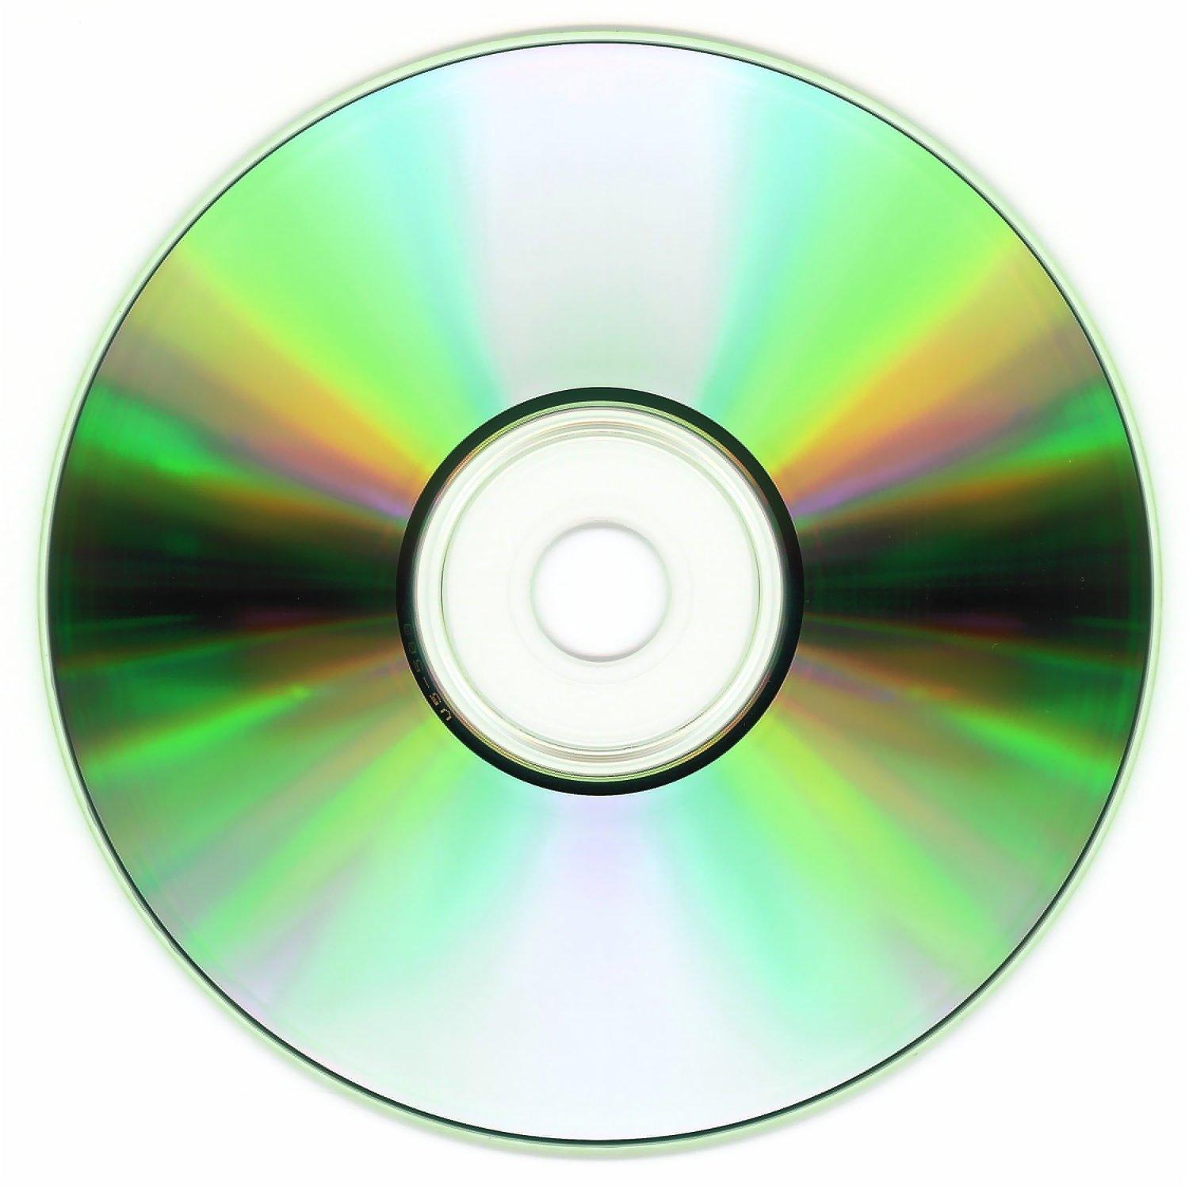
Physical Media (Elliott)
In the modern video game landscape, it is mostly only console hardware that will have physical media for it, with exceptions being mostly for merchandise. As for the types of physical media, most consoles will use discs, while outliers such as the Nintendo Switch exist, using smaller cartridges instead of discs.
Physical media allows owners of games to have tangible ownerships over their products, and have the ability to resell these games later on, as well as protect games when they are no longer supported. Most physical copies can also be played without internet access. This medium also has a share of disadvantages. Being that these copies can be lost, broken, stolen, or otherwise lose the ability to use. These products will be damaged over time, and take up physical space.

Slide 4


Digital Downloads (Edgar)
Characteristics: Digital Download services like Steam, Epic Games, Xbox Game Pass, and GOG are online game purchasing sites/applications that let you purchase and store games through their servers
Benefits: Instant access, larger libraries, no physical clutter, and account convenience
Drawbacks: loss of account loses all the games, potential piracy, doesn't feel as good as owning physical copies in some cases

Slide 5

Streaming Services (Cole)
Our game could get a lot of coverage and people interaction if someone streams it on twitch or youtube.
If a big streamer streams our game then some people who would have never heard of our game will see someone they like playing it and think “that looks like a fun game, I might buy it.” so we get more people seeing our game.

Slide 6
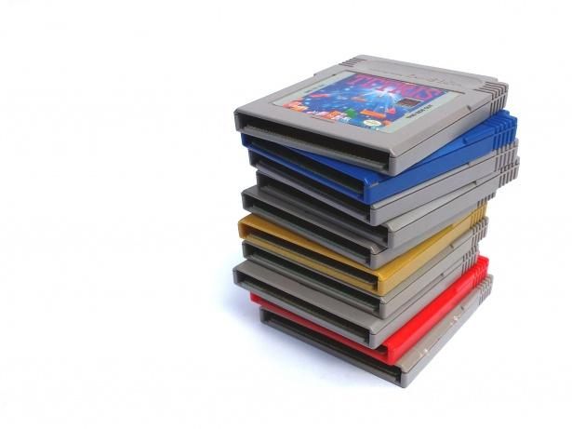

Platform-specific analysis (Edgar)
Some platforms of distribution have some platform specific features that can be a benefit to use over other platforms, for digital distribution things like the instant access or large library
Physical distribution platforms have big sales, let you ask employees for recommendations, and take up no digital space giving you a physical item to treasure
And Streaming Services, can give you many free games, and many platform specific titles

Slide 7
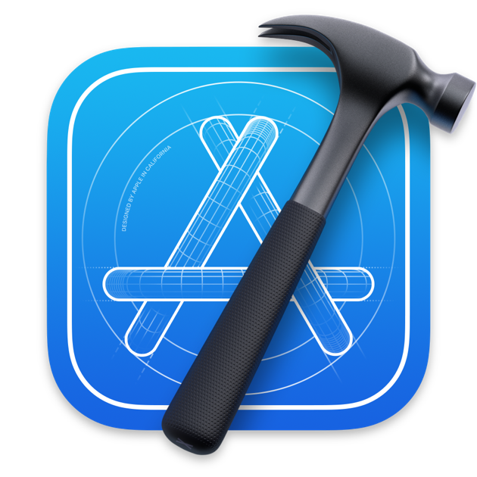

Apple App Store (Elliott)
Apple’s App store requires several things from developers to publish products on their storepage. Developers will require that you have an apple developer account, have your entire program coded in “Xcode” (whatever that is), access apple connect to set up your game’s listing, and use the appropriate metadata to setup your product page. And supply a distributable file of your game.

Slide 8

Microsoft Store (Cole)
Microsoft Store is a good choice for developers of any app type and size.
They offer a one time pay model for lone developers for 19$ and a 99$ one time pay model for a business or company.
One downside is that to get use out of all the features is that we would have to package it into a MSIX file which seems like a tedious task.
Microsoft Store offers developers a flexible and transparent revenue sharing model where you get 100% of the profits for non gaming apps and 88% for gaming apps.

Slide 9
Conclusion (Emil)
Our group would use digital downloads to distribute our game. Digital distribution is the easiest method to get started with, as it is the least expensive option. Having it available digitally also makes it easier for consumers to buy, so they are more likely to get the game.

