Slide 1
Python Project - Part A
Noa Schneider 312173347
Jenni Shechovitzky 313690307
Emil Raskin 207109471

Slide 2

The Challenge: Predicting & Preventing Customer Churn
What are we trying to predict?
We aim to predict which customers will churn (i.e., stop using the service).
Motivation- Why is this important?
Reduce customer loss- retaining customers is cheaper than acquiring new ones.
Helps businesses improve customer satisfaction and reduce revenue loss.
Data available:
A CSV file with 7,043 records and 21 columns.
20 Features:
Customer details (Gender, Tenure, ContractType, etc.)
Service usage (InternetService, StreamingTV, etc.)
Billing details (MonthlyCharges, PaymentMethod, etc.)
Label:
Churn (Yes/No)

Slide 3
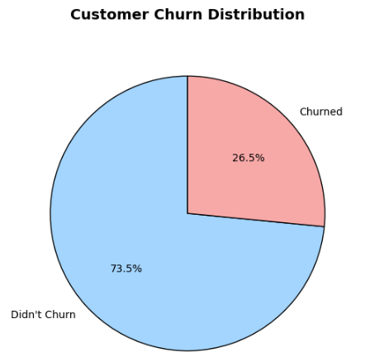
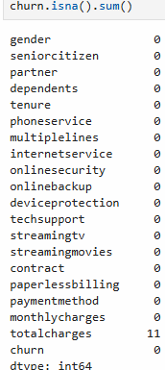
Data Description
Dataset Overview:
Total Examples: 7,043
Train-Test Split: 80% Train → ~5,643 examples | 20% Test → ~1,400 examples
Label Distribution:
Churned: 26.5%
Not Churned: 73.5%
Missing Values:
TotalCharges column had 11 missing values.

Slide 4
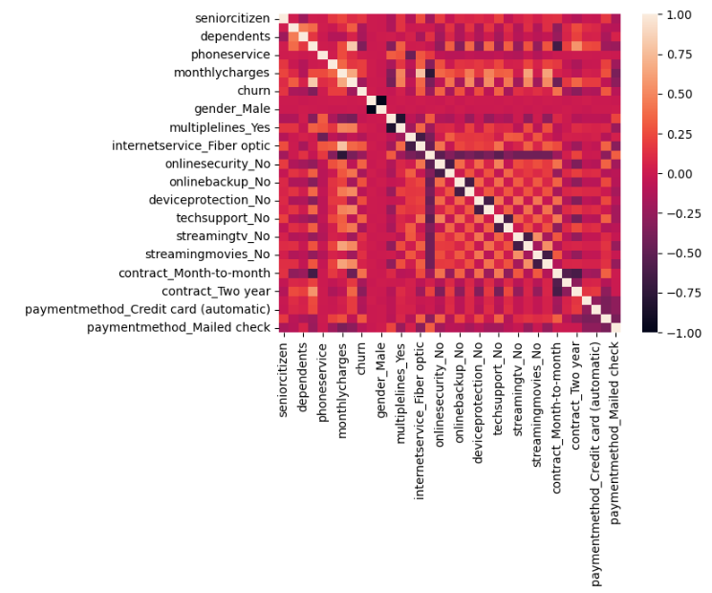
Churn Analysis: Trends, Correlations & Key Insights
Correlation to Churn:

Slide 5
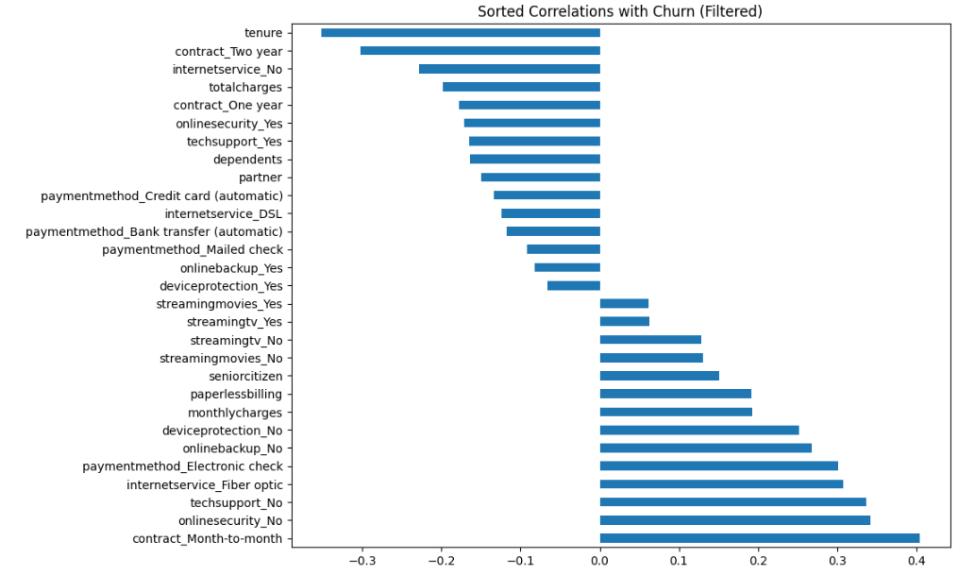
Identifying Key Features Influencing Churn
Removing Low-Correlation Features:
We set a correlation threshold of 0.05 to filter out features with negligible impact on churn.
Columns removed for visualization: PhoneService, Gender (Male/Female), MultipleLines (Yes/No).
Top Features Most Correlated with Churn:
Contract Type
Tenure
Internet Service Type, Online Security & Tech Support
Payment Method
Monthly Charges

Slide 6
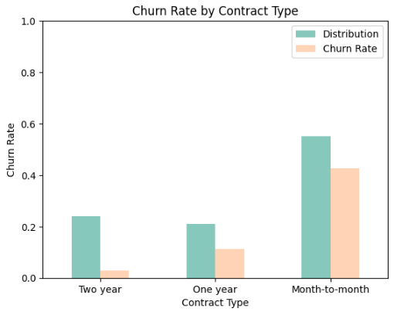
Zooming in on: Contract Type & Churn
Conclusion:
Month-to-month customers have the highest churn (42.7%), while two-year contract customers have the lowest (2.8%).
🚀 Key Takeaway:
Longer contracts reduce churn, indicating greater customer retention.

Slide 7
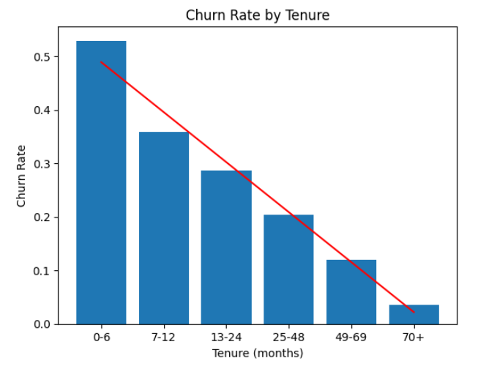
Zooming in on: Tenure & Churn
Conclusion:
Early-stage customers (0-6 months) have the highest churn rate (52.9%), while long-term customers (70+ months) have the lowest (3.5%).
Churn rate decreases as tenure increases, indicating that longer customer relationships lead to greater retention.
🚀 Key Takeaway:
The first 6 months are the most critical! Improving early retention efforts can significantly reduce churn.

Slide 8
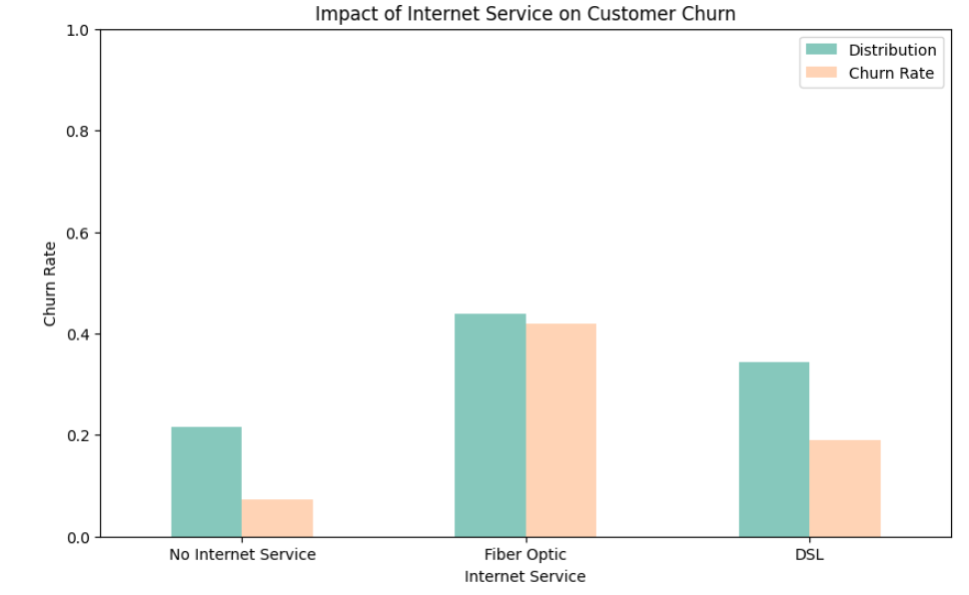
Zooming in on: Internet Service & Churn
Conclusion:
Customers with Fiber Optic service have the highest churn rate (~41.9%), compared to DSL (19%) and No Internet Service (7.4%).
Customers without internet service have the lowest churn rate, possibly because they have fewer service-related frustrations.
🚀 Key Takeaway:
Fiber Optic customers churn the most—improving service quality could enhance retention.

Slide 9
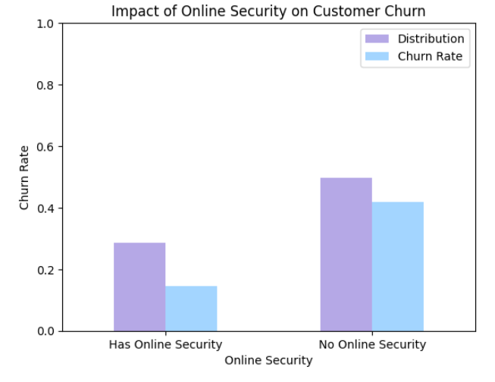
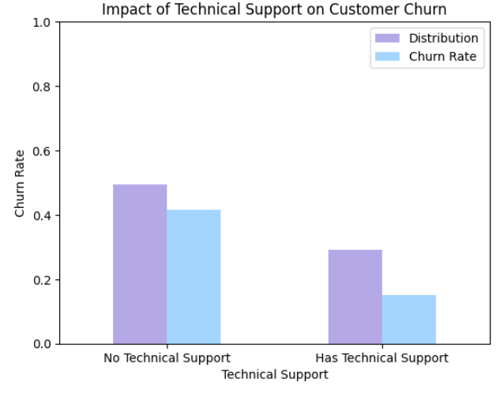
Zooming in on: Online Security, Tech Support & Churn
Conclusion:
Customers without online security or technical support are more likely to churn.
🚀 Key Takeaway: Providing online security & tech support significantly reduces churn—customers who feel supported stay longer.

Slide 10
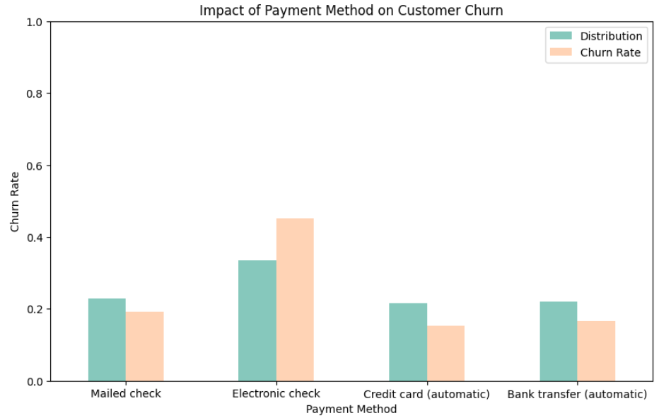
Zooming in on: Payment Method & Churn
Conclusion:
Customers using Electronic Check have the highest churn rate (~45%), significantly higher than other payment methods.
The combination of high churn and high distribution suggests this payment method may be causing dissatisfaction.
🚀 Key Takeaway:
Electronic Check is a high-risk payment method for churn.

Slide 11
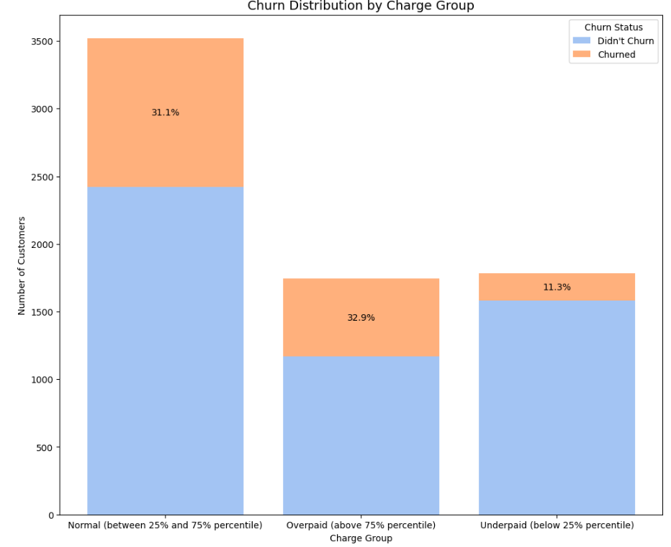
Zooming in on: Monthly Charges & Churn
Conclusion:
Overpaying customers have the highest churn rate (32.9%), followed closely by those in the Normal charge group (31.1%).
Underpaying customers have the lowest churn rate (11.3%), suggesting they may have discounted or promotional plans that encourage retention.
🚀 Key Takeaway:
Higher monthly charges are linked to higher churn—addressing pricing concerns and offering better value can improve retention.

Slide 12
Data Engineering
Handling Categorical Variables:
Applied One-Hot Encoding to: gender, multiplelines, internetservice, onlinesecurity, onlinebackup, deviceprotection, techsupport, streamingtv, streamingmovies, contract, paymentmethod.
Feature Removal:
Removed Customer ID – Not relevant for churn prediction.
Gender Feature Consideration- Gender had minimal impact on churn (Female: 26.9%, Male: 26.1%), and removing it resulted in no significant effect on model accuracy, so we kept it.
Removed Redundant One-Hot Encoded Columns:
We removed "No internet service" and "No phone service" columns as they were redundant, with internetservice_No and phoneservice providing the same information.
Cleaned the data from 41 features and one label to 34 features and one label
Handling Missing Values:
We filled missing TotalCharges values with 0 since they belonged to new customers (tenure = 0) who hadn’t been billed yet.
Feature Addition:
No new features were added.

Slide 13
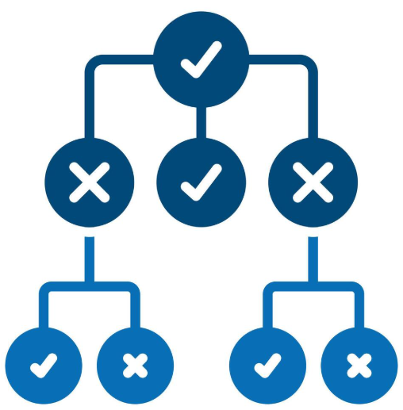
Machine Learning Models for Churn Prediction
Choosing the Right Model
To predict customer churn, we experimented with three different machine learning models and evaluated their performance:
K-Nearest Neighbors (KNN) – A distance-based model that classifies customers based on their similarity to others.
Decision Tree – A rule-based model that splits the data into meaningful decision paths.
Random Forest – An ensemble model that improves predictions by combining multiple decision trees.
Goal:
We compared these models to determine which one provided the most accurate churn predictions.

Slide 14
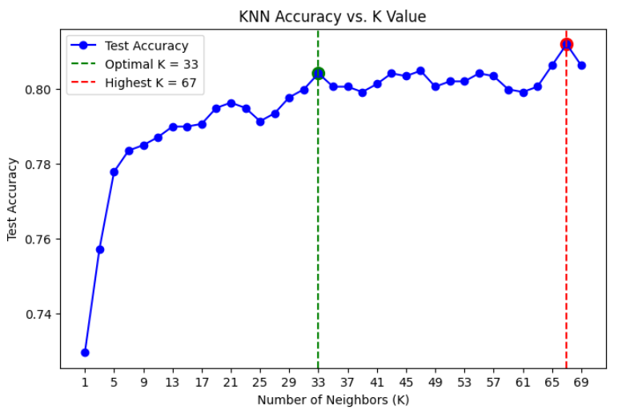
KNN
Initial Model & Feature Scaling:
The model was first tested with k=3, achieving 76.65% accuracy.
To improve performance, feature scaling was applied to both train and test sets.
Different odd k-values (1 to 69) were tested for optimization.
Results & Optimal K Selection:
k=33 → 80.4% accuracy (balanced performance with a simpler model).
k=67 → 81.2% accuracy (highest accuracy, but marginal improvement).
The accuracy difference between k=33 and k=67 is ~1%, making k=33 a preferable choice for its balance of accuracy and model simplicity.

Slide 15
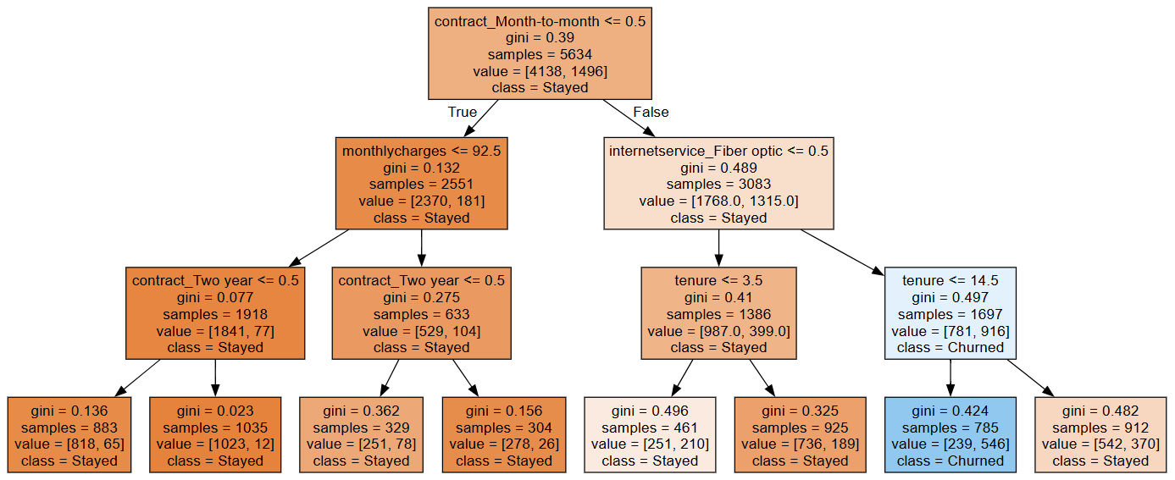
Decision tree
Initial Model & Feature Scaling:
We decided to set the model's depth to an arbitrary value of max_depth = 3, achieving 79.6% accuracy.
The decision tree results confirmed our insights regarding the factors influencing a customer's decision to churn. It is evident that the most significant factors include the type of monthly contract monthly charges, whether the customer uses fiber-optic internet services, tenure, and others. These key variables played a major role in predicting customer churn.

Slide 16
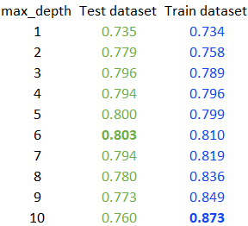
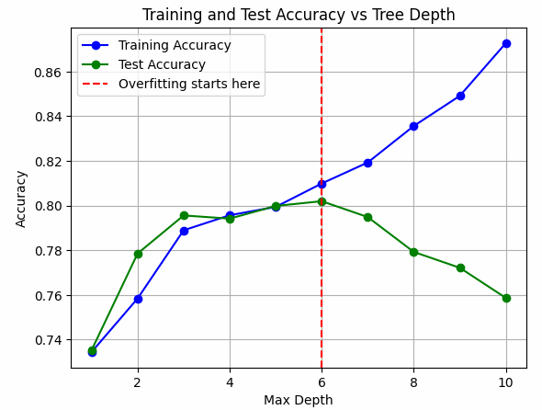
Decision tree
Optimal Depth for Maximum Accuracy for the Test and Train Samples
Conclusion-The optimal depth for accuracy on the test set is 6, while for the training set, it's 10. This highlights the overfitting phenomenon, where a model becomes too complex and performs well on the training data but struggles to generalize to unseen test data, leading to lower accuracy on the test set.

Slide 17
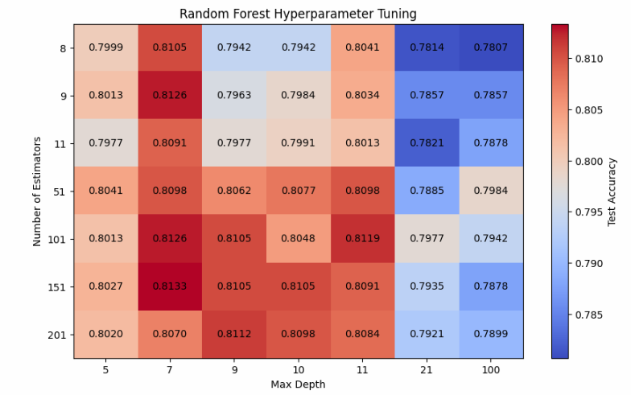
Random Forest
Initial Max Depth & Estimators :
The model was first tested with n_estimators=100 and max_depth=10, achieving test accuracy of 80.48%
and 87.4% of train accuracy.
To improve the accuracy, hyperparameters tested:
Number of estimators: [8, 9, 11, 51, 101, 151, 201]
Max depth values: [5, 7, 9, 10, 11, 21, 100]
Best hyperparameters found:
Number of Estimators = 151
Max Depth = 7
Best Test Accuracy = 81.33%
Train Accuracy = 81.72%

Slide 18
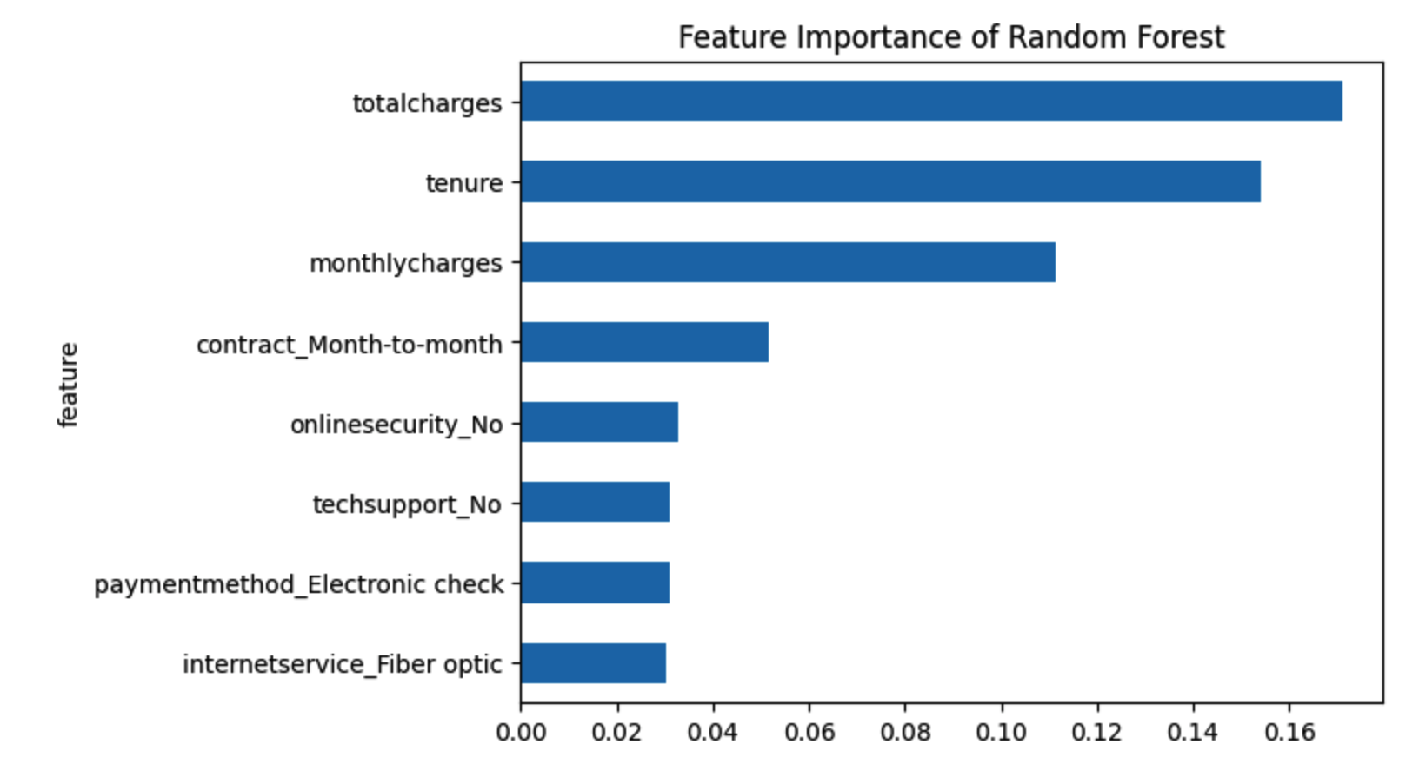
Random Forest
The model identified the most influential factors for predicting churn:
TotalCharges: 17.1%
Tenure: 15.4%
MonthlyCharges: 11.14%
Contract (Month-to-Month): 5.14%
OnlineSecurity (No): 3.27%
Techsupport (No): 3.1%
This closely aligns with our previous findings, further validating their significance.

Slide 19
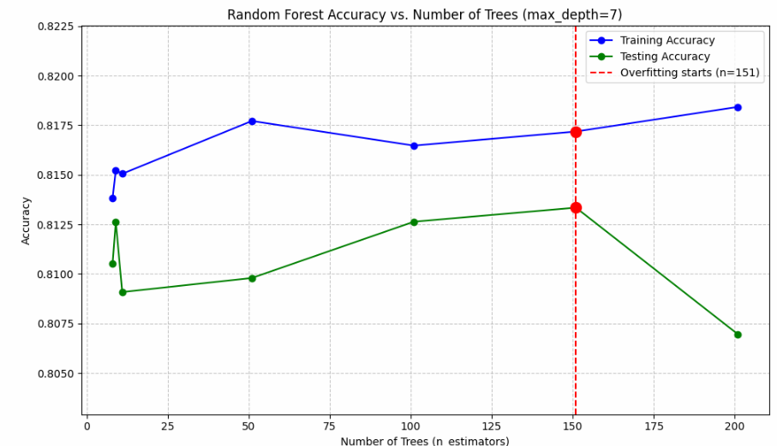
Random Forest
We evaluate the model’s performance by comparing accuracy on the training and test datasets.
Results:
Train Accuracy: 81.72 %
Test Accuracy: 81.33 %
The train-test gap is only 0.39%, meaning no significant overfitting.
Overfitting starts at 151 trees before declining.
Conclusion:
A well-balanced model with good predictive power.

Slide 20
Algorithms Comparison
Rank | Algorithm | Optimized Hyperparameters | Accuracy (%)
🥇 | Random Forest | Trees = 151 Max Depth = 7 | 81.3%
🥈 | KNN | K=33 | 80.4%
🥉 | Decision Tree | Max Depth = 6 | 80.2%
Overall, the accuracy results for all three models were similar, but Random Forest performed the best, achieving the highest accuracy. While KNN and Decision Tree provided competitive results, Random Forest's ensemble approach gave it a slight edge in predictive performance.
The benchmark model (always predicts "Not Churned") achieves 73.53% accuracy; thus, all models outperformed this benchmark.
🏆 In conclusion Random Forest is the best choice due to its higher accuracy, robustness, and ability to handle complex patterns, making it ideal for predicting customer churn.

