Slide 1
Analysis Project
Emil Raskin

Slide 2
Project Goal
The goal of the practical project is to experiment with the methodologies and aspects taught in my course - Technion Certified Big Data Analyst Program.
such as, architecture planning, development and analysis in different tools, languages ​​and platforms : Power BI, Power Pivot/Query and Dax.
Attached to the project are 2 databases, a SQL server and a CSV file as an additional data source with details of countries and regions.
The databases belong to an operational system called "Happy_Insurance" of the "Happy_Insurance" company with insurance sales transactions.
Together, they constitute the database of the "Happy_Insurance" company and represent 3 years of business activity (2011 – 2013).

Slide 3




Main stages
Development of an ETL process to transfer data from the databases to a star schema, using Power Query and M Language techniques.
Development of a Tabular model using Power Pivot that will provide a quick and high-quality answer to the organization's business questions with minimal effort by end users.
Reports and data visualization using Power BI.
2. Creating dashboards, reports, and visual insights with Dax.
2. Converting the tables into a suitable star schema.
SQL DB
Reading data from SQL tables and Excel/CSV files.
Establishing relationship, measures, and hierarchies in Power Pivot
1. Connecting to the Tabular Model or the Power Pivot data model.
1.Cleaning, filtering, merging, and shaping the data.
1.Extract
2.Transform
3.Load
4. Analysis & Visualization
Power Query
Power Pivot
Power BI
CSV “Region”

Slide 4
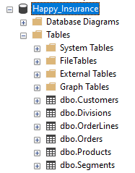
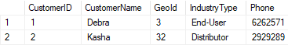
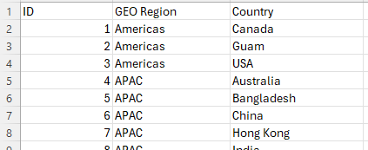




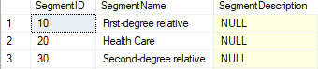
1. Extract
There is a logical connection between the "GEOID" and the "ID" in Excel.
CSV “Region”
SQL DB
We can see that we only have information about sales in years and quarters, we don't have information about days and months.
It can be understood that OrderLines will be our Fact table because it contains characteristics/descriptions of events and has numerical values ​​(quantifiable).

Slide 5


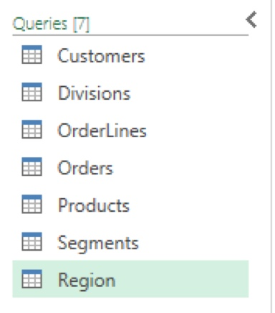

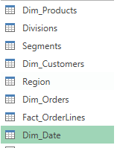
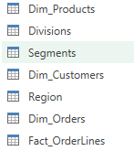
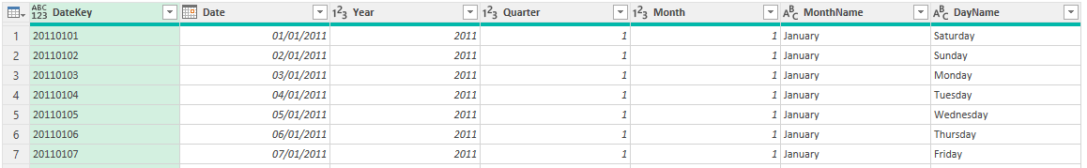
2.Transform
Power Query
Now it's time to connect all the dimensions into the Fact table.
But then I discovered a Problem.
I created 4 dimensions of tables and a Fact table, But I need to make another dimension table of date for Time analysis.
And I had to make that one myself.
Dim_Date Table
I imported the SQL tables and the CSV table into Power Query.
I did a Data Cleaning, filtering
and connected tables (Denormalized) that have the option of join as we have already seen in the Extract process and then Converting the tables to dimensions with a Surrogate Key for each dimension so that data from multiple sources can be combined into a Fact table.
Example of Customers table becoming Dim_Customers
Adding SK
BK is business Key - The original key from the source system

Slide 6
The Problem
The core challenge revolved around ensuring Fact_OrderLines proper relationships with the Dim_Date table
The Orders table only provided Year and Quarter columns, but there was no specific OrderDate to represent the exact day of an order.
This meant the Dim_Date table, which contains continuous daily dates, couldn’t directly be joined with Fact_OrderLines to retrieve the DateKey.
Without an exact OrderDate, I needed a strategy to map the broader Year and Quarter data to the continuous dates in Dim_Date.
The Fact_OrderLines required a DateKey to connect to Dim_Date for time-based analysis, alongside surrogate keys (SK) from other dimensions.
Joining OrderLines with Dim_Date was impossible without first deriving a meaningful OrderDate from the Year and Quarter columns

Slide 7
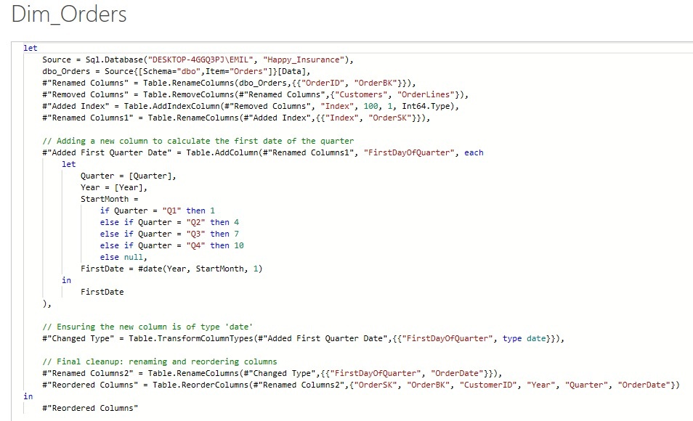
The Solution
I resolved the issue by introducing a calculated OrderDate column in Dim_Orders, propagating it to OrderLines, and then using it to join with Dim_Date.
Calculated the first day of the quarter for each row in Dim_Orders.
I Used the following logic:
Q1 → YYYY-01-01
Q2 → YYYY-04-01
Q3 → YYYY-07-01
Q4 → YYYY-10-01
And Implemented this calculation in Power Query using M Language approach with if...then...else conditions and the date function.

Slide 8
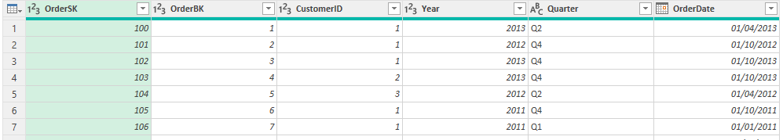
Adding an OrderDate column to the Dim_Orders table
Now it is possible to connect Dim_Date and Dim_Orders with Date and OrderDate columns
It will now be possible to connect Dim_Orders to Fact_OrderLines and attach the DateKey
Dim_Date Table

Slide 9

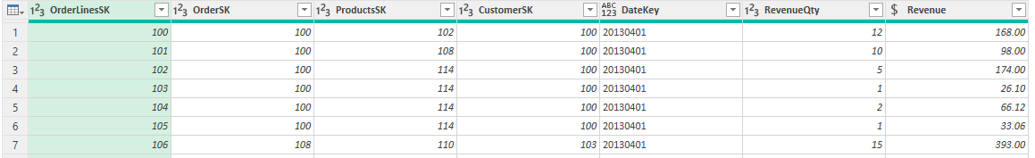
2.Transform
Power Query
Fact_OrderLines

Slide 10
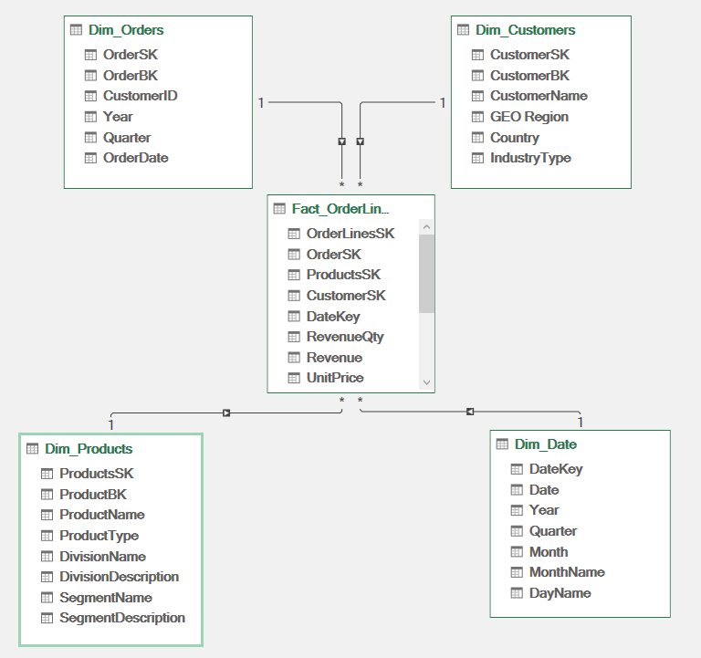
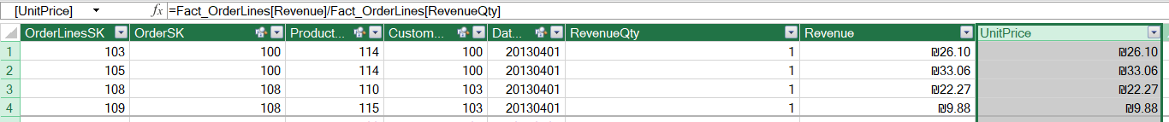
3. Load
Power Pivot
After the Transform I was able to connect and create the star schema in Power Pivot.
Along with this I did some measures that I will need for a quick and high-quality answers to the organization's business questions
TotTRev:=SUM(Fact_OrderLines[Revenue]) for Total revenue
OrderQty_Fact:=DISTINCTCOUNT(Fact_OrderLines[OrderSK])
for Total Orders
AvgOrderRev:=[TotTRev]/[OrderQty_Fact] for average order revenue
And I made a new calculated column for unit price.

Slide 11
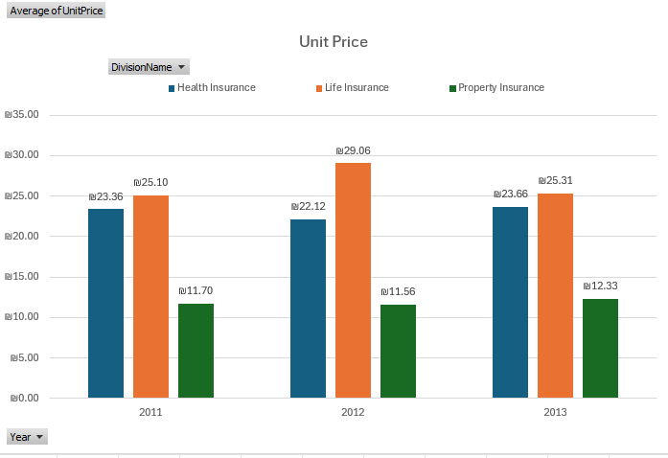
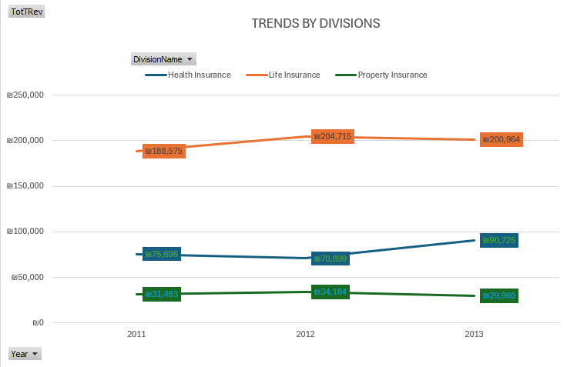
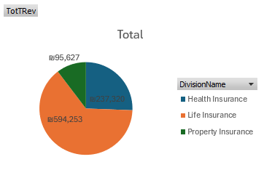
Life Insurance had the highest revenue, starting at ₪188,575 in 2011, peaking at ₪204,715 in 2012, but slightly dropping to ₪200,964 in 2013.
Property Insurance had the lowest revenue and showed a small decline over the years, from ₪31,483 in 2011 to ₪29,960 in 2013.
Life Insurance had the highest unit price across all years, increasing from ₪25.10 in 2011 to ₪29.06 in 2012, before settling at ₪25.31 in 2013.
Health Insurance fluctuated, with a dip in 2012 (₪22.12) before recovering to ₪23.66 in 2013.
Property Insurance had the lowest unit price, remaining relatively stable between ₪11.56 and ₪12.33.
The Life Insurance division accounts for more than half of the total revenue, while Property Insurance represents a small fraction.

Slide 12
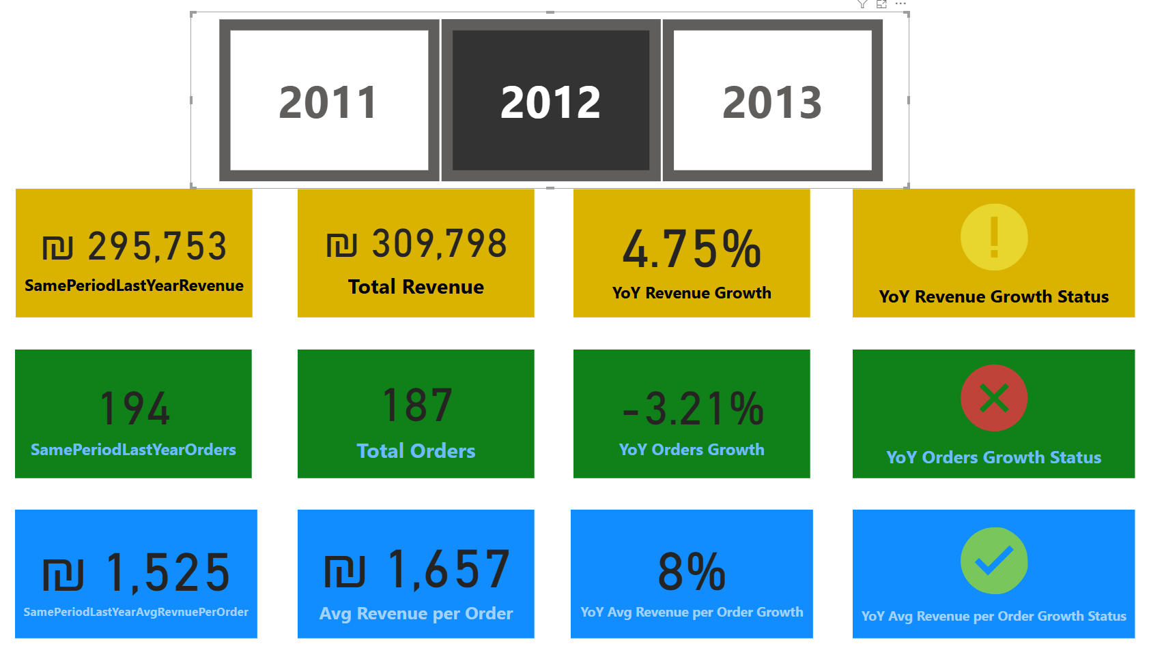
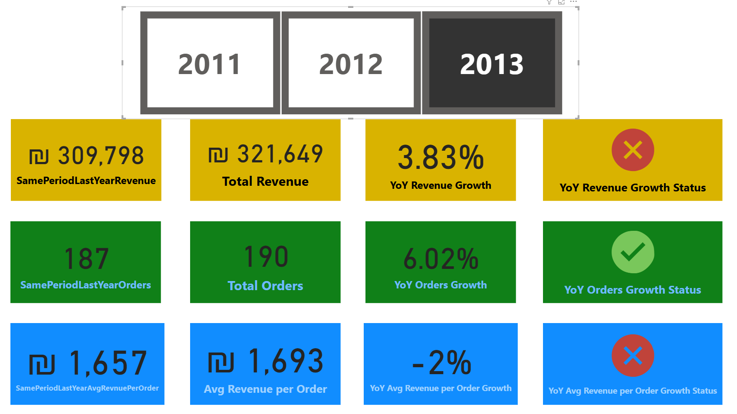
4. Analysis & Visualization
I imported my model into PBI and after cleaning and organizing, I was able to produce a number of reports, some of which I will present here.
This dashboard provides a year-over-year (YoY) performance analysis of key business metrics. Each KPI compares the current year’s performance to the previous year and categorizes the results using color-coded status indicators based on performance against the company's growth targets.
🟢 Green → Growth of 5% or more (Strong Performance).
🟡 Yellow → Growth between 4% and 4.99% (Stable, but below target).
🔴 Red → Growth below 4% (Underperformance).
2012 was a mixed year, with stable revenue growth but a decline in orders. 2013 showed improvement in orders, but revenue growth is slowing, and the average revenue per order declined slightly.

Slide 13
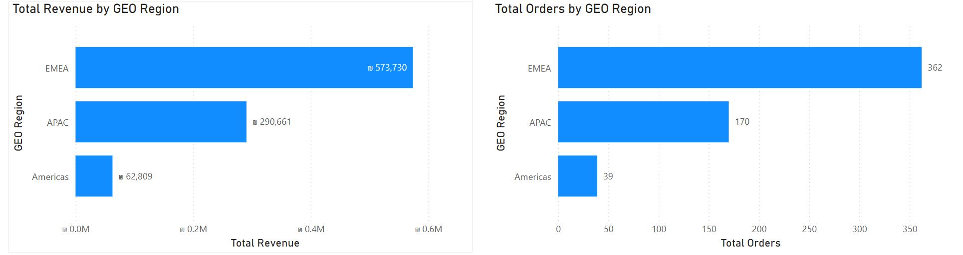
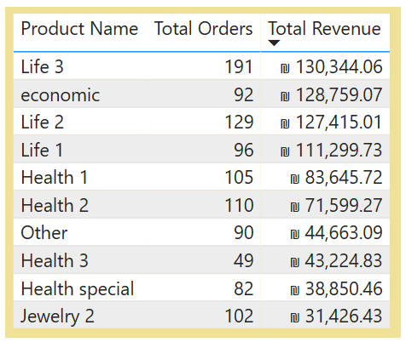
EMEA is the strongest performing region in both revenue and order volume, indicating a highly active and profitable market. APAC is a growing market, contributing significantly but still trailing behind EMEA. Americas struggles in both orders and revenue, suggesting a weak presence or lack of demand in this region.
"Life 3" leads with ₪130,344 from 191 orders, making it the highest-performing product in terms of revenue

Slide 14
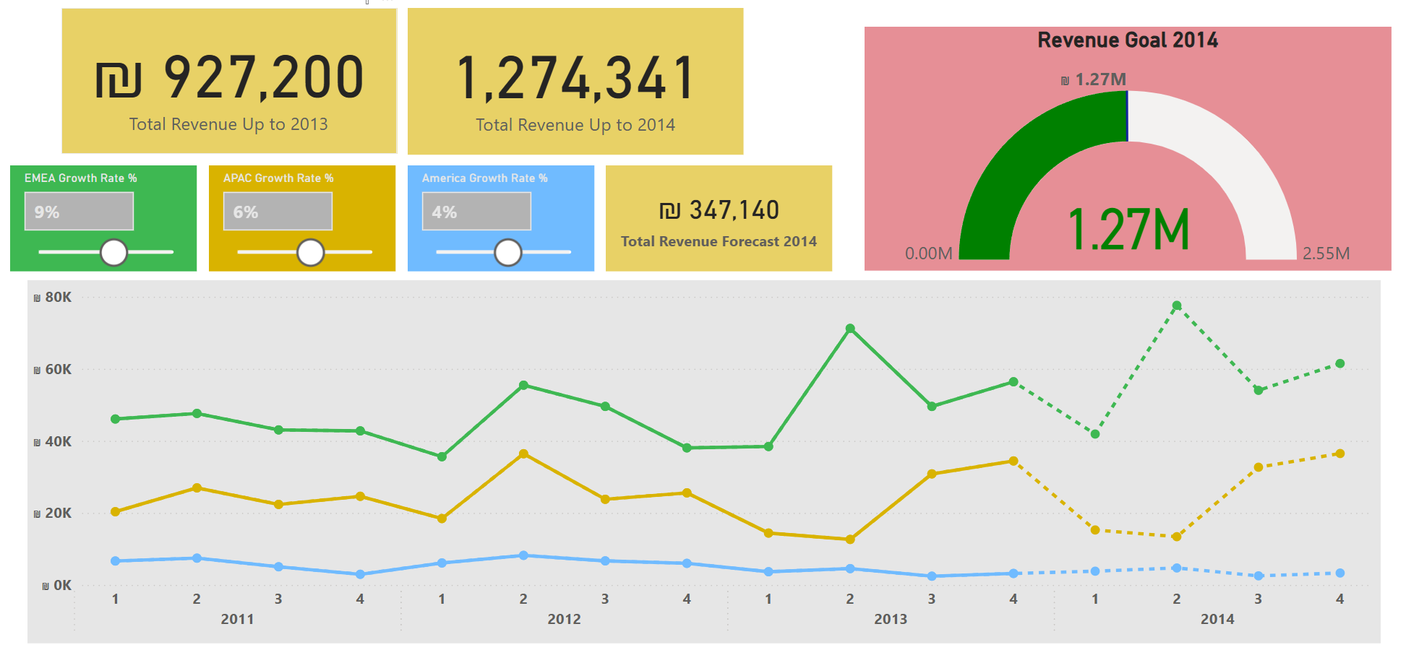
Currently, for 2013, Total Revenue is 927,000, but let's say our goal for 2014 Total Revenue will be at least 1,270,000 - we can see that if we focus on increasing by another 9 percent in the EMEA region (the region that generates more Revenue), 6 percent in the APAC region, and 4 percent in America, we will reach the goal of 1,270,000.

Slide 15
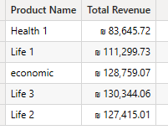
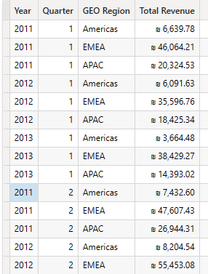
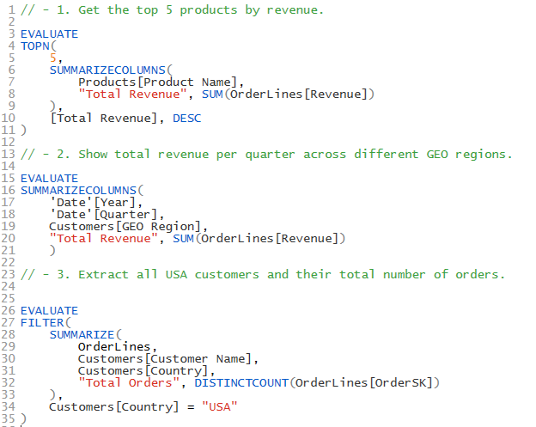

I also used Dax studio for queries.

Slide 16
Final Thoughts
Thank you very much for looking at and being interested in the project I prepared.
I would be happy if you will see the PBI file and experiment with it yourself and see the great investment I put into it, both in visualization and design.
This project was very challenging but also very educational. I am glad I had the opportunity to work on it.
I have undoubtedly increased my skills and only hope to increase them even more in the future.

