Slide 1
Lecture 3b block 2
High-dimensional problems

Slide 2
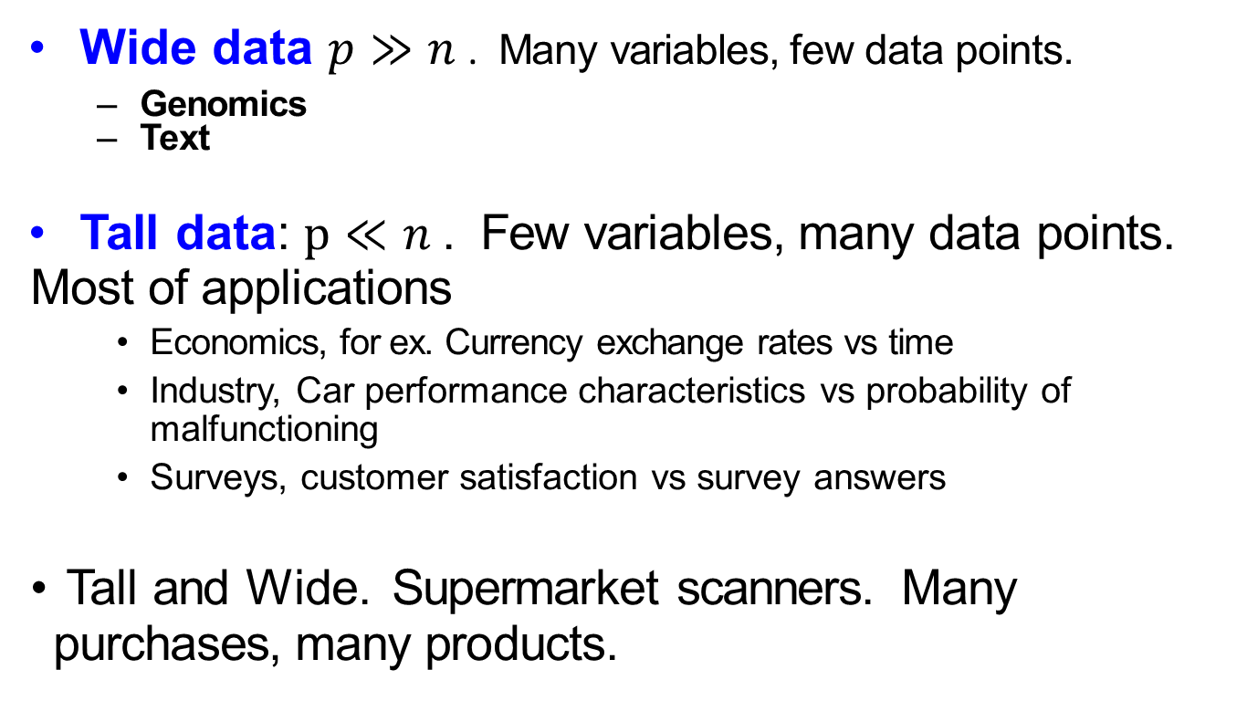
Wide data
Wide data $p≫n$ . Many variables, few data points.
Genomics
Text
Tall data: $p≪n$ . Few variables, many data points. Most of applications
Economics, for ex. Currency exchange rates vs time
Industry, Car performance characteristics vs probability of malfunctioning
Surveys, customer satisfaction vs survey answers
Tall and Wide. Supermarket scanners. Many purchases, many products.

Slide 3
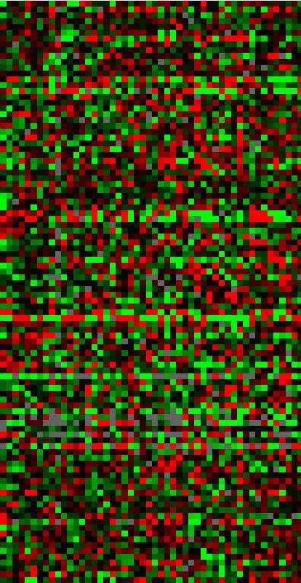
Genomics-microarrays
Hastie et al:. DNA microarray data: expression matrix of 6830 genes (rows) and 64 samples (columns), for the human tumor data. Only a random sample of 100 rows are shown. The display is a heat map, ranging from bright green (negative, under expressed) to bright red (positive, over expressed). Missing values are gray. The rows and columns are displayed in a randomly chosen order.

Slide 4
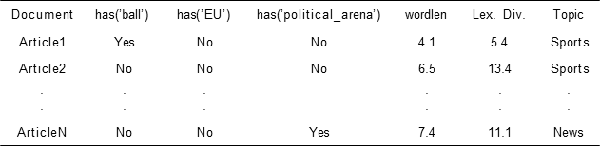
Text – document classification

Slide 5
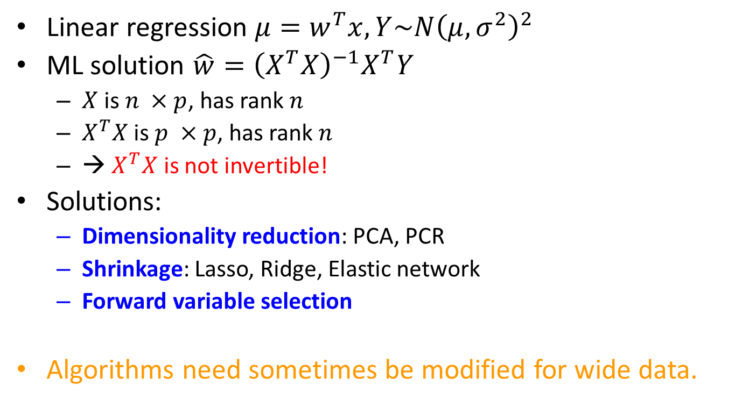
A problem with wide data
Linear regression $μ=w^{T}x, Y\sim N{\left(μ,σ^{2}\right)}^{2}$
ML solution $\hat{w}={\left(X^{T}X\right)}^{−1}X^{T}Y$
$X$ is $n ×p$, has rank $n$
$X^{T}X$ is $p ×p$, has rank $n$
→ $X^{T}X$ is not invertible!
Solutions:
Dimensionality reduction: PCA, PCR
Shrinkage: Lasso, Ridge, Elastic network
Forward variable selection
Algorithms need sometimes be modified for wide data.

Slide 6
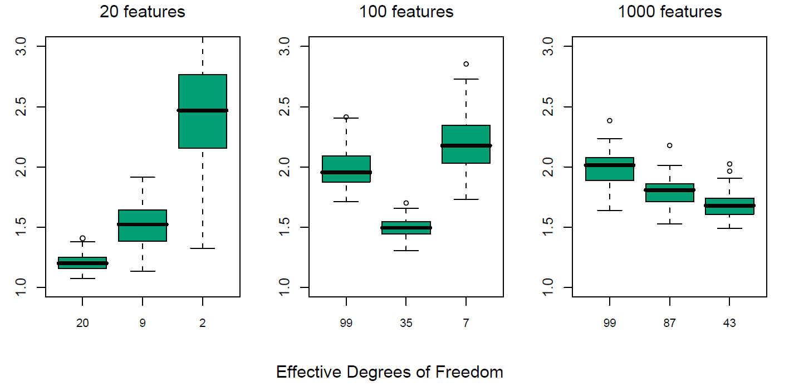

Effective amount of features for wide data
Linear response generated with different p, n=100
Ridge is applied with different $λ$
Models with smaller effective number of features have better prediction
Source: Hastie et al (2009)

Slide 7

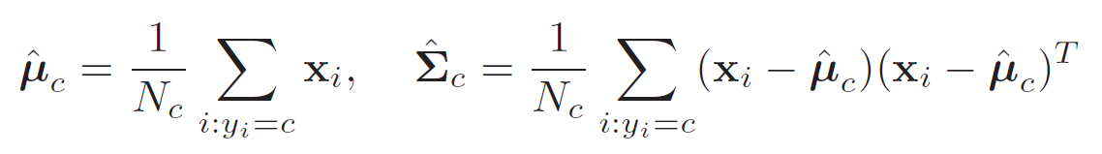

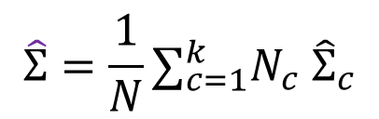
Classification: LDA
Standard LDA
→ $Σ^{−1}$ does not exist…
$$\hat{Σ}={\frac{1}{N}∑}_{c=1}^{k}N_{c} {\hat{Σ}}_{c}$$

Slide 8
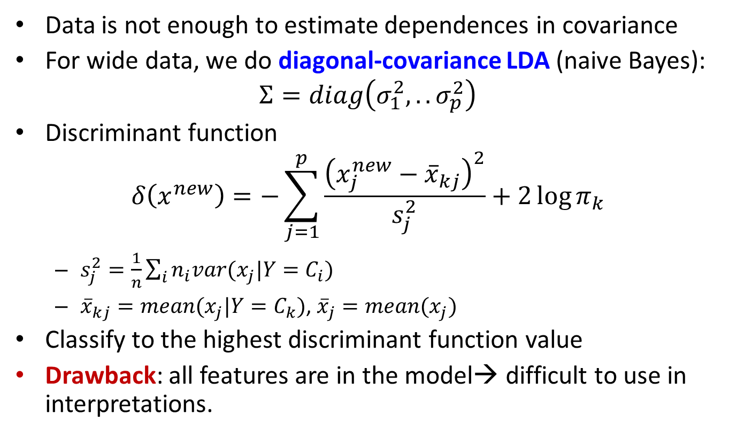
Classification: diagonal-covariance LDA
Data is not enough to estimate dependences in covariance
For wide data, we do diagonal-covariance LDA (naive Bayes):
$$Σ=diag\left(σ_{1}^{2},..σ_{p}^{2}\right)$$
Discriminant function
$$δ\left(x^{new}\right)=−\sum_{j=1}^{p}{\frac{{\left(x_{j}^{new}−{\overline{x}}_{kj}\right)}^{2}}{s_{j}^{2}}+2\log{π_{k}}}$$
$s_{j}^{2}=\frac{1}{n}\sum_{i}{n_{i}var(x_{j}|Y=C_{i})}$
${\overline{x}}_{kj}=mean(x_{j}|Y=C_{k})$, ${\overline{x}}_{j}=mean(x_{j})$
Classify to the highest discriminant function value
Drawback: all features are in the model→ difficult to use in interpretations.

Slide 9
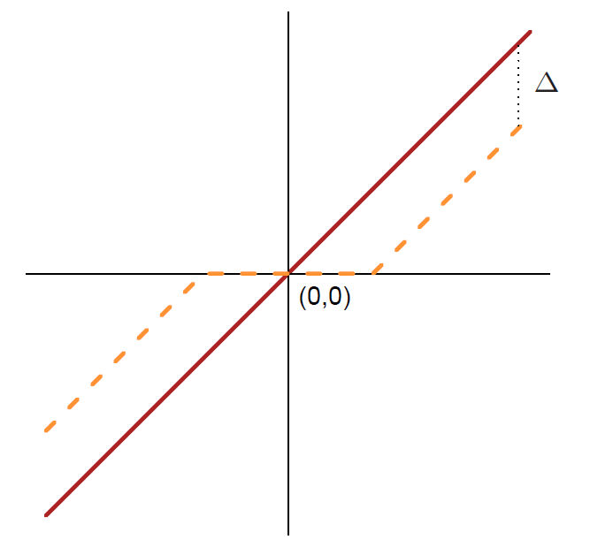


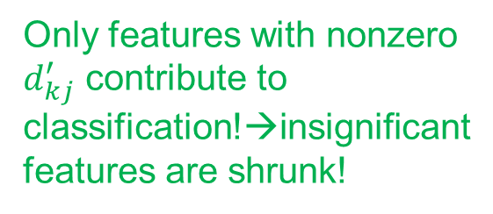
Classification: NSC
Nearest Shrunken Centroids
Idea: Shrink classwise means towards overall mean
Compute $d_{kj}=\frac{{\overline{x}}_{kj}−{\overline{x}}_{j}}{m_{k}(s_{j}+s_{0})}$
Shrink $d_{kj}^{′}=sign\left(d_{kj}\right){\left(\left|d_{kj}\right|−∆\right)}_{+}$
Set $x_{kj}^{′}={\overline{x}}_{j}+m_{k}\left(s_{j}+s_{0}\right)d_{kj}^{′}$
Only features with nonzero $d_{kj}^{′}$ contribute to classification!→insignificant features are shrunk!
Define $∆$ by CV

Slide 10

NSC: example
LSVT Voice Rehabilitation Data Set
Target: Quality of voice rehabilitation
1=acceptable, 2=not acceptable
Features: Properties of the signal (voice)

Slide 11
NSC: example
Package pamr
pamr.train()
pamr.cv
data0=read.csv2("voice.csv")
data=data0
data=as.data.frame(scale(data))
data$Quality=as.factor(data0$Quality)
library(pamr)
rownames(data)=1:nrow(data)
x=t(data[,-311])
y=data[[311]]
mydata=list(x=x,y=as.factor(y),geneid=as.character(1:nrow(x)), genenames=rownames(x))
model=pamr.train(mydata,threshold=seq(0,4, 0.1))
pamr.plotcen(model, mydata, threshold=1)
pamr.plotcen(model, mydata, threshold=2.5)
a=pamr.listgenes(model,mydata,threshold=2.5)
cat( paste( colnames(data)[as.numeric(a[,1])], collapse='\n' ) )
cvmodel=pamr.cv(model,mydata)
print(cvmodel)
pamr.plotcv(cvmodel)

Slide 12
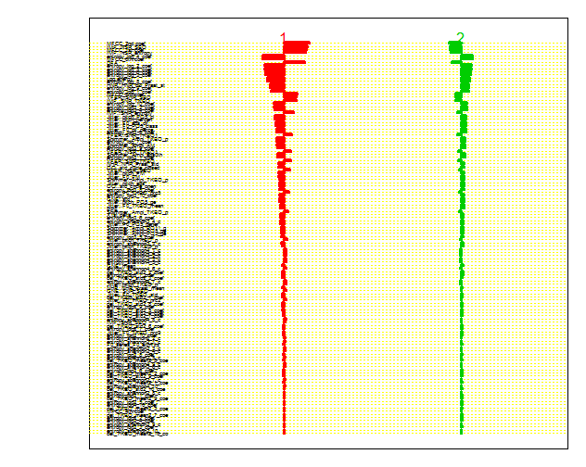
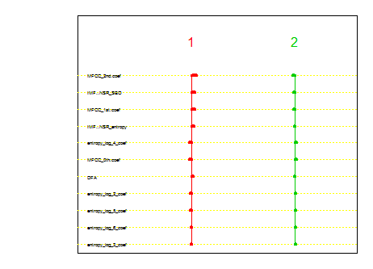

NSC: example
Centroid plot, $∆=1$ and $∆=2.5$

Slide 13
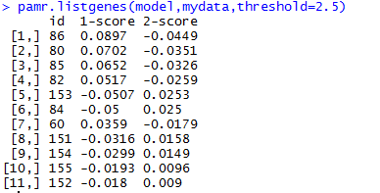
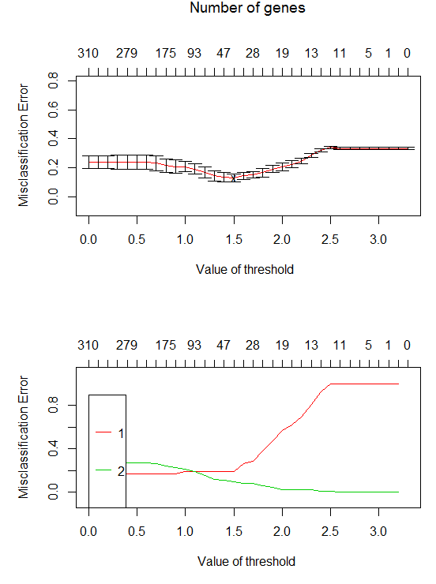
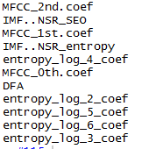

NSC: example
Confusion matrix optimal $∆$
 | Pred 1 | Pred 2
True 1 | 33 | 9
True 2 | 5 | 79

Slide 14
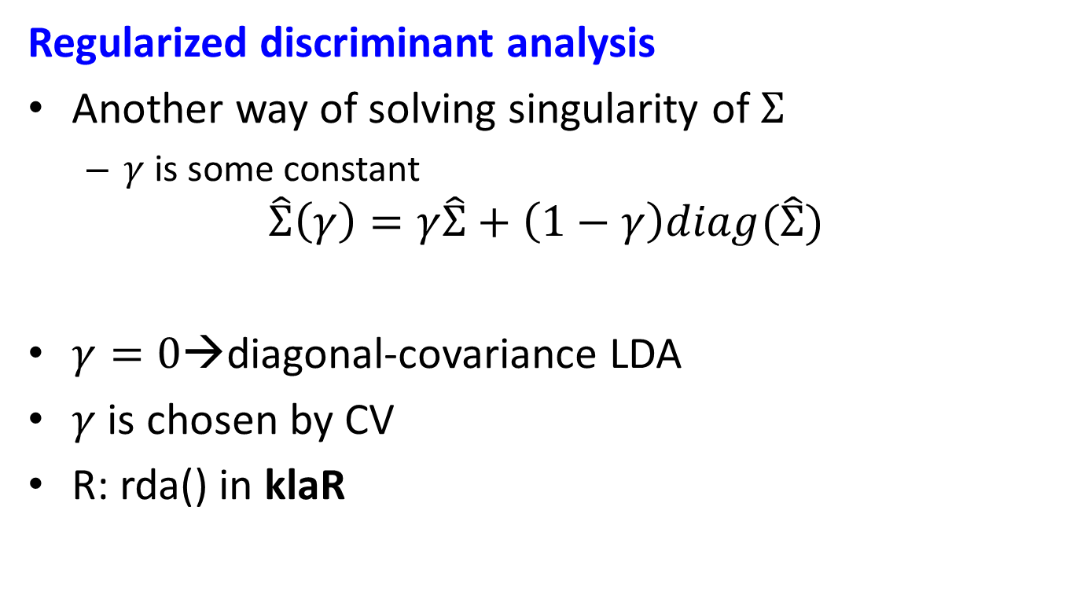
RDA
Regularized discriminant analysis
Another way of solving singularity of $Σ$
$γ$ is some constant
$$\hat{Σ}\left(γ\right)=γ\hat{Σ}+\left(1−γ\right)diag(\hat{Σ})$$
$γ=0$→diagonal-covariance LDA
$γ$ is chosen by CV
R: rda() in klaR

Slide 15
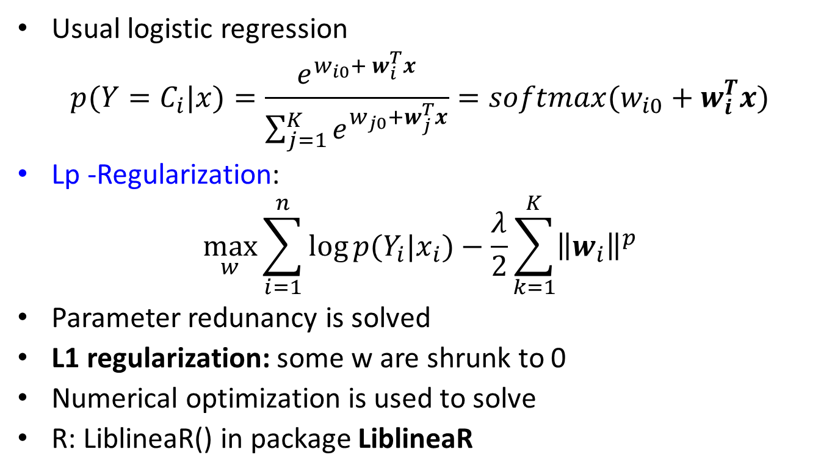
Regularized logistic regression
Usual logistic regression
$$p(Y=C_{i}|x)=\frac{e^{{w_{i0}+ w}_{i}^{T}x}}{\sum_{j=1}^{K}{e^{{w_{j0}+w}_{j}^{T}x}}}=softmax(w_{i0}+w_{i}^{T}x)$$
Lp -Regularization:
$$\max_{w}{\sum_{i=1}^{n}{\log{p(Y_{i}|x_{i})}}−\frac{λ}{2}\sum_{k=1}^{K}{{\left\|w_{i}\right\|}^{p}}}$$
Parameter redunancy is solved
L1 regularization: some w are shrunk to 0
Numerical optimization is used to solve
R: LiblineaR() in package LiblineaR

Slide 16
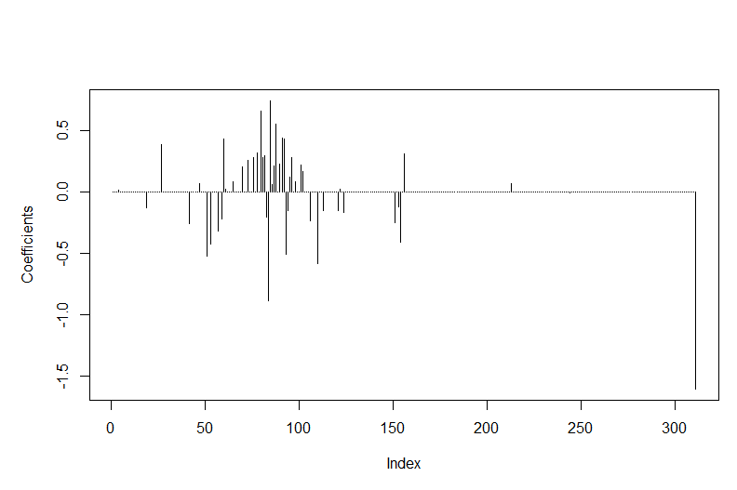
L1 logistic regression
Voice rehabilitation
W=model2$W
plot(t(W), type="h", ylab="Coefficients")
 | Pred 1 | Pred 2
True 1 | 41 | 1
True 2 | 0 | 84
Overfitted?

Slide 17
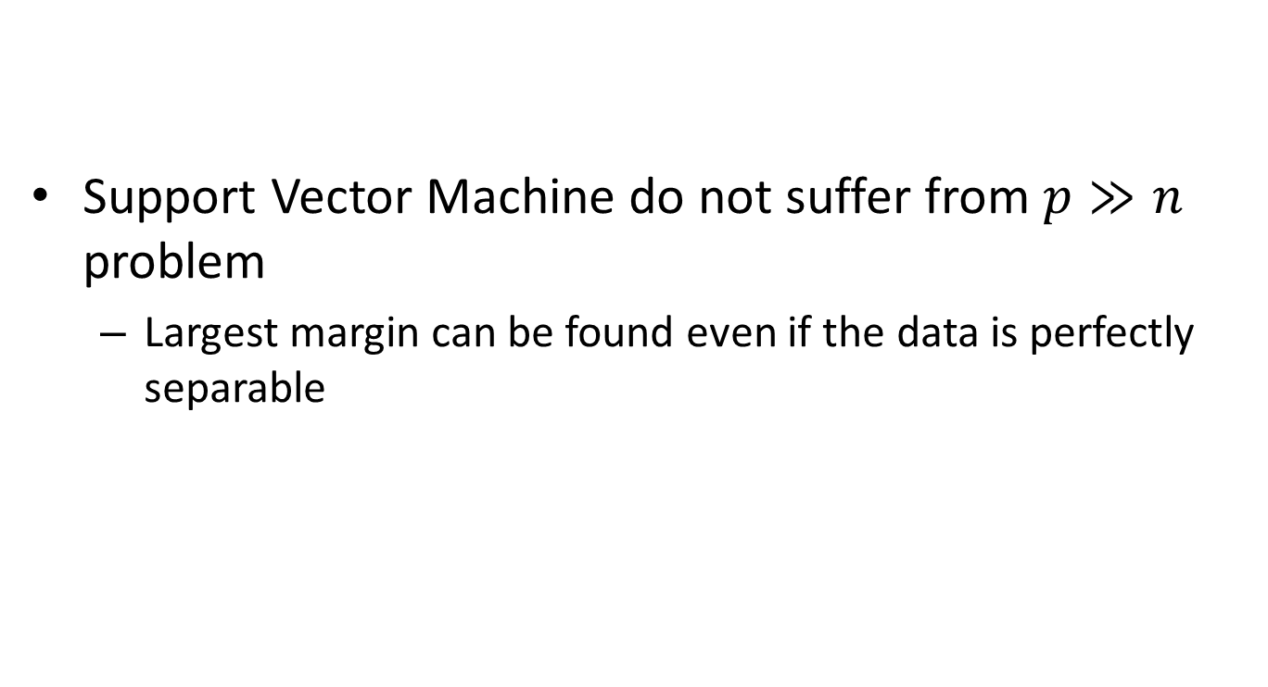
SVM
Support Vector Machine do not suffer from $p≫n$ problem
Largest margin can be found even if the data is perfectly separable

Slide 18
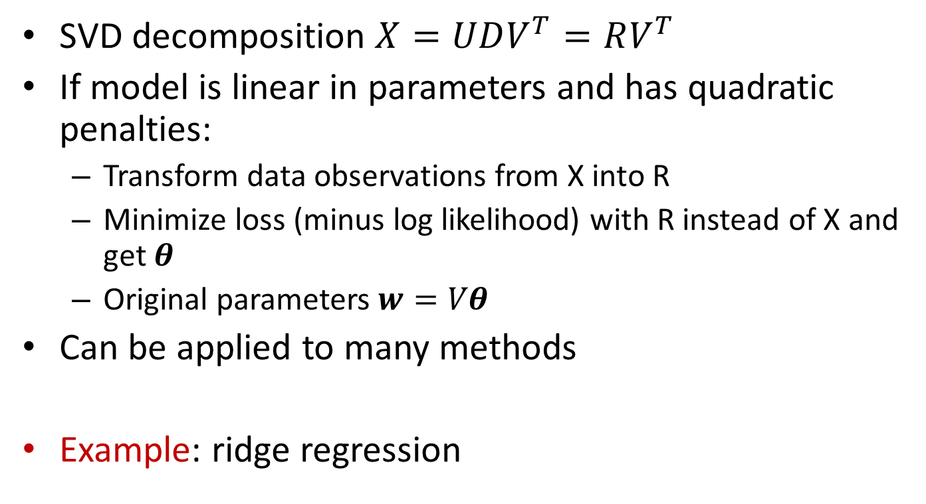
Computational shortcuts p>>n
SVD decomposition $X=UDV^{T}=RV^{T}$
If model is linear in parameters and has quadratic penalties:
Transform data observations from X into R
Minimize loss (minus log likelihood) with R instead of X and get $θ$
Original parameters $w=Vθ$
Can be applied to many methods
Example: ridge regression

Slide 19
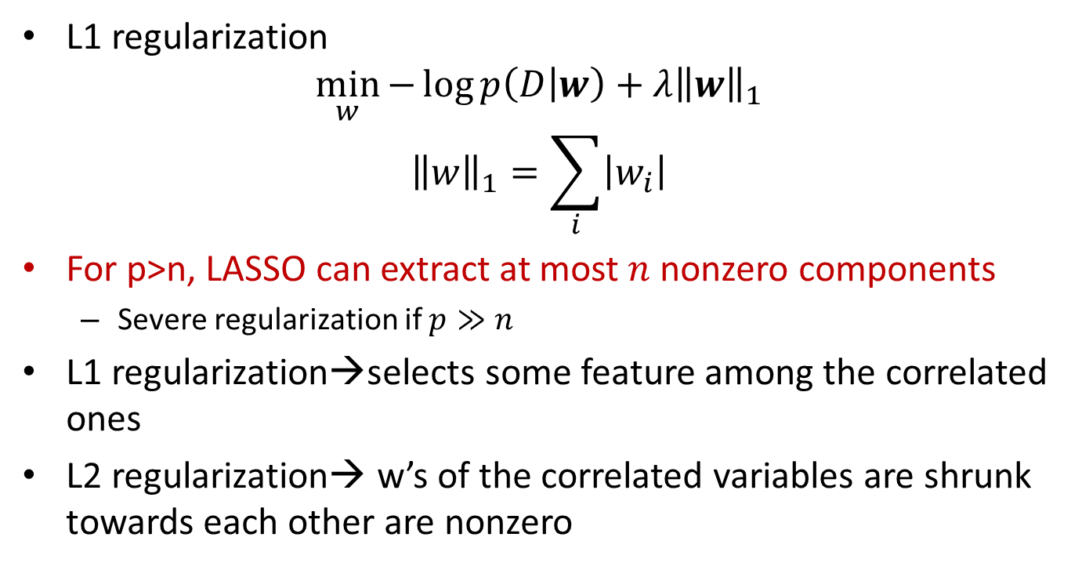
Elastic net
L1 regularization
$$\min_{w}{−\log{p\left(D | w\right)}+λ{\left\|w\right\|}_{1}}$$
$${\left\|w\right\|}_{1}=\sum_{i}{\left|w_{i}\right|}$$
For p>n, LASSO can extract at most $n$ nonzero components
Severe regularization if $p≫n$
L1 regularization→selects some feature among the correlated ones
L2 regularization→ w’s of the correlated variables are shrunk towards each other are nonzero

Slide 20
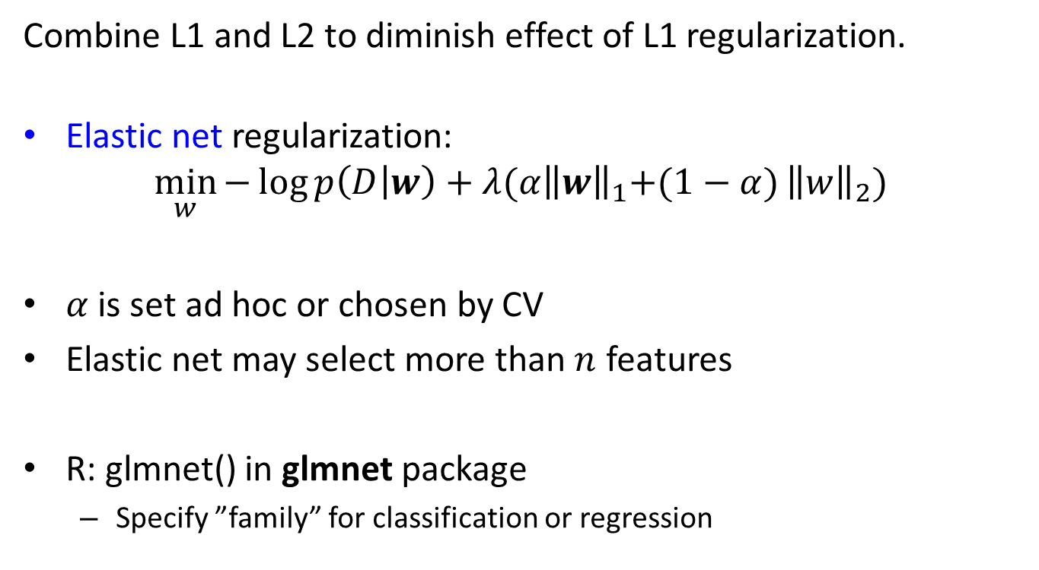
Elastic net
Combine L1 and L2 to diminish effect of L1 regularization.
Elastic net regularization:
$$\min_{w}{−\log{p\left(D | w\right)}+λ{(α\left\|w\right\|}_{1}+(1−α)}{\left\|w\right\|}_{2})$$
$α$ is set ad hoc or chosen by CV
Elastic net may select more than $n$ features
R: glmnet() in glmnet package
Specify ”family” for classification or regression

Slide 21
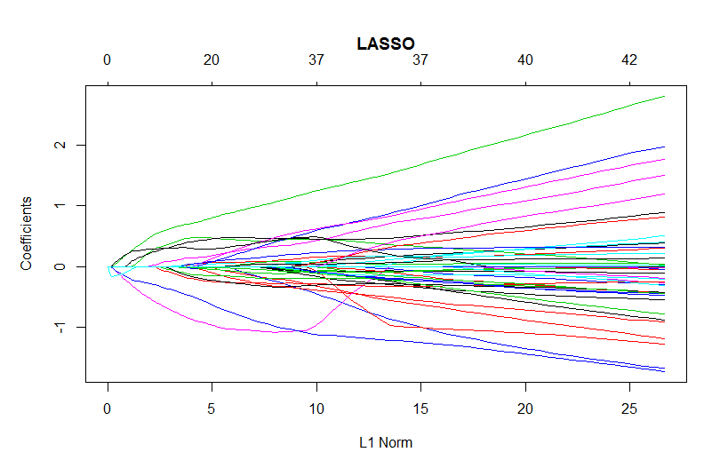
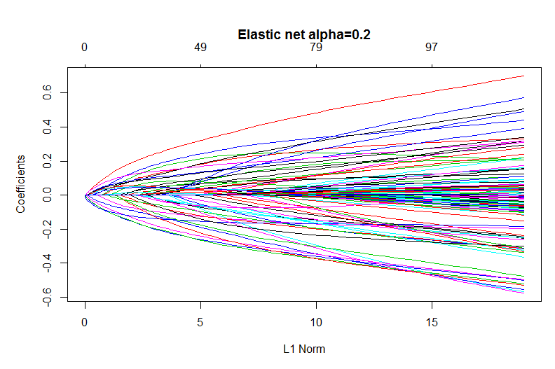
Elastic net
Voice rehabilitation

Slide 22
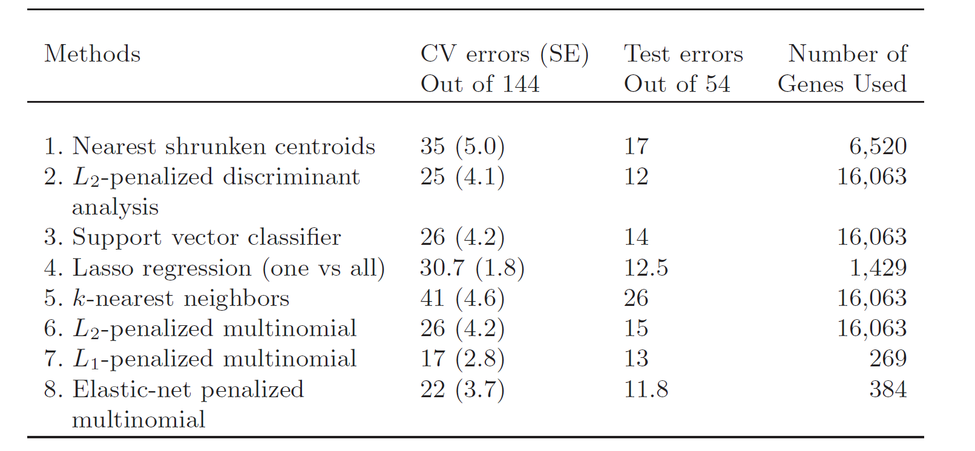
Comparative analysis
Gene expression data

Slide 23

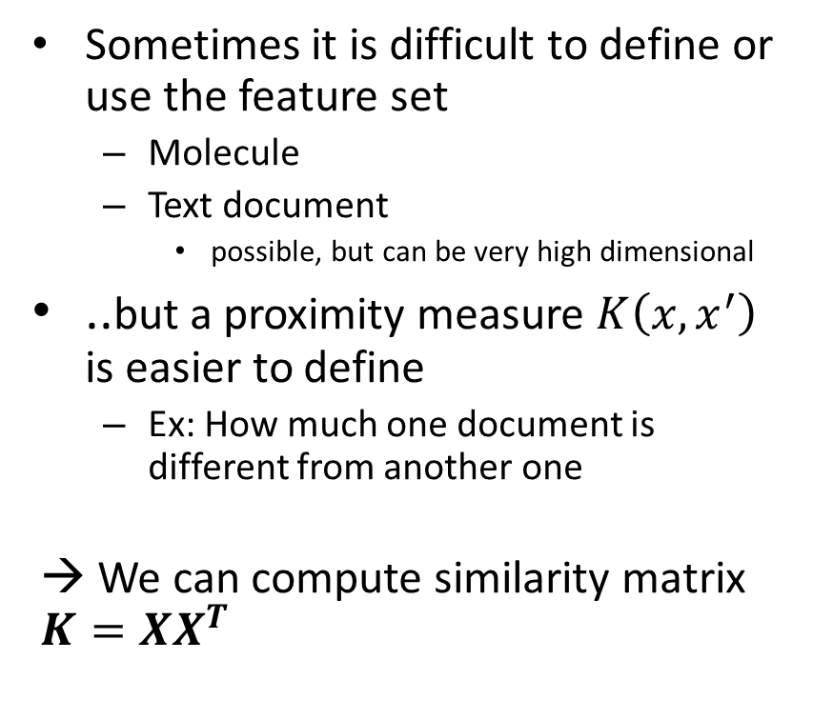
When features are not available
Sometimes it is difficult to define or use the feature set
Molecule
Text document
possible, but can be very high dimensional
..but a proximity measure $K\left(x,x^{′}\right)$ is easier to define
Ex: How much one document is different from another one
→ We can compute similarity matrix $K=XX^{T}$
Source:http://images.wisegeek.com/illustration-of-a-molecule.jpg

Slide 24
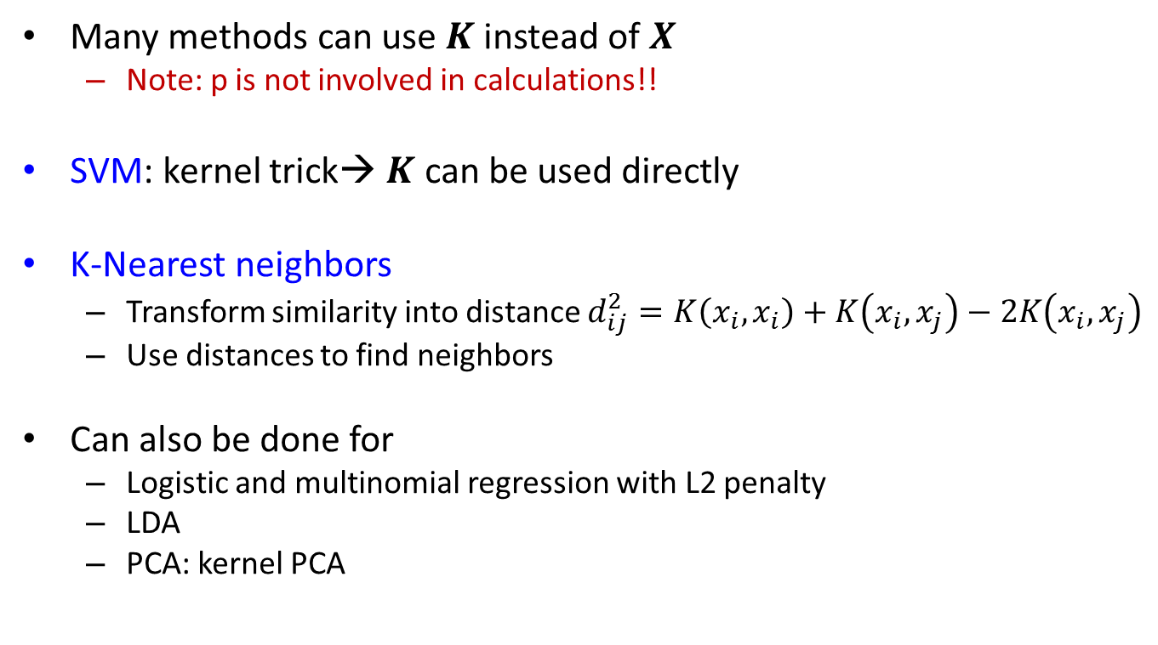
When features are not available
Many methods can use $K$ instead of $X$
Note: p is not involved in calculations!!
SVM: kernel trick→ $K$ can be used directly
K-Nearest neighbors
Transform similarity into distance $d_{ij}^{2}=K\left(x_{i},x_{i}\right)+K\left(x_{i},x_{j}\right)−2K\left(x_{i},x_{j}\right)$
Use distances to find neighbors
Can also be done for
Logistic and multinomial regression with L2 penalty
LDA
PCA: kernel PCA

Slide 25
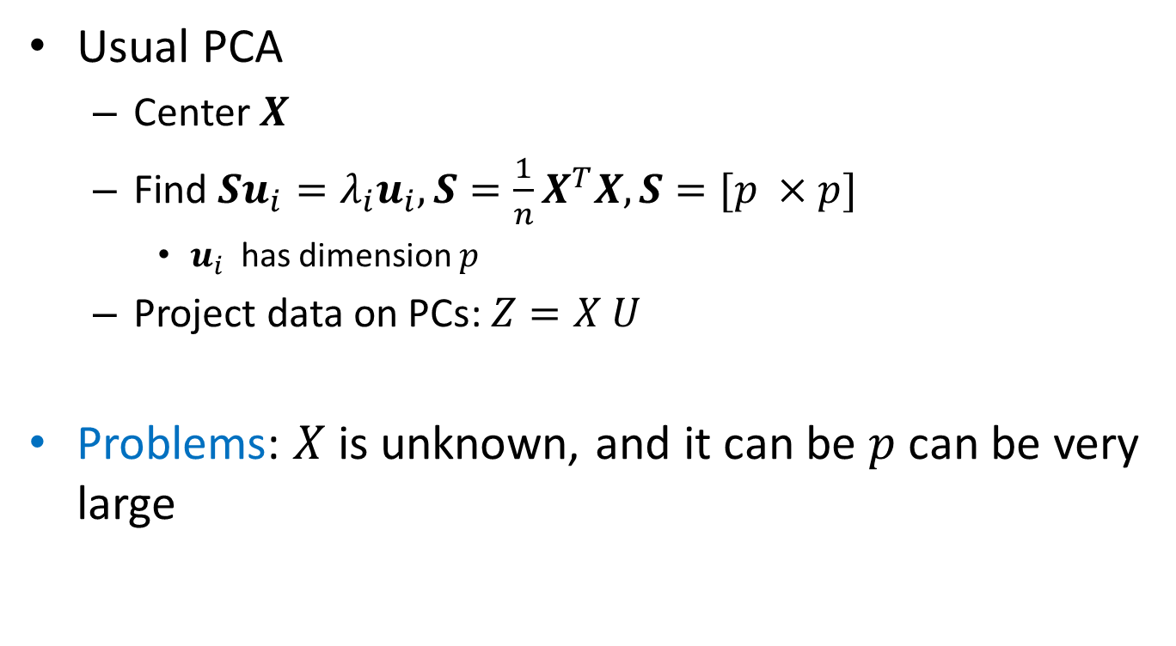
Kernel PCA
Usual PCA
Center $X$
Find $Su_{i}=λ_{i}u_{i}, S={\frac{1}{n}X}^{T}X, S=[p ×p]$
$u_{i}$ has dimension $p$
Project data on PCs: $Z=X U$
Problems: $X$ is unknown, and it can be $p$ can be very large

Slide 26
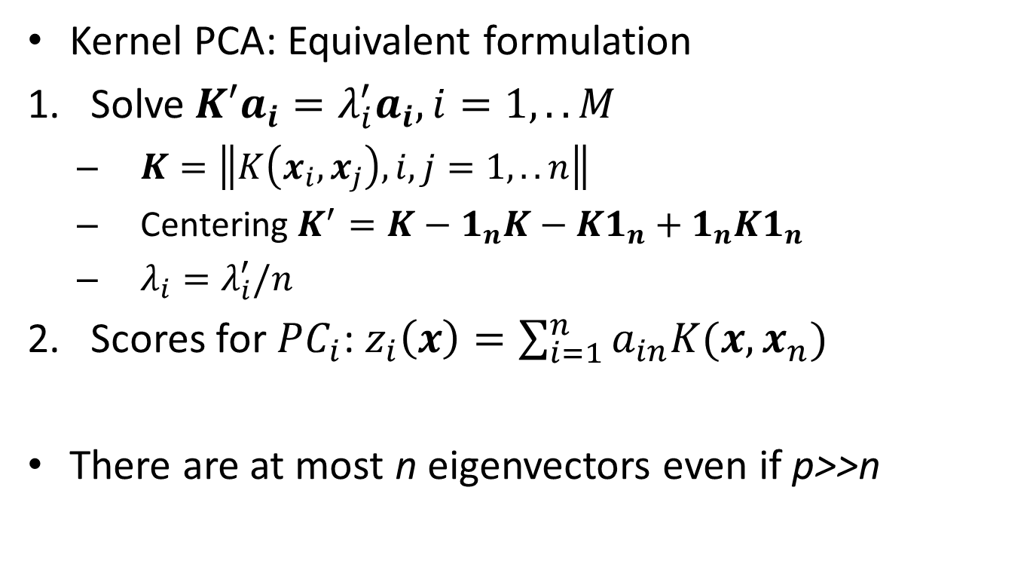
Kernel PCA
Kernel PCA: Equivalent formulation
Solve$K′a_{i}=λ_{i}^{′}a_{i}, i=1,..M$
$K=\left\|K\left(x_{i}, x_{j}\right), i,j=1,..n\right\|$
Centering $K^{′}=K−1_{n}K−K1_{n}+1_{n}K1_{n}$
$λ_{i}=λ_{i}^{′}/n$
Scores for $PC_{i}$: $z_{i}\left(x\right)=\sum_{i=1}^{n}{a_{in}K(x,x_{n})}$
There are at most n eigenvectors even if p>>n

Slide 27
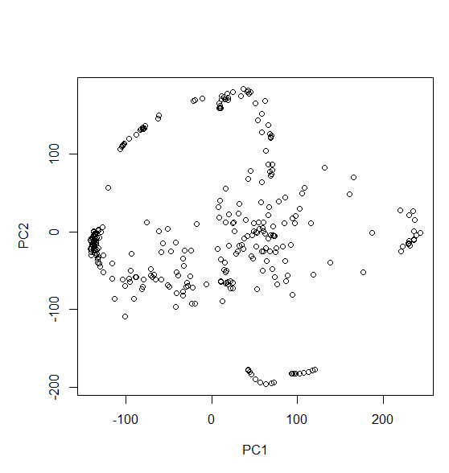
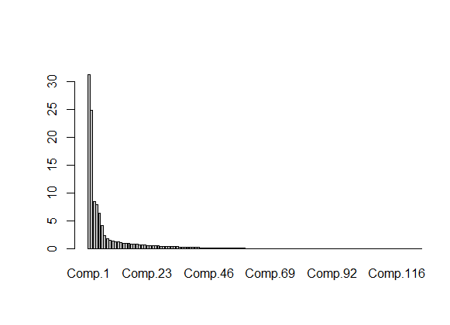
Kernel PCA in R
Use kpca() in kernlab
library(kernlab)
K <- as.kernelMatrix(crossprod(t(x)))
res=kpca(K)
barplot(res@eig)
plot(res@rotated[,1], res@rotated[,2], xlab="PC1", ylab="PC2")

Slide 28
Feature assessment
Which features are important?
Ex: Which protein values differ between normal and cancer samples
P-values in our predictive models can not be computed (too few observations)
→ Traditional hypothesis testing is used

Slide 29
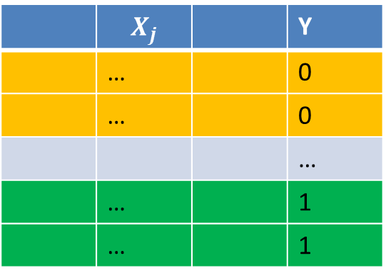
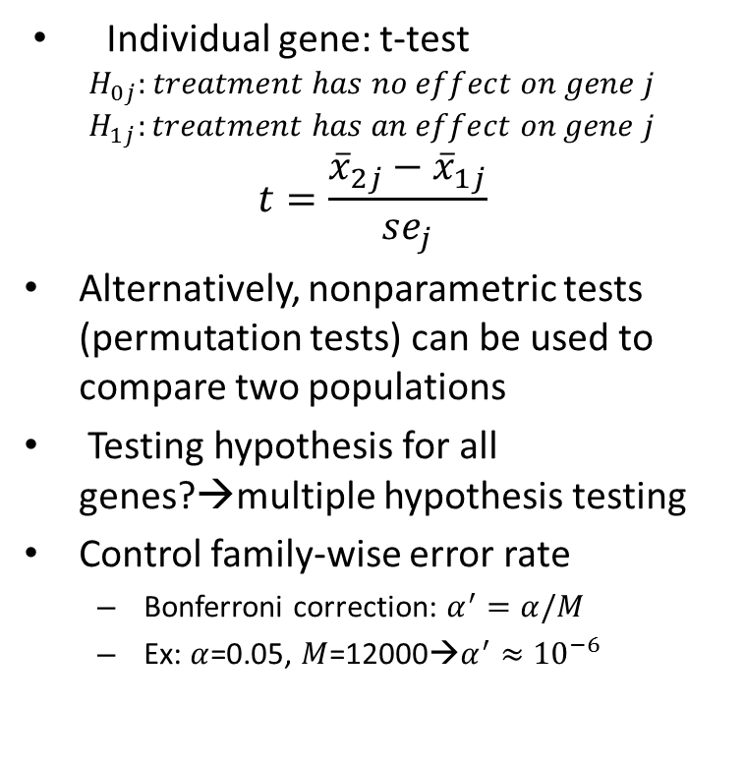


Feature assessment
Individual gene: t-test
$$H_{0j}:treatment has no effect on gene j$$
$$H_{1j}:treatment has an effect on gene j$$
$$t=\frac{{\overline{x}}_{2j}−{\overline{x}}_{1j}}{se_{j}}$$
Alternatively, nonparametric tests (permutation tests) can be used to compare two populations
Testing hypothesis for all genes?→multiple hypothesis testing
Control family-wise error rate
Bonferroni correction: $α^{′}=α/M$
Ex: $α$=0.05, $M$=12000→$α^{′}≈{10}^{−6}$
mean: ${\overline{x}}_{1j}$
 | $$X_{j}$$ |  | Y
 | … |  | 0
 | … |  | 0
 |  |  | …
 | … |  | 1
 | … |  | 1
In practice, no genes with such small p-values
mean: ${\overline{x}}_{2j}$

Slide 30


Feature assessment
Hypothesis testing Voice Rehabilitation
Feature ”MFCC_2nd.coef”
res=t.test(MFCC_2nd.coef~Quality,data=data, alternative="two.sided")
res$p.value
res=oneway_test(MFCC_2nd.coef~as.factor(Quality), data=data,paired=FALSE)
pvalue(res)

Slide 31

Feature assessment
Alternative: false discovery rate (FDR)
Can not be exactly computed in practice
$$FDR=E\left(\frac{V}{R}\right)$$
 | Called nonsignif | Called signif | Total
H0 true | U | V | M0
H0 false | T | S | M1
Total | M-R | R | M

Slide 32
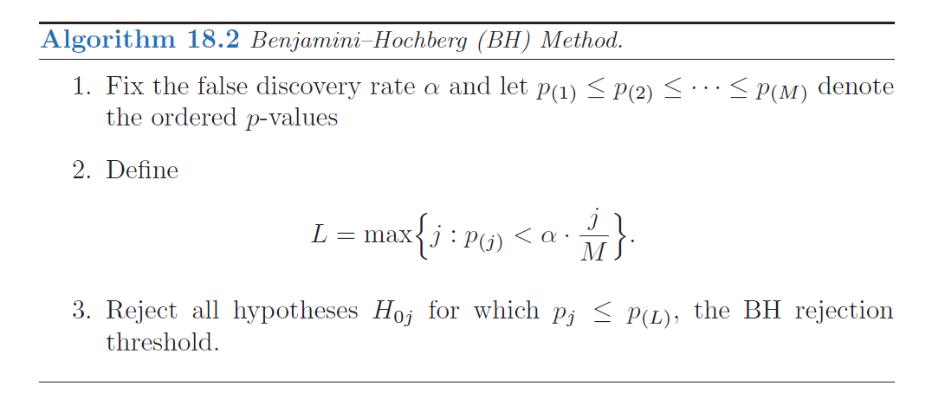

Feature assessment
Benjamini-Hochberg method (BH method)
Shown that $FDR\left(BH\right)<α$ for independent hypotheses
→we can control FDR!
Rejected hypotheses

Slide 33
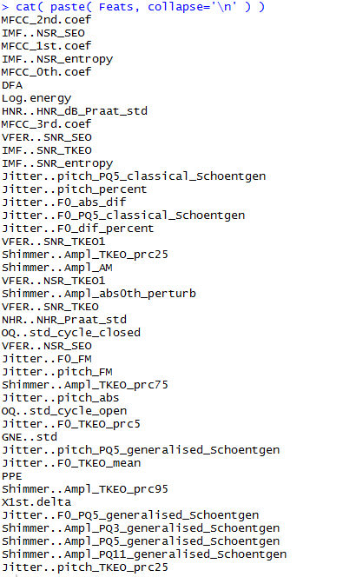
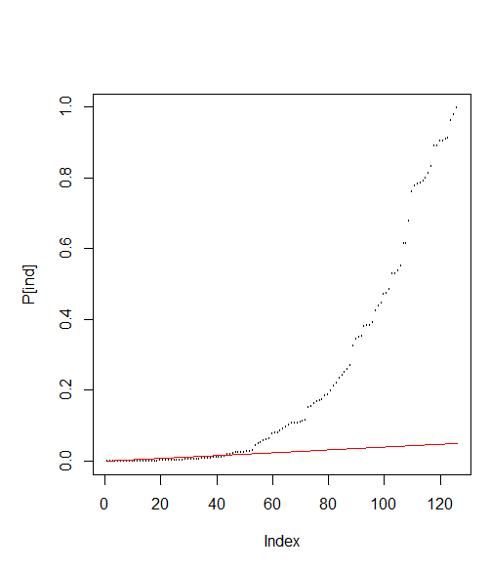
Feature assessment
Voice rehabilitation

