Slide 1

The Impact of Crude Oil Prices on the iShares US Transportation ETF
Crude oil is a critical resource influencing many sectors, especially transportation.
Fuel costs account for a major portion of expenses for companies in this sector.
The iShares US Transportation ETF mesures the tranportation sector in a broad way and is sensitive to factors such as oil price fluctuations.
Brosgard Emil 22299009

Slide 2

Why iShares US Transportation ETF (IYT)?
- Non-diversed fund with 80 % of its assets in component securities of its underlying index.
IYT aims to track its underlying index (Dow Jones Transportation Index).
ETFs can be traded like stocks while index funds can only be traded at the end of the trading day when the net asset value (NAV) is calculated.
ETFs is usually better for active management while index funds might be better for passive managment.

Slide 3
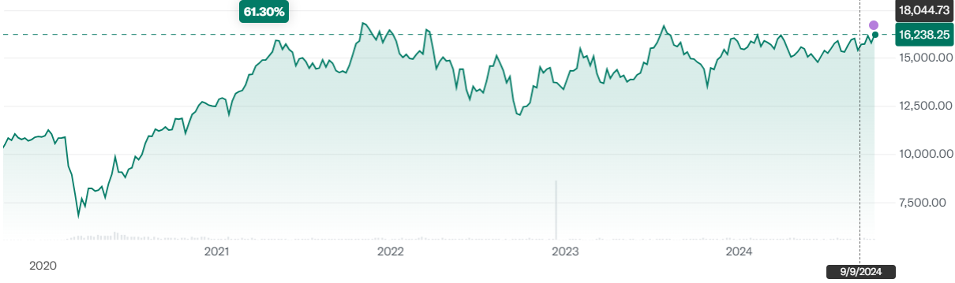
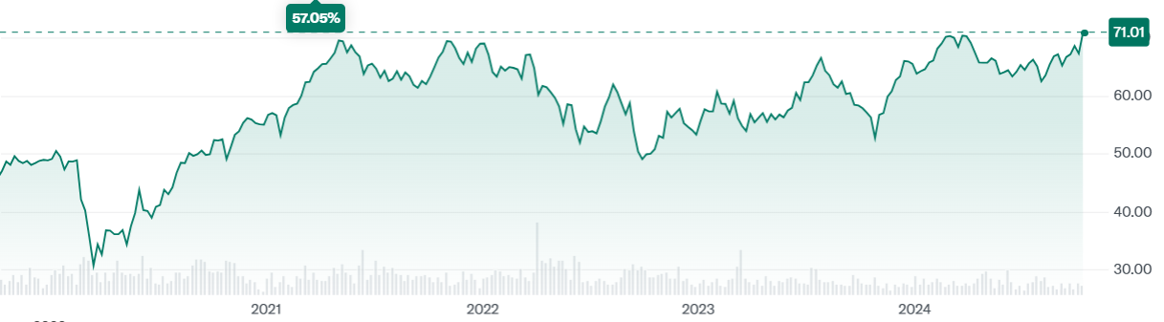
DJTA IYT

Slide 4

Research Question & Hypothesis
Research question: How does an increase in crude oil prices impact the iShares US Transportation ETF?
H₀ : An increase in crude oil prices has no effect on the iShares US Transportation ETF.
H₁: An increase in crude oil prices negatively impacts the iShares US Transportation ETF.

Slide 5
Data and Methology
Data Sources:
- Crude oil prices, obtained from Alpha Vantage using the CL ticker.
- Historical price data for IYT, also obtained from Alpha Vantage using IYT ticker.
Time Frame:
- The primary analysis covers a 20-year period, this wide time frame helps capture trends, cycles, and other long-term effects that may not appear in a shorter time frame.
- To complement this a 5 year analysis was conducted to explore recent trends and gather different insights.
Statistical Methods:
- T-test was used to determine the significance of the relationship over the 20-year timeframe.
- Correlation analysis was used to determine the strength of the relationships between crude oil prices and IYT.

Slide 6
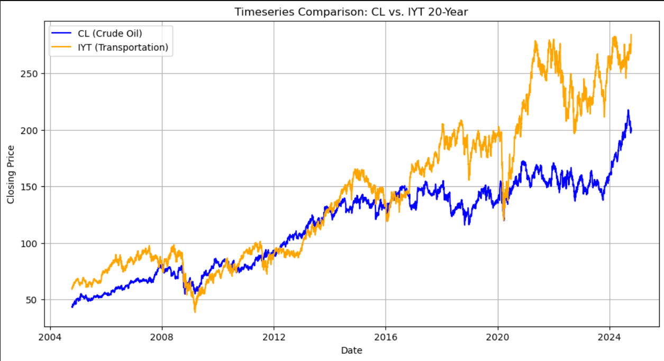
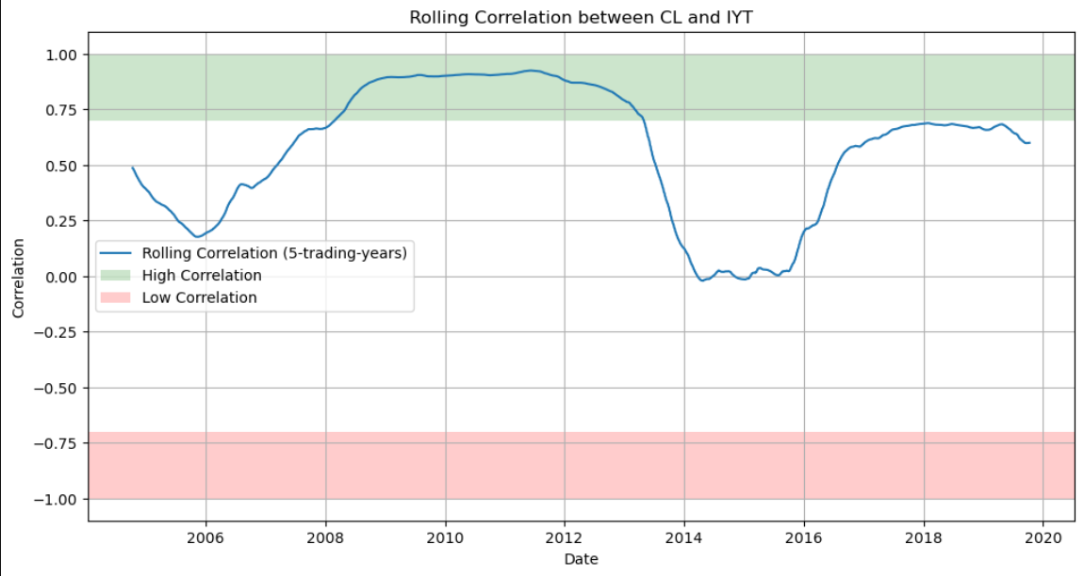
Results
Correlation : 0,91
T-statistic : 154
P-value = 0
Alpha = 0.05
Data points = 5034
H₀ : An increase in crude oil prices has no effect on the iShares US Transportation ETF (Rejected).
H₁: An increase in crude oil prices negatively impacts the iShares US Transportation ETF (Not accepted).
Observing trends with rolling correlation.

Slide 7

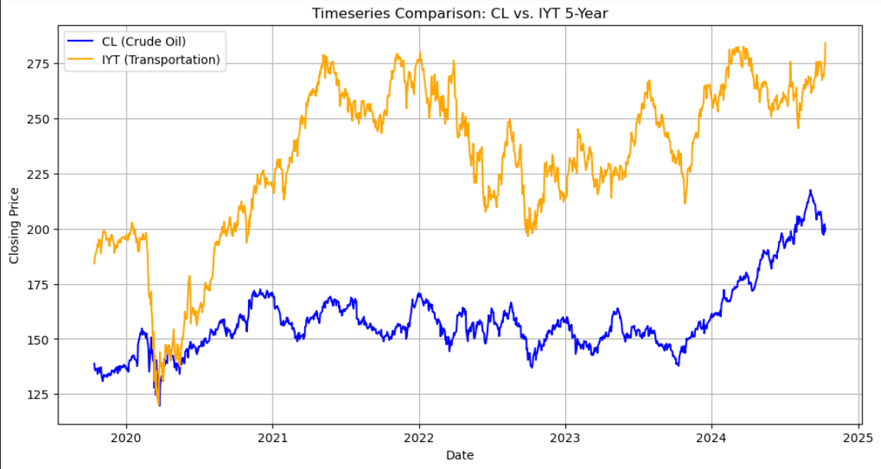
20-Year vs 5-Year
Correlation: 0.9
Correlation: 0.6
- Current market cycle
- Geopolotical events
- Rise of electric transportation

Slide 8
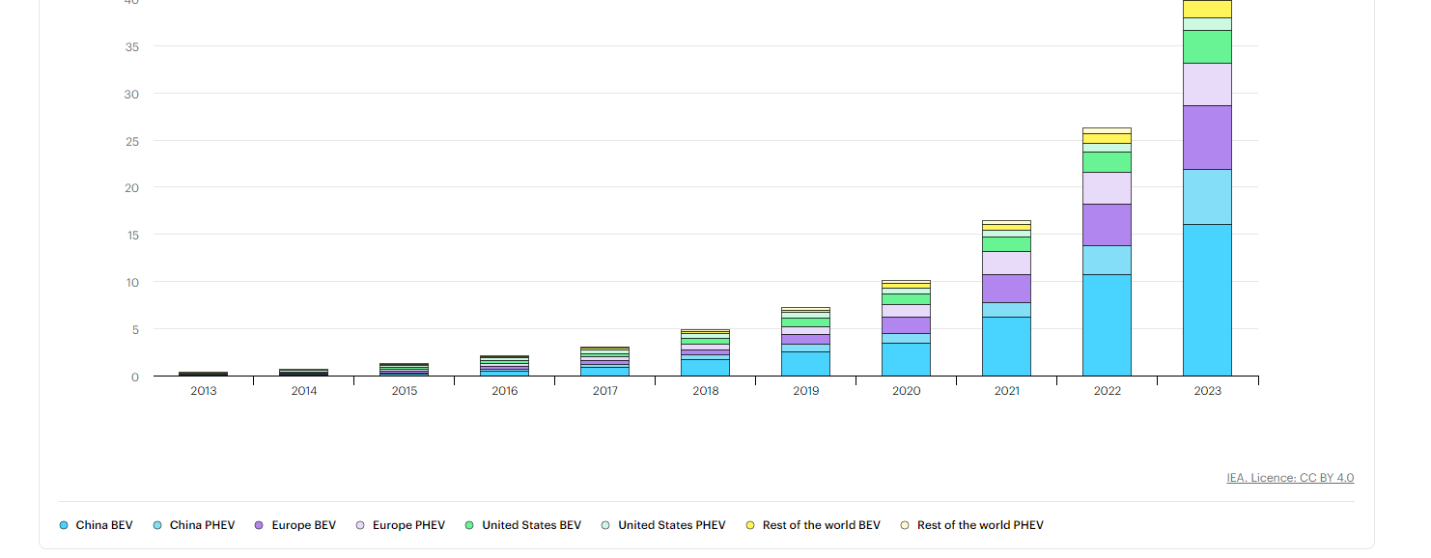
Global electric car stock 2013-2023

Slide 9

Interpetation of Result
Statistically significant relationship between crude oil prices and the transportation sector
Moderate positive relationship last 5 years
Increase in EV in trasportation sector may weaken the historical correlation
H₀ Rejected, H₁ Not accepted

Slide 10

Future Research
Future reserach could invistigate how the trend progresses over the next 10-20 years as the electric vechiels and alternative energy sources become more prevalent.
Analyze different sub-sectors within the transportation sector (airlines, trucking, shipping) to determine which industrie are more or less affected by crude oil prices.

Slide 11
Refereces
Yahoo Finance. (n.d.). Dow Jones Transportation Average (^DJT). Retrieved October 04, 2024, from https://finance.yahoo.com/quote/%5EDJT/
Yahoo Finance. (n.d.). iShares U.S. Transportation ETF (IYT). Retrieved October 04, 2024, from https://finance.yahoo.com/quote/IYT/
ETF Insider. (2023). What is the underlying index that the IYT ETF aims to track? Retrieved October 09, 2024, from https://etfinsider.co/blog/what-is-the-underlying-index-that-the-iyt-etf-aims-to-track
International Energy Agency (IEA). (2023). Global electric car stock 2013-2023. Retrieved October 13, 2024, from https://www.iea.org/data-and-statistics/charts/global-electric-car-stock-2013-2023
International Energy Agency (IEA). (n.d.). Electric vehicles. Retrieved October 13, 2024, from https://www.iea.org/energy-system/transport/electric-vehicles

