Slide 1
When to Use Parallel Programming
ITF23019, Spring 2026

Slide 2

When to Use Parallel Programming
Sub-problem 1
Sub-problem 2
1 Big
Problem
…
Sub-problem N

Slide 3
When to Use Parallel Programming
Sub-problem 1
Core 1
Sub-problem 2
Core 2
1 Big
Problem
…
…
Sub-problem N
Core N

Slide 4
When to Use Parallel Programming
Sub-problem 1
Core 1
Sub-problem 2
Core 2
How can we say that a problem is big?
1 Big
Problem
…
…
Sub-problem N
Core N

Slide 5
Impact factors
Time Complexity
Data size
Whether or not the problem can be parallelized?

Slide 6
Time Complexity

Slide 7
Time Complexity
Time complexity is a measure that characterizes the number of computations (steps) an algorithm takes to complete
Time complexity is a function of the input data size (problem size)
Time complexity is expressed by Big‑O notation

Slide 8
Why Time Complexity matters
Helps to predict performance
Shows where parallelism might help — or where it won’t.

Slide 9

Big‑O notation examples
$O\left(1\right)$: constant time
$O\left(n\right)$: linear time
$O\left(n^{2}\right)$: quadratic
$O\left(\log{n}\right)$: logarithmic
$O\left(2^{n}\right)$: exponential

Slide 10
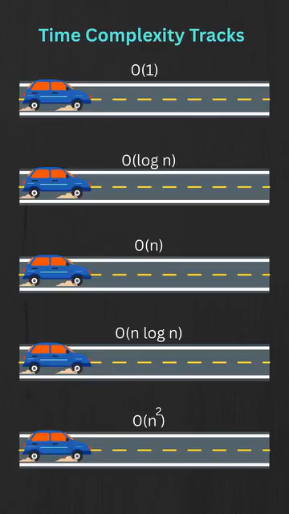

Slide 11
Time complexity
Notes:
Which one is scalable?

Slide 12
Example 1: Sum of an array
1. Array:
[1, 2, 3, 4, 5]

Slide 13
Example 1: Sum of an array
1. Array:
[1, 2, 3, 4, 5]
2. Step-by-Step Summation:
- Start with sum = 0; number of computations : 1

Slide 14
Example 1: Sum of an array
1. Array:
[1, 2, 3, 4, 5]
2. Step-by-Step Summation:
- Start with sum = 0; number of computations : 1
- Add the first element: sum = 0 + 1 = 1; number of computations : 2

Slide 15
Example 1: Sum of an array
1. Array:
[1, 2, 3, 4, 5]
2. Step-by-Step Summation:
- Start with sum = 0; number of computations : 1
- Add the first element: sum = 0 + 1 = 1; number of computations : 2
- Add the second element: sum = 1 + 2 = 3; number of computations : 3

Slide 16
Example 1: Sum of an array
1. Array:
[1, 2, 3, 4, 5]
2. Step-by-Step Summation:
- Start with sum = 0; number of computations : 1
- Add the first element: sum = 0 + 1 = 1; number of computations : 2
- Add the second element: sum = 1 + 2 = 3; number of computations : 3
- Add the third element: sum = 3 + 3 = 6; number of computations : 4

Slide 17
Example 1: Sum of an array
1. Array:
[1, 2, 3, 4, 5]
2. Step-by-Step Summation:
- Start with sum = 0; number of computations : 1
- Add the first element: sum = 0 + 1 = 1; number of computations : 2
- Add the second element: sum = 1 + 2 = 3; number of computations : 3
- Add the third element: sum = 3 + 3 = 6; number of computations : 4
- Add the fourth element: sum = 6 + 4 = 10; number of computations : 5

Slide 18
Example 1: Sum of an array
1. Array:
[1, 2, 3, 4, 5]
2. Step-by-Step Summation:
- Start with sum = 0; number of computations : 1
- Add the first element: sum = 0 + 1 = 1; number of computations : 2
- Add the second element: sum = 1 + 2 = 3; number of computations : 3
- Add the third element: sum = 3 + 3 = 6; number of computations : 4
- Add the fourth element: sum = 6 + 4 = 10; number of computations : 5
- Add the fifth element: sum = 10 + 5 = 15; number of computations : 6

Slide 19
Example 1: Sum of an array
1. Array:
[1, 2, 3, 4, 5]
2. Step-by-Step Summation:
- Start with sum = 0; number of computations : 1
- Add the first element: sum = 0 + 1 = 1; number of computations : 2
- Add the second element: sum = 1 + 2 = 3; number of computations : 3
- Add the third element: sum = 3 + 3 = 6; number of computations : 4
- Add the fourth element: sum = 6 + 4 = 10; number of computations : 5
- Add the fifth element: sum = 10 + 5 = 15; number of computations : 6
3. Total sum = 15; number of computations : 6

Slide 20
Example 1: Sum of an array - Ο(N)
1. Array:
[1, 2, 3, 4, 5]
2. Step-by-Step Summation:
- Start with sum = 0; number of computations : 1
- Add the first element: sum = 0 + 1 = 1; number of computations : 2
- Add the second element: sum = 1 + 2 = 3; number of computations : 3
- Add the third element: sum = 3 + 3 = 6; number of computations : 4
- Add the fourth element: sum = 6 + 4 = 10; number of computations : 5
- Add the fifth element: sum = 10 + 5 = 15; number of computations : 6
3. Total sum = 15; number of computations : 6
4. Array of size N, the number of computations is N => Time complexity is Ο(N)

Slide 21

Example 2 : Vector – Vector Multiplication (Dot product)
A=$\left(a1 a2 …aN\right)$; B=$\left(\begin{aligned}b1 \\ b2 \\ … \\ bN\end{aligned}\right)$
A. B = $\left(a1 a2 …aN\right).\left(\begin{aligned}b1 \\ b2 \\ … \\ bN\end{aligned}\right)$=a1b1 + a2b2+…+ aNbN
Notes:
Run‑time complexity describes how fast a specific algorithm runs as the input grows.

Slide 22
Example 2 : Vector – Vector Multiplication (Dot product)
A=$\left(a1 a2 …aN\right)$; B=$\left(\begin{aligned}b1 \\ b2 \\ … \\ bN\end{aligned}\right)$
A. B = $\left(a1 a2 …aN\right).\left(\begin{aligned}b1 \\ b2 \\ … \\ bN\end{aligned}\right)$=a1b1 + a2b2+…+ aNbN
The number of computations is: 2N -1
Time complexity: Ο(N)
Notes:
Run‑time complexity describes how fast a specific algorithm runs as the input grows.

Slide 23
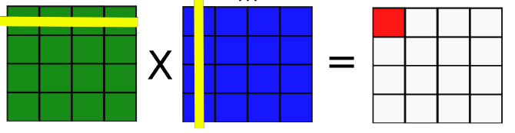
Example 3: Matrix – Matrix Multiplication
Matrix A (M, N)
Matrix B (N, P)
Matrix C(M,P)

Slide 24
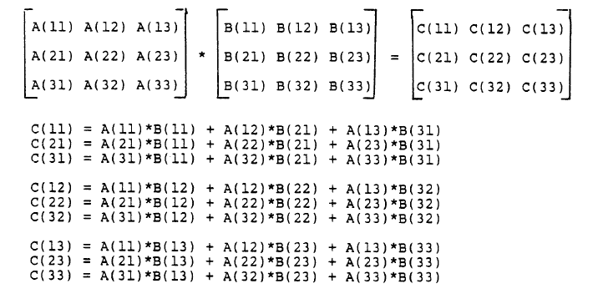
Example

Slide 25

Matrix – Matrix Multiplication
Time complexity: Ο(N³)
Parallel version runs faster than serial version if the problem size is not too small.

Slide 26
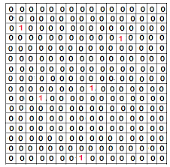
What if input matrices are spare matrixes ?

Slide 27
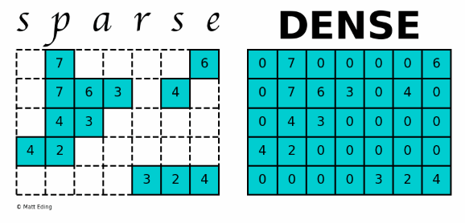
What if input matrices are spare matrixes ?

Slide 28
Input size

Slide 29
Input size
When time complexity is small, a parallel version run faster than its serial version when the input data size is large enough
Parallel programming only pays off when the amount of work is large enough to overcome the overhead of splitting and coordinating tasks.

Slide 30
Input size
Small inputs (not high complexity)→ serial is often faster
Large inputs → parallelism becomes beneficial
Overhead:
Threads/processes management
Communication

Slide 31
Whether or not the problem can be parallelized
Notes:
?

Slide 32
Example of non-parallelized problem
Fibonacci series: 1,1,2,3,5,8,13,21….
F(0) =F(1)=1
F(n) = F(n-1) + F(n-2)

Slide 33

Example of non-parallelized problem
Fibonacci series: 1,1,2,3,5,8,13,21….
F(0) =F(1)=1
F(n) = F(n-1) + F(n-2)
Possible implementation:
Simple, easy to implement, but high complexity

Slide 34
Conclusion

Slide 35
When to use a parallel program
High time-complexity
Large input size
Problem can be divided into independent tasks

Slide 36
When NOT to use a parallel program
The task is simple or small
Parallelism introduces overhead and is even worse than serial program
The task is inherently serial
Impossible to divide into parallel tasks
No parallel hardware

