Slide 1

StudentLink

Slide 2
Table of contents
Our Team
Stages of Realization
3. Used Technologies

Slide 3

01
Our Team
Everything you need to know about us

Slide 4
Hercules
Georgi
Pavlov
Front-end Dev.
Kaloyan
Pozharliev
Front-end Dev.
Plamen
Chatalbashev
QA
Roberta
Hristova
QA
Plamen
Petrov
Back-end Dev.
Valeri Prenerov
Back-end Dev.
Pavel
Penev
Back-end Dev.
Teodor
Vulkov
Database Dev.

Slide 5
02
Stages of realization
How we came up with the idea

Slide 6
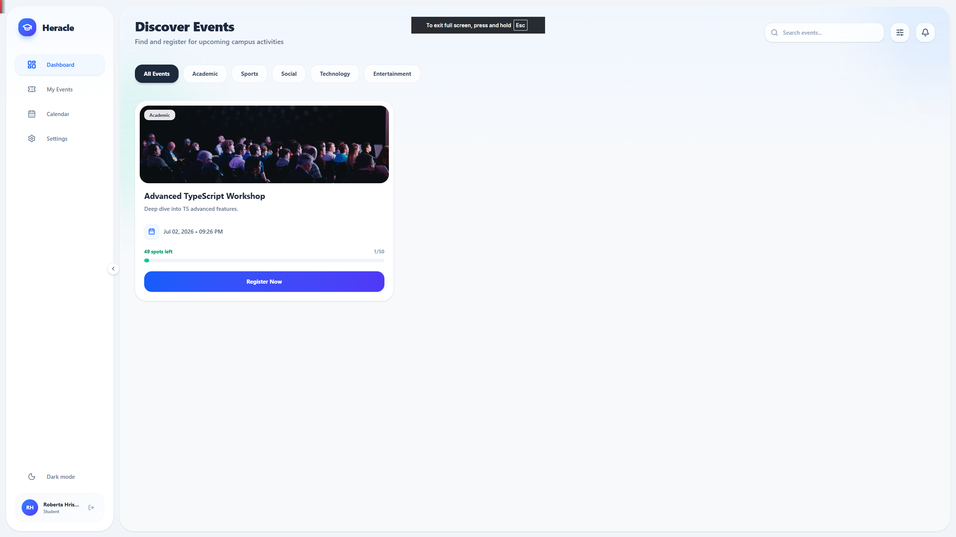
Stages of realization
We wanted to build a platform where organizers can easily create and manage school events, while students can browse, register, join waitlists and receive notifications.

Slide 7
Stages of realization
Week 1
Week 2
Week 3
Planning,
project set
up, GitHub
workflow
Front-end,
back-end and
database
implementation
Testing, bug
fixes, final
improvements

Slide 8
03
Used technologies
The technologies used in the project

Slide 9

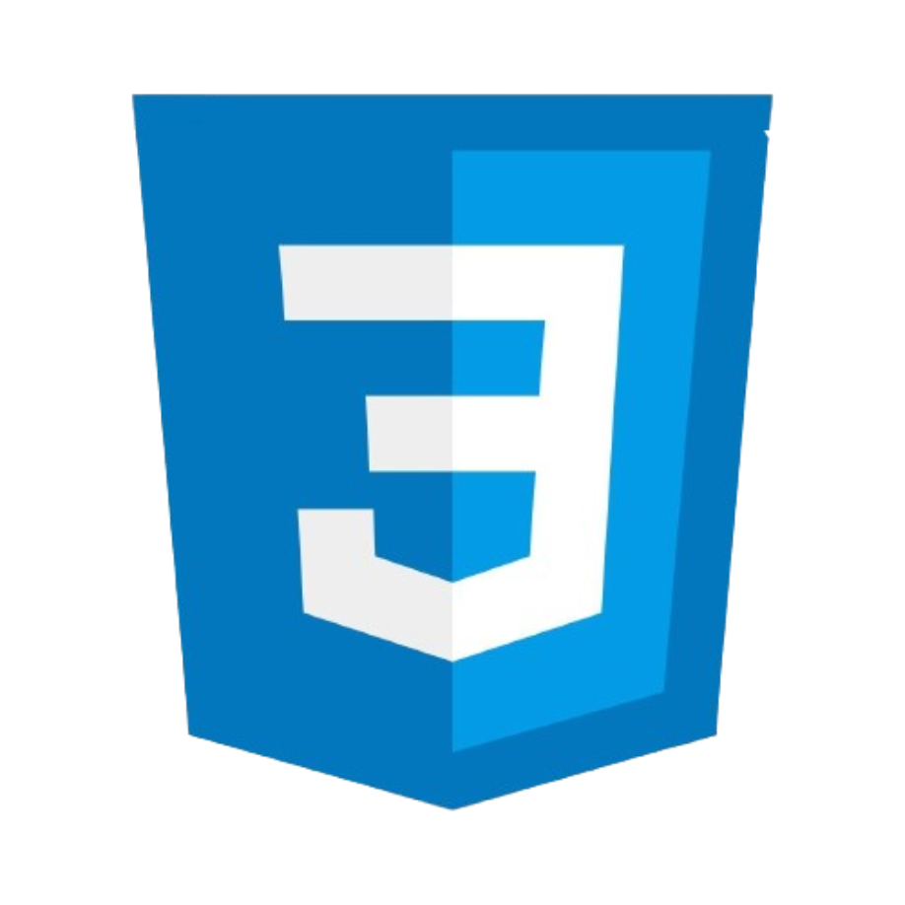

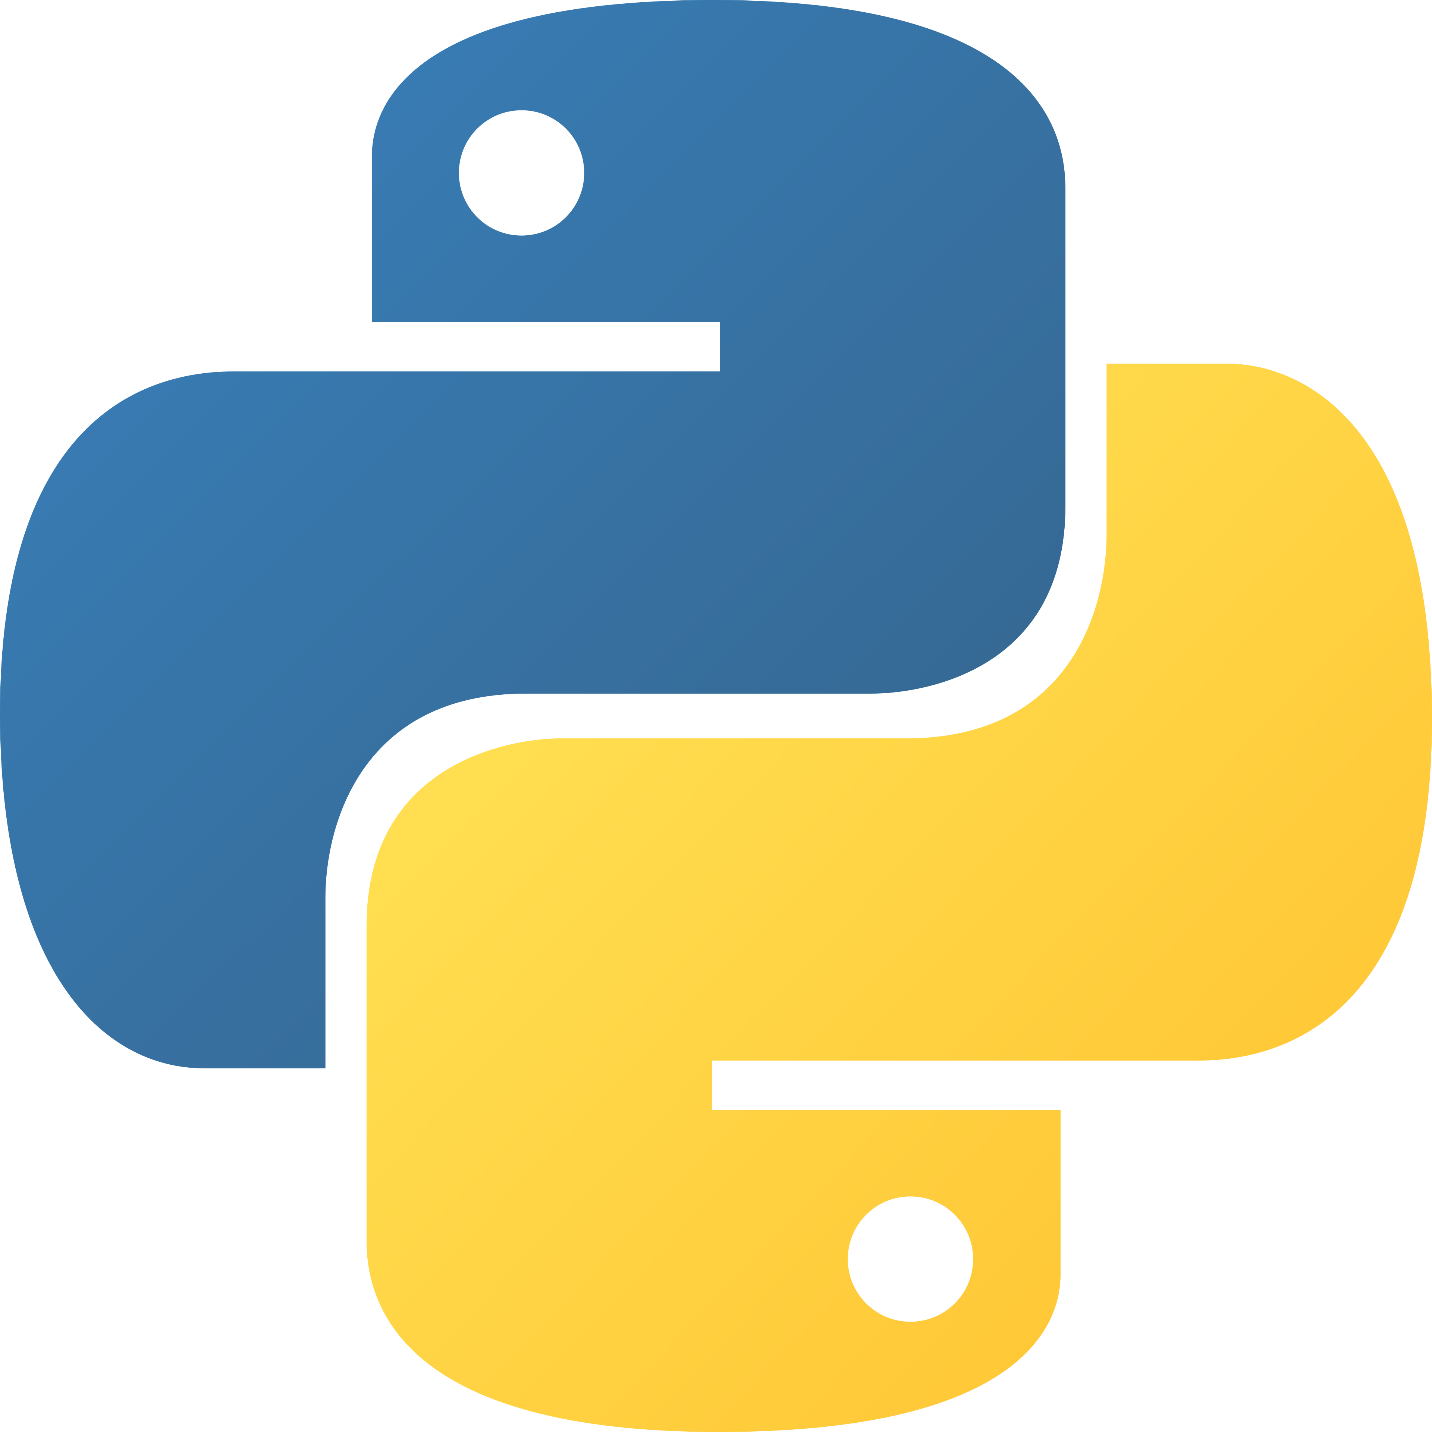








The tools and technologies used

Slide 10
04
Lets go to our project
https://github.com/EmilD93/Heracle

