Slide 1
Hable
Project Kickoff
Classroom presentation
A Flutter habit app pitch focused on social accountability, gamification, and real implementation depth

Slide 2
Presentation flow
01 | Problem, idea, and why Hable matters | Emil
02 | Website and phone walkthrough | Nabeil
03 | Add habit, points, profiles, leaderboard, friends | Nabeil
04 | Shared habits, nudges, and social accountability | Nabeil
05 | Development evidence from the codebase | Amir
06 | Future scope, innovation, and scalability | Abdul

Slide 3
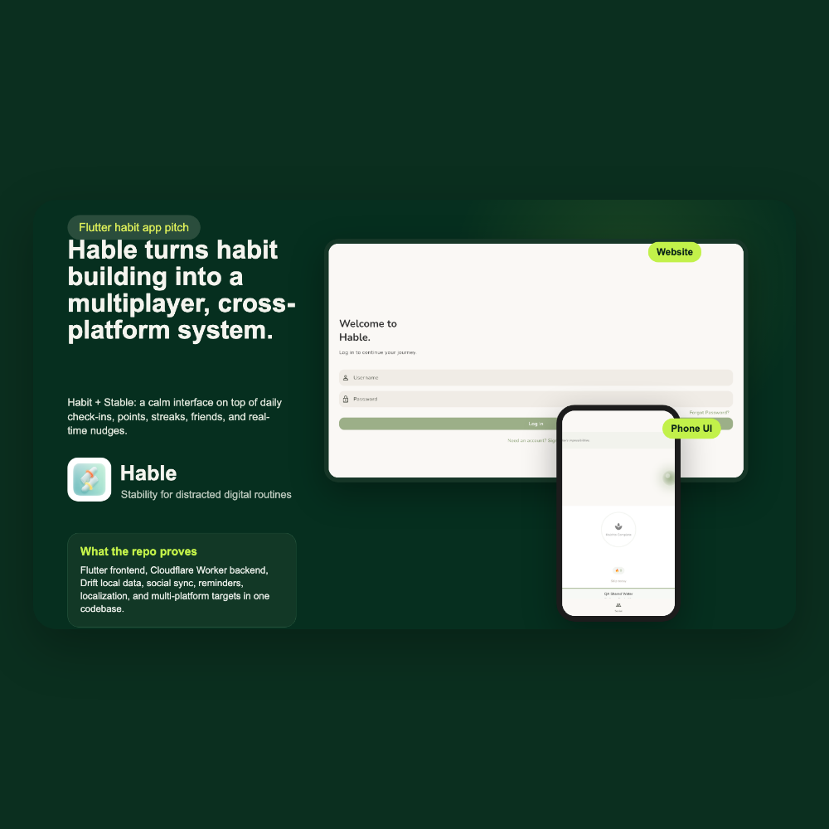
Why Hable matters
Problem
Short-form content, constant distractions, and instant gratification make consistent focus harder for students every day.
Hable
Hable, short for Habit + Stable, turns that same screen time into daily check-ins, streaks, points, and shared accountability.

Slide 4
Multiplayer productivity is the core advantage
Social accountability\nShared habits turn consistency into a team sport where friends can track progress together.
Interactive motivation\nThe nudge flow lets users remind a friend in real time without needing full push-notification complexity.
Gamified retention\nPoints, levels, badges, and visible progress make the habit loop feel rewarding instead of repetitive.
Cross-platform ecosystem\nFlutter keeps web, mobile, and desktop targets aligned so the same social graph can travel everywhere.

Slide 5
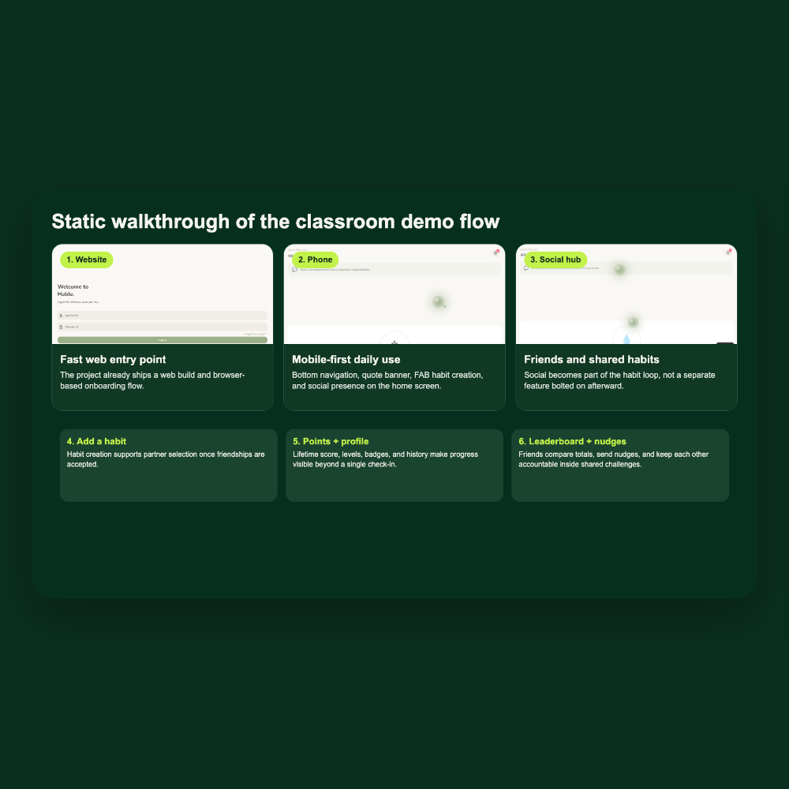
Classroom demo flow
Demo start
Begin on the website, then move into the phone-style dashboard to show that the app works beyond one device surface.
Demo finish
Add a habit, show points and profiles, open the leaderboard, and explain how shared habits and nudges keep users engaged.

Slide 6
The app loop stays simple while the system underneath grows
The presenter can walk from habit creation to social motivation in one continuous story instead of switching between unrelated features.
Add the habit
Create a personal challenge or attach an accepted friend to a shared habit.
Earn points
Every valid completion feeds lifetime progression, streaks, and backend-owned score state.
Show the profile
Levels, badges, and history make progress visible beyond a single daily check-in.
Close the social loop
Friend profiles, leaderboard rankings, shared habits, and nudges all support accountability.

Slide 7
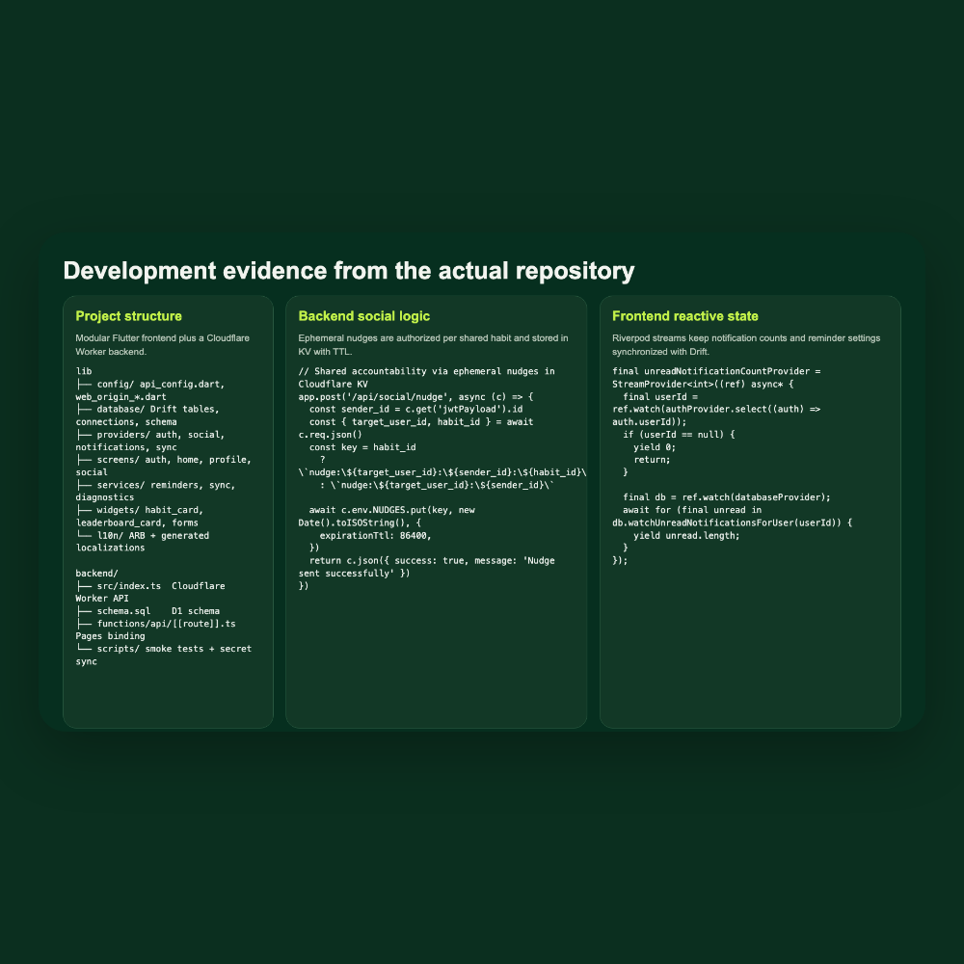
Development evidence from the repo
Architecture
The frontend is organized around Drift, Riverpod, screens, services, and reusable widgets instead of one giant Flutter file.
Backend depth
The Cloudflare Worker handles auth, friendships, nudges, invitations, scoring, and leaderboard sync with D1 and KV.

Slide 8
Future scope: innovation first, then scale
What Abdul can push next
Innovation ideas
AI-guided habit suggestions, context-aware reminders, deeper celebrations, and richer social motivation loops.
The next version can go beyond basic tracking into smarter habit suggestions, richer social experiments, and more adaptive reminder copy while still preserving the calm Hable interface. At the same time, the architecture already points toward scale: server-owned gamification, replay-safe sync, and cloud-backed social state are startup-friendly foundations rather than throwaway demo code.
Scalability path
Harden sync, expand analytics safely, and keep one Flutter client while backend services grow with real users.

Slide 9
Hable is aligned with how the project is evaluated
Lecturer fit
The grading priorities are innovation and usefulness, deployment on multiple devices, and implemented functionality. Hable is built to show all three in one coherent story: a useful student problem, real app surfaces, and a codebase that already contains social sync, reminders, gamification, and deployment targets.
30%
40%
40%
Innovation and usability: solving the focus problem with a stable but social habit loop.
Device coverage: web today, phone-style UI now, and desktop/mobile targets already present in the repo.
Implemented functionality: auth, habits, friends, nudges, points, profiles, and leaderboard flow.

Slide 10
Presentation ownership and sequence
Emil | Nabeil | Social | Amir | Abdul
Problem and idea
Website and phone walkthrough
Shared habits, points, profiles, leaderboard
Code snippets and architecture highlights
Future scope and startup scalability
Wrap-up: connect innovation, device breadth, and functionality before Q&A

Slide 11
Thank you
Hable
Habit + Stable
Questions, feedback, and live demo time

