Slide 1
quarto-revealjs.pptx
Emil Hvitfeldt
2026-03-03
1

Slide 2
Introduction
Welcome to this presentation!
First point
Second point
Third point
2

Slide 3
Slide with Code
1
def hello_world():
2
print("Hello, World!")
3
4
def greet(name):
5
message = f"Hello, {name}!"
6
print(message)
7
return message
8
9
if __name__ == "__main__":
10
hello_world()
11
greet("Alice")
3

Slide 4

Slide with Image
A beautiful scene
4

Slide 5
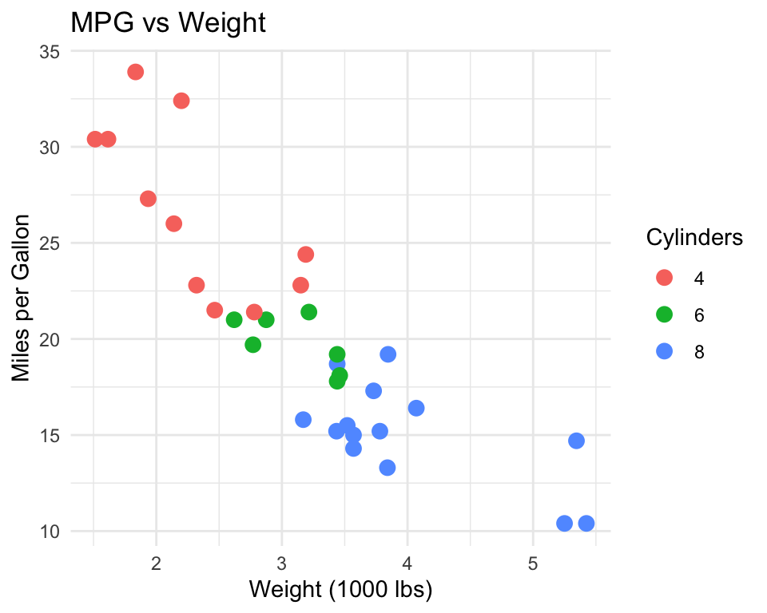
ggplot2 Example
1
library(ggplot2)
2
3
ggplot(mtcars, aes(x = wt,
4
y = mpg,
5
color = factor(c
6
geom_point(size = 3) +
7
labs(title = "MPG vs Weight",
8
x = "Weight (1000 lbs)",
9
y = "Miles per Gallon",
10
color = "Cylinders") +
11
theme_minimal()
5

Slide 6
gt Table Example
1
library(gt)
Motor Trend Cars
2
Top 5 rows
3
mtcars |>
mpg cyl
disp
hp
drat
wt
qsec vs am gear
carb
4
head(5) |>
21.0
6 160.0 110.0 3.90 2.620 16.46
0
1
4
4
5
gt() |>
6
tab_header(
21.0
6 160.0 110.0 3.90 2.875 17.02
0
1
4
4
7
title = "Motor Trend Cars",
22.8
4 108.0
93.0 3.85 2.320 18.61
1
1
4
1
8
subtitle = "Top 5 rows"
21.4
6 258.0 110.0 3.08 3.215 19.44
1
0
3
1
9
) |>
18.7
8 360.0 175.0 3.15 3.440 17.02
0
0
3
2
10
fmt_number(
11
columns = c(mpg, disp, hp),
12
decimals = 1
13
)
6

Slide 7
LaTeX Example
Inline math:
𝐸
=
𝑚
2
𝑐
Display math:
∞
−
2
𝑒
𝑥
𝑑𝑥
=
√
𝜋
∫
−∞
Matrix notation:
1
2
𝐀
=
[
]
3
4
7

Slide 8



Absolute Positioning
8

