Slide 1
Topic modelling from book descriptions
Emil Javurek
13331124​

Slide 2
can we use book descriptions to group books by topic?
How does it compare to book genres?

Slide 3
Learning goals
Scraping dynamic websites using webdriver (Selenium, Scrapy)
NLP topic modelling (spaCy, LDA )

Slide 4
OUTLINE
​Scraping the data (Goodreads.com)
Processing the data
​Creating the model
Interpretation

Slide 5
Scraping the data
Goodreads.com
I want:
Title
Author
Description
Book Genres

Slide 6
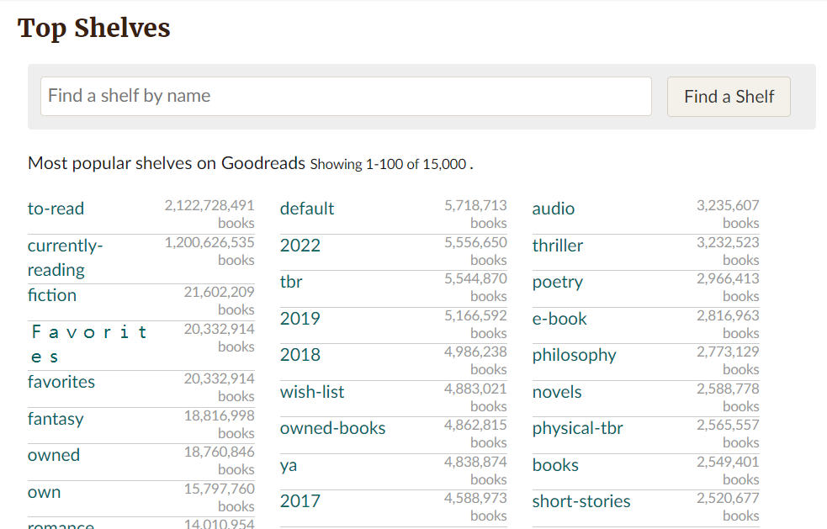
Goodreads shelves

Slide 7
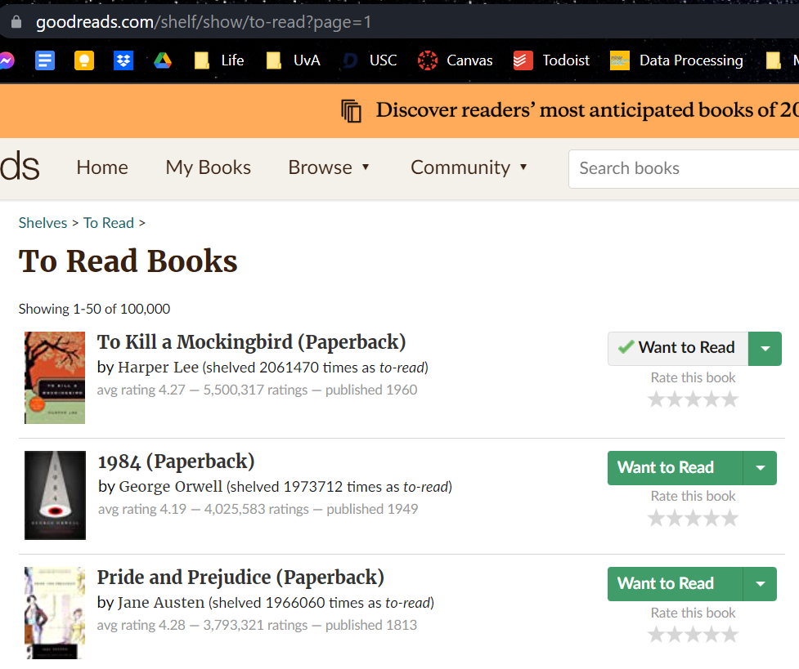
To-read shelf

Slide 8
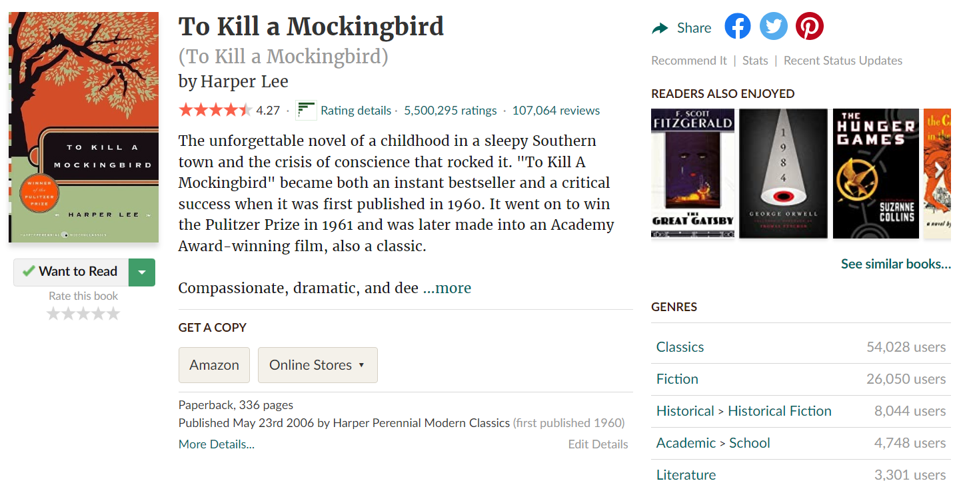
book page – old

Slide 9
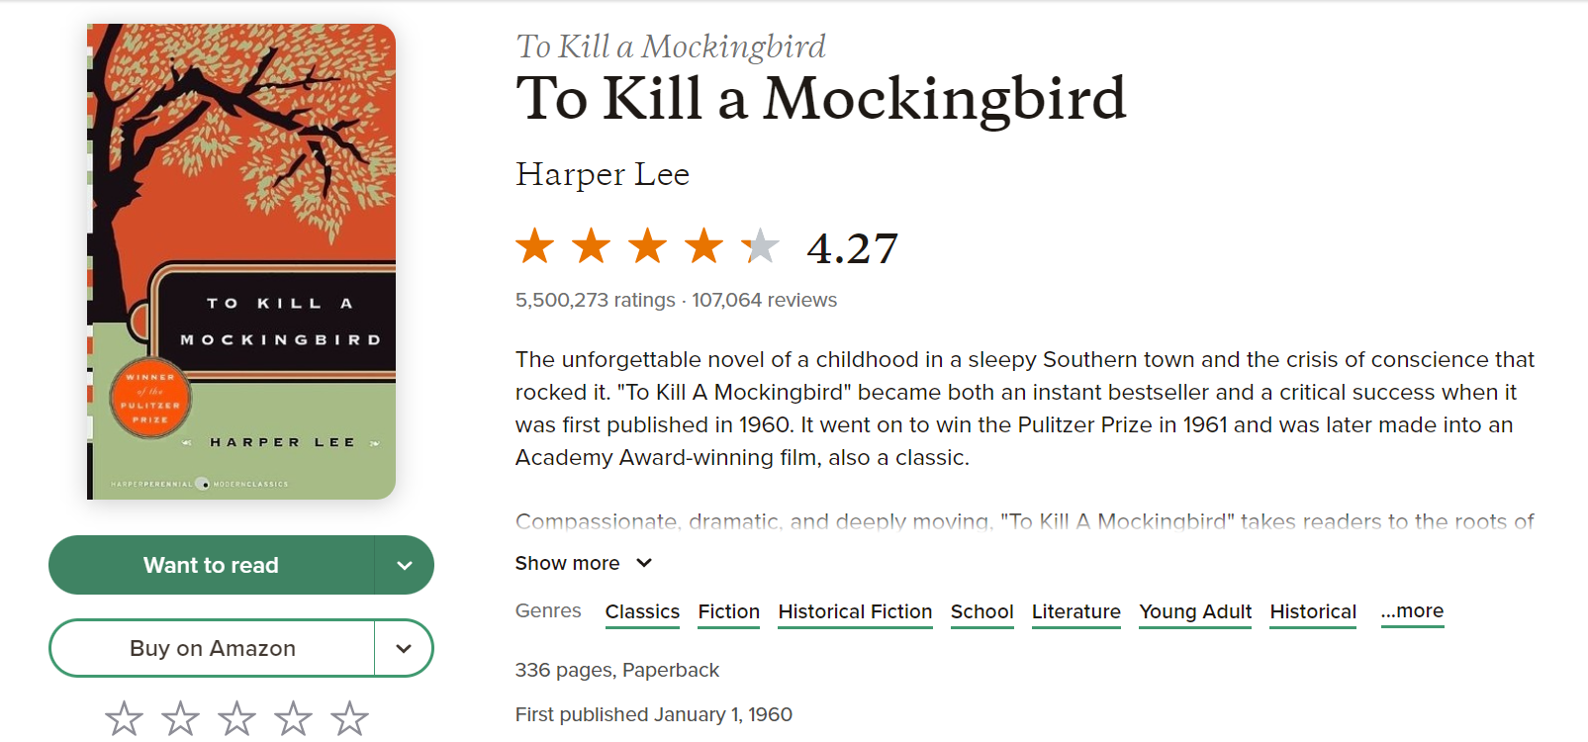
book page – new

Slide 10
Issues
Website uses Javascript
You need to be logged in to see all the information
Goodreads is in the middle of A/B testing a new website design
Goodreads has measures in place against excessive scraping

Slide 11
solution
Use Selenium and Chrome webdriver
Start each scrape by logging in (goodreads_login.py)
Pray for the old version of the page to pop up (once it does, the whole session stays in the old version)
Suffer the slowdown of goodreads having a limit on server requests
Create emergency back up saving system
scrape_shelf.py (~few minutes)
crawl_books.py (~one hour)

Slide 12
modelling
Use descriptions of books to create general topics
Compare topics to given book genres

Slide 13
Latent Dirichlet allocation
Unsupervised machine learning algorithm LDA from Gensim
Finds topics in descriptions based on co-occurrence of words
Use spaCy to use lemmas of tokens instead of words

Slide 14
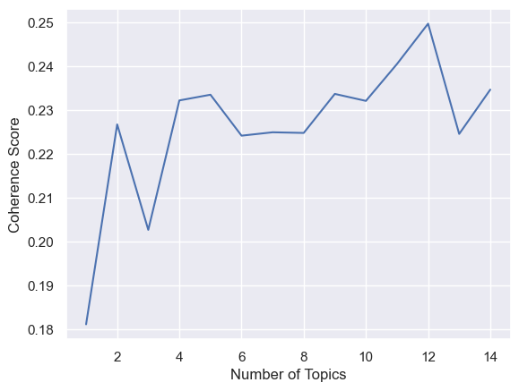
Step by step
Clean scraped data (1175 out of 1209 books left)
Preprocess:
Tokenize descriptions (en_core_web_md)
Remove non-alphabetics tokens and stopwords (general list + problem-specific: “book”, “author”, “reader”,…)
Remove unwanted Parts-of-Speech tags (i.e. punctuation, adverbs, adpositions)
Create Gensim Dictionary (token gets unique id and frequency counter)
Filter out top 1000 words (exclude words that are in more than 50% of descriptions or in less than 5 books)
Create corpus (bag of words – id and frequency only)
Figure out how many topics to model
Coherence score using C_v algorithm (in Gensim)
Make model

Slide 15
Visualization
pca_visualization.html

Slide 16
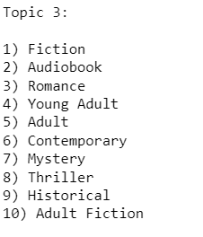
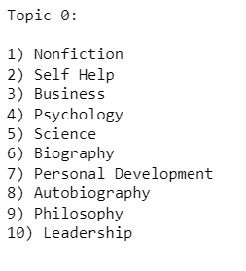
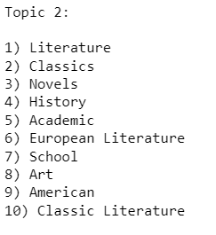
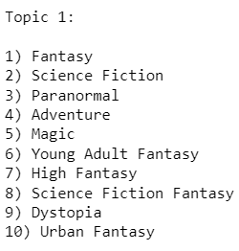
Genres to topics
Non-fiction?
Fantasy/Sci-fi?
Classical?
Novel?

Slide 17
“follow up research”
How much does the model improve with more books?
Can we get to 1-to-1 correspondence with main genre of a book?
How would this compare to a learning model with outcome being assigning to genres?

Slide 18
THANK YOU
Questions?

