Slide 1
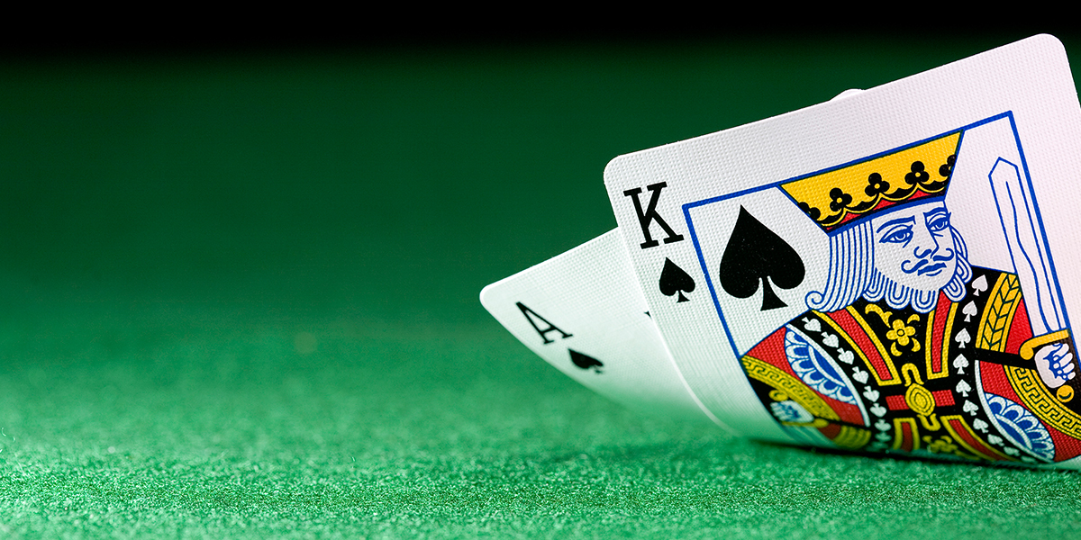
Q-Learning for Blackjack
Emil Kalbaliyev, Mardan Safarov, Vasif Vahidov

Slide 2
Purpose
To create simple version of blackjack
To show player best action based on situation
To get best actions policy with reinforcement learning

Slide 3
Blackjack
Blackjack, also known as twenty-one, is a comparing card game between players and a dealer, where each player in turn competes against the dealer.

Slide 4
Objectives of Blackjack
Get 21 points on the player's first two cards without allowing dealer get 21 points;
Reach a final score higher than the dealer without exceeding 21
Or let the dealer draw additional cards until their hand exceeds 21.

Slide 5
Decisions
Hit: Take another card from the dealer.
Stand: Take no more cards
Double down: The player is allowed to increase the initial bet by up to 100% in exchange for committing to stand after receiving exactly one more card

Slide 6
Rewards
-1 : if player busts (get more than 21); dealer get 21; dealer get more than player
0 :both get 21
1 : if dealer busts; player get more than dealer
1.5 : if player is 21
*2 : increase reward by 2 times if double down chosen

Slide 7
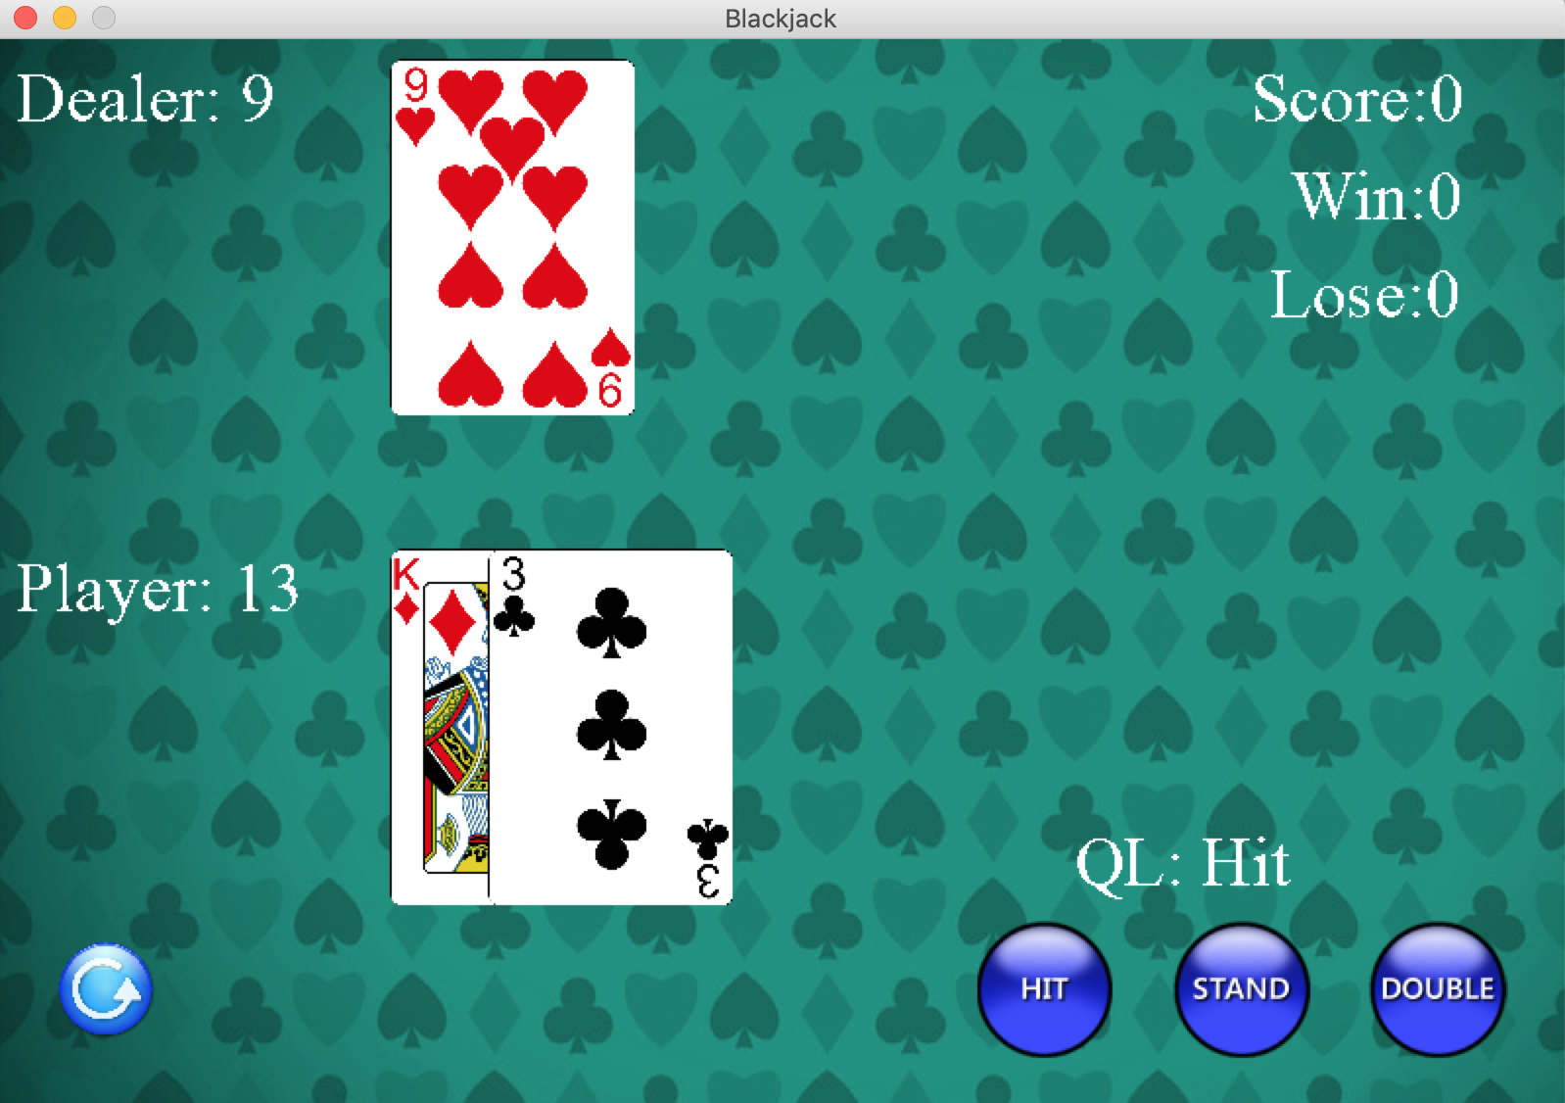
Our Game

Slide 8
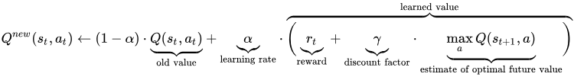
Q-Learning

Slide 9
Action Selection
Epsilon greedy
With (small) probability ε, act randomly
With (large) probability 1-ε, act on current policy

Slide 10
Unknown variables
Let take γ (discount factor) as 1
What about α (learning rate) and ε (epsilon) ?

Slide 11
Finding best value for α and ε
Games: 10000
0.01 <α<0.5
0.01< ε <1
Increase by 0.01
Tested:10000

Slide 12
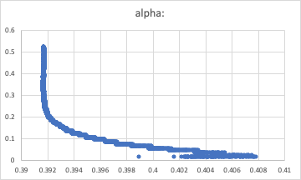
Alpha

Slide 13
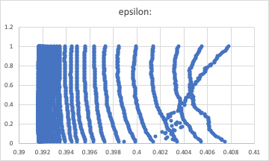
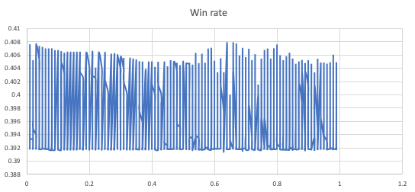
Epsilon

Slide 14
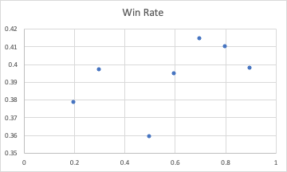
Lowering ε over time
Does not give optimal solution

Slide 15
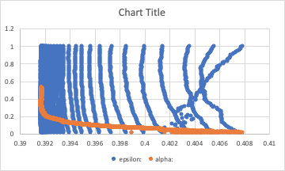
Best result
Best values:
α =0.01
ε = 0.99
Winning rate: 41.6 %
Lose rate: 49.8 %

Slide 16
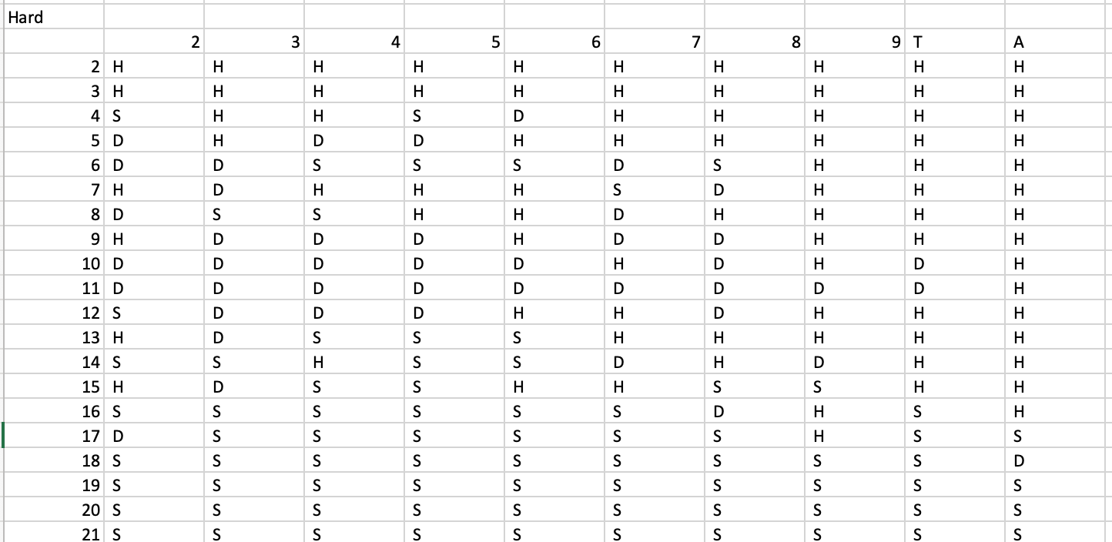
Hard

Slide 17
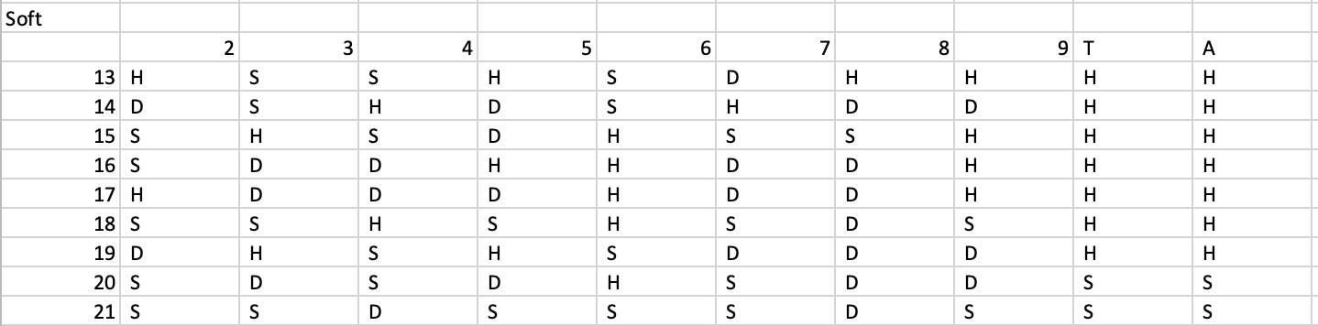
Soft

Slide 18
Thanks for listening
Thanks for listening

