Slide 1
ТехноМаркет
IT-Talents Season 12
https://github.com/EmilKoev/FinalProject

Slide 2
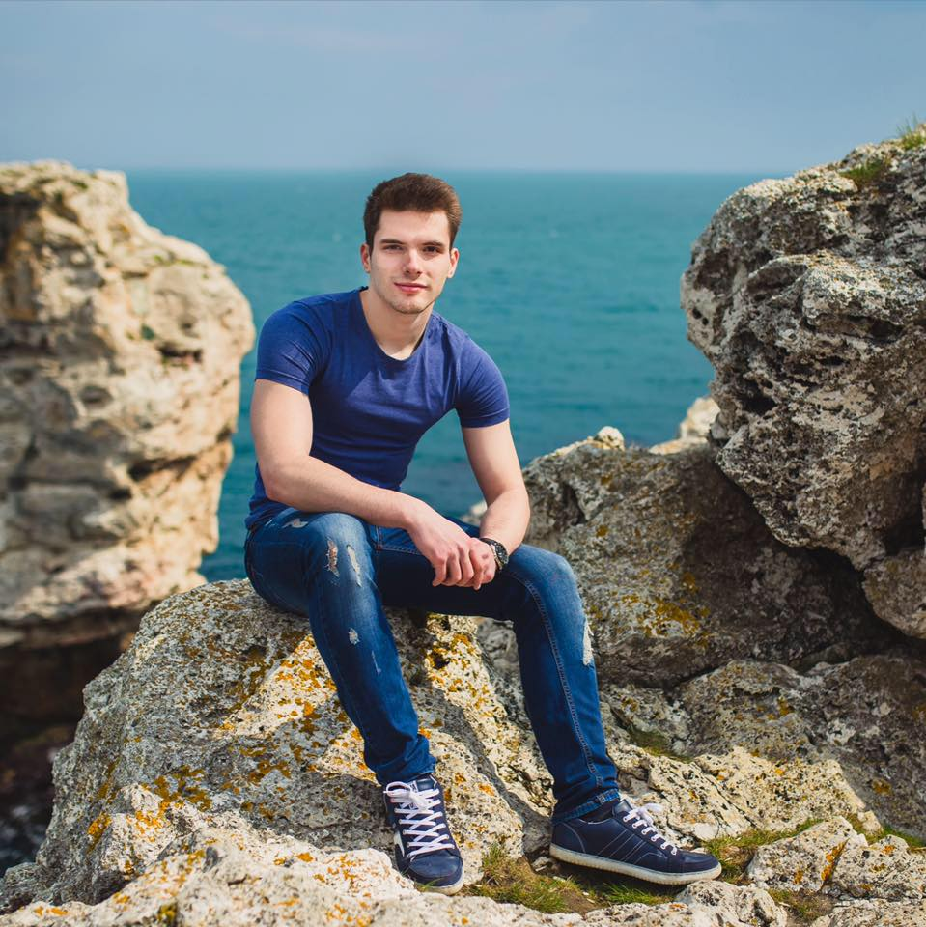

Кои сме ние?

Slide 3
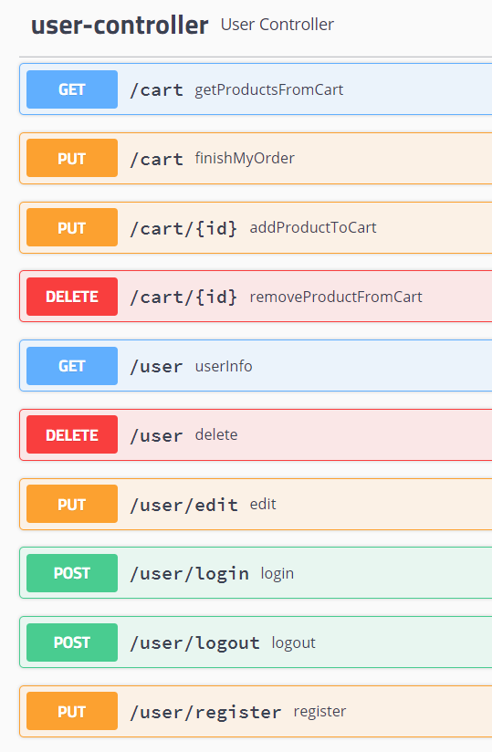
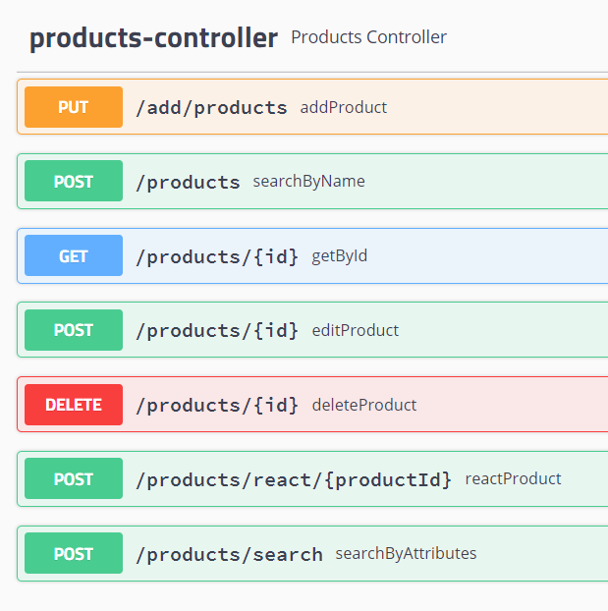
Функционалности
http://78.90.70.28:7878/swagger-ui.html#/

Slide 4
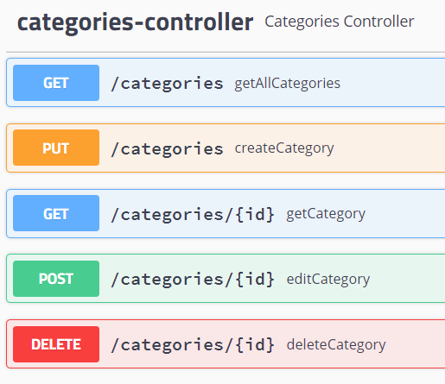
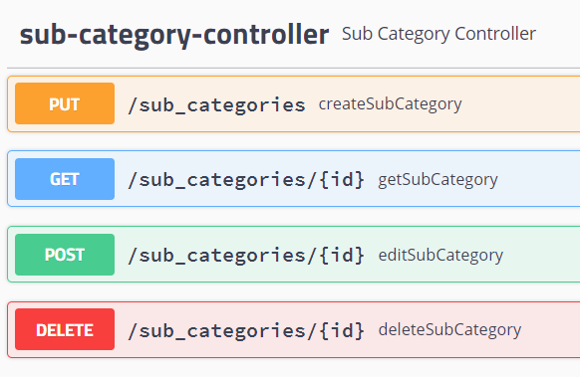
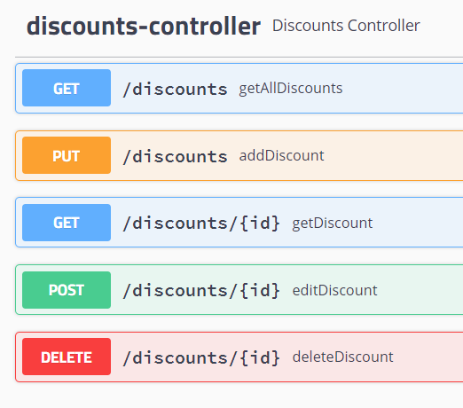

Slide 5
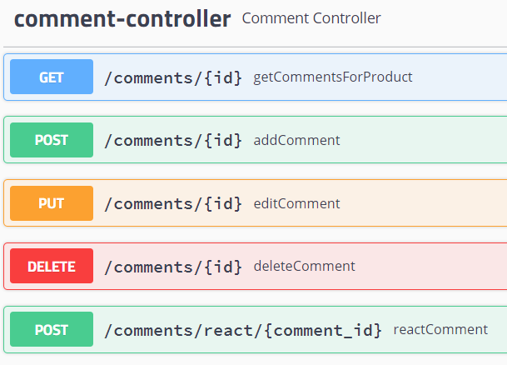
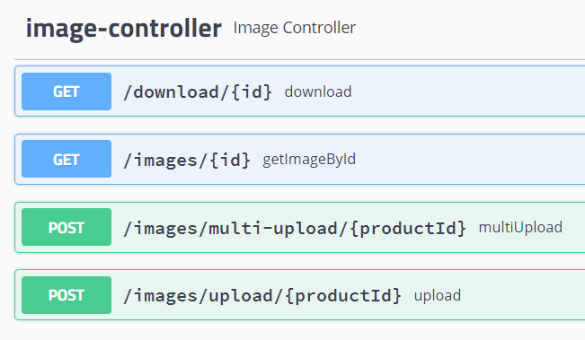
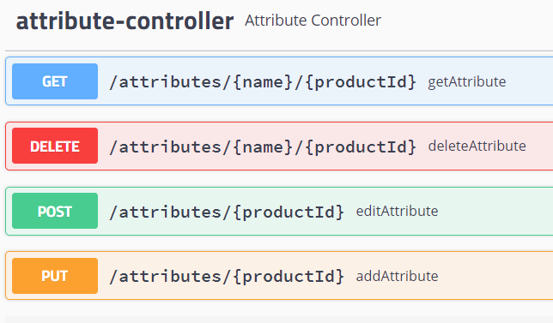

Slide 6











Използвани технологии
IDE: Intelij
JDK: JAVA 11
Maven
Spring:
Spring boot
Spring validation
Spring Security
Lombok
Hibernate
BCrypt HASH
MySql
TomCat
Postman
Git

Slide 7
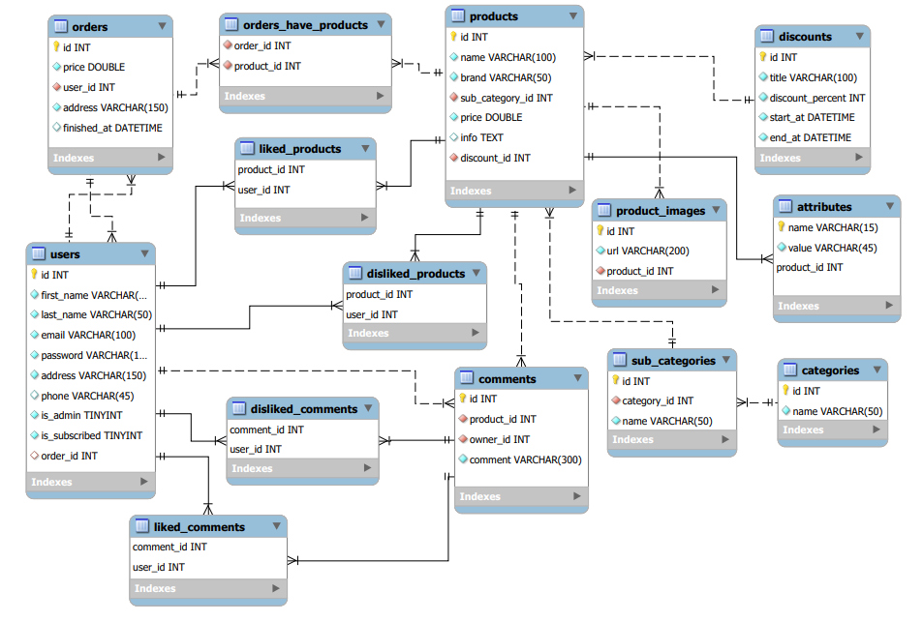

Slide 8
Диаграма на класовете
CONTROLLER
POJO
SERVICE
REPISITORY
User
Product
ProductAttribute
ProductImage
Category
SubCategory
Discount
Comment
Order
AttributeId
Controller
UserController
ProductController
AttributeController
CategoryController
SubCategoryController
DiscountController
CommentController
ImageController
SessionManeger
UserService
ProductService
AttributeService
ProductImageService
CategoryService
SubCategory
DiscountService
CommentService
EmailService
UserRepository
ProductRepository
AttributeRepository
CategoryRepository
SubCategoryRepository
DiscountRepository
CommentRepository
OrderRepository
ProductImageRepository
DAO

Slide 9
Диаграма на класовете
DTO
Request DTO
UTILL
DTO
UserRegisterRequestDTO
UserEditRequestDTO
LoginRequestDTO
ProductRequestDTO
EditProductRequestDTO
AttributeRequestDTO
EditAttributeRequestDTO
CategoryRequestDTO
SubCategoryRequestDTO
DiscountRequestDTO
CommentRequestDTO
FilterRequestDTO
PasswordRequestDTO
ReactRequestDTO
SearchByStringRequestDTO
Response DTO
DBConnector
ValidationUtil
UserWithoutPassResponseDTO
ProductResponseDTO
CategoryResponseDTO
SubCategoryResponseDTO
CommentResponseDTO
OrderResponseDTO
MessageResponseDTO
ErrorResponseDTO
DiscoundResponseDTO
DAO
EXEPTIONS
ProductDAO
NotFoundExeption
BadRequestExeprion
AuthenticationExeption

Slide 10
Демо

Slide 11
Благодарим за вниманието!
Емил Коев и Павел Коев

