Slide 1

Car Race F1

Slide 2
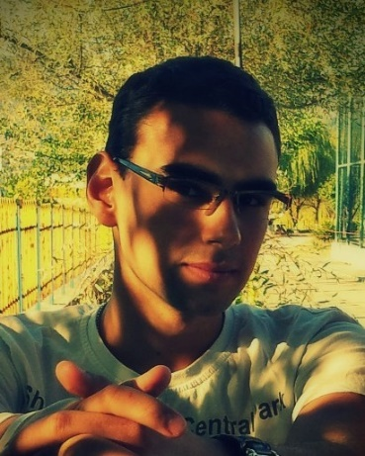
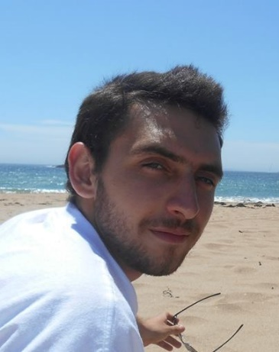
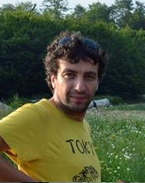
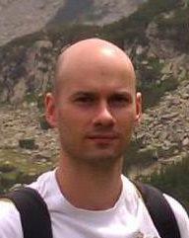

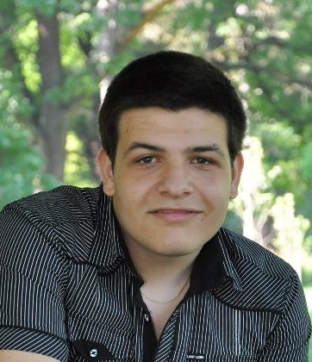
Team “Genie”
1
Members that took part in different aspects of the game development:
E.Mitev - Emil Mitev
ni4ka7a - Nikolay Atanasov
apch2 - Georgi Kojuharov
nenko.dimov - Nenko Dimov
SDobrev - Stoyan Dobrev
ggeorgiev9396 - Georgi Georgiev

Slide 3
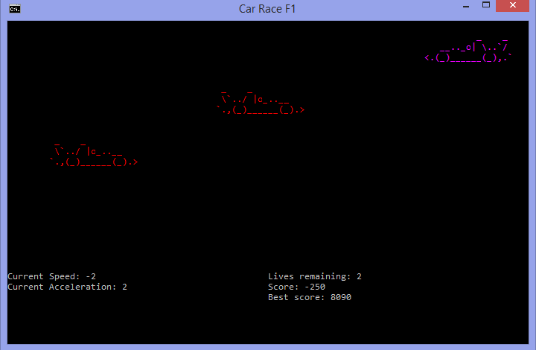
Game itself
2

Slide 4
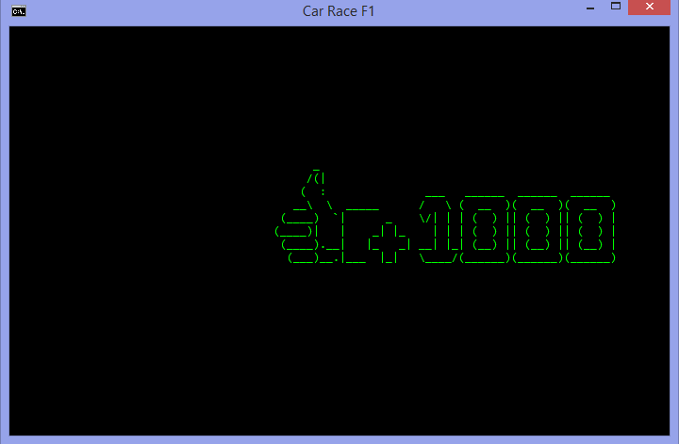
Bonus
2

Slide 5
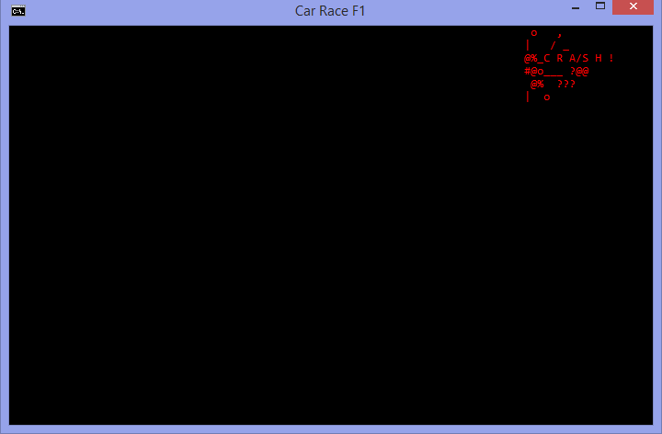
Hitting car
4

Slide 6
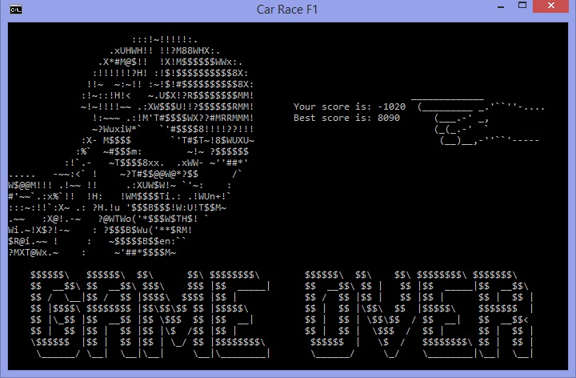
End Game
5
When the player’s out of lives:
  Find out by playing our game!

Slide 7

Link to GitHub
6
We used https://github.com/ for developing our project so here’s the link of our Cars Game:
https://github.com/EmilMitev/TelerikTeamProject

