Slide 1

Comparison of Parallel and Serial Execution of Shortest Path Algorithms
ECEN433 – Introduction to Parallel Computing
Ahmed Taha– 18101385
Ahmed Fouad– 18101467
Emil Mourad– 18101962
Rawan Abdelkhaleq – 18101703
Shorouk Abdelfattah– 18100433

Slide 2
Shortest Path problem
In the modern world, the Shortest Path Algorithms set of algorithms is crucial. It has numerous uses, including network design, route finding, and traffic consultation.
These applications must be quick and effective because they typically need to be executed in real time. For huge graphs with plenty of nodes, shortest path techniques must be executed sequentially.
On the other hand, these apps may run more quickly when executed in parallel.
In the report, Dijkstra's algorithm, Bellman Ford's algorithm, and Floyd Warshall's algorithm are three shortest path algorithms that we propose algorithms for. The parallel model used for this is the input decomposition model.

Slide 3
Shortest Path problem
Message Passing Interface (MPI), Open Multi-Processing (Open MP), Parallel Virtual Machine (PVM), and other parallel programming environments are only a few examples of the many parallel programming models and environments available.
The algorithms will be implemented using Open Multi-Processing (OpenMP), and their performance will be examined.
These systems are scalable, allowing for effective execution of both demanding sequential and parallel workloads.
They may be adjusted to the available budget and computational needs. For the parallelization of the shortest path techniques in the research, we employed OpenMP

Slide 4
Shortest Path problem
The shortest path problem is about finding a path between two vertices in a graph such that the total sum of the edges weights is minimum.
This can be defined for undirected, directed and mixed graphs. A path is a sequence of vertices
(P= (Vi, Vi+1, Vi+2……, Vn)) such that Vi is adjacent to Vi+1 (the two vertices have a common edge).
The length of path P is (n-1). A path from vertex 0 to vertex 7 is marked in rad

Slide 5
Time complexity of The implemented sequential execution of algorithms
Algotithm | Runtime
Bellman-Ford | O( | V| . | E | )
Dikstra’s (with list) | O( | V |² )
Floys-Warshall | O( | V| ³ )

Slide 6
Our Objective
Develop a program including three separate algorithms using parallelism from a sequential algorithm
Using openMP .
Test and compare efficiency of sequential and parallel solutions

Slide 7
DIJKSTRA ALGORITHM

Slide 8
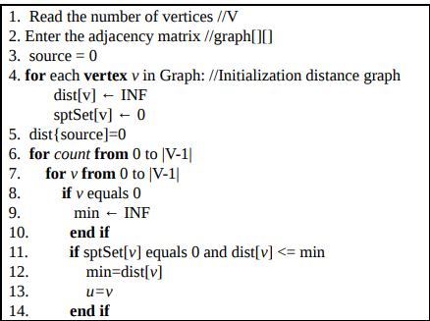
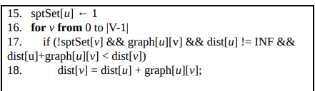
SEQUENTIAL ALGORITHM
Dijkstra’s sequential algorithm is implemented through the following steps:
1. Setting a distance for each node, let the distance be zero to the source node and infinity to all other nodes.
2. Creating a list of the unvisited nodes, adding all nodes to the unvisited list except the initial node.
3. Setting the initial node as current.
4. For the current node, calculate the tentative distances. Overwrite the value of the distance with the new calculated distance if it is smaller than the previous distance.
5. After checking all neighbors of the current node, mark the current node as visited and remove it from the unvisited list and it won’t be checked again.
6. If the destination node is marked visited or the smallest distance among the nodes in the unvisited set is infinity, then the algorithm should stop.
7. Select the unvisited node that has the smallest distance and set it as the new current node then repeat from step 4.

Slide 9
Dependencies Analysis
The closet node each time depends on the previous closet node , thus we can’t parallize nodes relaxation
Updating the distances for each node depends only on the current closet node , Thus we can parallize updating distances for each closet node (single instruction multiple data)

Slide 10
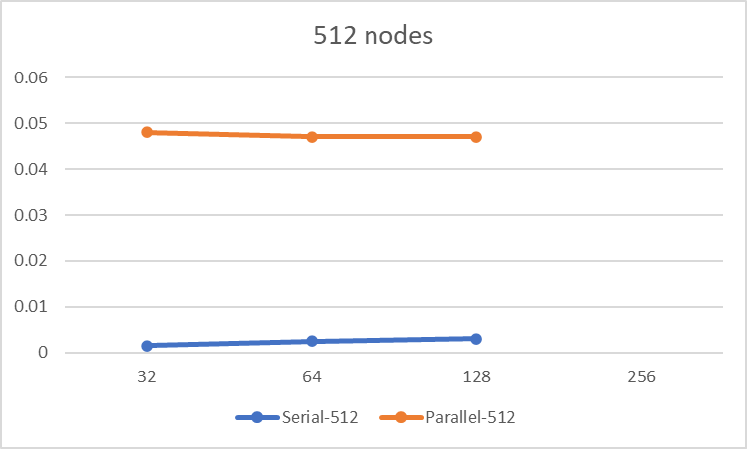
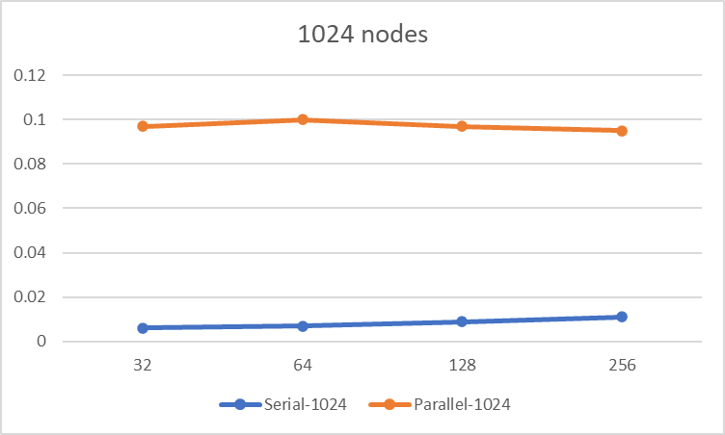
Sequential vs parallel results 4 Threads(UNIT seconds)

Slide 11
Sequential vs parallel results 4 Threads(UNIT seconds)

Slide 12
Sequential vs parallel results 4 Threads(UNIT seconds)

Slide 13
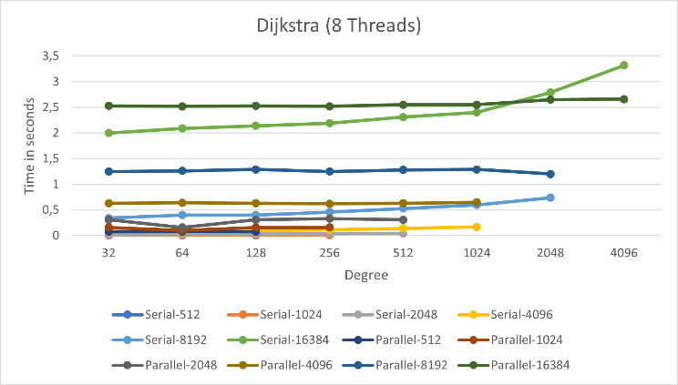
Sequential vs parallel results 4 Threads(UNIT seconds)

Slide 14
Bellman-ford ALGORITHM

Slide 15
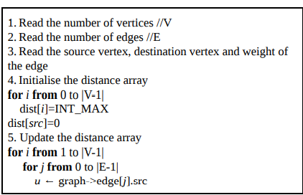
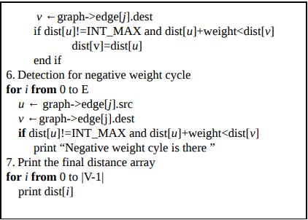
SEQUENTIAL ALGORITHM
The algorithm works as follows:
1.From the given source vertex, initialize all distances as infinite, except the distance to source itself. The number of times the edges must be processed is equal to the total number of vertices in the graph.
2.Starting from the source node, calculate the distance to the other nodes which are directly connected to the source node. In other words, visit the nodes which are one edge long to the source node and calculate their distance.
3.The first iteration guarantees to give all shortest paths which are at most 1 edge long. We get following distances when all edges are processed second time
4.The second iteration guarantees to give all shortest paths which are at most 2 edges long.
5. Repeat the algorithm for n number of times where n is the total number of edges in the graph and the final result would be the shortest distance from the source node to all the other nodes.

Slide 16
Dependencies Analysis
Each iteration depends on the previous iteration . Thus we can’t divide work over iteration.
Relaxation for edges doesn’t depend on each other . Thus we can divide relaxation for edges over threads.

Slide 17
Sequential vs parallel results 4 Threads(UNIT seconds)

Slide 18
Floyd-Warshall ALGORITHM

Slide 19
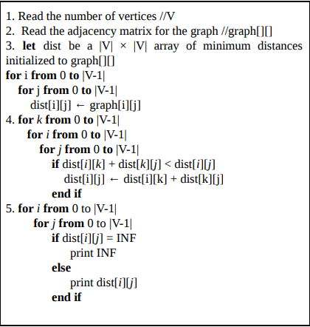
SEQUENTIAL ALGORITHM
The algorithm works as follows:
1. This algorithm find the shortest path by constructing the distance matrix from the source node to all the other nodes. The distance matrix follow the following things i. If i=j, distance should be 0 ii. Distance[i][j] should be equal to Distance[j][i]. iii. If two nodes are not connected, distance should be infinity i.e. a very large number.
2.Then the weighted matrix is generated according to the k formula W ij = min ( W ij , W ik + W jk ).
3. Now, construct a matrix D1, in which first row and column will remain the same and the other values will be filled by the above mentioned formula.
4. Now, construct matrix D2, in which second row and second column of D1 will remain the same and other values will be filled by the above formula.
5. Repeat this for all the rows and columns i.e. repeat this n times where n is equal to the number of edges.

Slide 20
Dependencies Analysis
Each iteration depends on the previous iteration . Thus we can’t divide work over iteration.
Relaxation for edges doesn’t depend on each other . Thus we can divide relaxation for edges over threads.

Slide 21
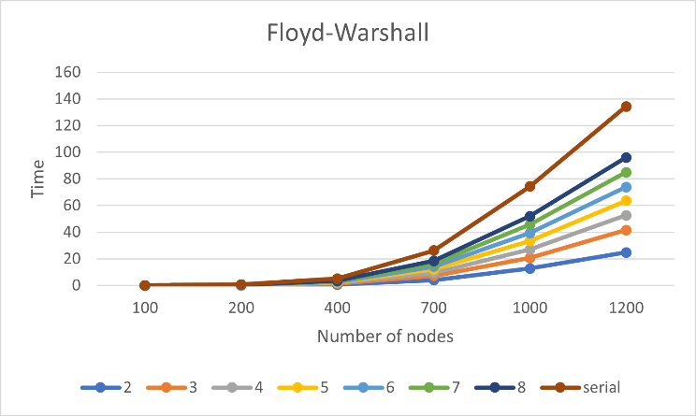
Sequential vs parallel results 4 Threads(UNIT seconds)

Slide 22
Conclusion
In Dijkstra algorithm the time was relatively close to each other with the smaller graphs, but with extremely large graphs it was significantly faster than the sequential program. In addition to that the performance was better with four threads than with eight threads. In the literature, the largest number of vertices tried was 1000, and it was shown that the sequential program is much better than the parallel program.
In Bellman Algorithms, the parallel program was better than the sequential, in addition the greater number of threads were added the better the performance was. In the literature, it was shown that the best performance is with only 4 threads.
In Floyd Warshall algorithms the time was the same for all below 400 vertices, but more than that the parallel program was better. Running on two threads has given the best performance. Which also contradicts the literature that shows that serial program was much slower in time than the parallel program.

