Slide 1
Fraud Prevention
Team B4U
Tao Shan, Yuxuan Liu, Fanghe Lin, Peiyi Zheng

Slide 2
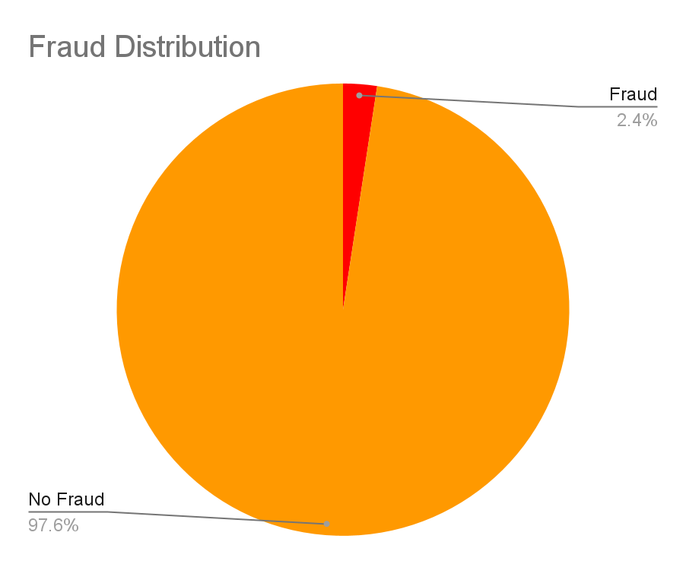
Introduction
Business Outcome
Detect Fraud Transactions - minimize financial lost, customer satisfaction
03
Dataset
credit card transaction - 89230 records and 173 features, External data
01
02
Data Analytics
Data Cleaning, Data Exploration, Data Preprocessing, Data Modeling, Business Idea Generation

Slide 3
Extra Data and Preprocessing
Why people fraud?
Pressure - Health problems, No income, Crippling debts
Opportunity to commit fraud
Possible data: COVID positive rate, hospitality service, Canada average debts per person
Extra Data we selected:
Covid Data
Bank of Canada, money market and other interest rates
Min-max Scaler, Frequency Encoding, Remove Duplicate/Similar Columns, Sparse dataset, Distribution Analysis
Notes:
Fraud is a complex issue that can be driven by a variety of factors. Accounting to our analysis on the reason of why fraud phenomenon would exist, people’s pressure can be one of the reason. Pressure can come in the form of financial stress, such as high levels of debt or a lack of job opportunity. Especially in recent years, under the impact of COVID-19 pandemic, many people may have been under financial pressure due to job loss, reduced income and health problem. Additionally, in Canada, average debts per person have been increasing over the past few years, which could provide an opportunity for someone to commit fraud in order to gain financial support easily.
So we choose to add another two extra data set from outside, Canada’s 2021 Covid-19 positive and death rate, Canada’s 2021 bank of interest rates.

Slide 4
Our Model
Candidate Models: Logistic Regression, Rigid Regression, XGBoost
Parameter Pruning for XGBoost, Maximize AUC
Best XGBoost Model: AUC = 0.962
 | Logistic Regression | Rigid Regression | XGBoost | XGBoost (Fine Tuning)
ROC-AUC | 0.922 | 0.914 | 0.956 | 0.962
Recall | 0.165 | 0.026 | 0.270 | 0.383
Precision | 0.706 | 0.772 | 0.764 | 0.777
Accuracy | 0.978 | 0.976 | 0.980 | 0.982

Slide 5
Key Attributes - Feature Importance by F-score
AMOUNT
Transaction amount
USER_AGENT
Client’s transactions operating system, vendor, and/or versions
AVAIL_CRDT
Available Credit for the card
EVENT_TIME
Time for current transaction
CREDIT_LIMIT
Credit limit for the card
COUNT_PHONE_ORDER_7D
Total Number of PHONE_ORDER transactions in the past 7 days

Slide 6
Modelling!
How to prevent fraud more effectively without creating operation overhead?

Slide 7
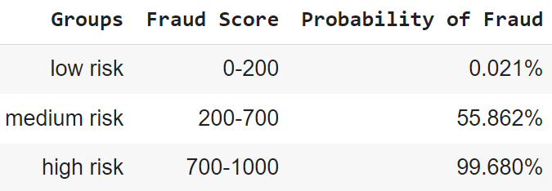
Fraud Scoring System
Notes:
When it comes to preventing fraud, it's important to focus on the transactions that are most likely to be fraudulent. That's why we used machine learning models to predict the likelihood of fraud based on historical data, and automatically decline transactions that are predicted to be fraudulent.
But we don't stop there. To minimize the negative effect on customer experience, we will not decline every suspected fraud. We will introduce a dynamic fraud scoring system, which assigns a fraud score to each transaction based on a set of predefined parameters. The system are designed to classify them and treat each level of scoring differently.
(scoring system 韬哥请讲)
By both techniques, we can significantly reduce the risk of fraudulent activity and keep customers' financial information secure.

Slide 8
Insights and Recommendations
Transactions to Decline
Fraud Scoring System
Automatically decline transactions that are predicted to be fraud
Example insights from data:
12:00 am and 8:45 each day - fraud rate is more than twice
Less credit limit will cause more fraud
Minimize Impact on Customer Experience
Provide clear and detailed explanations about our Fraud Scoring System
'Second Chance' Option
Notes:
As we have mentioned before, we implemented a dynamic fraud scoring system that utilizes machine learning models to predict the likelihood of fraud, assigns risk scores to transactions, and automatically declines high-risk transactions.
We understand that preventing fraud is important, but we also want to ensure that the customer experience is not negatively impacted. So each time our algorithm detect a suspected fraud and declined it, we'll make sure to provide clear and detailed explanations to customers regarding how our system treating different levels of scoring and how our customers can prevent future declines.
Additionally, we propose implementing a 'second chance' option for customers whose transactions are declined due to suspected fraud. This allows them to verify their identity and complete the transaction.

Slide 9
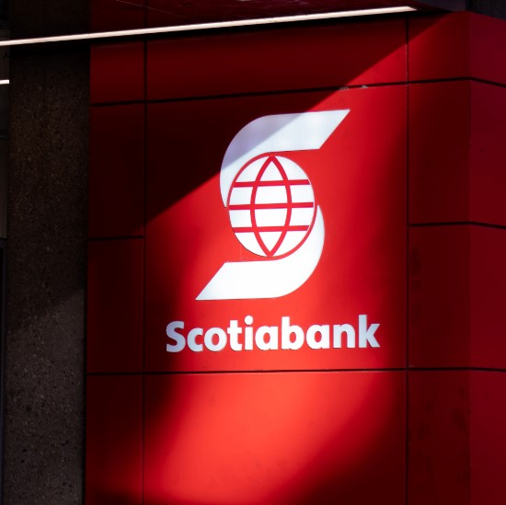
Long-term Suggestions
Continuous Updating
Exploring AI or NLP technologies
Collaborating with other organizations
Notes:
Preventing fraud is an ongoing process, and it's important to stay ahead of new types of fraud. That's why we suggest continuously monitoring and gathering data from various sources, updating our model to improve its performance and adapt to new types of fraud.
Additionally, we suggest exploring the use of other technologies such as AI or NLP to enhance the detection and prevention of fraud.
And by collaborating with other organizations, such as other banks or financial institutions, we can share information and intelligence on fraud, making us all better equipped to combat it.

Slide 10
Conclusion
Analytical Steps for raw dataset
Key Attributes
Treat groups of people differently - Fraud Score System
Insights and Recommendations
Suggestions - More data such as demographic and personal profile
Q&A

