Slide 1

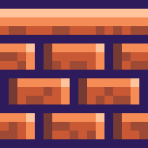







QUESTİONS
LET’S PLAY!

Slide 2

how to play
There are 3 different types of games!
Answer the question
Multiple choice
Complete the word

Slide 3
ARE YOU READY?

Slide 4


Answer the question
an/a umbrella?

Slide 5
Answer the question
Answer:
an umbrella

Slide 6
Multiple choice
who correct?
a. a university
b. an car
c. an apple
d. an cat

Slide 7
Multiple choice
who correct?
a. a university
b. an car
c. an apple
d. an cat

Slide 8
Complete the word
Hint: hiç
___

Slide 9
Complete the word
Answer:
ANY

Slide 10
THANKS FOR PLAYING
END

