Slide 1
HLT 90L
MLT 70L
Boil 140L
V5 (not used)
V4
V2
V1
V9
V3
V7
V8
(Pump Bypass)
V10
V6
Cooling water OUT
In
Out
Magnetic Pump
Cooling water IN
Notes:
Rev. 06, 23-07-2003

Slide 2
HLT 90L
MLT 70L
Boil 140L
V9
V8
(Pump Bypass)
V10
Cooling water OUT
In
Out
Cooling water IN

Slide 3
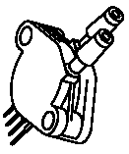

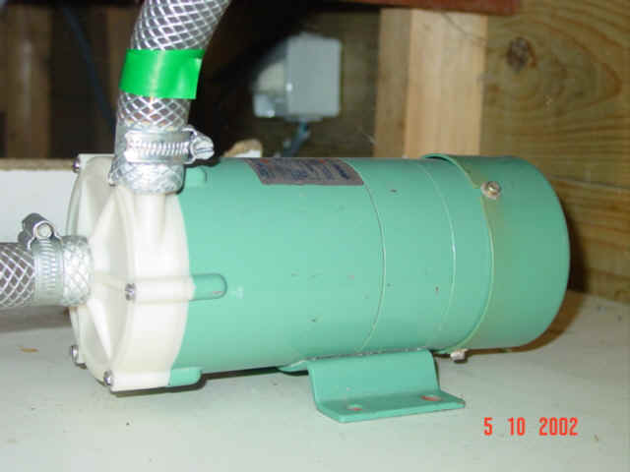
Hardware Architecture
PC-I²C
Parallel Port Interface (with PCF8584)
AD-DA / IO
PCF8591 / PCF 8574
0x90/0x91 0x42/0x43
LED1
SAA1064
0x70/0x71
LED2
SAA1064
0x72/0x73
I²C
I²C
I²C
I²C
I²C
PCF 8574
0x42/0x43
PCF 8574
0x44/0x45
PCF 8591
0x90/0x91
DAC output
bits 1..7
AD4 (Vmlt)
MPX12 Interface
Circuit
AD1
Pressure
Sensor
(MPX12)
bit 0
(Heater)
bit 2
(Pump)
AD3 (Triac temp.)
AD2
Power Electronics
TIC263M Triac (2x)
Zero-crossing circuit
Opto-coupler isolated (2x)
220 V ~
Temp.
Sensor (LM92)
Temp.
Sensor
(LM92)
Heating element 3 kW
HLT
MLT
Pump
24 Vdc
Valves
Interface
Circuit
V1
V2
V3
V4
V5
V6
V7
Notes:
V0.3, 23-07-2003

Slide 4
Software Architecture
Borland C++ Builder 4.5: Windows 98/ME program.
File: maisch.sch
File with temp. And time settings
TTimer: executed once every 50 msec.
All routines are called once every TS seconds.
Time-slicing used to divide computing-load
Misc.c
Read maisch.sch and calculate tset value
Application
User interface program, calls read_adc() and pid_reg() every TS seconds. Outputs PWM signal for Triac every TS seconds.
HLT temp.
% signal
Tset
Pid_reg.c
I2c.c
I²C application routines, such as read_adc(), set_led(), print_lcd(), ...
PID controller:
output: % signal
Input: Tset – HLT temp.
I2c2.c
Low-level routines to communicate with I²C bus
i2c_write(), i2c_read(), i2c_start(), i2c_stop(), i2c_address()
I²C Hardware

Slide 5
100 %
Tset_hlt [°C]
e[k]
PID
Controller
Gamma [%]
0 %
Thlt [°C]
PID Controller
e[k]
T
e[k-1]
T
e[k-2]
K₂
100 %
K₁
Gamma [%]
K₀
0
vrg
0 %

Slide 6
Brewer
Commands
0
Ebrew System
Status
Registry
Registry
Variables
Mash Scheme
Mash Scheme
0 Ebrew System
Mash Scheme
1
Soft-ware
hw_settings
2
Hard-ware
Status
Commands
measurements
Registry
Variables
Notes:
System Overview: decomposition in Hardware and Software

Slide 7
Commands
Status
1.1
GUI Objects
1.4
Idle
Process
Mash Scheme
1.2
Init.
Sequence
Registry
Variables
Ebrew_status
1.3
50 msec.
Interrupt
1.5
I2C Routines
i2c_data
measurements
hw_settings
DFD 1 Software

Slide 8
Unit1.cpp
TMainForm()
Main_Initialisation()
Start_i2c_communication()
Restore_Settings()
i2c_init()
i2c_start()
decode_log_file()
i2c_dll.dll
misc.c

Slide 9
Unit1.cpp
t50msec2timer()
50 msec.
Generate_IO_Signals()
Reset_I2C_Bus()
TS4
5 sec.
TS9
1 sec.
TS4
5 sec.
TS1
1 sec.
TS2&TS3
1 sec.
TS5-TS8
1 sec.
50 msec.
TS9: 1 sec.
50 msec.
update_tset()
update_std()
pid_reg2()
read_adc()
lm92_read()
set_led()
WriteIOByte()
misc.c
i2c_dll.dll

Slide 10
Controller output [%]
Δp
time
Temperature [°C]
y = a.x + b
a = ΔT / Δt
T₂
ΔT
T₁
time
t₀
Θ
t₁
Δt
t₂

Slide 11
Δp
time
Temperature [°C]
T₂
T₁+0.632* ΔT
ΔT
T₁+0.283* ΔT
T₁
time
t₀
(1/3).τ
τ

