Slide 1
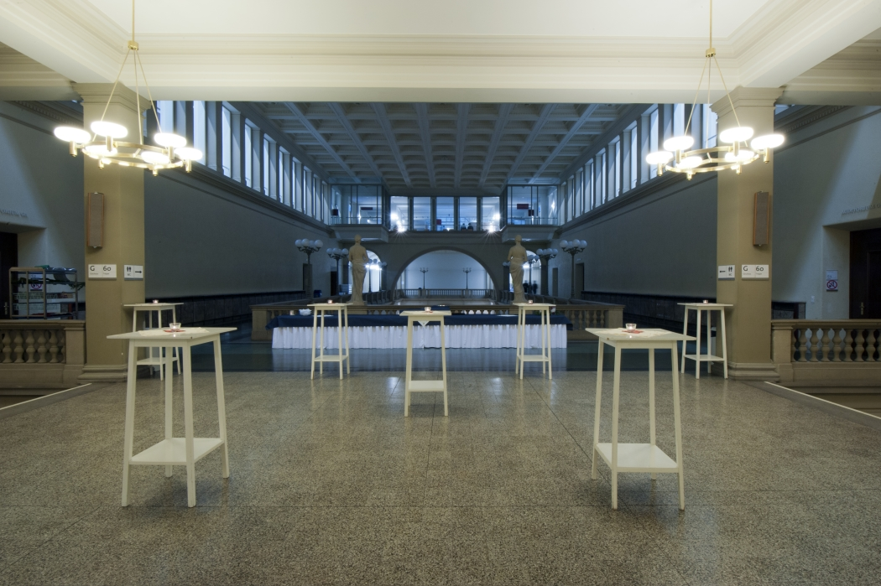
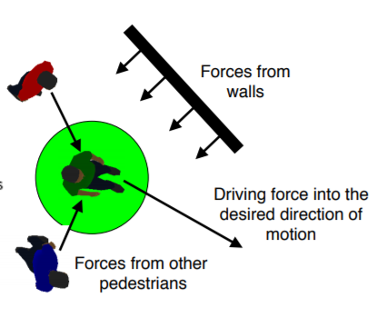
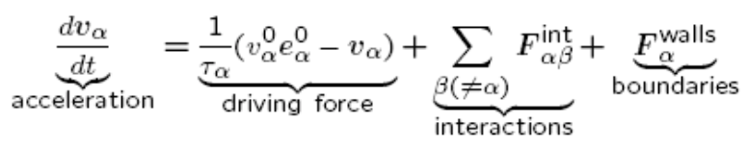
How do participants act during an apéro at ETH
How does the number of
People
Food / drinks
Tables
affect the behavior of the participants ?
What happens if there are several exits from the lecture hall ?
[1] D. Helbing, P. Molnar. Social force model for pedestrian dynamics (1995)
[2] D. Helbing. Modeling and Simulation in Computational Social Science, Course Material (2017)

