Slide 1
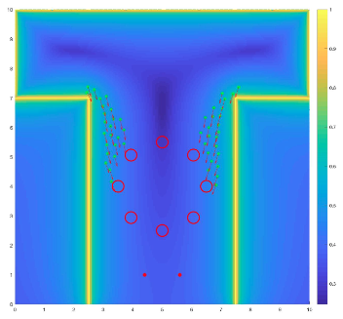
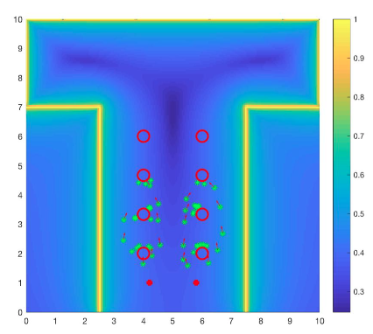
Simulation
3 functions are used to consider the cost of every simulations:
Time cost function
Velocity cost function
Force cost function
Simulation conducted by averaging different simulations over 20 attemps each.
The parameters that changed are:
Number of participants
Number of tables
Disposition of tables (circular or rectangular)
Distance between food positions on the buffet table
Source: Pix4D

Slide 2
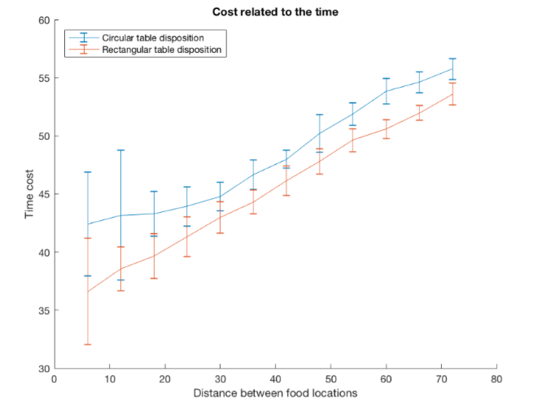
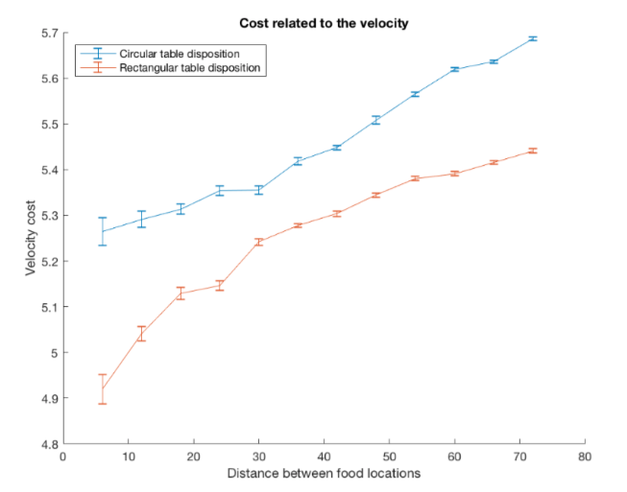
Simulation
Changing the number of participants
Number of people: from 6 to 72
Number of tables: 8
Capacity of tables:9
Distance between food points: 1
Results
Linear increase of time cost with increasing number of participants
Rectangular table disposition is preferred with respect to the circular table disposition
Rectangular table disposition:
the velocity cost is insignificant in case of few participants.
Clusters begin around 15 people
Stable situation in case of crowded apéros
Source: Pix4D

Slide 3
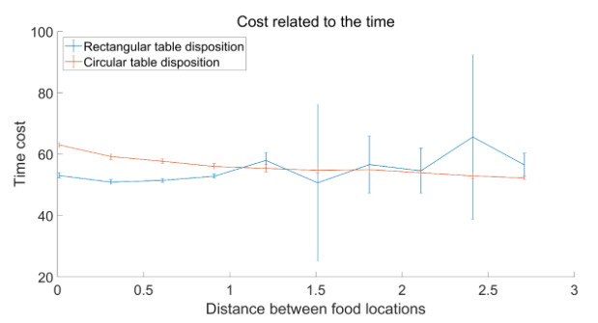
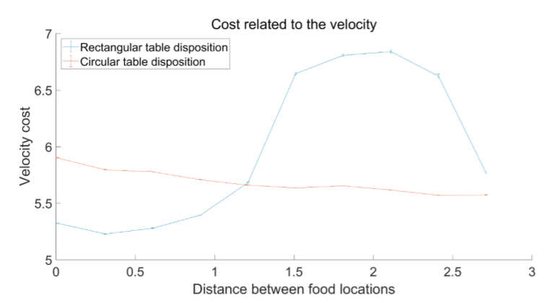
Simulation
Changing the food positions
Distance between food points: from 0 to 2.7
Number of tables: 8
Capacity of tables: 9
Number of people: 72
Results
Cost of time has no significant correlation with the distance of food points
Cost of velocity
Circle: decreases monotonously
Rectangle: down-”U”shape
Source: Pix4D

