Slide 1
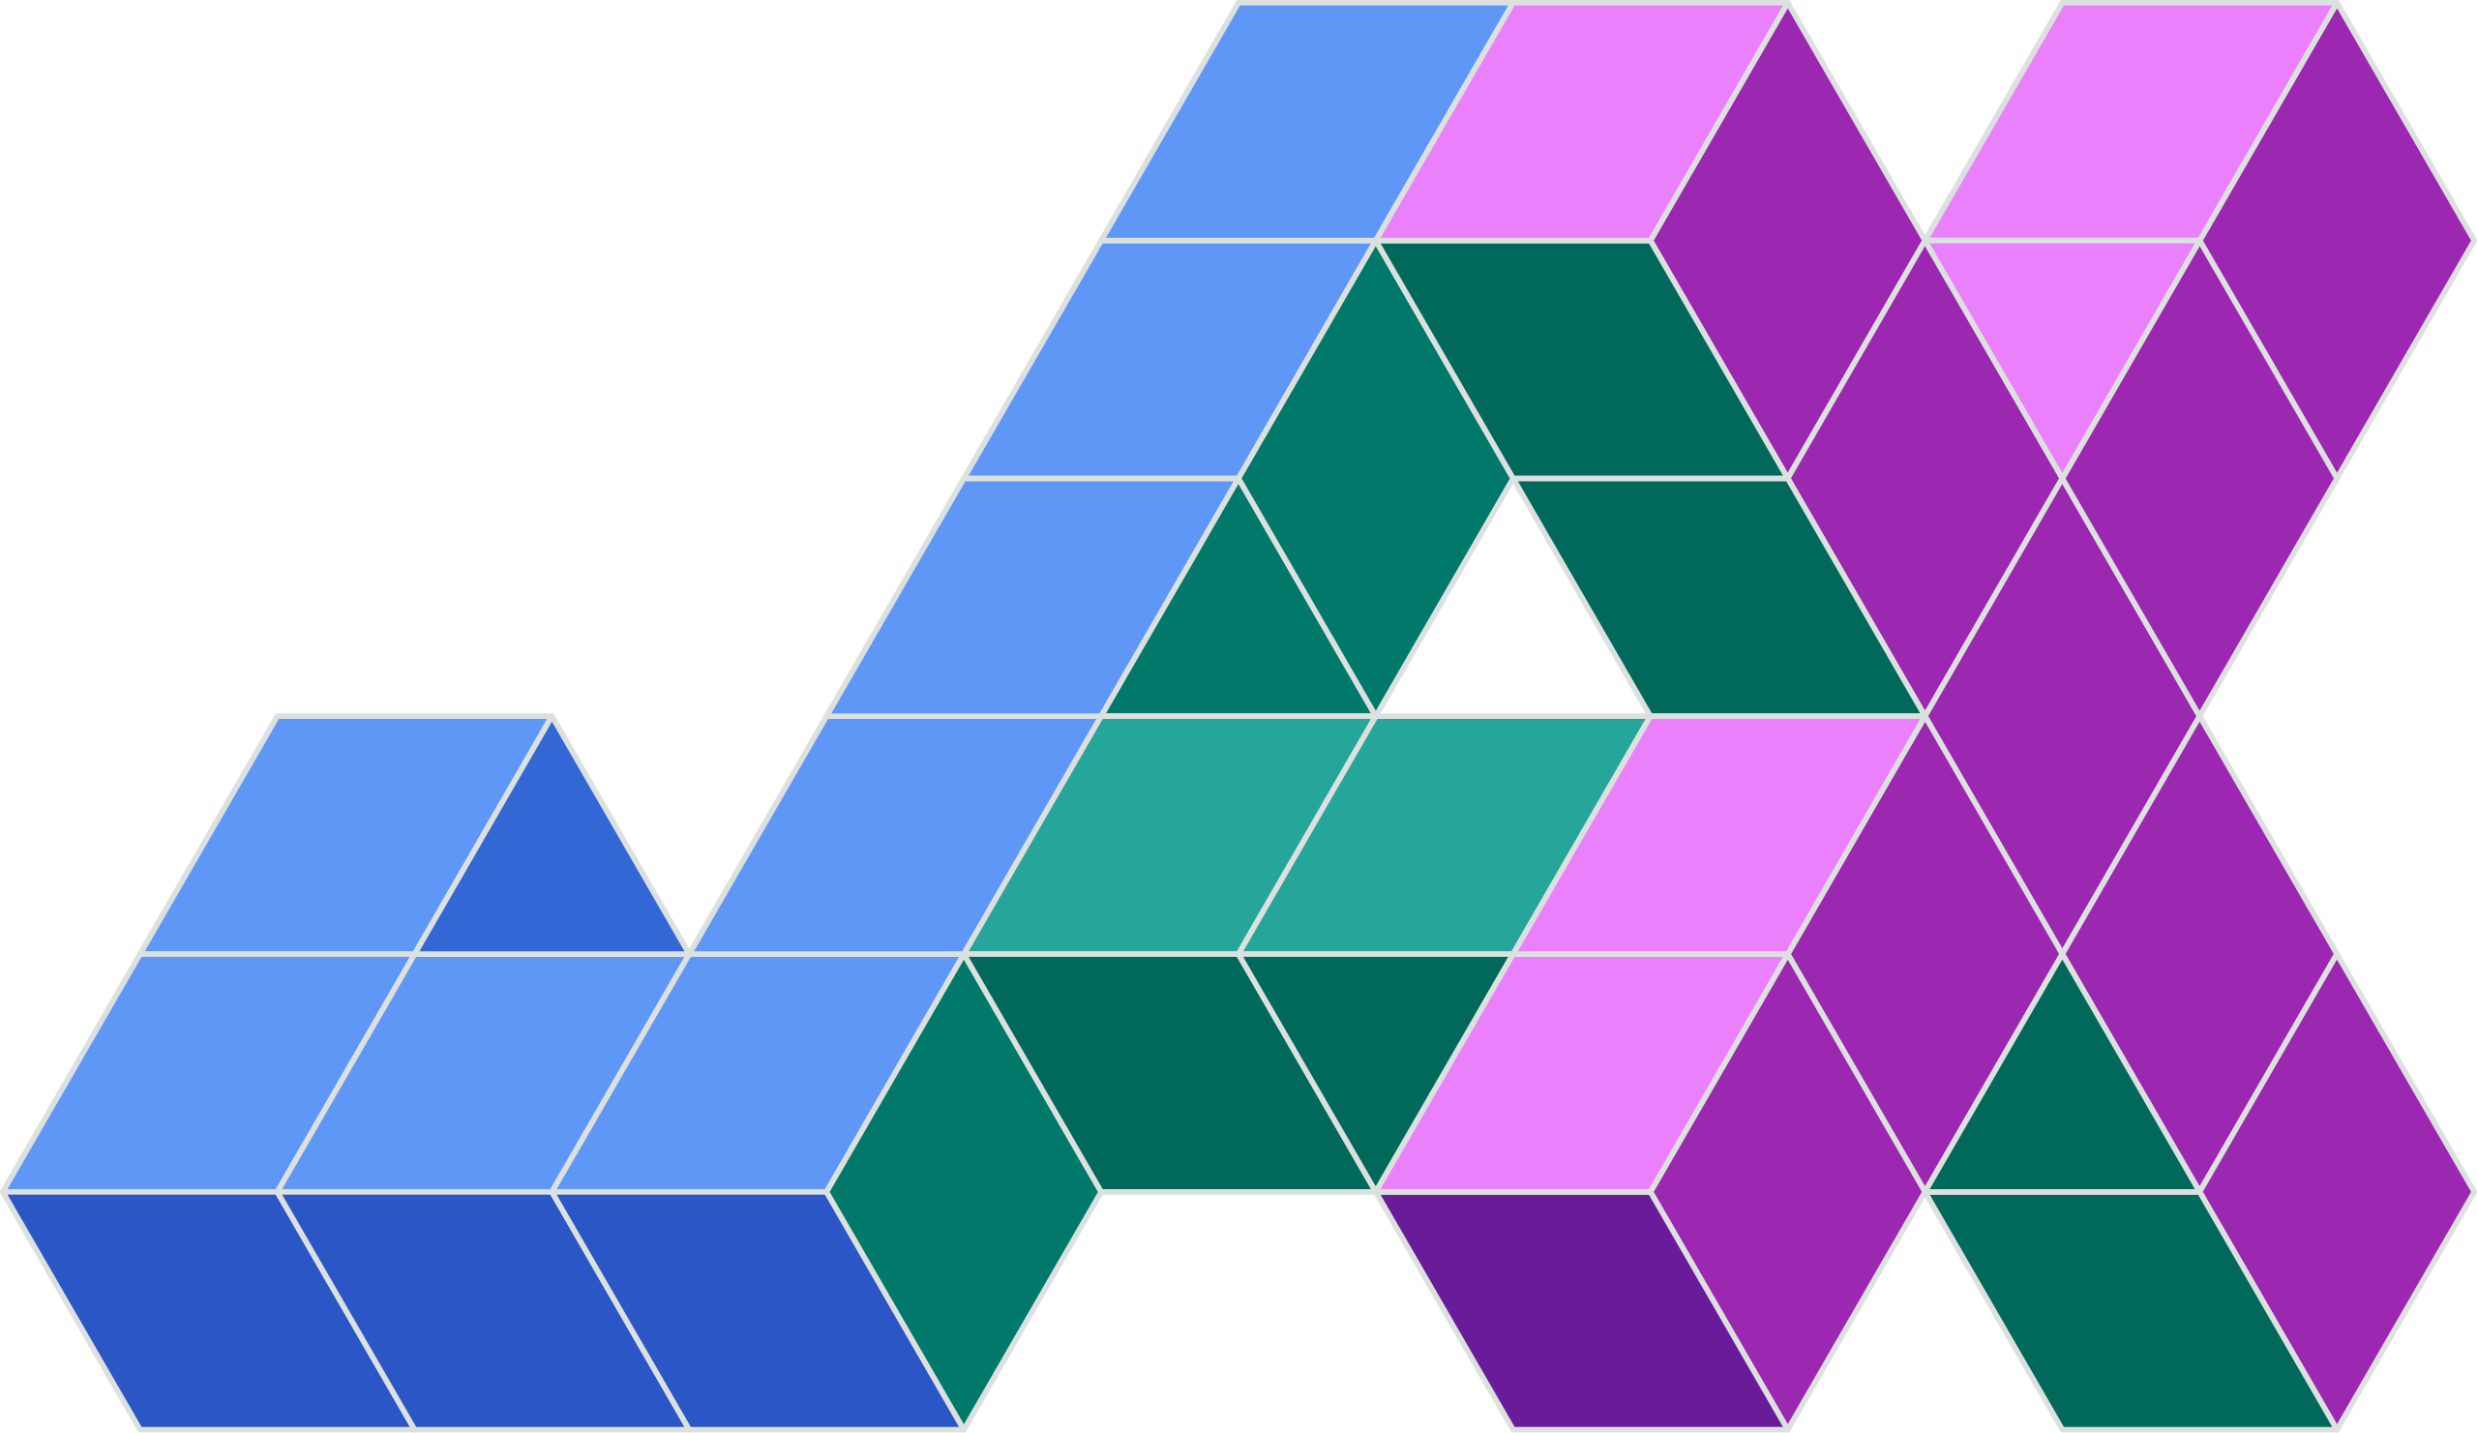
Batch processing
DIC Core
«abstract»
BatchBase
+run()
+before()
+sequence()
+end()
«abstract»
DICBase
+prepare()
+run()
inherits
inherits
inherits
BatchMeshBased
+before()
+sequence()
+end()
DICMeshBased
+prepare()
+set_initial_guess()
+run()
DICInitMotion
+prepare()
+run()
uses
uses
uses
Displacement
Propagator
Solver
«abstract»
DisplacementPropagatorBase
+propagate()
«abstract»
SolverBase
+compile()
+solve()
inherits
inherits
inherits
inherits
inherits
PreviousDisplacementPropagator
LocalGaussNewtonSolver
TranslationZNCCSolver
ConstantVelocityPropagator
GlobalCGSolver

