Slide 1
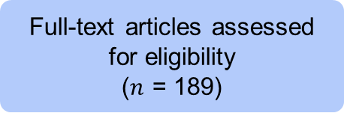
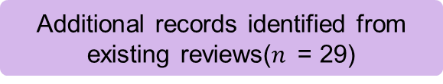

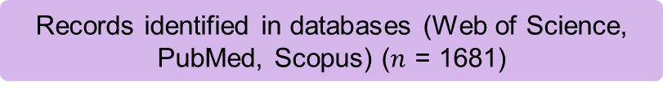
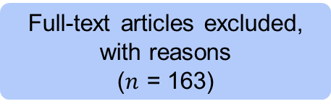
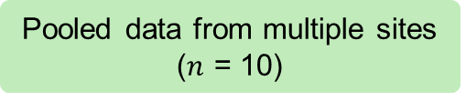

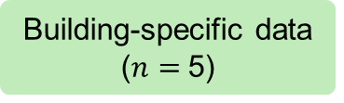
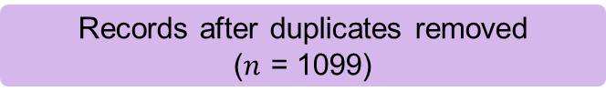
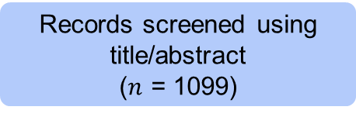
Records identified in databases (Web of Science, PubMed, Scopus) ($n$ = 1681)
Additional records identified from existing reviews($n$ = 29)
Identification
Records after duplicates removed
($n$ = 1099)
Records screened using title/abstract
($n$ = 1099)
Records
excluded
($n$ = 910)
Screening
Full-text articles assessed for eligibility
($n$ = 189)
Full-text articles excluded, with reasons
($n$ = 163)
Studies included
($n$ = 15)
Included
Building-specific data
($n=$5)
Pooled data from multiple sites
($n$ = 10)

