Slide 1
JES – Automated plant watering system
ICT Infrastructure project

Slide 2
Who are we?
Project Manager:
Jade Malin, 2nd year student
Project Members:
Emilia Hauskaviita, 3rd year student
Selma El Uharani, 2nd year student

Slide 3
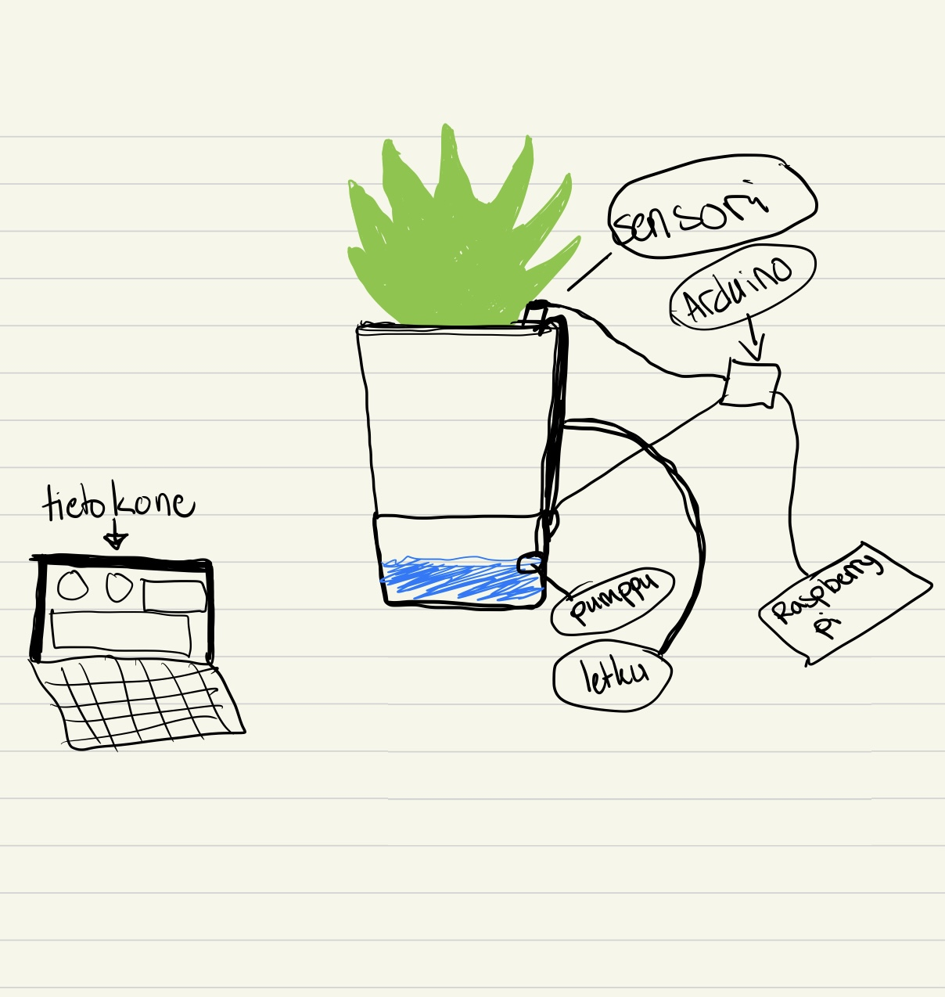
What are we doing?
Developing an Automatic Plant Watering System!
Sensors to measure soil moisture and temperature
System will detect dry soil and triggers the pump to water the plant.
Visualize moisture and temperature data in real-time using Grafana

Slide 4



What do we need?
Soil Moisture and DHT11 sensor
Measures soil moisture levels and temperature
Raspberry Pi
Acts as the central controller
Arduino Uno
Logs the analogs sensor data
Water Pump
Activated when soil is dry
Grafana
Graphical monitoring of data
Database
for storing data

Slide 5
How are we going to do it?
We are dividing our work into different phases:
Ordering the components
Building the physical IoT part
Building the non-physical IoT part
Coding and debugging
Database
Graphical Interface
Finalizing the project
Notes:
Phase 1 involves ordering the necessary components for the project. The workload includes online shopping for the required parts, which will take place in Week 7. This phase depends on the completion of project planning, and the expected outcome is the successful delivery of all components.
In Phase 2, the physical IoT components will be assembled. This will occur in Week 8 and requires the completion of Phase 1. The workload includes connecting the Arduino Uno to the Raspberry Pi 3, as well as attaching sensors and the water pump to the Arduino. By the end of this phase, the physical IoT part will be fully assembled.
Phase 3 focuses on building the non-physical IoT components. This phase is scheduled for Week 9 and is dependent on the completion of Phase 2. The main tasks include configuring the Raspberry Pi and setting up the database. The expected result is a functional non-physical IoT infrastructure.
Phase 4 is dedicated to coding and debugging which will take place between Weeks 10 and 13. It depends on the successful completion of Phase 3. The workload includes writing code and debugging the codes for the database, water pump activation, and sensor functionality. The outcome of this phase will be a fully functional IoT infrastructure.
Phase 5 focuses on setting up and configuring the database. This will occur in Week 14, following the completion of Phase 4. The primary task is finalizing the database setup, resulting in a fully operational database.
In Phase 6, the graphical interface will be built and integrated using Grafana. This phase is scheduled for Week 16 and requires the completion of Phase 5. The workload includes integrating data into Grafana to develop a functional graphical interface. By the end of this phase, the graphical interface should be fully operational.
Finally, Phase 7 involves finalizing the project and completing the final report. This phase will take place in Week 18 and is dependent on the completion of Phase 6. The primary task is writing the final project reports. The result will be a completed and fully documented project.

Slide 6

The END!
Thank you!
Any questions? ☺
Image sources:
Grafana
Arduino
Raspberry Pi
Question mark

