Slide 1
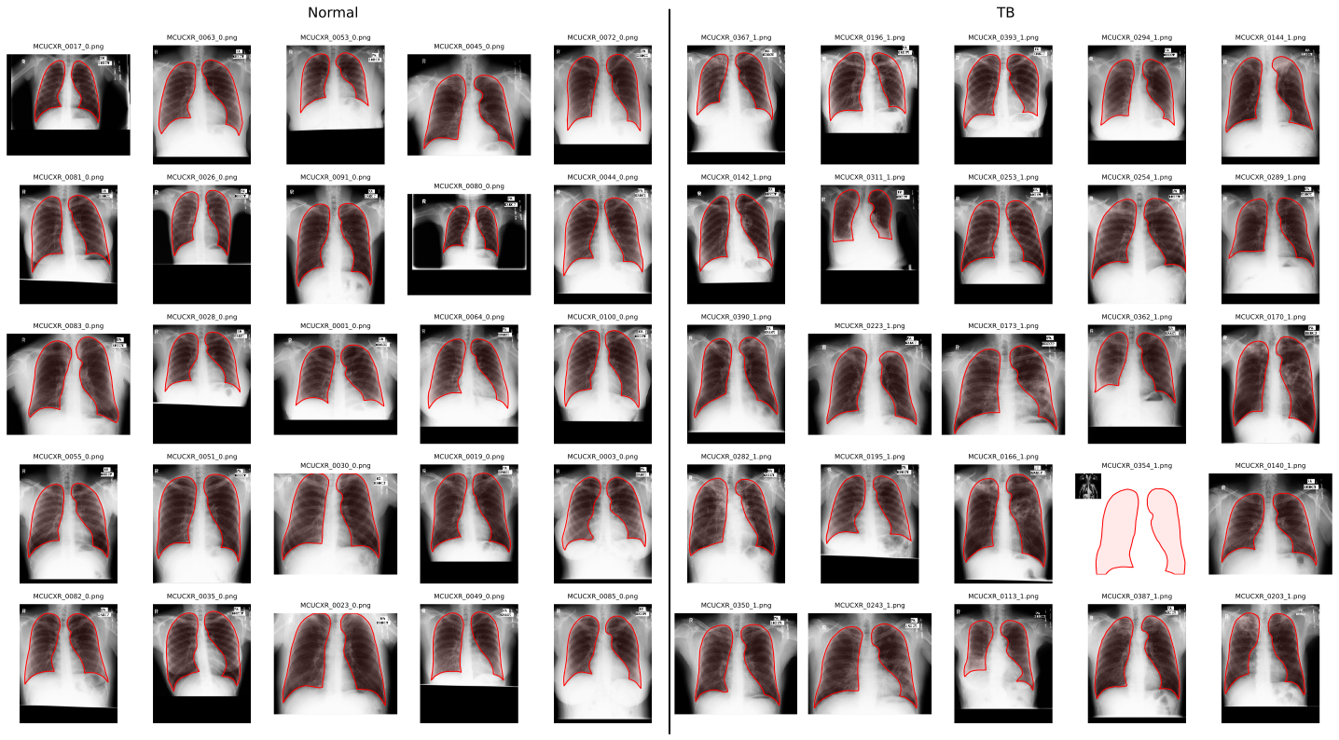
Lung segmentation from chest X-rays
Dataset
Montgomery County chest X-ray set.
Each X-ray contains radiologist supervised masks of both the left and right lung, used as the ground truth.
Original images were 4020x4892 pixels, and were resized to 512x512 with anti-aliasing.
One X-ray turned out to be a photo of a cat, so was excluded, leaving 137 cases, 80 normal, and 57 TB.
Aims
Compare Thresholding methods (Mean, Manual, Otsu, MultiOtsu and Local)
Measure what filtering and morphology can add
Compare segmentation quality on normal and TB cases
Test if the texture or brightness features inside lungs can classify them as normal or TB.

Slide 2
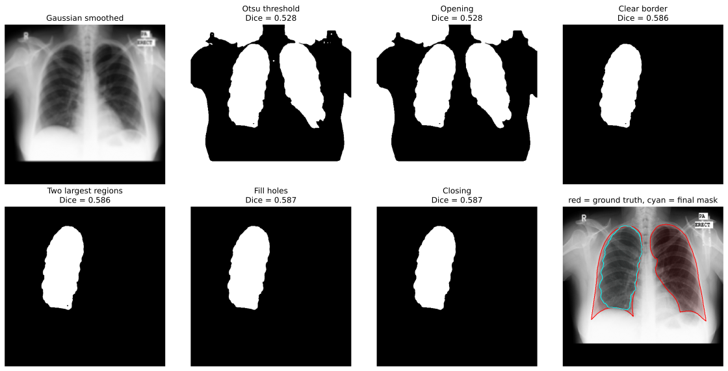
Segmentation Results
The threshold alone barely matters, as mean, manual selection, Otsu and Local all achieved a Dice of 0.52-0.55 on all 137 cases, as each one also selected the outside air and black border.
The biggest issue, as seen in the figure, was that with two-class Otsu, the soft tissue at the image edges would join the lungs to the background, meaning they were removed when the border was cleared.
Switching the threshold to MultiOtsu, and then to Local helped mitigate this, but the biggest change came from splitting up the opening step, and selecting the lungs on the eroded mask, prior to dilation.
The different versions of the segmentation function were tested on 16 random images, and the performance is summarised in the table.
Version | Key Change | Mean Dice | Empty Masks
1 | Changed the opening radius | 0.247 | 11/16
3 | Three class Otsu | 0.496 | 4/16
4 | Lung selection on eroded masks | 0.746 | 0
5 | Local thresholding | 0.864 | 0
Notes:
Trained by supervised gaussian denoising on LIDC
Take clean LIDC slices (3300)
Add synthetic gaussian noise at random sigma to each
Feed noisy image and noise level map to network
Train to regress clean image under MSE loss
Adam optimiser, cosine schedule, batch 8, 50 epochs
Training added noise at sigma/255 but the noise level map was sigma/50 causing the shift

Slide 3
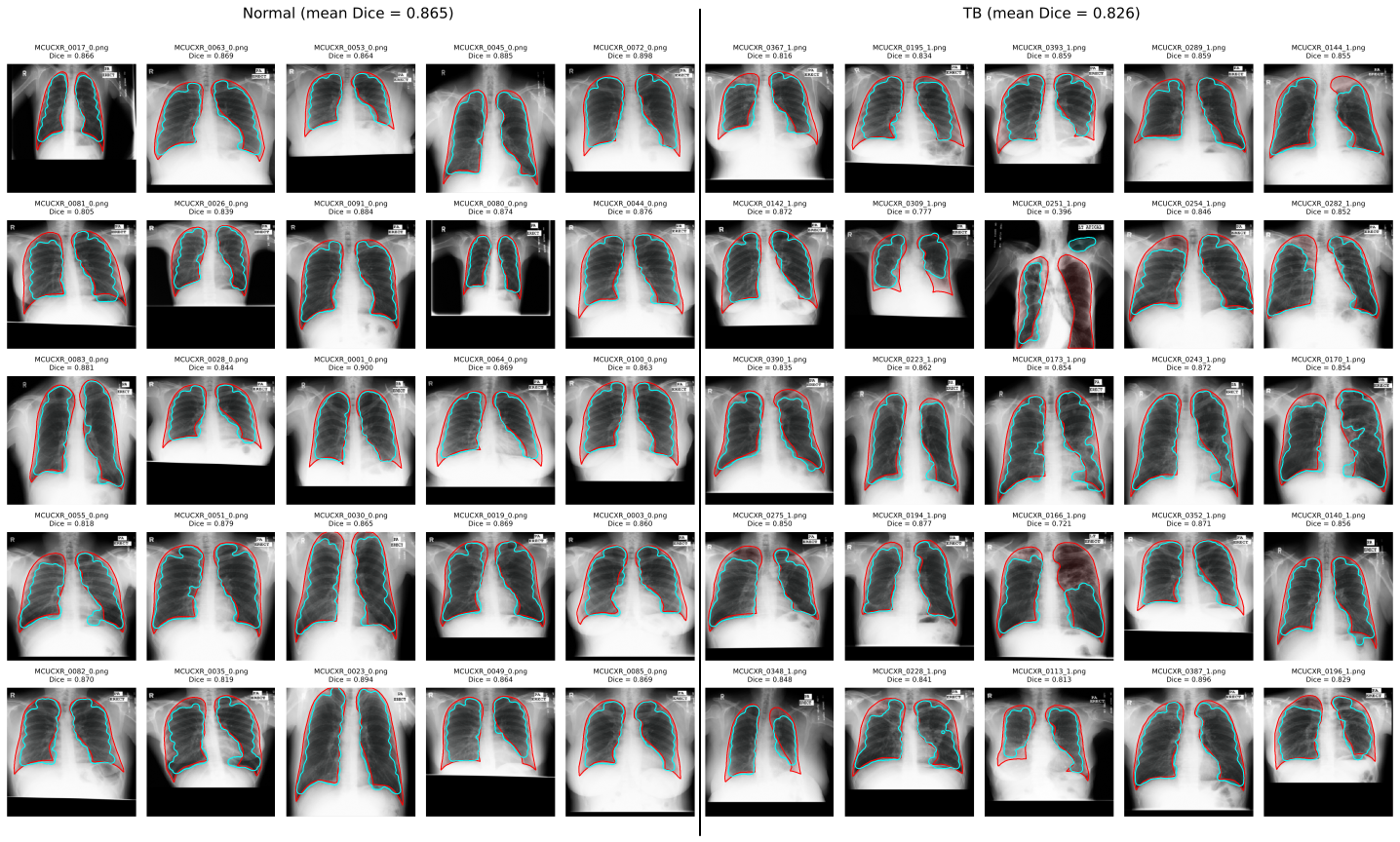
Normal vs TB
On the full dataset (80 normal / 57 TB), the segmentation achieved:
 | Mean Dice | Median Dice
Normal | 0.849 | 0.868
TB | 0.825 | 0.848
Classification was poor, as GLCM texture features were weak, with only the energy differing before correction. The upper minus lower brightness was the strongest feature, as TB raised the brightness of the upper lungs, and the final score was:
Classifier | TB found | ROC AUC
GLCM only | 5/17 | 0.666
Balanced weights and brightness | 10/17 | 0.788
Notes:
Trained by supervised gaussian denoising on LIDC
Take clean LIDC slices (3300)
Add synthetic gaussian noise at random sigma to each
Feed noisy image and noise level map to network
Train to regress clean image under MSE loss
Adam optimiser, cosine schedule, batch 8, 50 epochs
Training added noise at sigma/255 but the noise level map was sigma/50 causing the shift

Slide 4
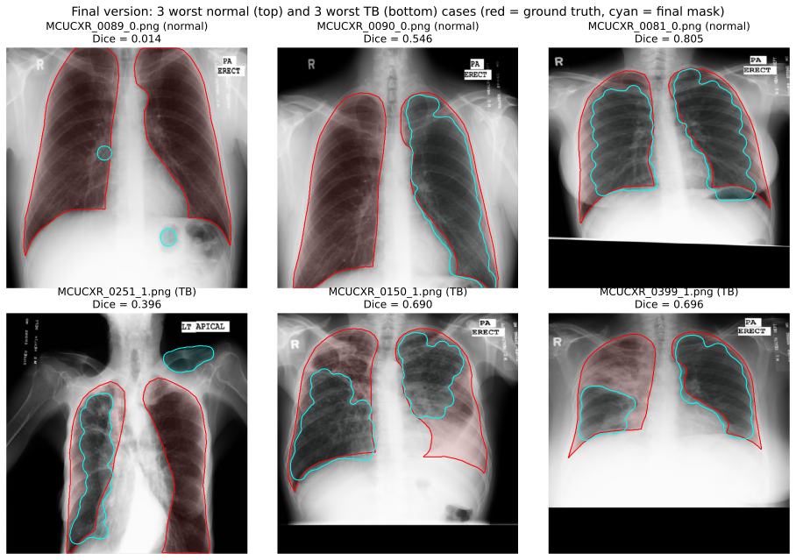
Failures
There were three main types of failures:
Framed black regions inside of a white frame were bigger than the lungs are were kept instead, but this was eliminated by ignoring pixels below 0.05.
Lungs touching the image edge were removed during border clearing.
TB making the lungs brighter meant the segmentation struggled to capture the entire area when compared to the ground truth.
Notes:
Trained by supervised gaussian denoising on LIDC
Take clean LIDC slices (3300)
Add synthetic gaussian noise at random sigma to each
Feed noisy image and noise level map to network
Train to regress clean image under MSE loss
Adam optimiser, cosine schedule, batch 8, 50 epochs
Training added noise at sigma/255 but the noise level map was sigma/50 causing the shift

