Slide 1

S&P 500
A SECTOR SUMMARY
Sectors
history
services
teams
timeline
about
Team: FINTECH WARRIORS

Slide 2

history
MESSAGE FROM
focus
team
about
report
timeline
FinTech Warriors:
Emiliano Amador, Kowsalya Jeyabalan, Nate Walker, Cody Sifford
This Project presents Exploratory Data Analysis (EDA) of the S&P 500 Stocks in Contrast to the COVID-19 Crisis

Slide 3
Project Description
Review the 11 Sectors of the S&P 500
Sector Performance
Correlation Matrix
Beta Comparison
Deep Dive into each Individual Sector:
Review the Stock Performance
5D
1M
1Yr
5Yr
focus
team
history
report
Plots
project

Slide 4



Sectors
Stocks
Report
1
2
3
focus
Performance
Analysis
Dashboard
Agenda
report
team
timeline
about
Charts
Charts
Interactive Charts

Slide 5











S&P 500 Sectors
focus
Energy
Consumer Staples
Health Care
Sectors
report
team
timeline
Industrials
Consumer Discretionary
about
IT
Materials
Financials
Communications
Utilities
Real Estate

Slide 6
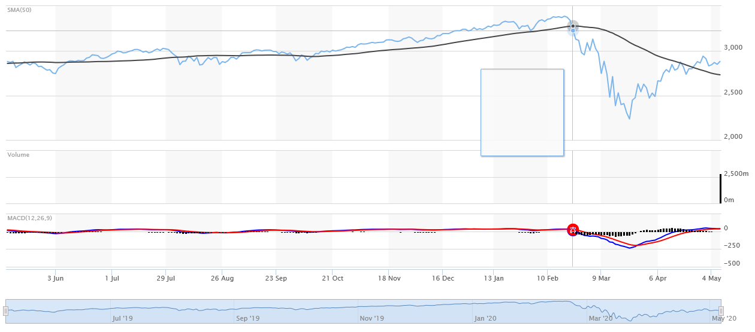
S&P 500 Index
Feb. 2,2020
COVID-19
focus
history
report
S&P 500
timeline
about
We want to know how the 11 Sectors are impacted by the Global Pandemic?

Slide 7
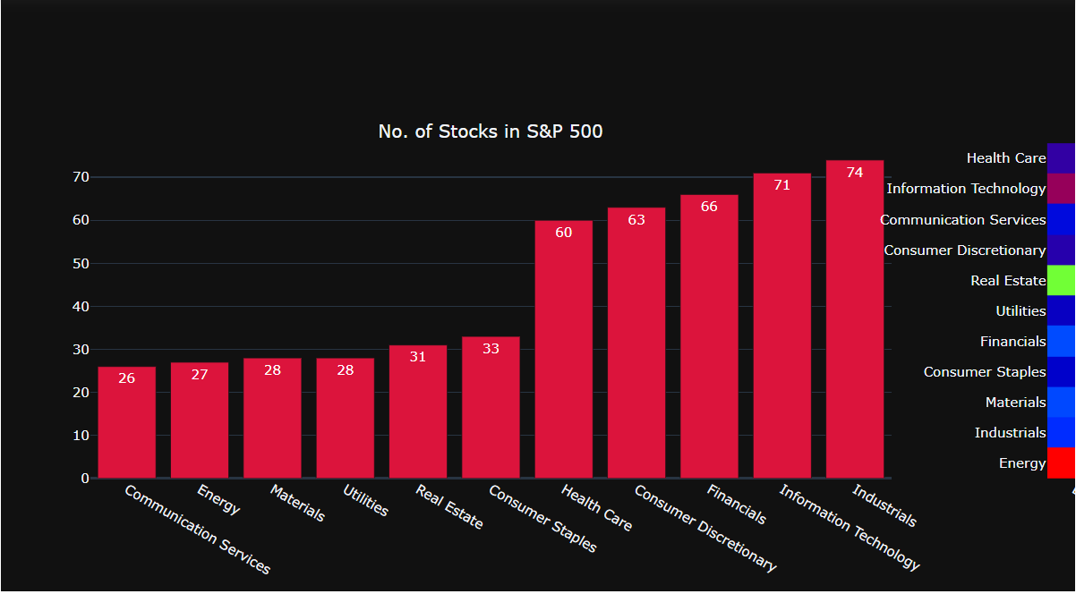
S&P 500: Total Stocks by Sector
report
history
focus
timeline
about
S&P 500
EDA Insight: Sectors w/Least and Most Stocks

Slide 8
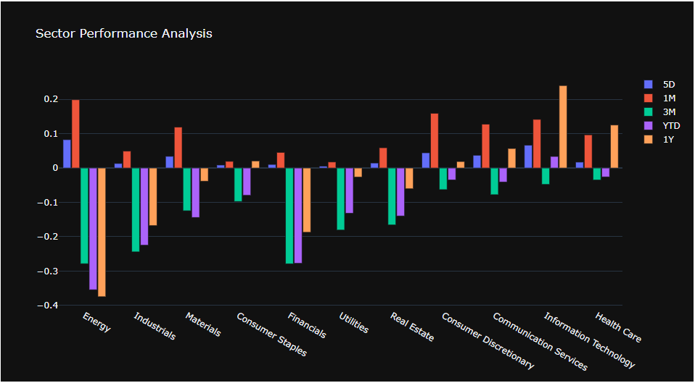
S&P 500: Sector Performance
report
history
focus
timeline
about
S&P 500
EDA Insight: Sectors are Down Overall; 5D & 1M

Slide 9
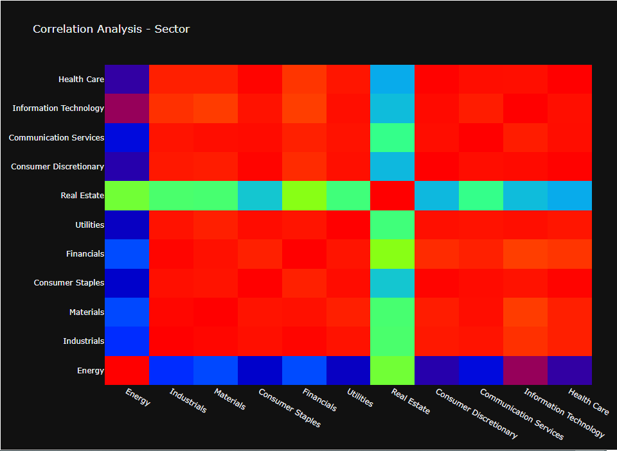
S&P 500: Sector Correlation Heat Map
report
history
focus
timeline
about
S&P 500
EDA Insight: Sectors are Highly Correlated

Slide 10






Bar Plots
Stocks
focus
Correlation
Beta
team
sectors
report
timeline
about
Performance
Dashboard

Slide 11
Dashboard Demo
d
S
p
focus
sectors
report
team
timeline
about
11
500
$
S&P 500 Sectors
Individual Stocks
Portfolio

