Slide 1

Computer Vision project
Pedestrian Intention Estimation on JAAD Dataset
Paradiso Emiliano, 1940454
10 September 2024

Slide 2
Outline
Introduction
Related work
Proposed method
Dataset and metrics
Implementation details
Experimental results
Conclusion and future works

Slide 3
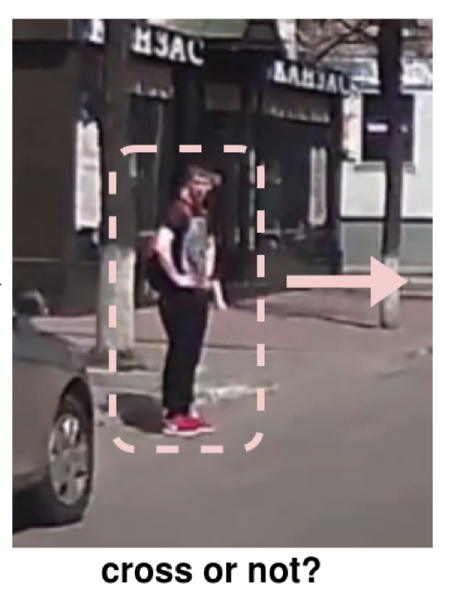
Introduction
Why? ->Safe autonomous driving system (ADS)
How?-> Vision-based pedestrian crossing intention prediction algorithm
So?-> ADS can generate more safe and effcient manouver

Slide 4
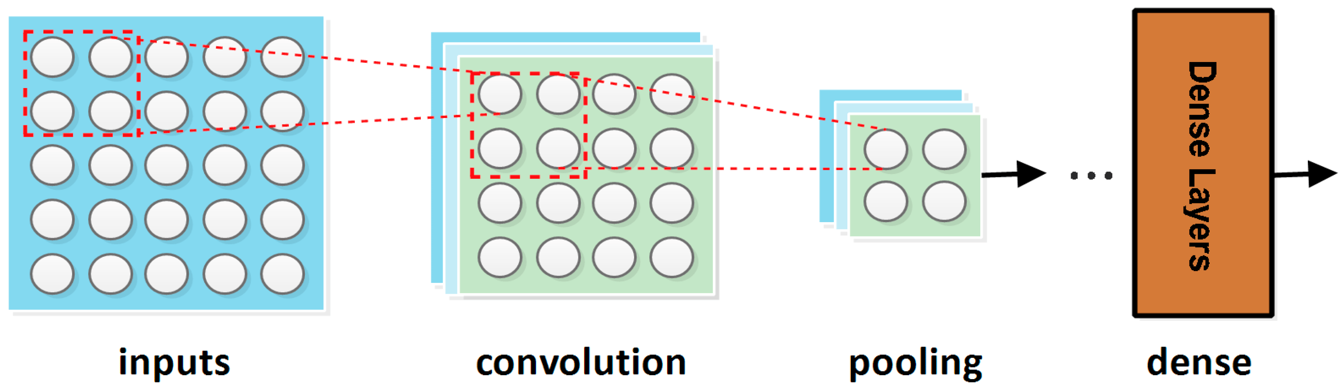
Related works
Feature extraction from one frame using 2D CNN

Slide 5
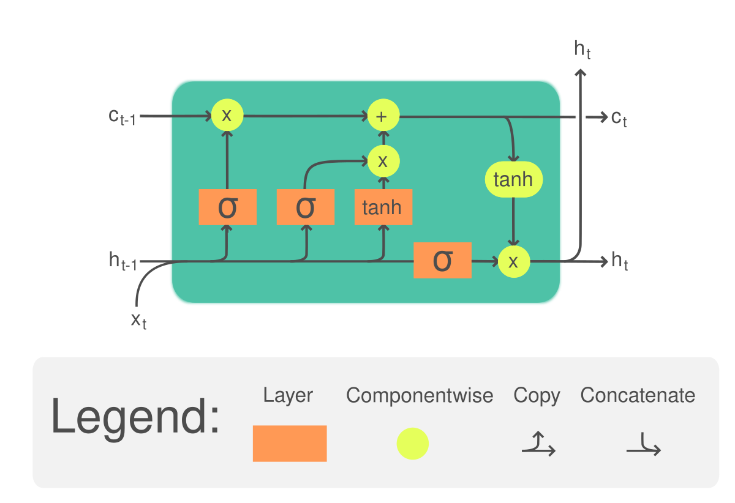
Related works
+
Spatio temporal modeling using image sequences 2D CNN+ RNN

Slide 6
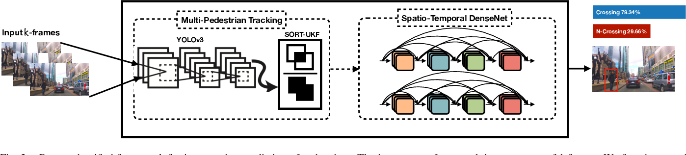
Related works
3D CNN

Slide 7
Previous works limitations
But…
Pedestrian’s bounding box, body- pose keypoints, vehicle motion, and the ocal context can be modeled as separate channels as inputs to the prediction model.
This requires a proper way of fusing the above information.

Slide 8
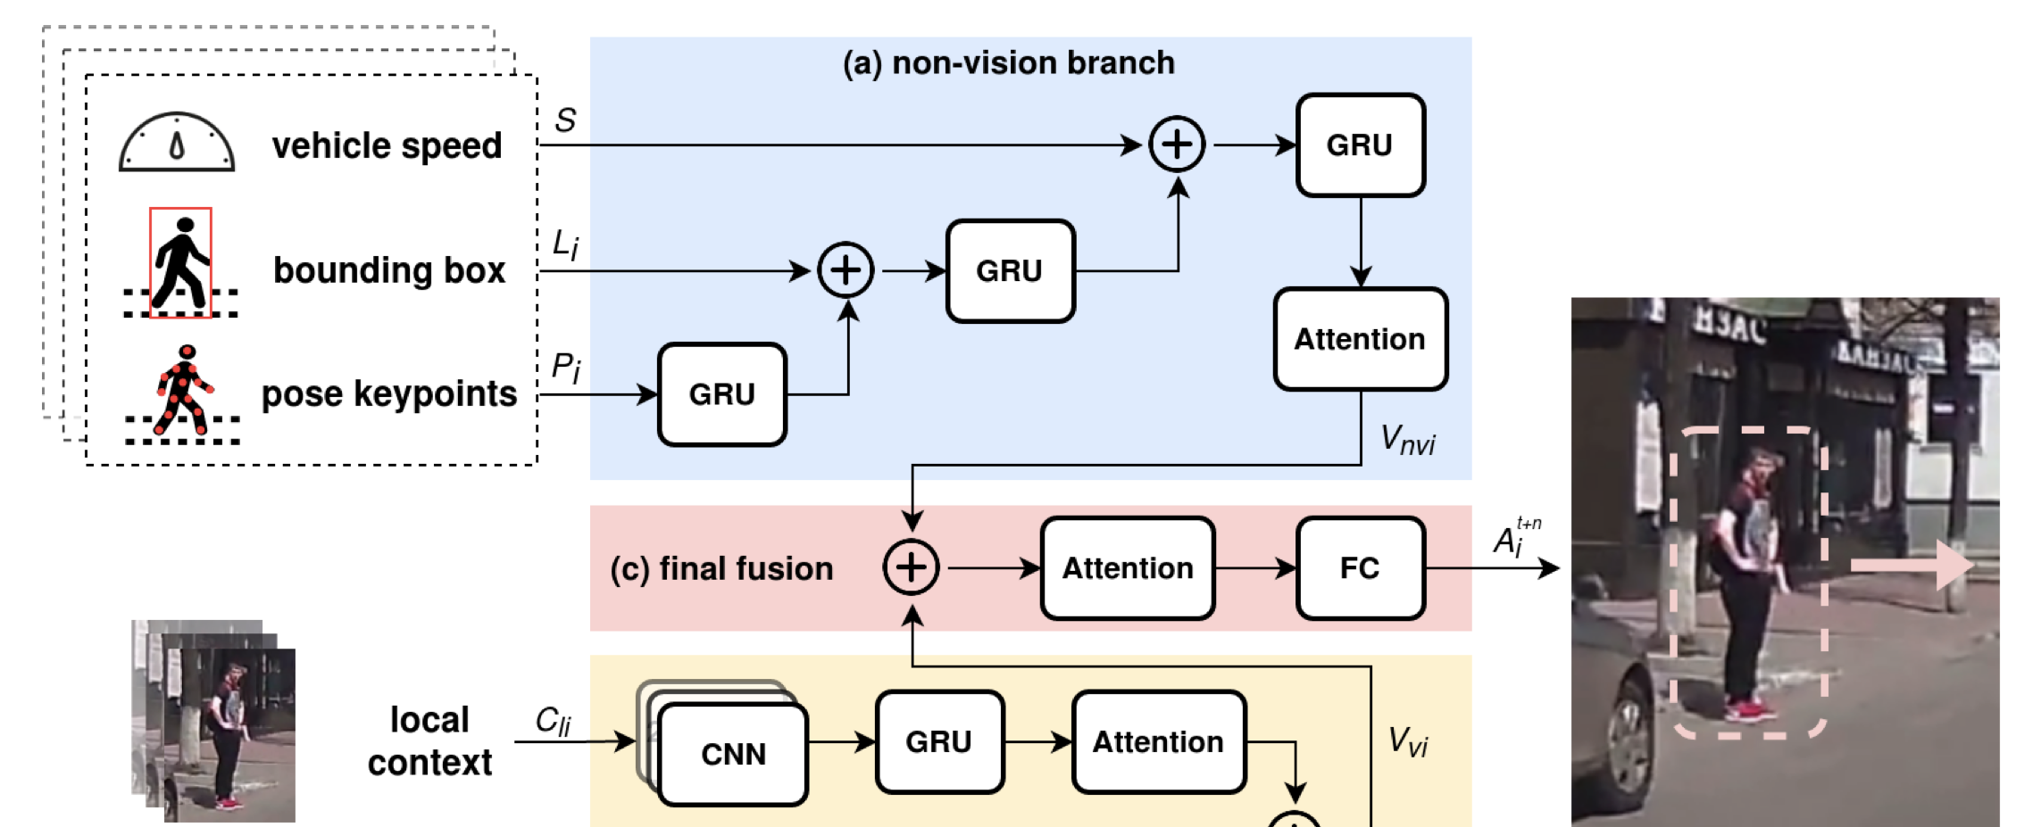

Proposed method
$$\frac{8}{30}$$
This represent a lighter version of the inspiring work:
[1]”Predicting Pedestrian Crossing Intention with Feature Fusion and Spatio-Temporal Attention” ,Dongfang Yang1,2,*, Haolin Zhang1,*, Ekim Yurtsever1, Keith Redmill1, Senior Member, IEEE, and U ̈mit O ̈zgu ̈ner1, Life Fellow, IEEE

Slide 9
Lighter version motivations
I proposed a more lightweight architecture compared to the cited work, designed to efficiently adapt to the available resources.
This approach addresses challenges in managing large datasets, but requires making certain restrictive assumptions regarding inputs, model architecture, and test reliability.
Specifically, due to limited access to high-end resources, I opted for a simplified version as a trade-off.

Slide 10
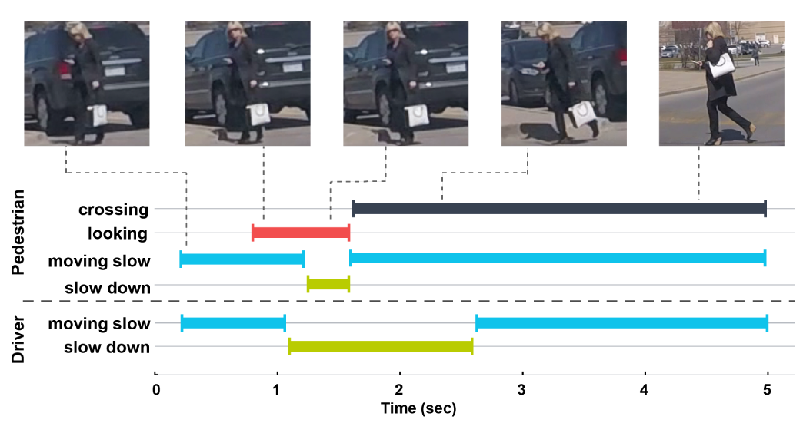
JAAD Dataset
346 short video clips (5-10 sec long) extracted from over 240 hours
Annotations including: bounding boxes, vehicle speed, pedestrian id, occlusion, intent for behavioral data.

Slide 11
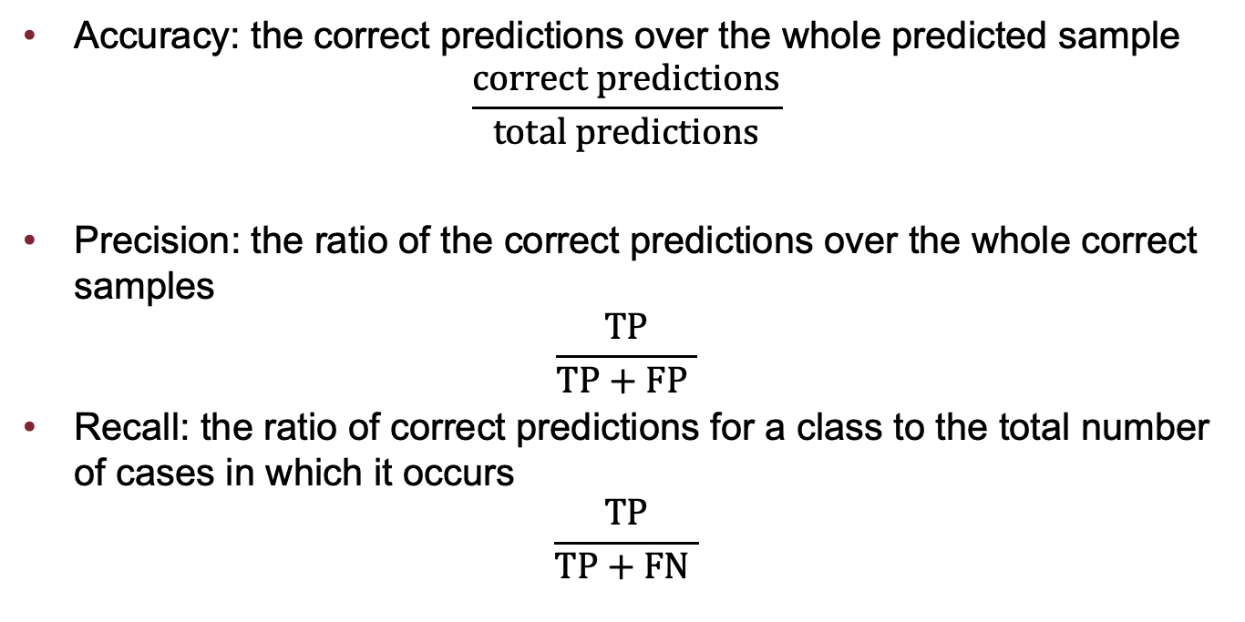
Evaluation metrics
Accuracy: the correct predictions over the whole predicted sample
$$\frac{correct predictions}{total predictions}$$
Precision: the ratio of the correct predictions over the whole correct samples
$$\frac{TP}{TP+FP }$$
Recall: the ratio of correct predictions for a class to the total number of cases in which it occurs
$$\frac{TP}{TP+FN }$$

Slide 12
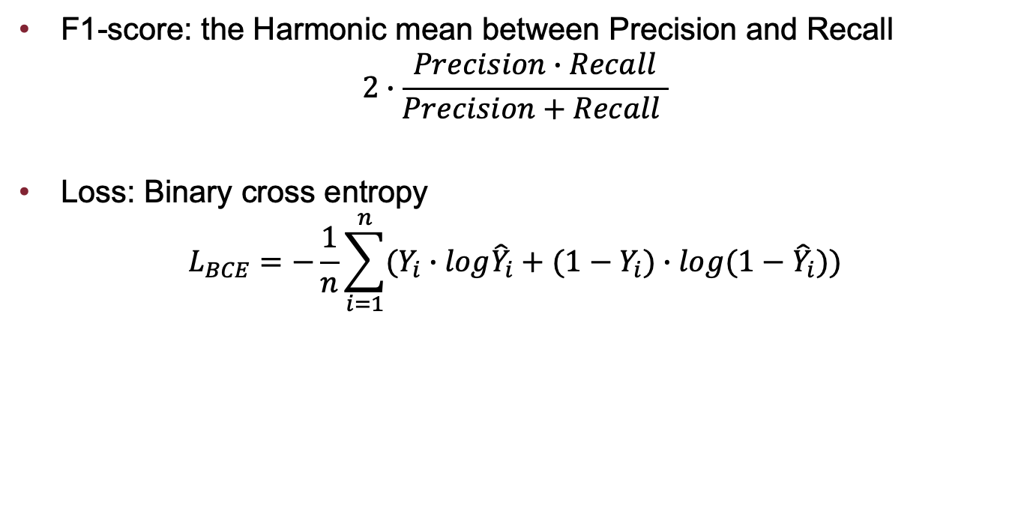
Evaluation metrics
F1-score: the Harmonic mean between Precision and Recall
$$2∙\frac{Precision∙Recall}{Precision+Recall }$$
Loss: Binary cross entropy
$$L_{BCE}=−\frac{1}{n}\sum_{i=1}^{n}{(Y_{i}∙log{\hat{Y}}_{i}+(1−Y_{i})∙log{(1−\hat{Y}}_{i}))}$$

Slide 13
Implementation details
Pre-trained VGG-19 is used in the Visual branch to extract local context features
Attention mechanisms are used for better memorizing sequential sources
Hierarchical fusion
Regularization techniques: Dropout, L2 penalization,Data augmentation
Prediction step fixed to n=8 frame, corresponding to 0,2666 s

Slide 14
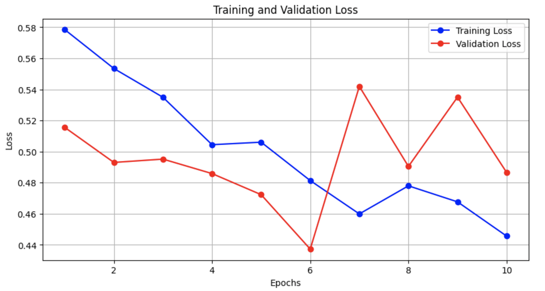
Results

Slide 15
Results
Label | Precision | Recall | F1-score | Test Samples
Not-crossing | 0.81 | 0.94 | 0.87 | 54
Crossing | 0.62 | 0.29 | 0.40 | 17
 | Predicted NC | Predicted C
Actual NC | 51 | 3
Actual C | 12 | 5

Slide 16
Results
Model | Global context | Precision | Recall | F1-score | Dataset
Ours | ⛌ | 0.62 | 0.29 | 0.40 | Reduced
Baseline | ✓ | 0.51 | 0.81 | 0.63 | All

Slide 17
Conclusion
Based on the results, we can conclude that the model performs poorly on positive labels due to significant overfitting, as demonstrated by the Losses. Despite applying regularization techniques such as L2 norm penalization, Dropout, and Data Augmentation, the issue persists, likely due to the limited number of samples extracted in my work, which is insufficient given the large request of data by the implemented model.
Overfitting appears to be the primary reason for the poor performance.
Although i wanted to use cross-validation to perform a more reliable evaluation, it is impractical to apply it to this dataset given my available resources.

Slide 18
Future works
Lighten the model in order to make it able to produce acceptable performance despite of data paucity
Explore the effect of different kind of fusion strategies

