Slide 1

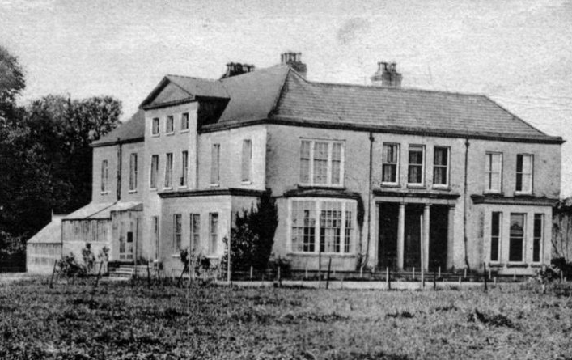
ILLUSTRATED WEEKLY NEWSPAPER
Est. 1869
Wednesday, November 24, 1872
TWELVE MEN FOUND DEAD
Police stumbled upon a mansion in the outskirts of West Scotland and found twelve rotting corpses, but the currently missing Lorraine was not found. Lewis Reid and his squad of five received a tip-off
from a local in Glasgow. They claimed to have seen Lorraine, alone, in the periphery of the city. Reid’s squad searched the area, uncovering a deserted manor off-road. The reports show that torches were still lit, but no trace
of habitation. After further investigation, Reid’s men found twelve bodies wearing black robes indicating an affiliation to an ancient Celtic cult. Candles, occult books, and a large summoning circle were found with the decaying corpses suggesting a
failed ritual or a mass suicide.

