Slide 1
Current State (Week 2)
Group: Emilie Terhaar, Sara Rolfs, Tyra Kausch

Slide 2
Darts
Data and RQ‘s on subtopics:
Development of tournaments
Strategies and tactics
Players
Notes:
Development of tournaments:
How do the (average) winning scorings of tournaments/matches vary over the years?
Strategies and tactics:
In which countries are tournaments held and how does it influence singular participants if at all?
Players:
How do the rankings vary over age, nationality and left/right-handed people of participants?

Slide 3
Data Extraction
no (good) APIs, no datasets to download
web scraping
HTML of websites not well structured
catching a lot of exceptions
Data Extraction was time consuming
executing through the night
new extraction process for all different websites

Slide 4
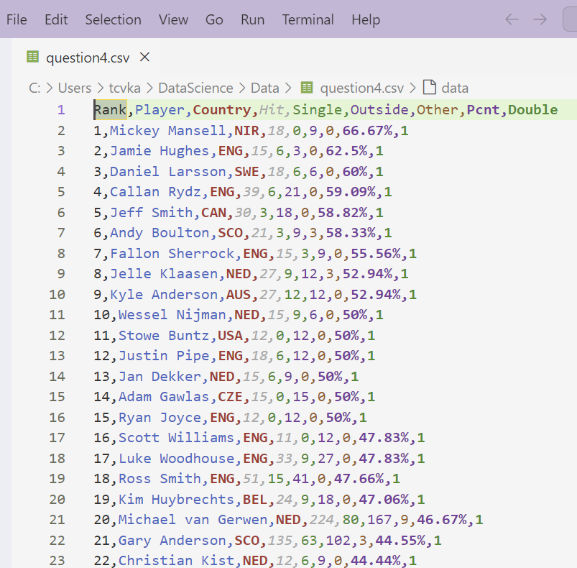
Data Extraction

Slide 5
Data Visualization
incomplete datasets
search for missing data
most RQs result in line charts
RQs that don‘t result in a chart
only check if two events are stochastically (in)dependent
overloaded visualizations
separate into different visualizations
only visualize the important categories
Jupyter Notebooks could not be executed (path not resolvable)
use .py files

Slide 6
Current Hurdles
README.md file documentation
deploy and build website
finish the visualizations

Slide 7
Upcoming Steps
visualization of results for each RQ
write explanatory texts for website
build repository for website

Slide 8
Have a nice weekend!

