Slide 1

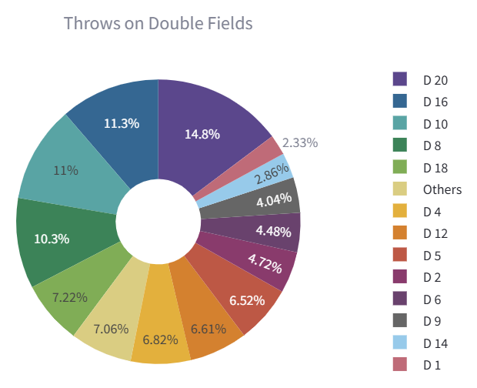
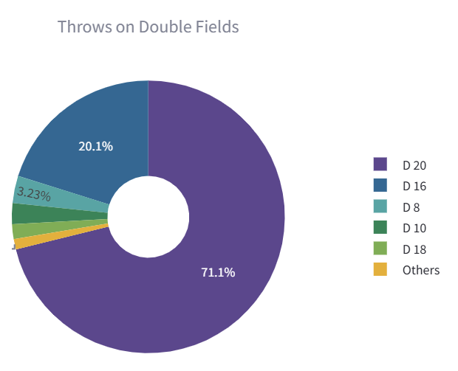
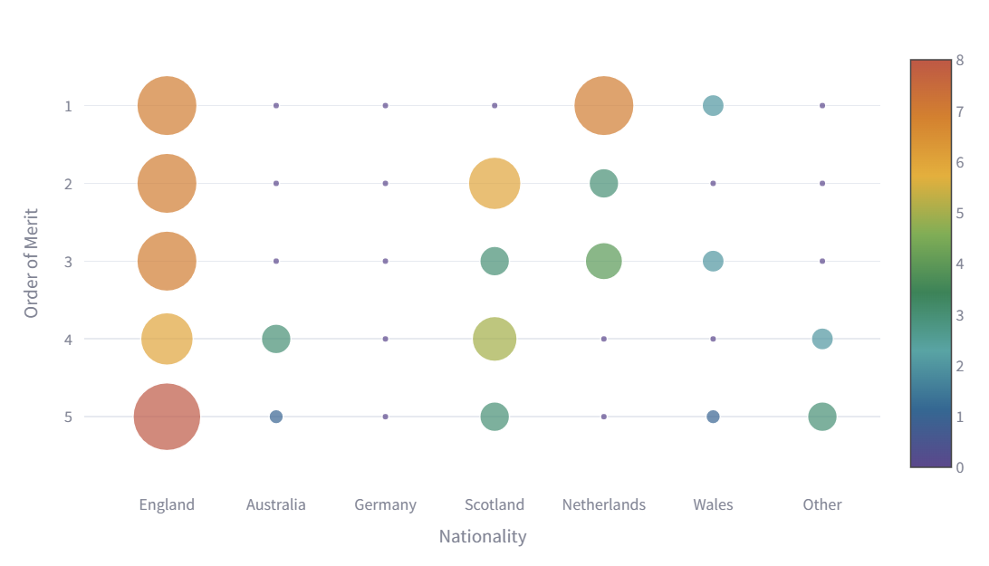
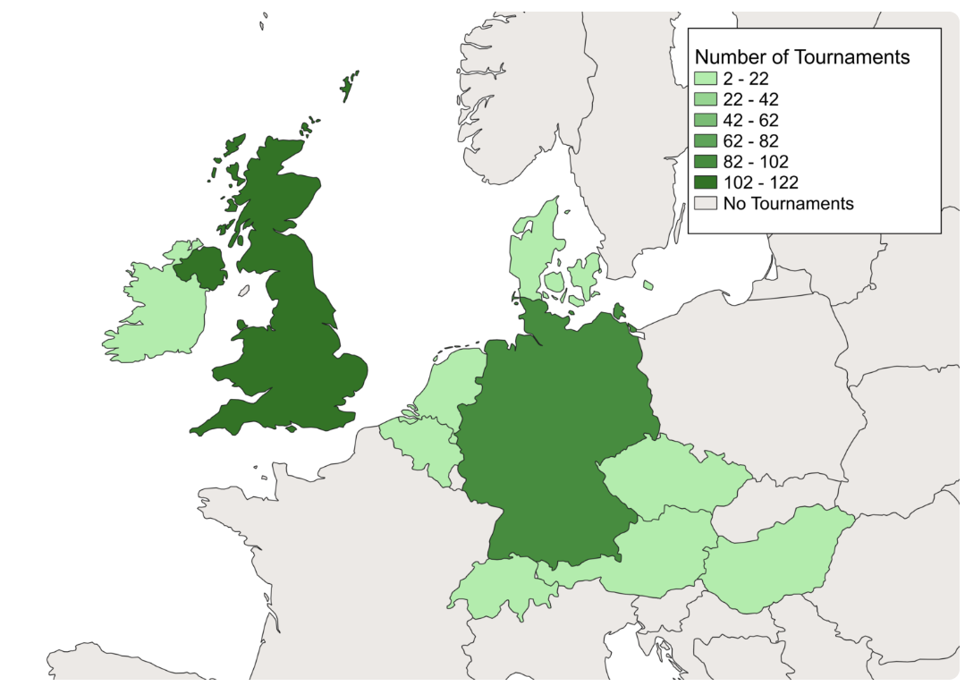
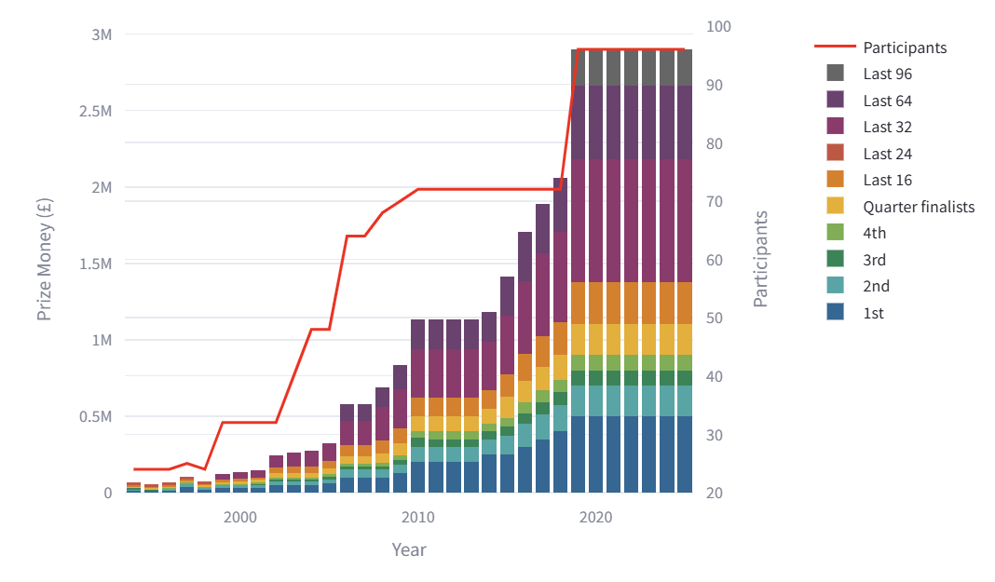
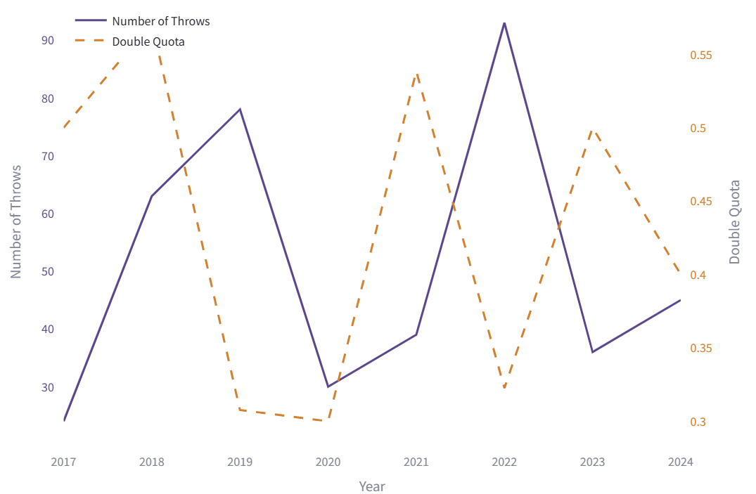
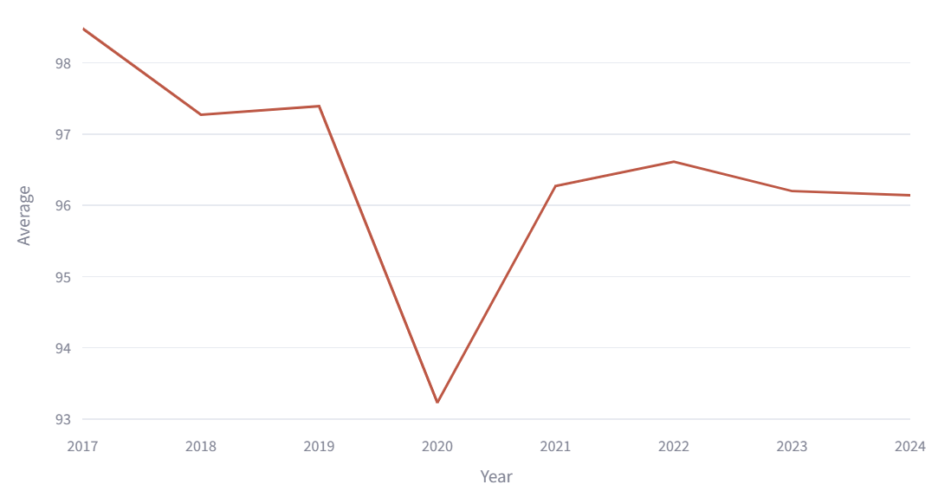

Data Science Project - Darts
Emilie Terhaar, Sara Rolfs, Tyra Kausch
Introduction
What are most popular double fields and their corresponding checkout quotes?
This project dives into the world of darts using data science techniques to uncover fascinating insights. It aims to transform raw data into structured datasets suitable for visualization and analysis. The goal is to answer predefined research questions by gathering data from multiple sources, processing it, and generating analytical datasets.
Method
The research questions – of which a few are represented on this poster – were formulated while looking ahead at available data sources. Web scraping scripts were then developed and executed to extract structured data. This data consisted of player statistics, match results, and other relevant information. The extracted data was validated, cleaned, and stored in organized CSV files. In the next step, datasets were transformed to ensure correctness and consistency, addressing any missing values or errors manually. The final datasets were then analysed and visualized using appropriate graphical representations, forming the basis for answering the research questions.
Results
How do the averages of tournaments vary over time?
2 first diagram: world championship, players championship, regression, avg.
How does nationality effect the rankings?
How does the price money and number of participants vary over time?
15 How does the performance of individual players change over time?
For this question, only the data for the PDC World Championship was analysed.
In this graph, the prize money and number of participants is rising. The coloured stacked bars indicate prize allocation by
tournament stage, while the red line shows the increasing participant numbers. There's a clear correlation between participant numbers and prize money: Major increases in participants typically coincided with significant prize money increases. The graphs show that while the total prize pool has increased, the distribution maintains a similar structure.
Bibliography
https://app.dartsorakel.com/
https://mastercaller.com/tournaments/pdc-world-championship/
https://www.dartn.de/Dart-Profis
https://de.wikipedia.org/wiki/Professional_Darts_Corporation
https://de.wikipedia.org/wiki/PDC_World_Darts_Championship
https://www.flashscore.de/

