Slide 1
ECG Heartbeat Categorization Dataset (From Kaggle) Casper Andersen – Emilie Trouillard

Slide 2
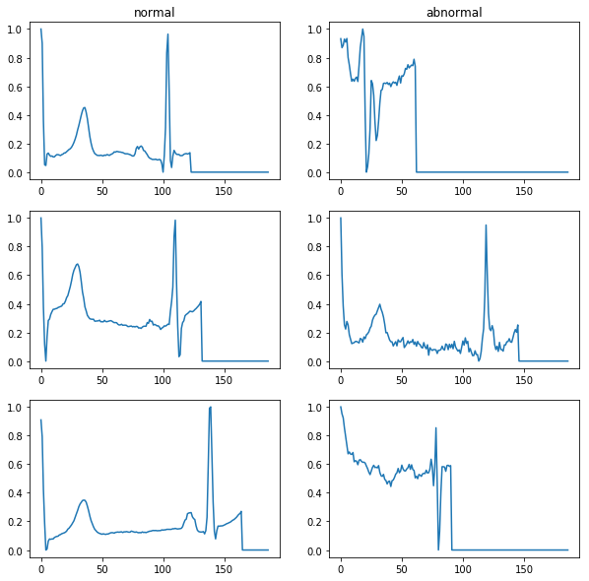
2 datasets
10 000
4 000

Slide 3
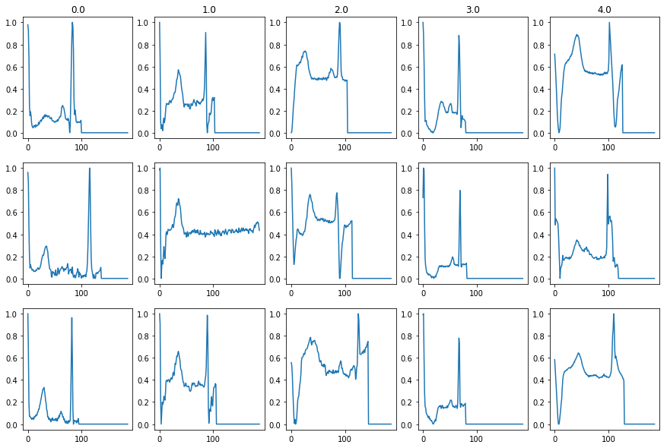
2 datasets
72 000
2 000
6 000
600
6 000

Slide 4
Baseline KNN model
95% global
accuracy
10 000
4 000
Recall:
94%
96%

Slide 5

Baseline KNN model
95% global
accuracy
10 000
4 000
Recall:
94%
96%

Slide 6
Baseline KNN model
97.8% global
accuracy
72 000
2 000
6 000
600
6 000
Recall:
99.4%
62.1%
89.6%
63.6%
94.4%

Slide 7

Baseline KNN model
97.8% global
accuracy
72 000
2 000
6 000
600
6 000
Recall:
99.4%
62.1%
89.6%
63.6%
94.4%

Slide 8
Baseline KNN model
Conclusions:
We might have issues due to imbalanced datasets

Slide 9
Baseline KNN model – New Features
New features
Mean
Median
Std
Length
Quantiles: 5%, 25%, 75%, 95%

Slide 10
Baseline KNN model – New Features
Results
Binary dataset:
82.5% accuracy
72.0% (normal) and 86.6% (abnormal) recall values
5-class:
90.4% accuracy
97.8% (normal), 42.2%, 48.5%, 25.9%, 67.8% (abnormal) recall values

Slide 11
Baseline KNN model
Conclusions:
We might have issues due to imbalanced datasets
The new features that have been tested don’t seem relevant

Slide 12
Baseline KNN model
Dealing with an unbalanced dataset…
Initial split: 72 471, 2 223, 5 788, 641, 6 431 Initial recalls: 99.4%, 62.1%, 89.6%, 63.6%, 94.4%
Undersample the majority class
Oversample the 2 smallest minority classes (duplicates)
New split: 50 000, 4 000, 5 788, 2 000, 6 431 New recalls: 98.8%, 70.3%, 89.4%, 79.6%, 94.7%

Slide 13
Baseline KNN model
Dealing with an unbalanced dataset…
Initial split: 72 471, 2 223, 5 788, 641, 6 431 Initial recalls: 99.4%, 62.1%, 89.6%, 63.6%, 94.4%
Undersample the majority class
Oversample the 2 smallest minority classes (duplicates)
New split: 50 000, 4 000, 5 788, 2 000, 6 431 New recalls: 98.8%, 70.3%, 89.4%, 79.6%, 94.7%

Slide 14
Balancing dataset attempts
Under sampling class0 | SMOTE | Duplicate |  | Class0 | Class1 | Class2 | Class3 | Class4
 |  |  |  | 99.4 | 62.1 | 86.6 | 63.6 | 94.4
 |  |  |  | 98.8 | 70.3 | 89.4 | 79.6

Slide 15
Dealing with minority classes
Already done:
Duplicate samples with replacement
Other leads:
Add small white noise
Add delay in the temporal signal
SMOTE (interpolating between neighbors)

Slide 16
Convolutional Neural network
Using convolutional network
Not doing so well 50ish %
Homemade architecture
Try a premade one
Using SGD, maybe stop doing that

Slide 17
Convolutional Neural network
Kernels
Feature Maps
6x1
4x2
2x4
Fully connected
2
4
Flat layer

Slide 18
Considerations
Add batch-norm to make training easier.
Change optimization procedure.
Batch size 20- too big?
Throw out garbage network
Use premade

