Slide 1
ECG Heartbeat Categorization Dataset (From Kaggle) Casper Andersen – Emilie Trouillard

Slide 2
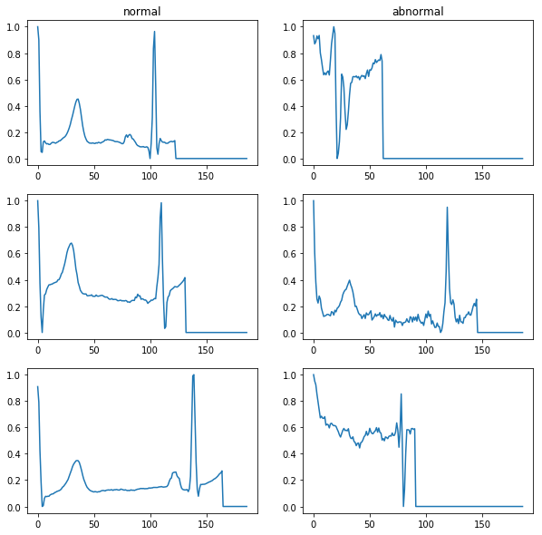
2 datasets
10 000
4 000

Slide 3
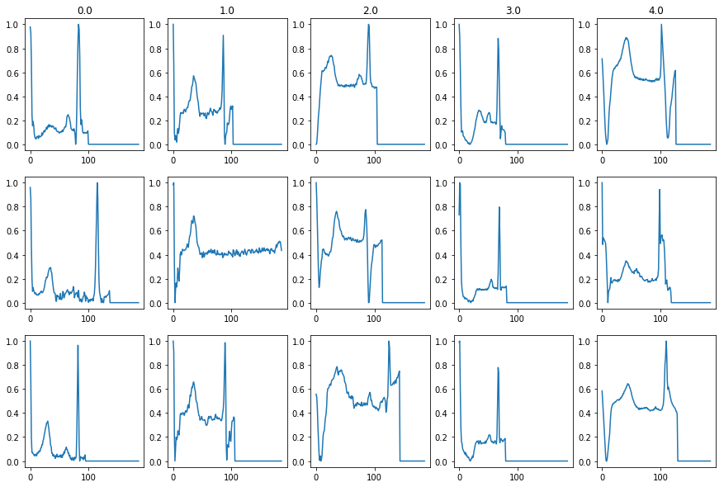
2 datasets
72 000
2 000
6 000
600
6 000

Slide 4
Baseline KNN model
95% accuracy
10 000
4 000
94% acc
96% acc

Slide 5

Baseline KNN model
95% global
accuracy
10 000
4 000
Recall:
94%
96%

Slide 6

Baseline KNN model
97.8% global
accuracy
72 000
2 000
6 000
600
6 000
Recall:
99.6%
69.1%
92.6%
70.2%
96.2%

Slide 7
Case progress #1
KNN:
Train, validation and test on the 2 class dataset: 94% accuracy
Train and validation on the 2 class dataset, and test on the 5 class: 39% accuracy…
Neural Networks:
Use recurrent NN
Actual structure from the litterature

