Slide 1

Annual Sales Performance & Strategic Recommendations
by Emilija Čėplė
January 2025

Slide 2
Agenda
Introduction
Executive Summary
Customer Retention & Strategic Recommendations
Revenue Analysis & Strategic Recommendations
Customer Segmentation & Strategic Recommendations
Conclusion
Q&A

Slide 3

Introduction
Goal: understand customer behaviors, improve engagement, and create growth strategies
Dataset: uk-based Online retail all-occasion gift-ware
Period: December 2010-2011

Slide 4
Executive Summary
Total sales: £9M from 4,372 unique customers.
Customer Retention: Average retention rate is 26%.
Revenue: Average revenue is £ 55,30 per customer. Average cumulative growth is 16%.
Key Customer Segments: 14% Champions (with highest RFM scores), 14% Loyal Customers (with high RFM scores), 16% Lost Customers.

Slide 5
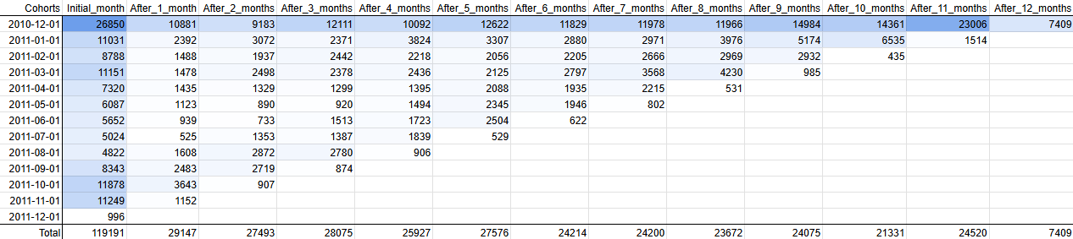
Customer Retention
1. First cohort have around 12% higher retention rate over the year than other cohorts
2. Initial month have the highest number of customers over the year (29% of all)
3. Significant 80% drop of customer retention rate after the initial month

Slide 6
Strategic Recommendations Retention
Engage
Stay loyal
Return
Unique & Personalized Products
Consistently High Product Quality
Occasion-Based Shopping
Attractive Promotions & Discounts
Excellent Customer Service
Email Reminders & Discounts
Strong Social Media & Advertising
Loyalty Programs & Exclusive Offers
New Product Collections
Easy & Intuitive Shopping Experience
Memorable Unboxing Experience
Improved Experience
Positive Reviews & Word-of-Mouth
Emotional Connection to the Brand
Positive Past Experience

Slide 7
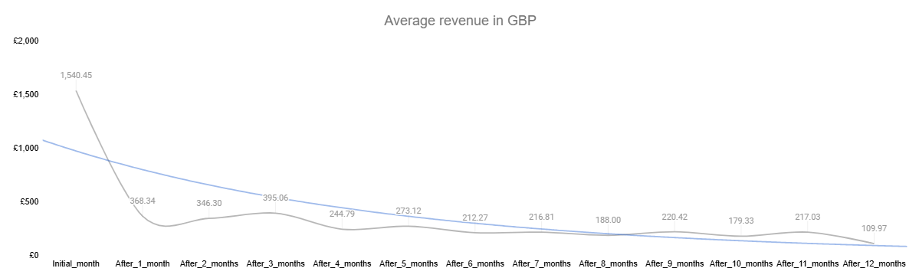
Revenue Analysis
Trendline
76% drop of avg revenue after the initial month
Overall revenue decreasing over the year

Slide 8
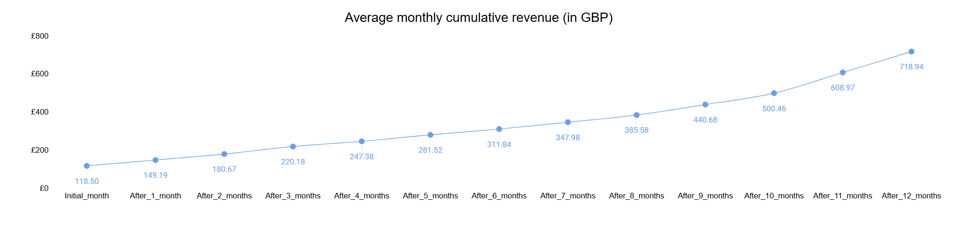
Revenue Analysis
Performance and effective marketing strategies
Efficient operational scaling
Predictable financial performance

Slide 9
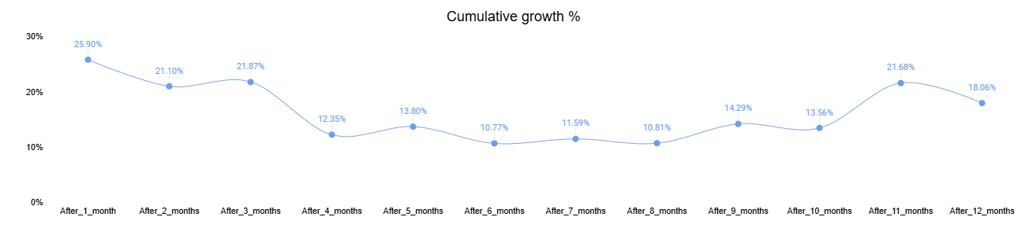
Revenue Analysis
Early slowdown during initial and 4th month
Stable fluctuations with no heavy spikes in mid-period (4th-10th months)
Decline after peak in the end of the year (11th-12th months)

Slide 10
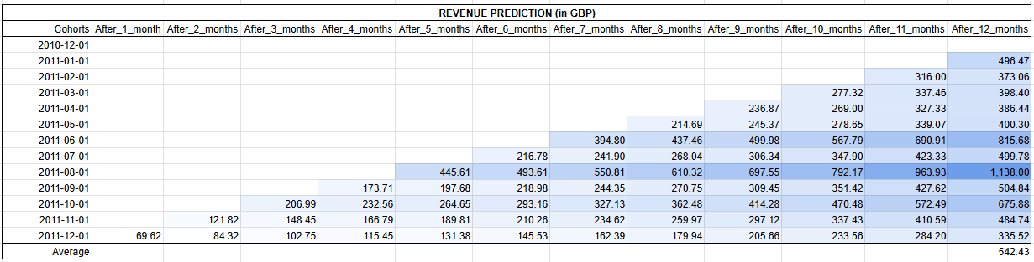
Revenue Analysis
Strong performance from June and August cohorts
Slightly higher revenue for October cohorts
Average revenue across cohorts - £542.43

Slide 11
Strategic Recommendations Revenue
Strategy
Why it works
How to implement
Offer personalized products
Enhances emotional value
Create AI-powered customization features, personalized recommendations, and ‘build-your-own’ gift bundles
Leverage seasonal campaigns and promotions
Giftware demand spikes during holidays and special occasions
Launch holiday-focused marketing campaigns with themed bundles, limited-time offers, and urgency-driving countdown timers
Upselling and cross-selling
Increase in the average order value (AOV)
Display related products at checkout, offer bundle discounts, and use tiered pricing incentives
Focus on subscription and loyalty programs
Builds long-term relationships
Introduce a subscription service, a rewards program, and VIP perks
Enhance customer experience and website usability
Reduce in cart abandonment and builds trust
Optimize website speed, add gift-finding tools, improve product presentation, and offer reliable shipping options

Slide 12
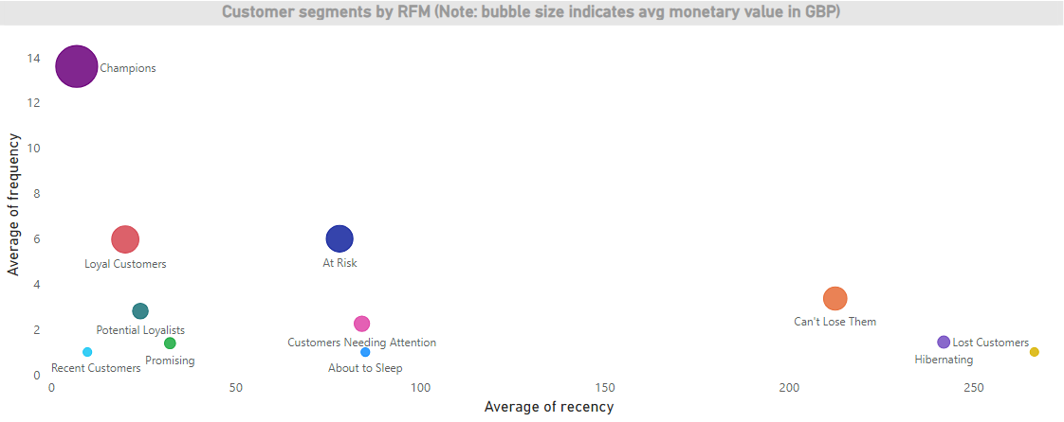
RFM & Customer Segmentation

Slide 13
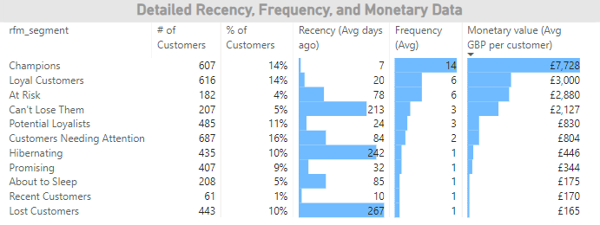
RFM & Customer Segmentation

Slide 14
Strategic Recommendations Revenue
High-Value Customers (Champions & Loyal Customers)
Growing Loyalty (Potential Loyalists & Recent Customers)
Early-Stage & Passive Customers (Promising & Customers Needing Attention)
At-Risk & Lapsing Customers (About to Sleep, At Risk, Can’t Lose Them, & Hibernating)
Lost Customers
Reward loyalty with exclusive perks, VIP experiences, and early access to new products
Strengthen their connection with loyalty programs, personalized recommendations, and onboarding support
Increase awareness through welcome campaigns, free trials, and first-time purchase discounts
Reignite interest with exclusive offers, personalized outreach, and re-engagement campaigns
Attempt reactivation through significant discounts and understanding their disengagement reasons
Upsell premium products and encourage them to refer friends or leave reviews
Offer discounts on their next purchase and educate them about the brand’s offerings
Use seasonal promotions, reminders, and faster delivery options to keep them engaged
Offer limited-time discounts, highlight brand value, and reduce friction in the buying process
If unresponsive, redirect resources to more promising segments
Keep them engaged with personalized offers, loyalty programs, and seamless service
Maintain engagement through thank-you messages and product highlights
Gather feedback to address concerns and encourage renewal through priority retention efforts

Slide 15
Conclusion
The business should focus on:
Customer Loyalty: Focus on building and maintaining strong, long-term relationships with customers.
Revenue Optimization: Maximize sales through personalized offers, targeted strategies, and value-driven incentives.
Data-Driven Segmentation: Tailor marketing efforts based on customer behavior and preferences for better engagement.
Sustainable Growth: Foster a cycle of satisfaction and loyalty that drives consistent and scalable growth.

Slide 16
Thank you
Questions?

