Slide 1


IoT Intrusion Detection
Presented by:
Serena SABA 233663
Rodolph NEAIMEH 231686
Ibrahim IBRAHIM 231724
Emilio SAKR 231596

Slide 2
Dataset — CIC-IoT-2023
5.8 M-row prepared sample of CIC-IoT-2023 (Canadian Institute for Cybersecurity, UNB).
47 numeric features per flow — flow timing, packet rates, TCP-flag counters, protocol indicators, packet-size statistics.
34 classes: 1 benign + 33 attacks (DDoS, DoS, Mirai, Recon, MITM/Spoofing, brute/scan, web/application-layer).
Severe class imbalance: ~230 : 1 between the largest class (~286 K rows) and the smallest (Uploading_Attack, 1 252 rows).
Why macro-F1, not accuracy?
Accuracy is dominated by majority DDoS / Mirai classes — a model that ignores rare attacks can still look strong.
A model that misses every web/application-layer attack would still report > 95 % accuracy.
Macro-F1 weights every class equally, so it actually penalises models that fail on the rare attacks we most care about.

Slide 3
End-to-end pipeline
STEP 1
STEP 2
STEP 3
STEP 4
STEP 5
Ingest
Clean & split
Preprocess
Train
Serve
169 raw CSVs → Parquet.
Schema validation.
Two-pass median downsampler.
Drop duplicates.
Validate labels.
Stratified 70 / 15 / 15.
Median impute.
Yeo-Johnson on 19 skewed features.
Standard scale all features.
Logistic Regression.
Random Forest.
Three-stage hierarchical RF.
FastAPI + Docker.
/predict, /predict/batch.
Sub-50 ms latency.

Slide 4
Models compared
Logistic Regression: multinomial softmax, L-BFGS, C = 2.0, class-weighted cross-entropy. Linear baseline.
Random Forest: 200 trees, max_features = sqrt, min_samples_leaf = 5, balanced_subsample. Trained on the full 4 086 646-row split.
Three-stage Random Forest: hierarchical decomposition (Benign/Attack → Family → Specific class). Same data budget.
Every model trained on identical preprocessed splits, so any lift reflects model capacity alone; not data leakage or split mismatch.
Class-weighted loss everywhere; no synthetic oversampling: SMOTE-style interpolation rejected as physically implausible on flow features.

Slide 5
Three-stage architecture
Stage 1
Stage 2
Stage 3
Binary RF
Family RF
Per-family specialists
BenignTraffic vs Attack.
Threshold 0.30.
Trained on all 4 M rows.
7 families:
DDoS · DoS · Mirai · Recon
Spoofing · BruteScan · Web.
One RF per family,
classifying the specific
attack within that family.
Why the hierarchy helps
Each sub-model solves a smaller problem; the Web RF spends all 200 trees on 6 rare attacks instead of 32 unrelated classes.
Imbalance inside each family is much milder, so class weights actually help (e.g. XSS vs. CommandInjection ≈ 1.4 : 1).
Tradeoff: errors compound across stages; a misrouted Web flow at Stage 2 cannot be recovered downstream.

Slide 6
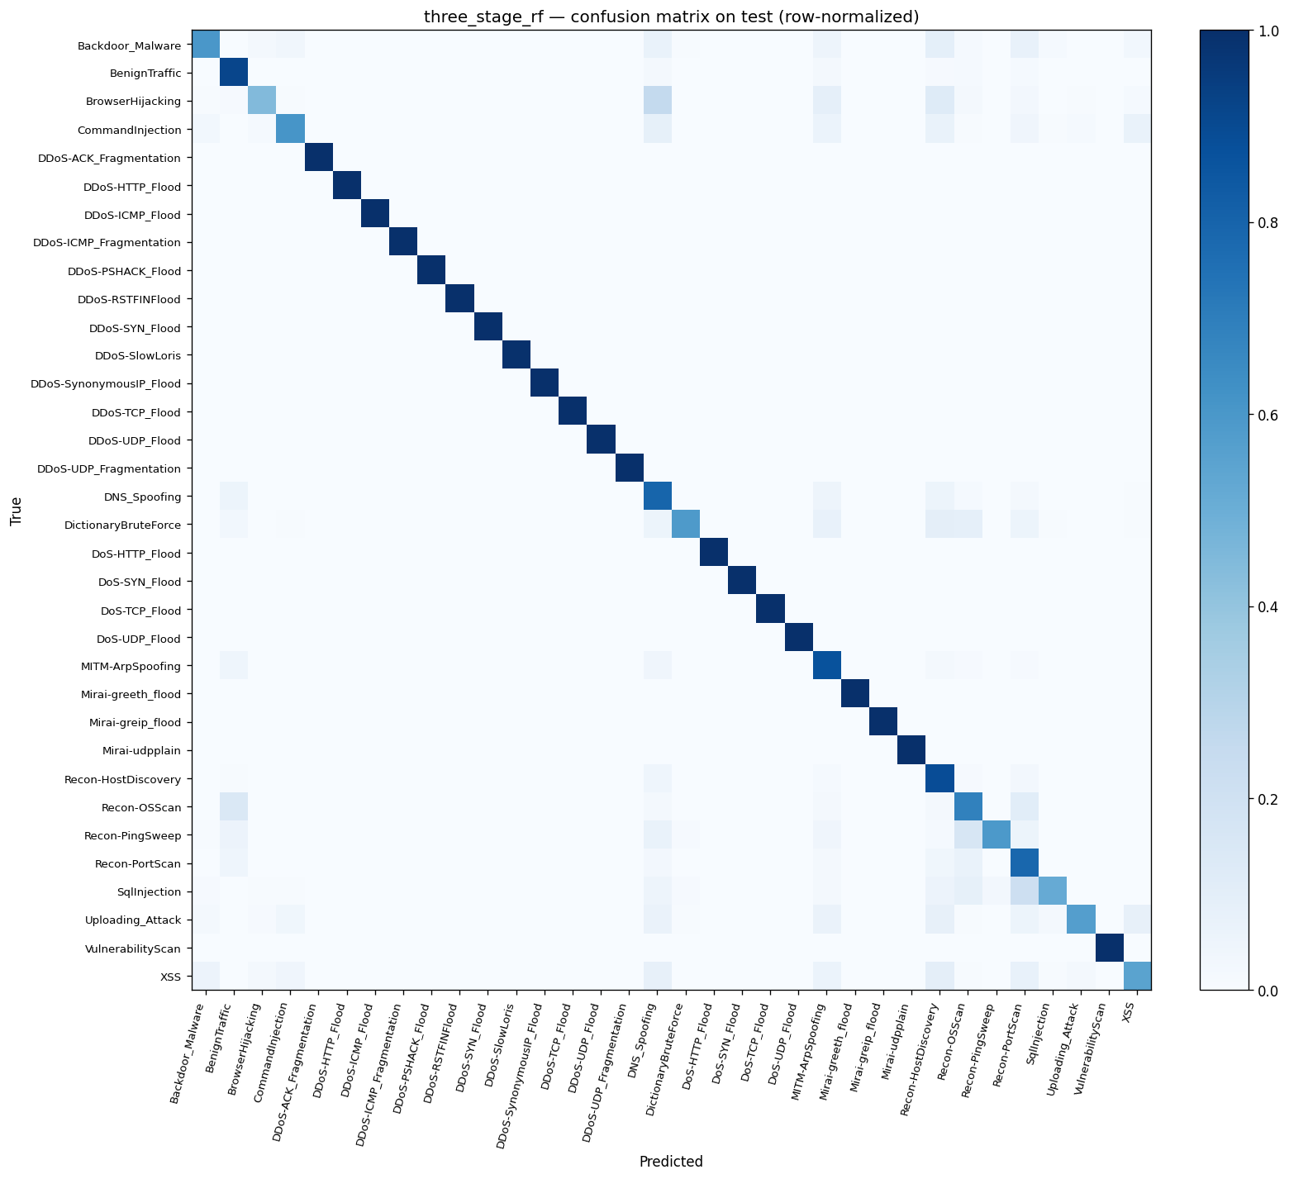
Results
Model | Training rows | Test accuracy | Test macro-F1
Logistic Regression | 4 086 646 | 0.7800 | 0.5727
Random Forest | 4 086 646 | 0.9670 | 0.8635
Three-stage RF (final) | 4 086 646 | 0.9687 | 0.8644
Key findings
Three-stage RF matches the flat RF on aggregate macro-F1 (0.8644 vs 0.8635) in a model 60 % smaller (3.2 GB vs 8.0 GB).
Validation-to-test macro-F1 is within ±0.002 on every model; the splits generalise, no overfit to validation.

Slide 7
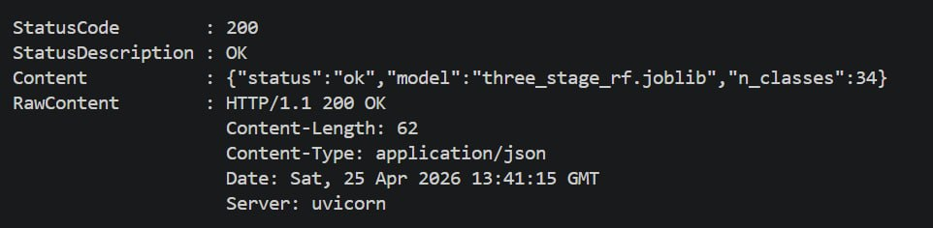
Serving FastAPI + Docker
FastAPI service in src/api.py exposes three HTTP endpoints.
GET /health; liveness probe plus the currently loaded model name.
POST /predict; single TrafficRecord → predicted class plus per-class probabilities.
POST /predict/batch; list of records → list of predictions, for high-throughput callers.
Preprocessor applied server-side; clients send raw flow features, no client-side prep.
Dockerfile bakes the trained joblib into the image, so the served model version is reproducible.
Public image: emiliosakr/iot-intrusion-detection:latest.

Slide 8
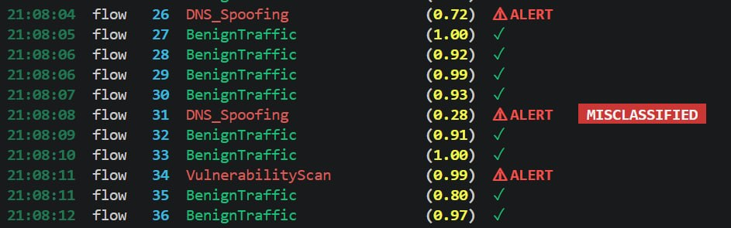
Streaming demo
demo_stream.py samples records from the held-out test set (with their ground-truth labels).
Each record is POSTed to the running API at a configurable rate, one at a time.
Output is a colour-coded SOC-style live feed: green tick on benign flows, red ALERT on attacks, MISCLASSIFIED badge when the prediction disagrees with ground truth.
python demo_stream.py --n 60 --rate 4 --attack-ratio 0.35

Slide 9
Conclusion & future work
Delivered
End-to-end training pipeline as four self-contained notebooks (preprocessing, LR, RF, three-stage RF).
Three-stage hierarchical Random Forest at 96.87 % accuracy and 0.8644 macro-F1 on the held-out test set.
Dockerised FastAPI inference service plus a live streaming demo for SOC-style visualisation.
Future work
Drift monitoring at the serving layer — feature-distribution drift and alert-rate spikes.
Replace the Stage-3 Web-family specialist with a gradient-boosted-tree model (LightGBM / XGBoost).
Payload-level features to break the ~0.86 macro-F1 dataset ceiling.

