Slide 1
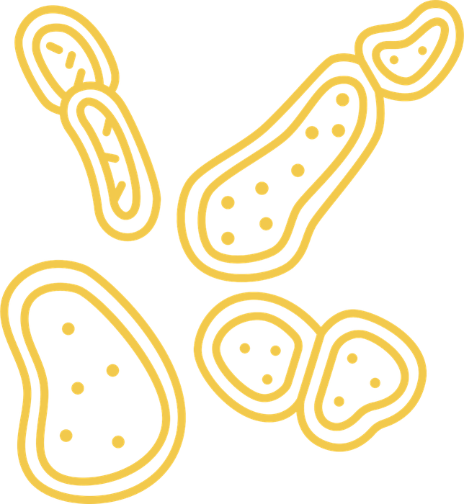

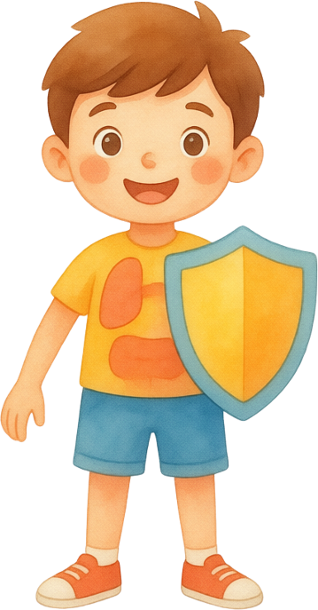

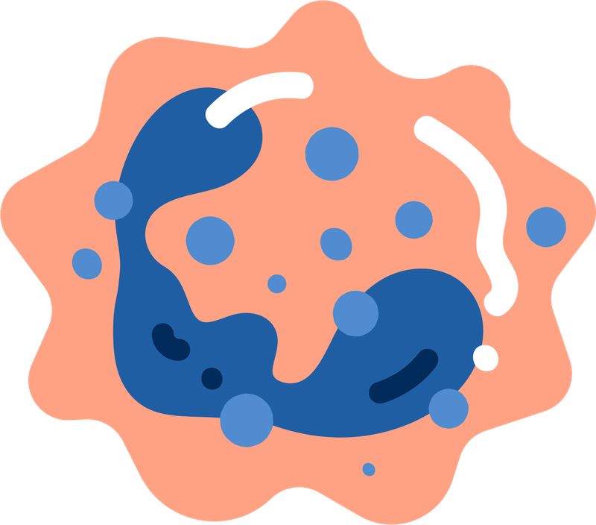
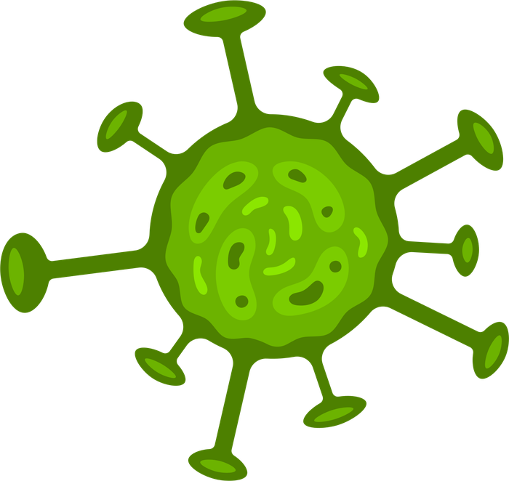
The Immune System
The super army that protects our body
SCIENCE
Mr. Gomes
Group No. 2
4th Grade B
Esther Arias
Diego Rivera
1
4
Lucia Mencia
José Rafael Garay
2
5
Meghan Padilla
Diego Moreno Jiménez
3
6

Slide 2





Funtion The System Immune
It's a main job is to protect you from germs.
Identify and destroy pathogens
Remove damaged or dead cells
Prevent infections and disease
Maintain internal balance

Slide 3


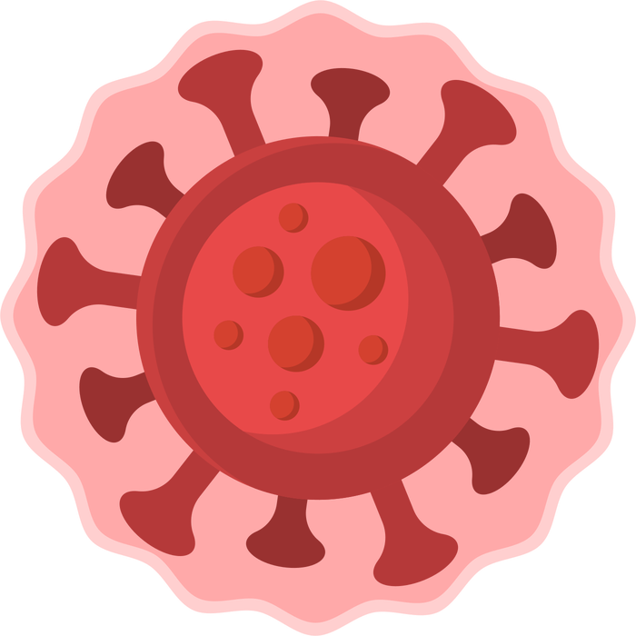
How does it work?
Innate immunity (fast defense):
This is the first line of protection you are born with.
Adaptive or acquired immunity (trained defense):
This part learns to recognize specific invaders. It uses white blood cells known as lymphocytes (B cells and T cells)

Slide 4


How does it work?
Skin & Mucus
Our first protective wall,
The Patrol Guards
The second line of defense activates White blood cells
Phagocyte: Their mission is to patrol the body, find the invading germs, and eat them whole to destroy them.

Slide 5



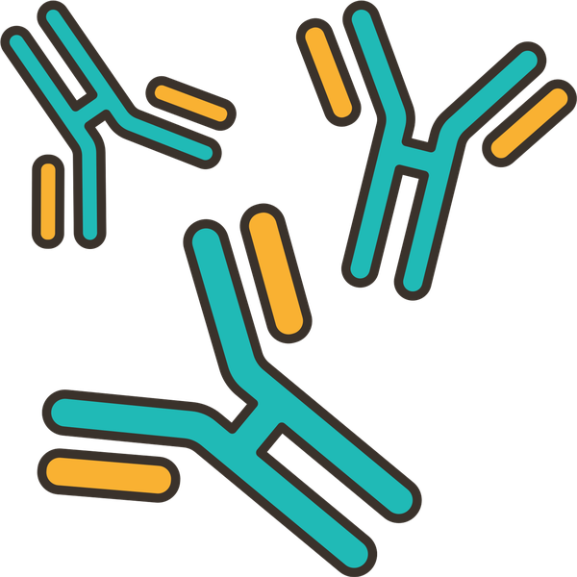
Parts Of The System
The Elite Soldiers (T-Cells and B-Cells)
T-Cells (The Scouts):
These cells identify exactly what kind of germ has entered and destroy cells that are already infected.
B-Cells (The Weapon Factories):
They create special proteins called antibodies. Antibodies are like "Wanted Posters" or magnets that stick to the germ, weaken it, and show the other white blood cells exactly where to attack.

Slide 6

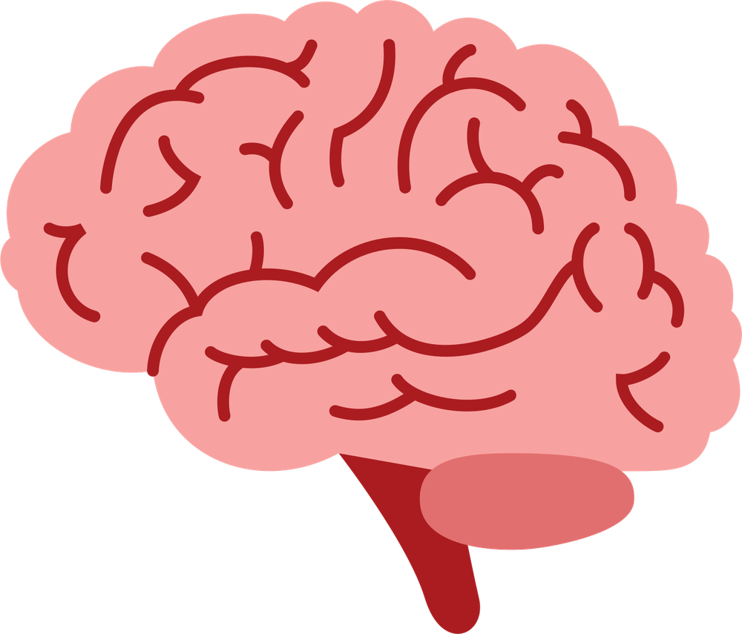
The Immune System's Superpower: Memory
Once your immune system defeats a germ for the first time, it creates memory cells. If that same germ tries to enter your body again weeks or years later, your army already knows exactly how to fight it. They destroy it so fast that you won't even feel sick.

Slide 7

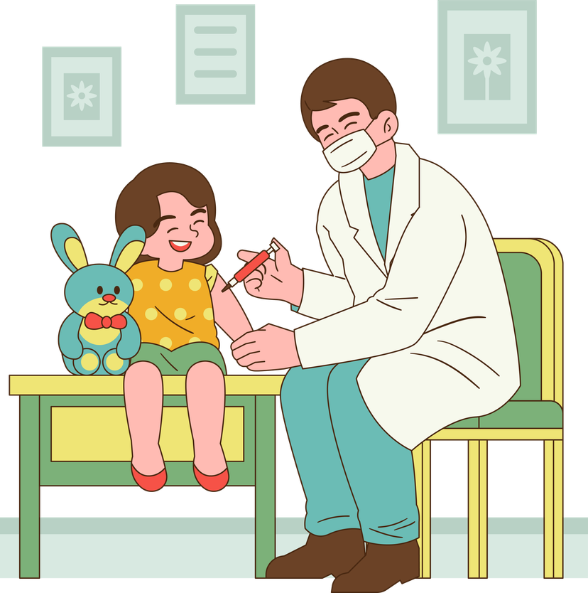


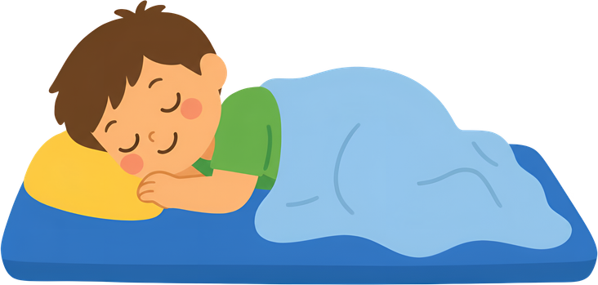
How to Help Your Immune System?
VACCINES:
Train your defenses
HYGIENE:
Water & soap to eliminate germs
HEALTHY DIET:
Eats fruits and veggies give energy
REST & Excercise:
Sleep to 8 - 10 hours & stay active

Slide 8


Thank You

