Slide 1
Emilio Flores
DSC 530-T303 Data Exploration and Analysis

Slide 2

Hypothesis
Do Treasury Yields Affect the S&P 500?

Slide 3
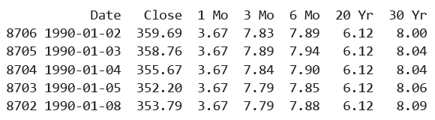
Data Sets - Sources
Daily Treasury Par Yield Curve Rates: https://home.treasury.gov/interest-rates-data-csv-archive
S&P 500 Historical data: https://www.wsj.com/market-data/quotes/index/SPX/historical-prices
Final data frame sample:

Slide 4
Description of Variables
Date: dates between 01/01/1990 and 07/24/2024 in a date time format
Close: The Standard and Poor's 500, or simply the S&P 500, is a stock market index tracking the stock
performance of 500 of the largest companies listed on stock exchanges in the United States. The
"Close" variable is the closing price of the S&P 500 index on a specific date.
1 Mo: the return on investment in U.S. government debt obligations expected to mature in 1 month.
3 Mo: the return on investment in U.S. government debt obligations expected to mature in 3 months.
6 Mo: the return on investment in U.S. government debt obligations expected to mature in 6 months.
20 Yr: the return on investment in U.S. government debt obligations expected to mature in 20 years.
30 Yr: the return on investment in U.S. government debt obligations expected to mature in 30 years.

Slide 5

Histograms

Slide 6
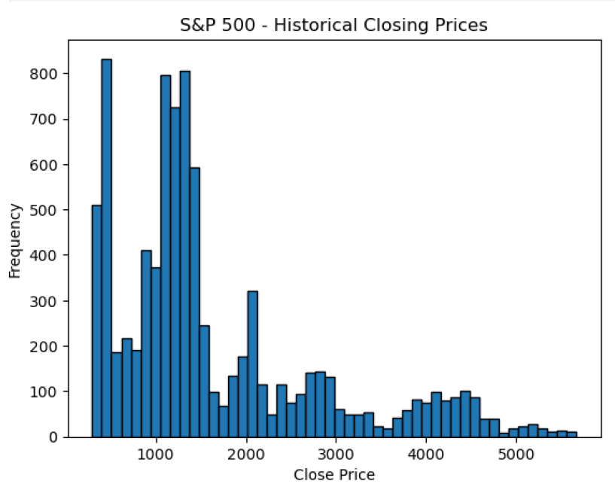
Histogram 1 – S&P 500 Historical Closing Prices

Slide 7
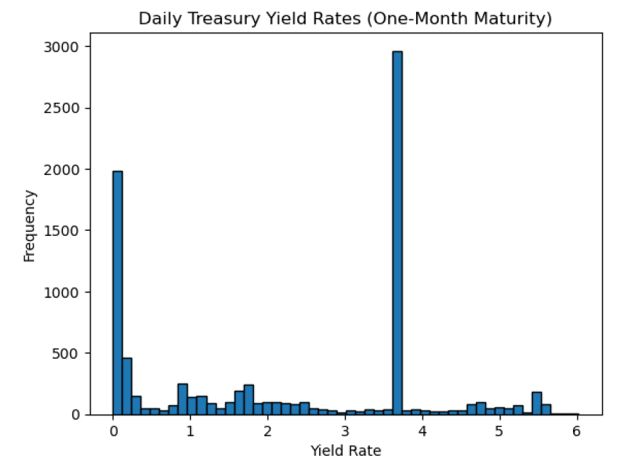
Histogram 2 – One-month Treasury Yield

Slide 8
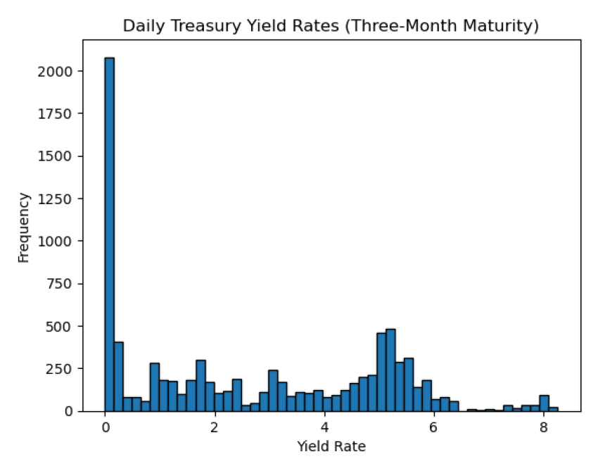
Histogram 3 – Three-month Treasury Yield

Slide 9
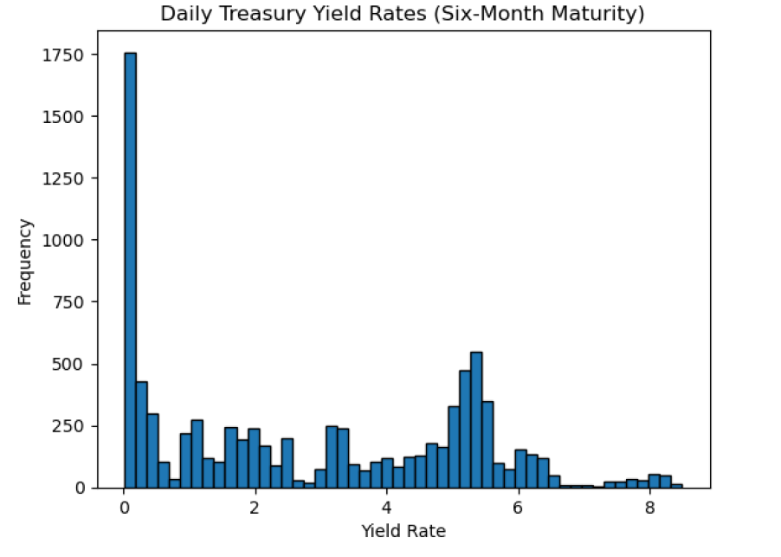
Histogram 4 – Six-month Treasury Yield

Slide 10
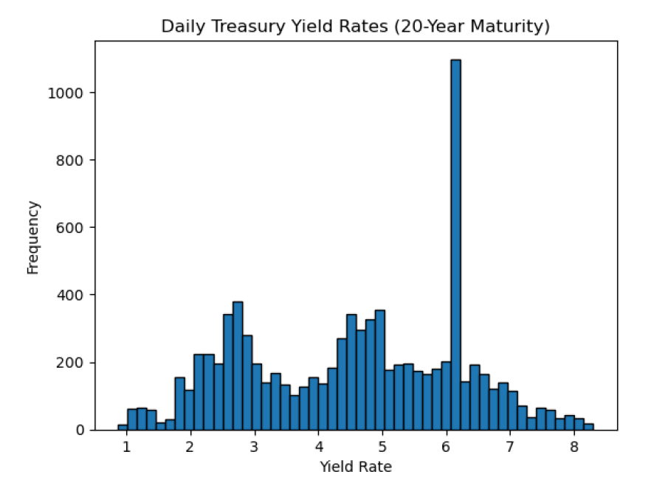
Histogram 5 – 20-Year Treasury Yield

Slide 11
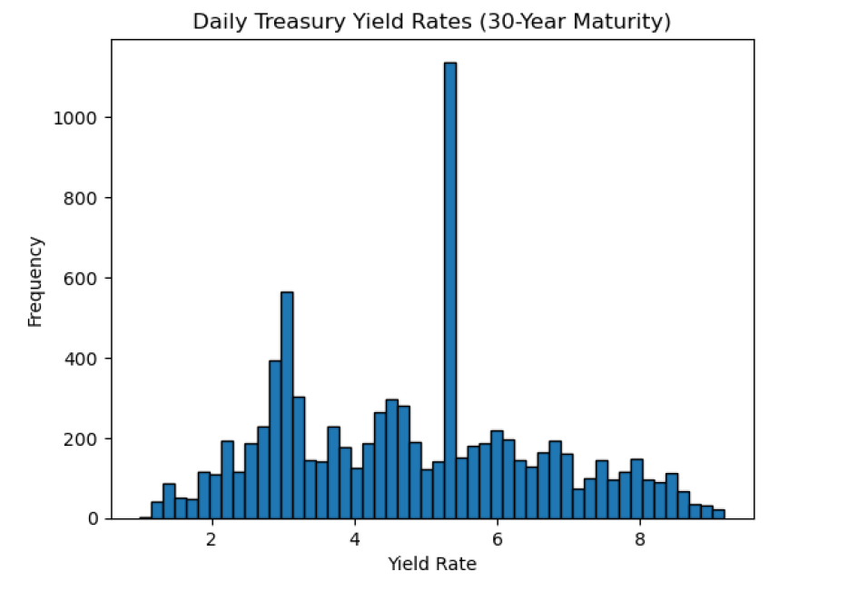
Histogram 6 – 30-year Treasury Yield

Slide 12
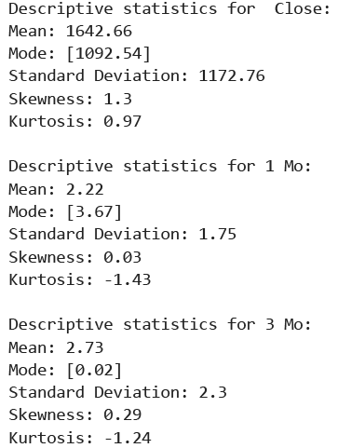
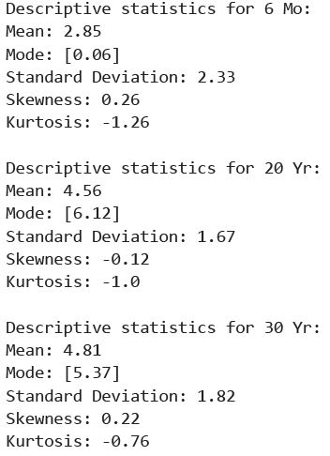
Descriptive Statistics

Slide 13
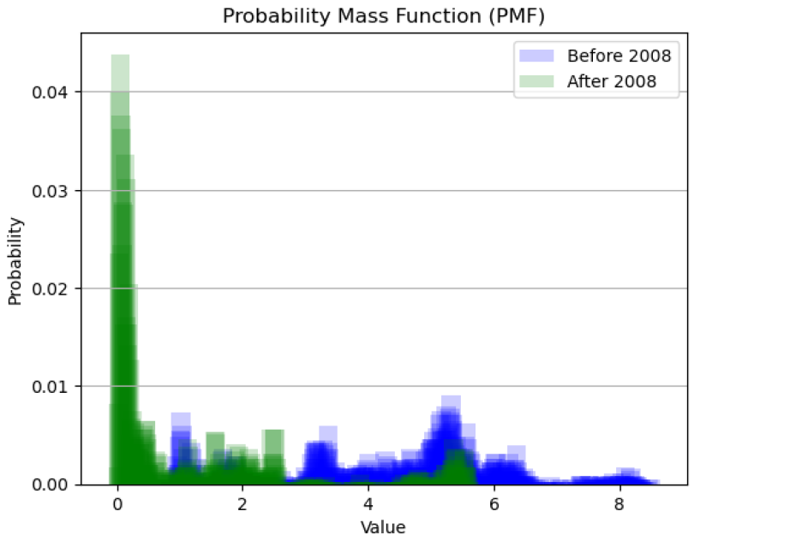
Probability Mass Function
The six-month treasury yield before and after the 2008 financial crisis:

Slide 14
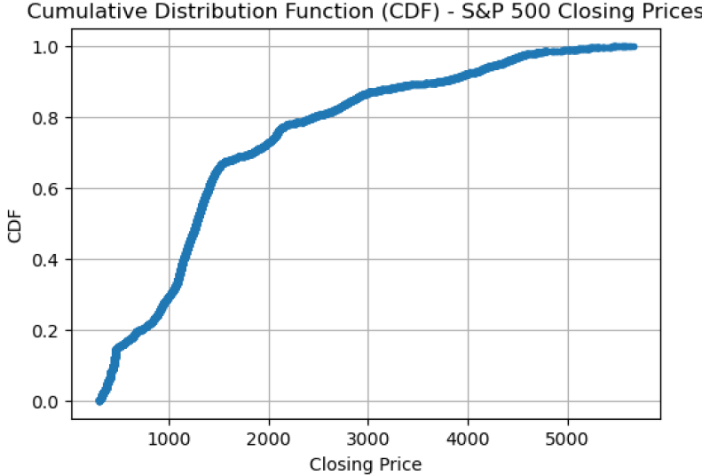
Cumulative Distribution Function
This CDF shows that the closing price of the S&P 500 has been lower than 2000 points for almost 80% of the time since 1990. This shows that most of the growth of the index occurred recently.
Furthermore, as shown in the PMF above, it can be observed that most of the growth of the index occurred after the 2008 financial crisis. Finally, if the closing prices of the S&P 500 are compared with the treasury yields after 2008, an inversed relationship can be observed as the yields have ranged between 0% and 2% for the last 15 years.

Slide 15
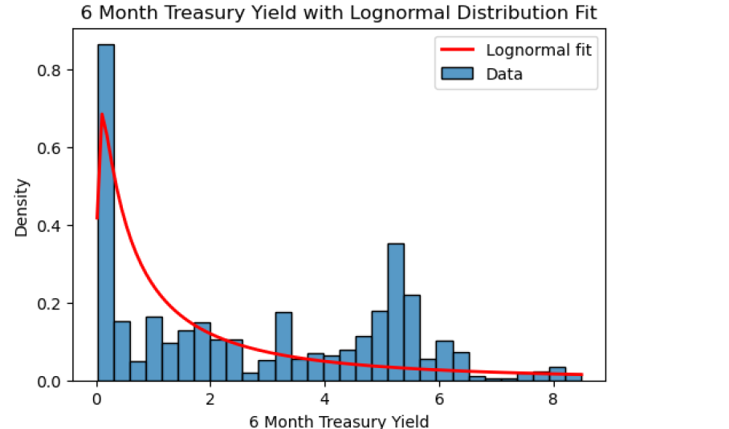
Analytical Distribution (Log Normal)
Log-normal distribution is normally used to analyze finances, such as stock prices, as these items cannot be negative and tend to be positively skewed.
The log-normal distribution plotted in this analysis shows how the distribution of the 6-month treasury yield is positively skewed. It also shows that in the last 30 years, this yield curve has been relatively low (less than 1%). This might be evidence that not all the treasury yields have the same effect on the S&P 500 index as the 20-30-year rates have been, on average, higher than the 1- month and 6-month rates.
A regression analysis might be needed to understand which rate has the strongest impact on the S&P 500.

Slide 16

Correlation vs. Causation

Slide 17
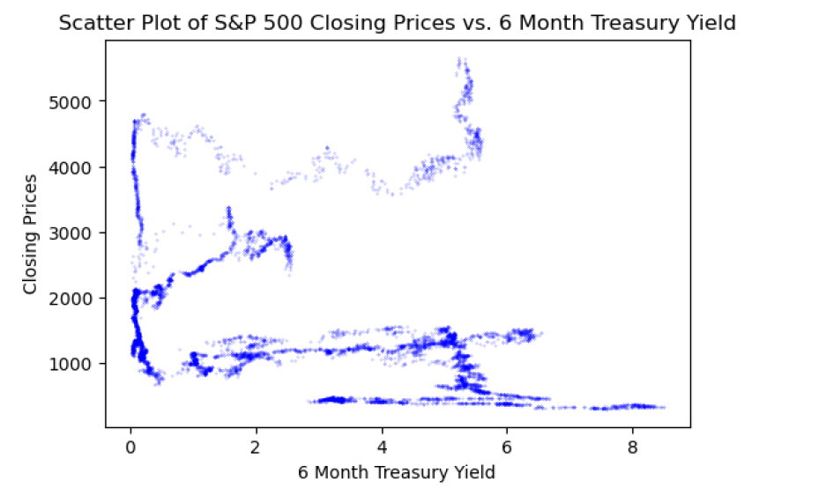
Scatter Plot

Slide 18
Correlation Tests – Slide 1
Covariance: Covariance between Closing Price and 6 Month Treasury Yield: -716.4168803910177
Pearson’s Correlation: Correlation Coefficient between Closing Price and 6 Month Treasury Yield: -0.2623894875108695

Slide 19
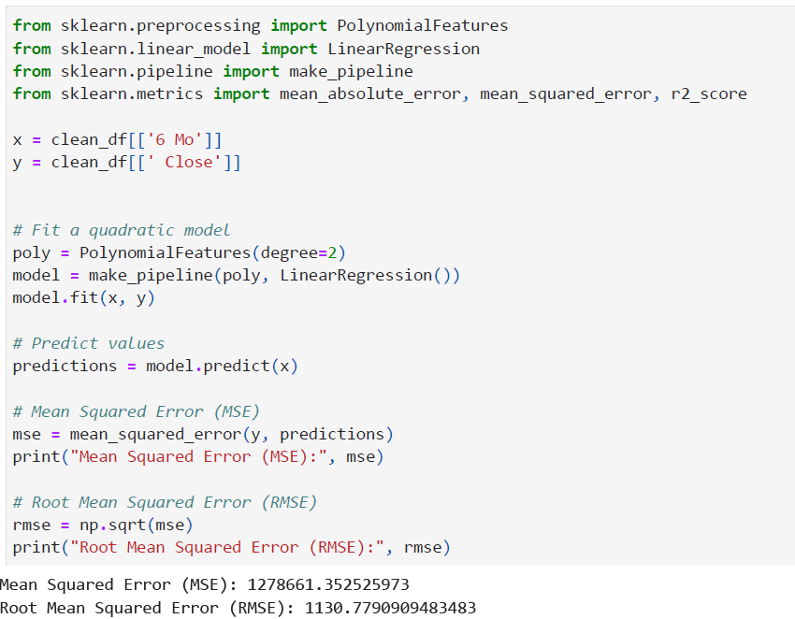
Correlation Tests – Slide 1 (Non-Linear Relationship)

Slide 20
Correlation vs. Causation (Analysis)
Several methods were used to find and/or explain the correlation and causation between two variables, the six-month treasury yield and the S&P 500 index. The scatter plot shows no obvious linear relationship between the six-month treasury yield and the S&P 500 closing prices.
The covariance calculation resulted in a value of -716, which might indicate a negative correlation, yet it is hard to interpret. Hence, Pearson’s correlation was calculated to normalize the relationship between these two variables.
Pearson's correlation resulted in -0.26, which could be interpreted as a small to moderate inverse relationship between these variables.
Finally, a non-linear relationship calculation was used to attempt to model the relationship between these two variables. A polynomial model was used to predict the closing prices of the S&P 500.Unfortunately, the R-squared value demonstrated that this model is not an accurate fit.
This analysis might prove that there is no strong relationship between the six-month treasury yield and the closing prices of the S&P500.

Slide 21
Hypothesis Test
The Fisher's Null hypothesis testing was used to test this hypothesis: "Treasury yields affect the S&P 500".
This testing measures the correlation of the data and the null hypothesis "Treasury yields do not affect the S&P 500".
A regression analysis is needed to use the Fisher's Null Hypothesis method.

Slide 22
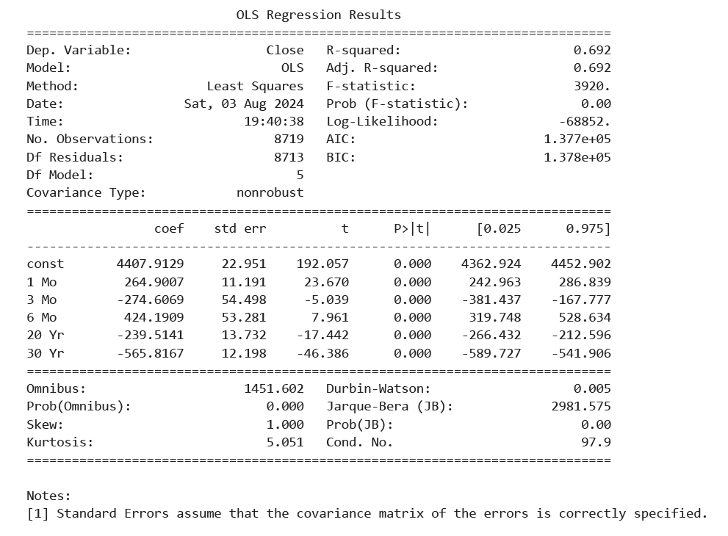
Regression Analysis

Slide 23
Interpretation of the Fisher's Null Hypothesis
The one-month, three-month, six-month, 20-year, and 30-year treasury yields were used to test the effect of treasury yields on the S&P 500.
The regression analysis represented that all coefficients had a p-value lower than 0.05.
Therefore, it can be concluded that all treasury yields significantly affect the S&P 500 closing prices, and the null hypothesis is rejected.

