Slide 1
Arrays and Linked Lists

Slide 2
Topics
1D arrays
2D arrays
Dynamic arrays
List (ADT)

Slide 3
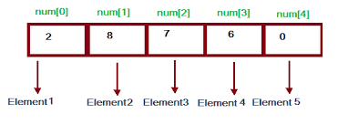
1D arrays in C++
An array is a fixed number of elements of the same type stored sequentially in memory.
The size of the array is referred to as its dimension.
To declare:
type arrayName[dimension];
int myIntArray[10]; // declares 10 elements integer array

Slide 4
How to access array elements [1D]
The elements of an array can be accessed by using an index into the array.
Arrays in C++ are zero-indexed,
int firstElement = myIntArray[0]; //first element of the array
int thirdElement = myIntArray[2]; // third element of the array

Slide 5
Other ways of defining arrays
int arr[4] = { 6, 0, 9, 6 };
int arr[] = { 6, 0, 9, 6, 2, 0, 1, 1 }; // no size
Compiler determines the size of the array from the list

Slide 6
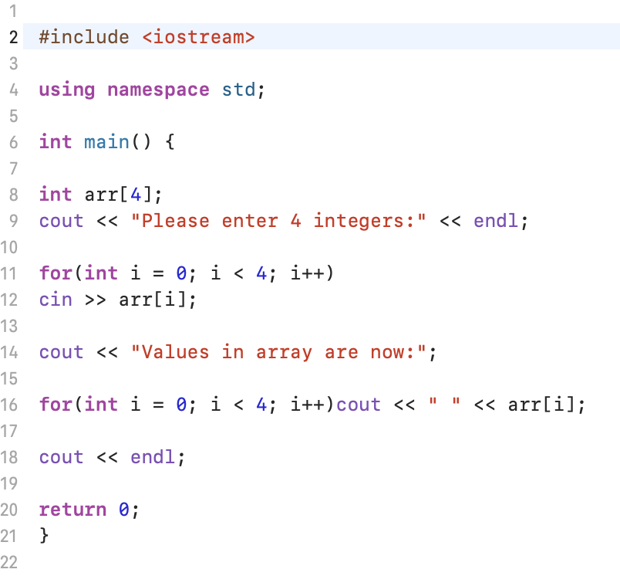
Example 1D array

Slide 7
Arrays can be used as a parameter
#include <iostream>
using namespace std;
int sum(const int array[], const int length) {
long sum = 0;
for(int i = 0; i < length; sum += array[i++]);
return sum;
}
int main() {
int arr[] = {1, 2, 3, 4, 5, 6, 7};
cout << "Sum: " << sum(arr, 7) << endl;
return 0;
}

Slide 8
2D arrays
type arrayName[dimension1][dimension2];
Ex: int my2DArray[5][10];
The array will have dimension1 x dimension2 elements of the same type and can be thought of as an array of arrays.
The first index indicates which of dimension1 subarrays to access, and then the second index accesses one of dimension2 elements within that subarray.
Initialization and access thus work similarly to the one-dimensional case:

Slide 9
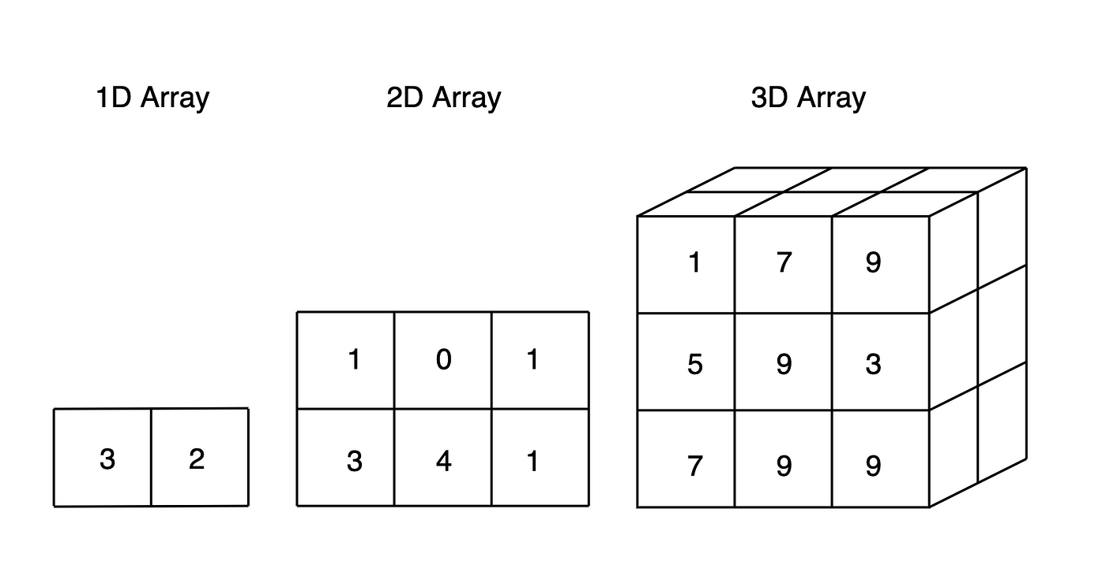
There can be more than 2D

Slide 10
Activity 1
Create a 3D array of 2x2x2
And store the value 24 in the cell indexed by 1,1,1,0

Slide 11
Check your answer
Create a 3D array of 2x2x2
And store the value 24 in the cell indexed by 1,1,1,0
int my3DArray[2][2][2]; // create an array
my3DArray[1][1][0] = 24; // assign 24 in the cell that is requested

Slide 12
More 3D example
int test[2][3][4] = {
{ {3, 4, 2, 3}, {0, -3, 9, 11}, {23, 12, 23, 2} },
{ {13, 4, 56, 3}, {5, 9, 3, 5}, {5, 1, 4, 9} }
}; // assigning all the values at the time of declaration
Please note the order in which we arrange the inner {s and the number of elements in each inner arrays

Slide 13
3D array example
// C++ Program to Store value entered by user in a 3D array
#include <iostream>
using namespace std;
int main() {
// This array can store upto 12 elements (2x3x2)
int test[2][3][2] = { { {1, 2}, {3, 4}, {5, 6} }, { {7, 8}, {9, 10}, {11, 12} } };
for (int i = 0; i < 2; ++i) {
for (int j = 0; j < 3; ++j) {
for (int k = 0; k < 2; ++k) {
cout << "test[" << i << "][" << j << "][" << k << "] = " << test[i][j][k] << endl;
}
}
}
return 0;
}

Slide 14
Activity 2
What is the output of the above example?

Slide 15
Check your answer
test[0][0][0] = 1
test[0][0][1] = 2
test[0][1][0] = 3
test[0][1][1] = 4
test[0][2][0] = 5
test[0][2][1] = 6
test[1][0][0] = 7
test[1][0][1] = 8
test[1][1][0] = 9
test[1][1][1] = 10
test[1][2][0] = 11
test[1][2][1] = 12

Slide 16
Challenge
You do not know the size of the array that is required to store values in advance
How do you create the array?

Slide 17
Dynamic Arrays in C++
#include<iostream>
using namespace std;
int main() {
int x, n;
cout << "Enter the number of items:" << "\n";
cin >>n;
int *arr = new int(n);
cout << "Enter " << n << " items" << endl;
for (x = 0; x < n; x++) {
cin >> arr[x];
}
cout << "You entered: ";
for (x = 0; x < n; x++) {
cout << arr[x] << " ";
} return 0;
}

Slide 18
You also can do this
int *array{ new int[5]{ 10, 7, 15, 3, 11 } };

Slide 19
Challenge
How do we create an array that resizes as we increase the number of elements that we must store in the array?

Slide 20
C++ thing
The length of a dynamic array is set during the allocation time.
However, C++ doesn’t have a built-in mechanism of resizing an array once it has been allocated.
One solution
Can do this by allocating a new array dynamically, copying over the elements, then erasing the old array.
Problem of the solution
This is prone to errors, inefficient and hence, try to avoid it.

Slide 21
What is our real solution for this?
Abstract Data Types (ADT)
List (Linked List)
Simple linked list
Doubly linked list
Stack
Queue
FIFO
LIFO

Slide 22
Abstract Data Types (ADT)
An abstract data type (ADT) is a set of objects together with a set of operations.
Objects such as lists, sets, and graphs, along with their operations, can be viewed as ADTs
operations can be adding, removing, checking size, and checking to see if the item is there.
ADT
List (Linked List)
Stack
Queue

Slide 23
List (Linked List)
We can simply implement this data type on an array
Printing the list can be done in linear time
Searching for an item can be done in a constant time
But
Insertion and deletion can be complicated and inefficient
Unused
Current
List
Size n
23 | 67 | 34 | 12 | 45 | 56
0 | 1 | 2 |  |  | n |  |  |  | N-1

Slide 24
Discussion
Why is it difficult to implement insertion and deletion?

Slide 25
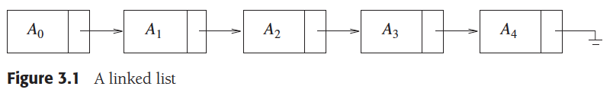
Linked List – ADT implementation
We try to eliminate the consecutive storage of elements to remove the disadvantage of shifting elements in case of insertion and deletion.
Head
Tail

Slide 26
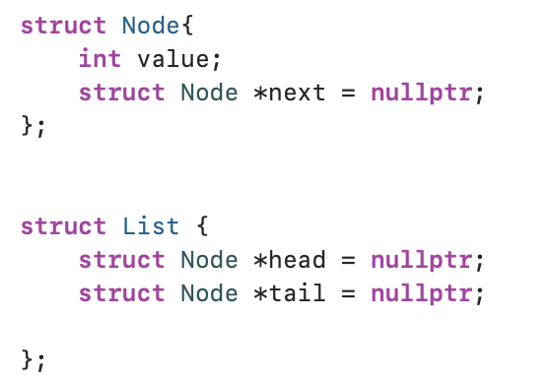
How do we represent nodes and list?
We need two structures
One for the list
One for the node

Slide 27
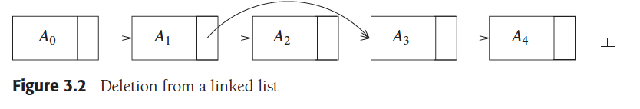
Delete from a list
Deleting is just a change in pointers
How?

Slide 28
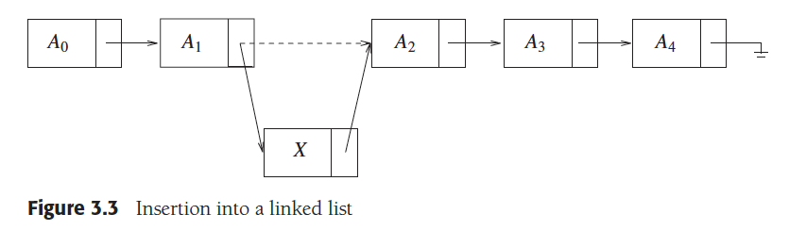
Insert in the middle
Same as delete
But the assignment is different

Slide 29
How to delete at the end of the list?
There is a challenge
Discuss the challenge

Slide 30
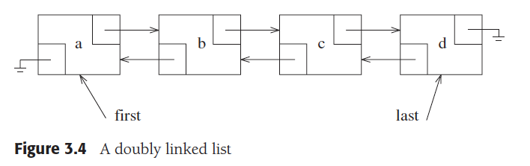
Solution – Doubly linked list
We maintain a link to the previous node in every node
Question
How do we represent this in the structure?

Slide 31
Implementation details
We will use functions to
Insert
Delete at front
Delete at the end
Delete in the middle
Search for an item
Display the list

Slide 32
Insert an item to the list - base
#include <iostream>
// Node structure representing a node in the linked list
struct Node {
int data;
Node* next;
Node(int val) : data(val), next(nullptr) {}
};

Slide 33
Adding the Class
class LinkedList {
private: Node* head, tail;
public: // Constructor to initialize an empty linked list LinkedList() : head(nullptr), tail (nullptr) {}
// Destructor to free memory when the object is destroyed
~LinkedList() {
Node* temp = head;
while (temp) {
Node* nextNode = temp->next;
delete temp;
temp = nextNode; } } };

Slide 34
Adding Insert Method
void insert(int val) {
Node* newNode = new Node(val);
if (temp == nullptr){
head = newNode;
tail = newNode;
return;
}
newNode->next = head;
head = newNode;
}

Slide 35
Adding Display function
// Function to display the elements of the linked list
void display() {
Node* temp = head;
while (temp) {
std::cout << temp->data << " ";
temp = temp->next;
}
std::cout << std::endl;
}

Slide 36
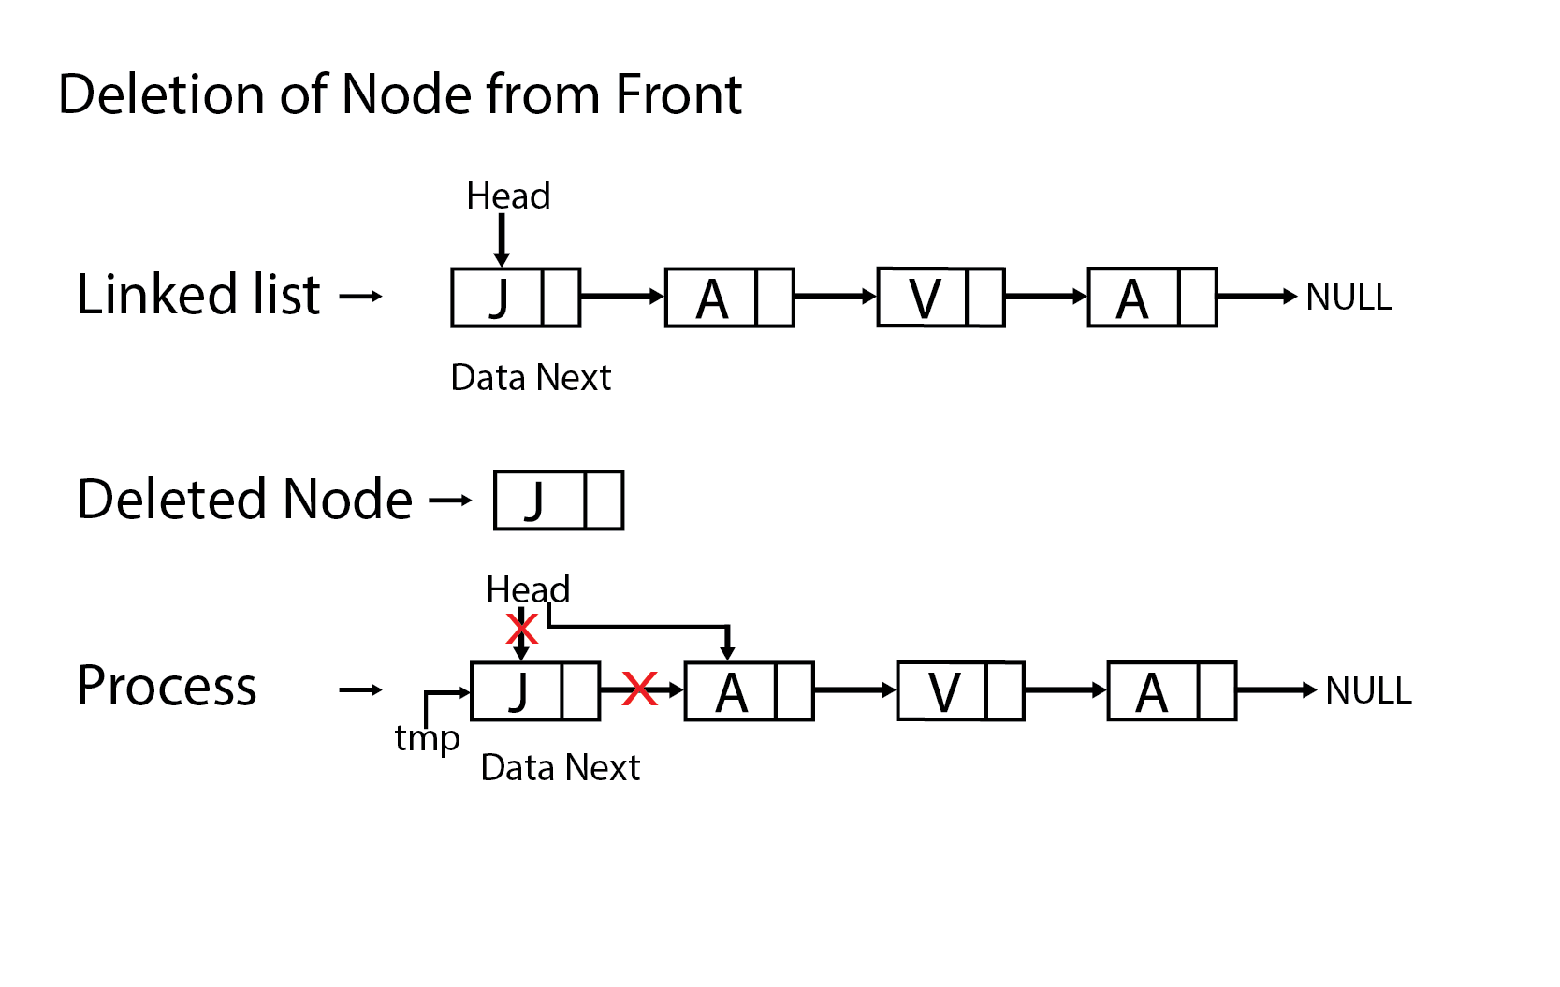
Class Exercise: Add delete from front function
?

Slide 37
Solution - deleteFront
void deleteFront() {
Node* temp;
//If the list is already empty
if(head == nullptr) {
cout<<"Empty Linked List. Deletion not possible.";
}
else {
temp = head;
head = head >next;
free(temp);
cout<<"Node deleted from the front.”;
}
}

