Slide 1
Refreshing C++ knowledge

Slide 2
Topics
References and Pointers
The formal concepts in OOP
C++ classes
Structures

Slide 3
Pass by Value
copy
main()
getRectangleArea(float L, float W)
float L
float L
float W
float W
C++ defaults to pass by value behavior when calling a function.
The function arguments are copied when used in the function.
Change values within the function -> does not affect the original variable values
When passing objects, entire dataset copied to the function. May slow down the program

Slide 4
Pass by Reference
Pass the memory address
main()
getRectangleArea1(float L, float W)
float L
float L
float W
float W
When using &, it is pass by reference
Memory address (pointer) of the variable is sent to the function
The const modifier can be used to prevent changes to the original variable in main().

Slide 5
Nothing returns
void getRectangleArea(const float& L, const float& W, float& area) {
area= L*W ;
}
Reference type can be used as an out variable
This can be a useful way for a function to return multiple values in the calling routine.

Slide 6
A C++ class
#include <iostream>
using namespace std;
class Rectangle
{
public:
float W ;
float L ;
};
int main()
{
cout << ”Rectable Class”<< endl;
Rectangle rectangle ;
rectangle.W = 1.0 ;
rectangle.L = 2.0 ;
return 0;
}

Slide 7
C++ Class Syntax
?
?
?
class Rectangle
{
public:
float W ;
float L ;
};
?
?
Creating an object from the class Rectangle
Rectangle rectangle ;
rectangle.W = 1.0 ;
rectangle.L = 2.0 ;

Slide 8
Accessing data in the class
Public members: can be accessed with the dot operator. Ex: rectangle.w
int main()
{
cout << ”Rectangle class" << endl;
Rectangle rectangle ;
rectangle.W = 1.0 ;
rectangle.L = 2.0 ;
return 0;
}

Slide 9
class Rectangle
{
public:
float W ;
float L ;
float getArea() {
return W * L ;
}
};
int main()
{
cout << ”Rectangle class<< endl;
Rectangle rectangle ;
rectangle.W = 21.0 ;
rectangle.L = 2.0 ;
cout << “Area of the rectangle is “
<< rectangle.getArea() << endl ;
return 0;
}
No argument method. It uses class members to calculate the area.
Methods are accessed just like members:
object.method(arguments)

Slide 10
Best practice of defining a class
Defining a class in the main.cpp file is not a good practice.
Two parts to a C++ class:
Header file (my_class.hpp)
Contains the interface (definition) of the class – members, methods, etc.
Source file (my_class.cpp)
Contains implementation of methods, initialization of members.
You may ignore the interface (header file) and only create the source file

Slide 11
rectangle.hpp
rectangle.cpp
#ifndef RECTANGLE_H
#define RECTANGLE_H
class Rectangle
{
public:
Rectangle();
virtual ~Rectangle();
protected:
private:
};
#endif
#include “rectangle.hpp"
Rectangle::Rectangle()
{
//constructor
}
Rectangle::~Rectangle()
{
//destructor
}

Slide 12
Modify rectangle.hpp
#ifndef RECTANGLE_H
#define RECTANGLE_H
class Rectangle
{
public:
Rectangle();
virtual ~Rectangle();
float m_length ;
float m_width ;
float Area() ;
};
#endif
As in the sample Rectangle, add storage for the length and width to the header file. Add a declaration for the Area method.
Access modifier can be
Protected or private too.
Private: No outside class can access these members.
Protected: Sub classes can access this member but not others

Slide 13
rectangle.cpp
The getArea() method now has a basic definition added.
The syntax:
class::method
tells the compiler that this is the code for the getArea() method declared in rectangle.hpp
Now take a few minutes to fill in the code for getArea().
#include "rectangle.h”pp
Rectangle::Rectangle()
{
//constructor
}
Rectangle::~Rectangle()
{
//destructor
}
float Rectangle::getArea()
{
}

Slide 14
Last Step
Go to the main.cpp file
Add an include statement for “rectangle.hpp”
Create a Rectangle object in main()
Add a length and width
Print out the area using cout.

Slide 15
Solution
You should have come up with something like this:
#include <iostream>
using namespace std;
#include "rectangle.hpp"
int main()
{
Rectangle rT ;
rT.m_width = 1.0 ;
rT.m_length = 2.0 ;
cout << rT.getArea() << endl ;
return 0;
}

Slide 16
References and Pointers
Part 1 introduced the concept of passing by reference when calling functions.
Selected by using the & character in function argument types: int add (int &a, int b)
References hold a memory address of a value.
int add (int &a, int b)→ a has the value of a memory address, b has an integer value.
Used like regular variables and C++ automatically fills in the value of the reference when needed:
int c = a + b ; → “retrieve the value of a and add it to the value of b”

Slide 17
References and Pointers
From C there is another way to deal with the memory address of a variable: via pointer types.
Similar syntax in functions except that the & is replaced with a *:
int add (int *a, int b)
To get a value from a pointer requires a manual dereferencing by the programmer:
int c = *a + b ; → “retrieve the value of a and add it to the value of b”

Slide 18
 | Reference | Pointer
Declaration | int &ref ; | int *ptr ;
Set memory address to something in memory | int a = 0 ; int &ref = a ; | int a = 0 ; int *ptr = &a ;
Fetch value of thing in memory | cout << ref ; | cout << *ptr ;
Can refer/point to nothing (null value)? | No | Yes
Can change address that it refers to/points at? | No. int a = 0 ; int b = 1 ; int &ref = a ; ref = b ; // value of a is now 1! | Yes int a = 0 ; int b = 1 ; int *ptr = &a ; ptr = &b ; // ptr now points at b
Object member/method syntax | MyClass obj ; MyClass &ref = obj ; ref.member ; ref.method(); | MyClass obj ; MyClass *ptr = obj ; ptr->member ; ptr->method(); // OR (*ptr).member ; (*ptr).method() ;

Slide 19
When to use a reference or a pointer
Both references and pointers can be used to refer to objects in memory in methods, functions, loops, etc.
Avoids copying due to default call-by-value C++ behavior
Could lead to memory/performance problems.
Or cause issues with open files, databases, etc.
If you need to:
Hold a null value (i.e. point at nothing), use a pointer.
Re-assign the memory address stored, use a pointer.
Otherwise, use a reference.
References are much easier to use!
No need to check if a reference has a null value…since they can’t hold one.
// Pointer to a null value
int *a = NULL ; // C-style
int *b = nullptr ; // C++11 style.
// Reference to a null value
// won't compile.
int &c = nullptr ;

Slide 20
Null Value Checking
// Pointer version
void add(const int *a, const int b, int *c)
{
if (a && c) { // check for null pointer
*c = *a + b ;
}
}
// a && c → this means if a AND c are not // null
// Reference version
void add(const int &a, const int b, int &c)
{
c = a + b ;
}
A null value means the pointer is not currently pointing at anything.
It’s a good idea to check before accessing the value they point at.
References cannot be null, so the code on the right does not need checking.

Slide 21
C++ Classes
#ifndef RECTANGLE_H
#define RECTANGLE_H
class Rectangle
{
public:
Rectangle();
virtual ~Rectangle();
float m_length ;
float m_width ;
float Area() ;
protected:
private:
};
#endif // RECTANGLE_H
In the Rectangle class
Rectangle() is a constructor. This is a method that is called when an object is instantiated for this class.
Multiple constructors per class are allowed
~Rectangle() is a destructor. This is called when an object is removed from memory.
Only one destructor per class is allowed!
(what is virtual?)

Slide 22
A second constructor
rectangle.cpp
#include "rectangle.hpp"
/* OK to do this */
Rectangle::Rectangle(float width, float length)
{
m_width = width ;
m_length = length ;
}
rectangle.hpp
class Rectangle
{
public:
Rectangle();
Rectangle(float width, float length) ;
/* etc */
};
OR
#include "rectangle.h“
/* Better to do this */
Rectangle::Rectangle(float width, float length) :
m_width(width),m_length(length) { }
Two styles of constructor. Above is the C++11 member initialization list style. At the top is the old way. C++11 is preferred.
With the old way the empty constructor is called automatically even though it does nothing – it still adds a function call.
Same rectangle.hpp for both styles.

Slide 23
Member Initialization Lists
Syntax:
MyClass(int A, OtherClass &B, float C):
m_A(A),
m_B(B),
m_C(C) {
/* other code can go here */
}

Slide 24
And now use both constructors
#include <iostream>
using namespace std;
#include "rectangle.h"
int main()
{
Rectangle rT ;
rT.m_width = 1.0 ;
rT.m_length = 2.0 ;
cout << rT.getArea() << endl ;
Rectangle rT_2(2.0,2.0) ;
cout << rT_2.getArea() << endl ;
return 0;
}

Slide 25
Default values
#ifndef RECTANGLE_H
#define RECTANGLE_H
class Rectangle
{
public:
Rectangle();
virtual ~Rectangle();
// could do:
float m_length = 0.0 ;
float m_width = 0.0 ;
float getArea() ;
};
#endif
C++11 added the ability to define default values in headers in an intuitive way.

Slide 26
Default constructors and destructors
The two methods created by C::B automatically are explicit versions of the default C++ constructors and destructors.
Every class has them – if you don’t define them then empty ones that do nothing will be created for you by the compiler.
If you really don’t want the default constructor you can delete it with the delete keyword.
Also in the header file you can use the default keyword if you like to be clear that you are using the default.
class Foo {
public:
Foo() = delete ;
// Another constructor
// must be defined!
Foo(int x) ;
};
class Bar {
public:
Bar() = default ;
};

Slide 27
Custom constructors and destructors
You must define your own constructor when you want to initialize an object with arguments.
A custom destructor is always needed when internal members in the class need special handling.
Examples: manually allocated memory, open files, hardware drivers, database or network connections, custom data structures, etc.

Slide 28
Destructors
This class just has 2 floats as members which are automatically removed from memory by the compiler.
Destructors are called when an object is destroyed.
No return type
No arguments
Not called by the programmer
Rectangle::~Rectangle()
{
//dtor
}

Slide 29
Destructors
Example:
class Example {
public:
Example() = delete ;
Example(int count) ;
virtual ~Example() ;
// A pointer to some memory
// that will be allocated.
float *values = nullptr ;
};
Example::Example(int count) {
// Allocate memory to store "count"
// floats.
values = new float[count];
}
Example::~Example() {
// The destructor must free this
// memory. Only do so if values is not
// null.
if (values) {
delete[] values ;
}
}

Slide 30
C++ Inheritance Syntax
Inheritance syntax pattern:
class SubclassName : public SuperclassName
Here the public keyword is used.
Methods implemented in class Sub can access any public or protected members and methods in Super but cannot access anything that is private.
Other inheritance types are protected and private.
class Super {
public:
int i;
protected:
int j ;
private:
int k ;
};
class Sub : public Super {
// ...
};

Slide 31
square.hpp
square.cpp
#ifndef SQUARE_H
#define SQUARE_H
#include "rectangle.hpp"
class Square : public Rectangle
{
public:
Square();
virtual ~Square();
};
#endif // SQUARE_H
#include "square.h"
Square::Square()
{
//ctor
}
Square::~Square()
{
//dtor
}
Note that subclasses are free to add any number of new methods or members, they are not limited to those in the superclass.

Slide 32
Structures
struct type_name { member_type1 member_name1; member_type2 member_name2; member_type3 member_name3; . . } object_names;
A data structure is a group of data elements grouped together under one name.

Slide 33
Structure example
struct product
{
int weight;
double price;
} ;
product apple;
product banana, melon;
We can create objects at the time of structure definition
struct product {
int weight;
double price;
} apple, banana, melon;

Slide 34
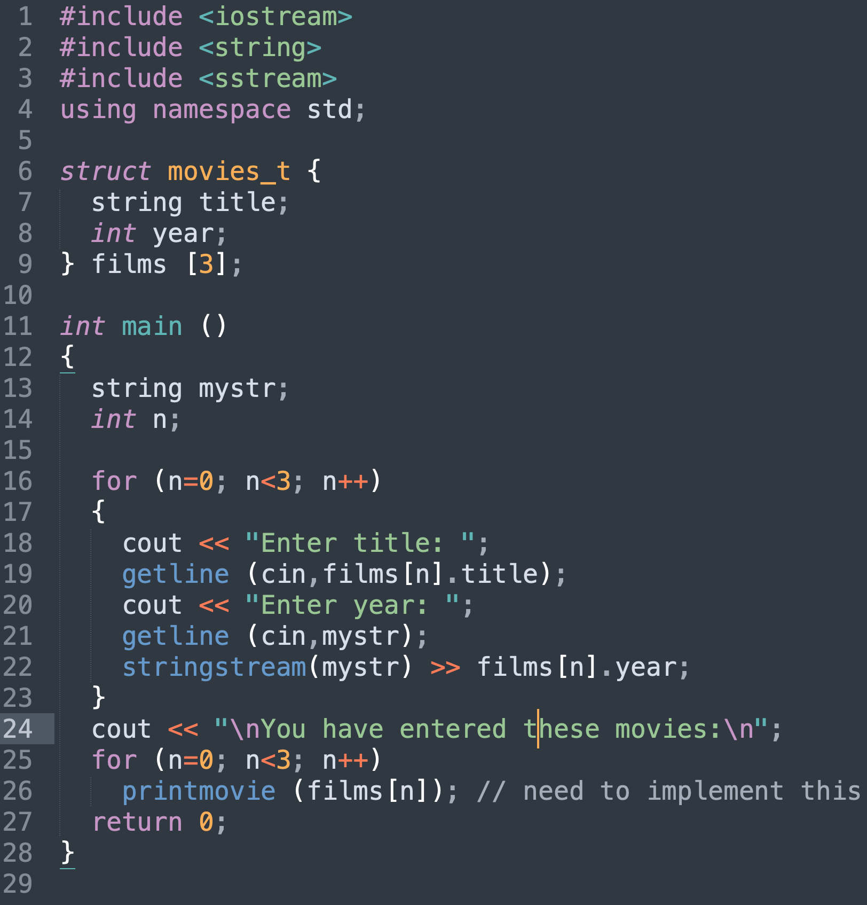
Complete example

Slide 35
Nesting Structures
struct movies_t {
string title;
int year;
};
struct friends_t {
string name;
string email;
movies_t favorite_movie;
} charlie, maria;

Slide 36
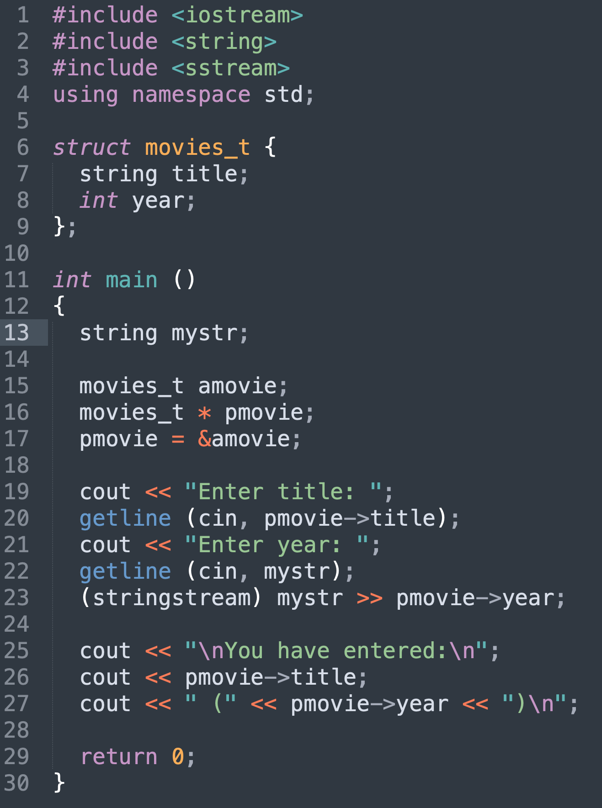
Pointers to structures

