Slide 1
Stacks and Queues

Slide 2

Topics
Abstract Data Types (ADT)
List (Linked List)
Simple linked list
Doubly linked list
Stack
Queue
FIFO
LIFO – Also Stack

Slide 3
Stack
Understand the fundamental concepts of stacks, their implementation, and how to use them in C++
Can be constructed from LinkedList
A stack is a list with the restriction that insertions and deletions can be performed in only one position, namely, the end of the list, called the top.

Slide 4
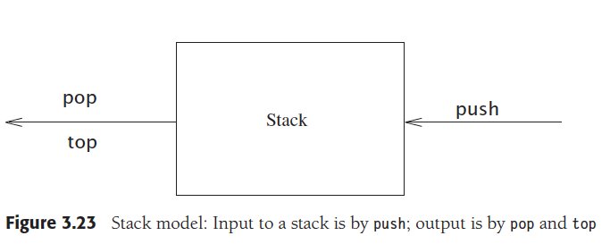
Stack operations

Slide 5
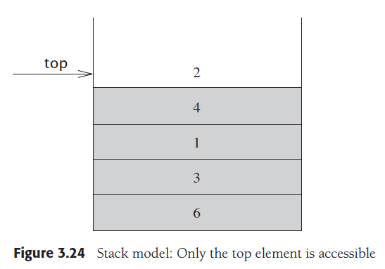
Stack – general representation

Slide 6
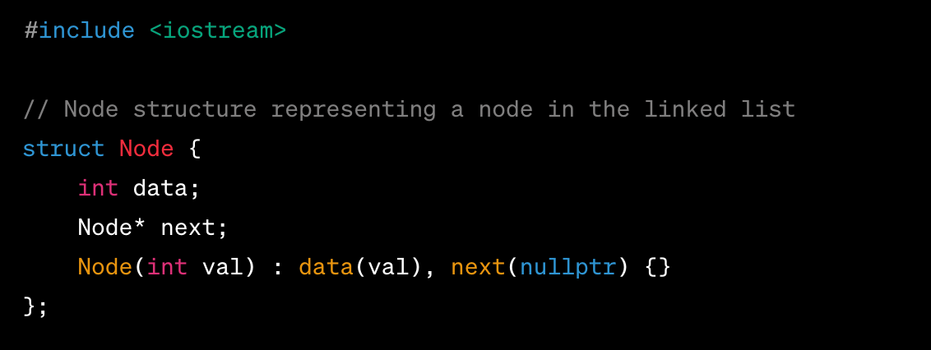

Slide 7
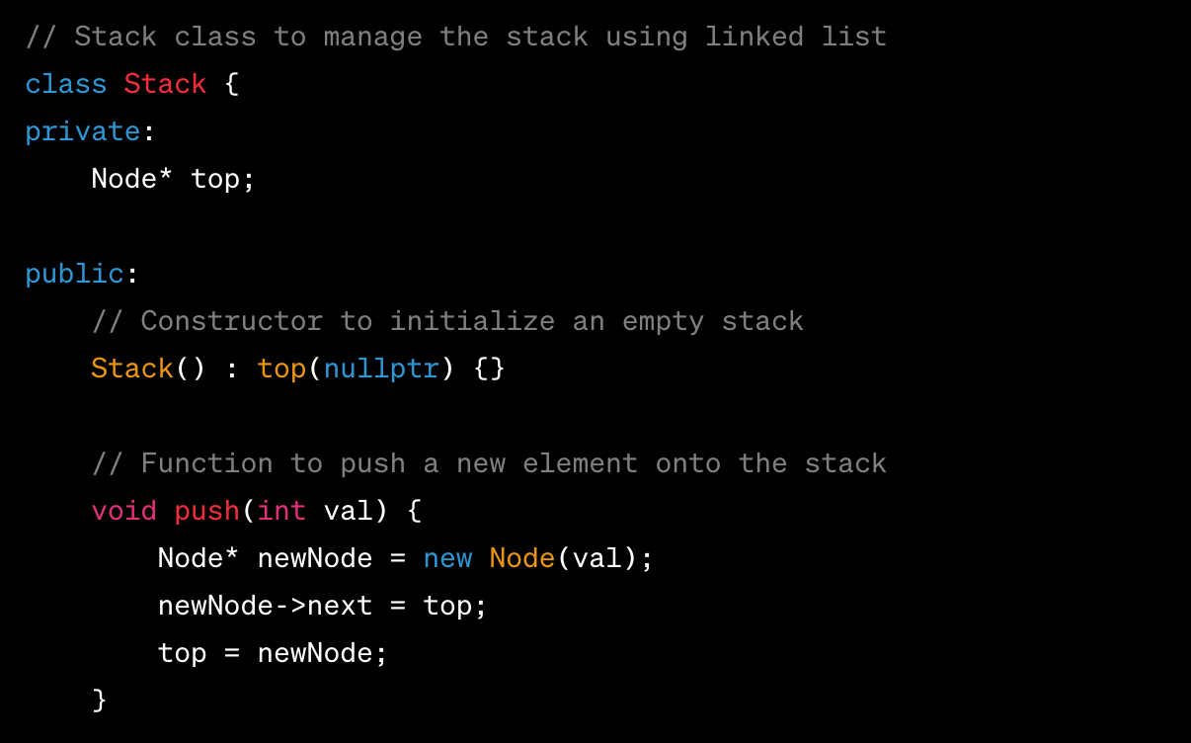

Slide 8
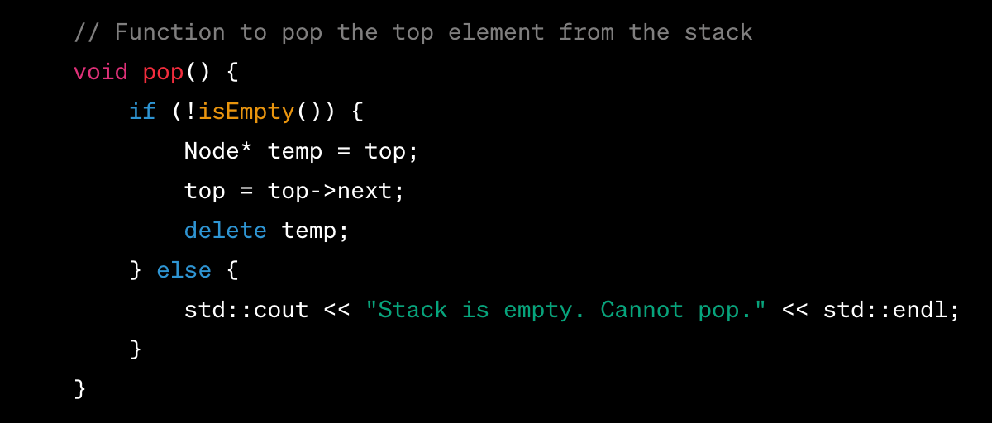

Slide 9
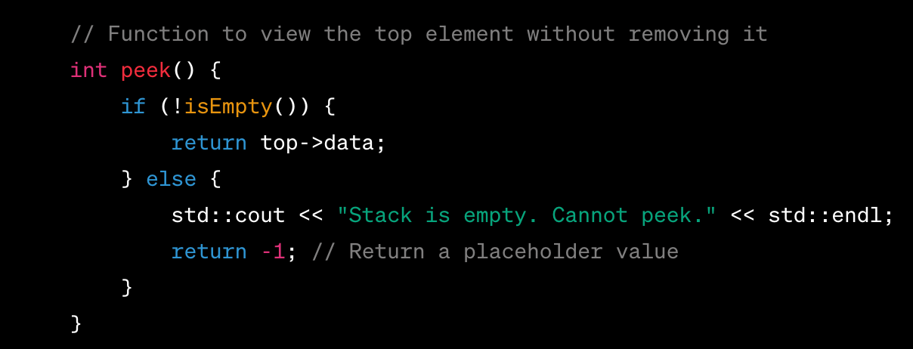

Slide 10
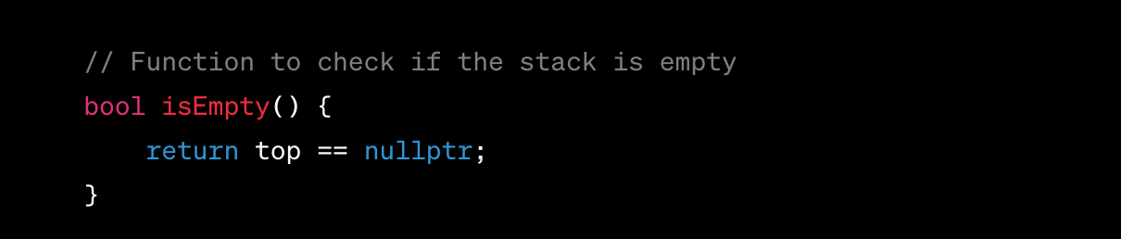

Slide 11
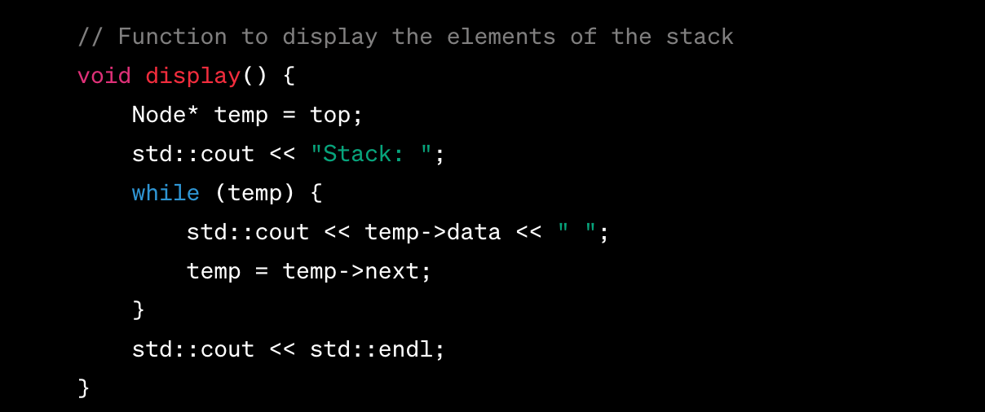

Slide 12
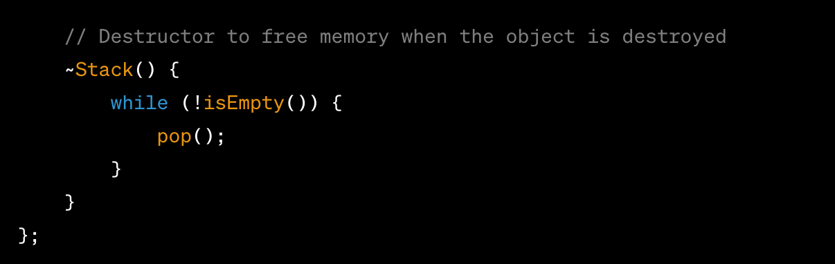

Slide 13
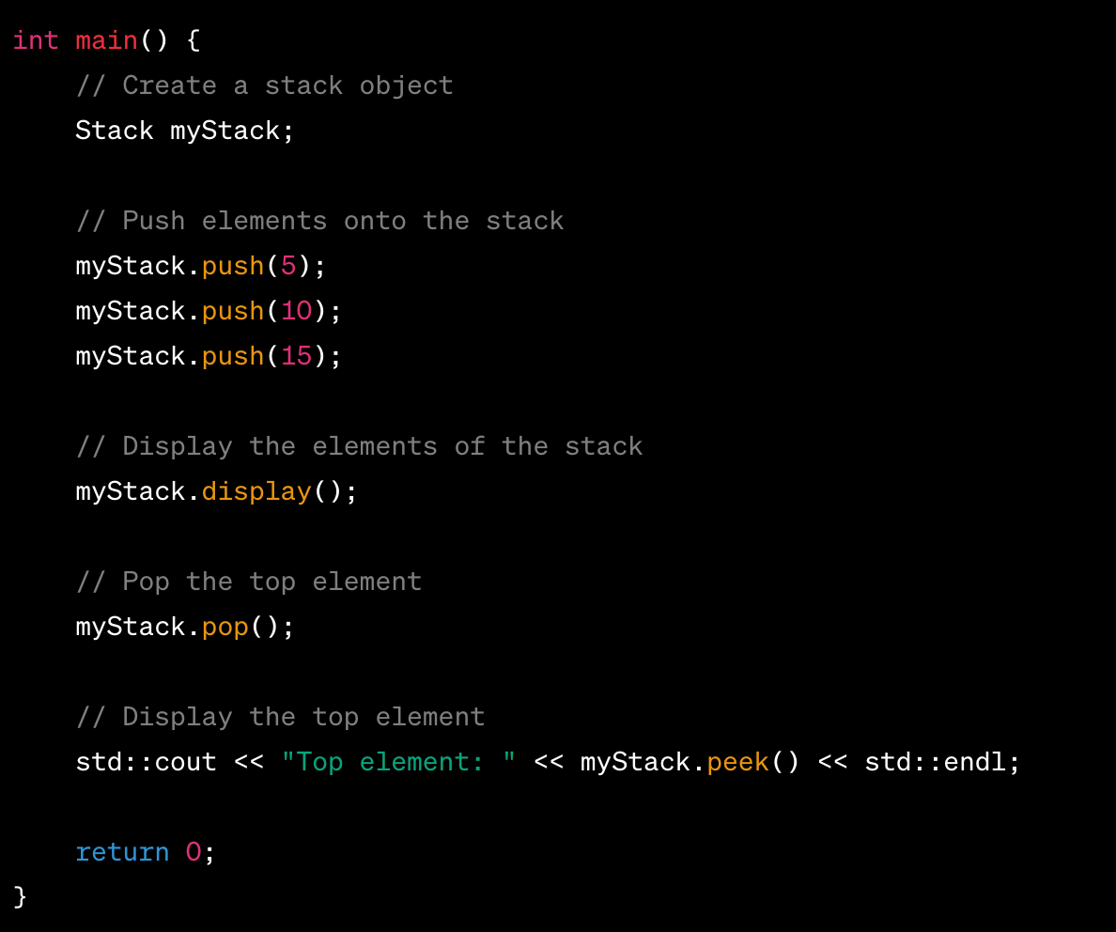

Slide 14
There is an easy way
Using STL in C++
But we do not use it in the first part of this lecture series
We want to learn the underline data structure for real
No abstractions please! I want to know the truth.
Once we learn the concept, we can use STL

Slide 15
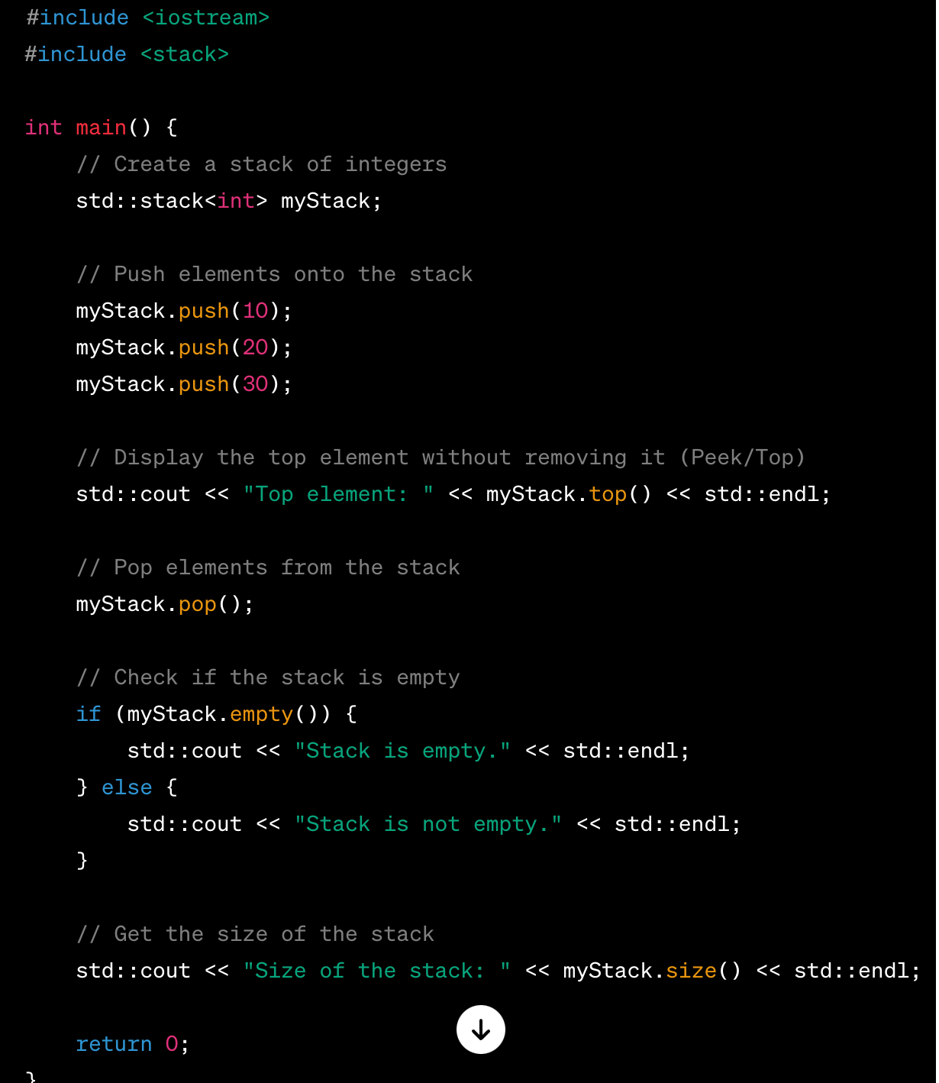

Slide 16
Use cases of Stacks
Function Call Management:
Stacks are used to manage function calls in programming languages. When a function is called, its local variables and the return address are pushed onto the stack.
Expression Evaluation:
Stacks are useful in evaluating expressions, especially in converting infix expressions to postfix or prefix form.
Undo Mechanisms:
Stacks are employed in applications with undo mechanisms, where the last action can be easily reversed by popping it from the stack.
Backtracking Algorithms:
Backtracking algorithms often use stacks to keep track of the path taken and revert to previous decisions when needed.

Slide 17
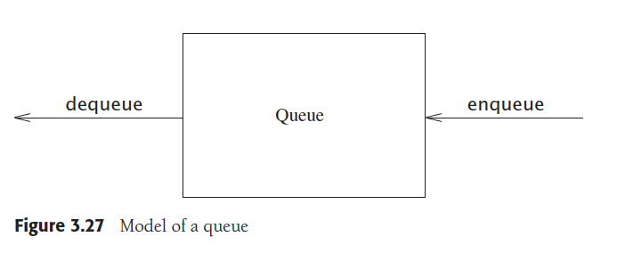
Queue - FIFO

Slide 18
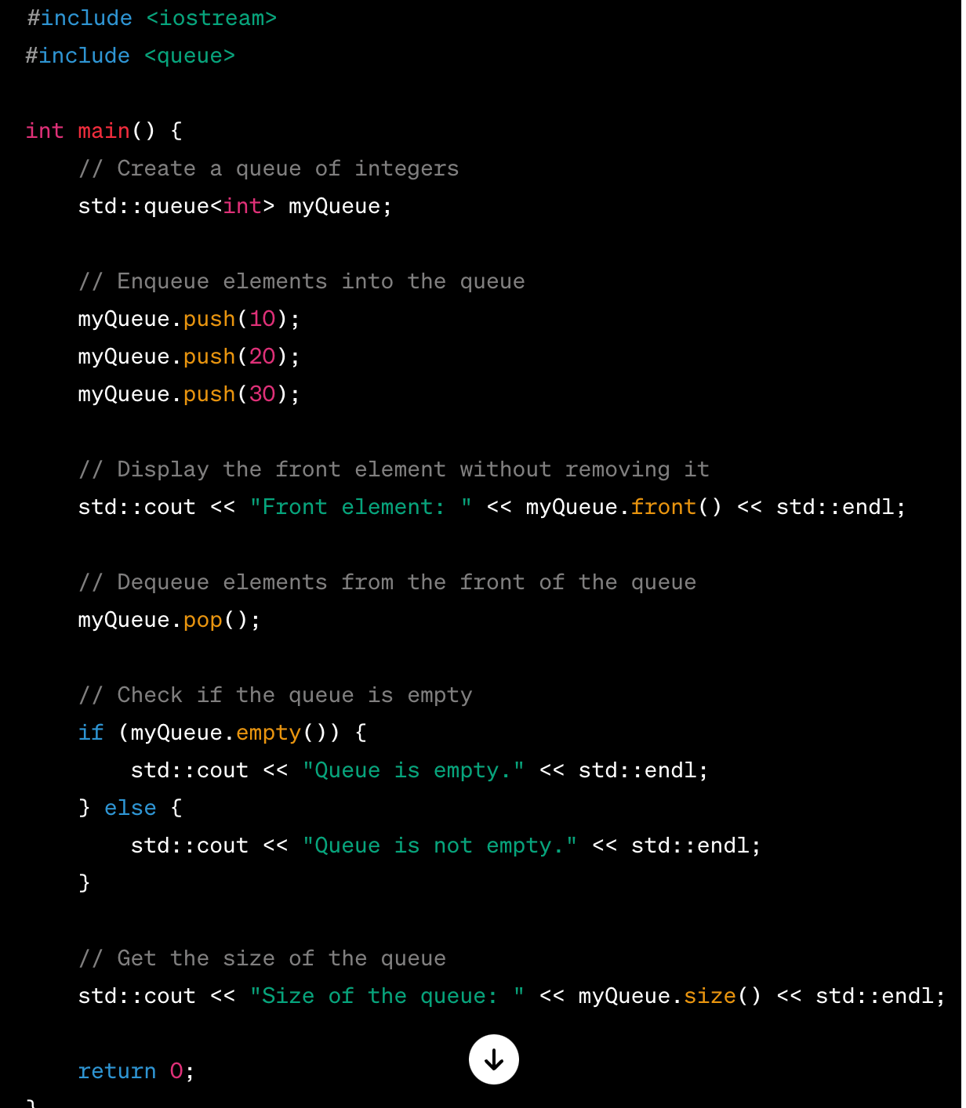

Not yet!

Slide 19
Let's do it hard way
Base components are the same as LinkedList and hence jump over them
Structure
Class
Constructors and destructor
We only concern about queue specific operations

Slide 20
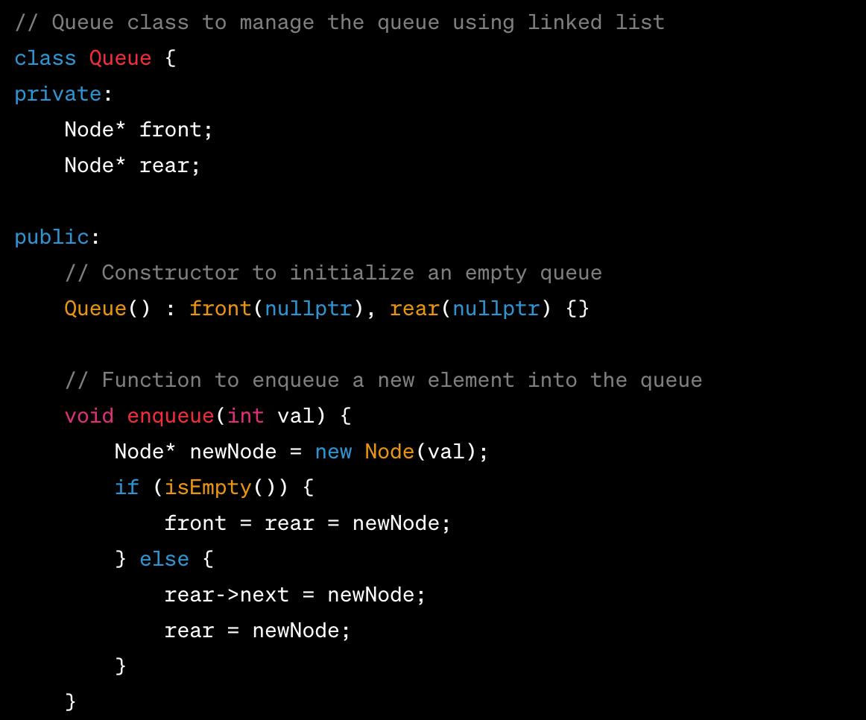

Slide 21
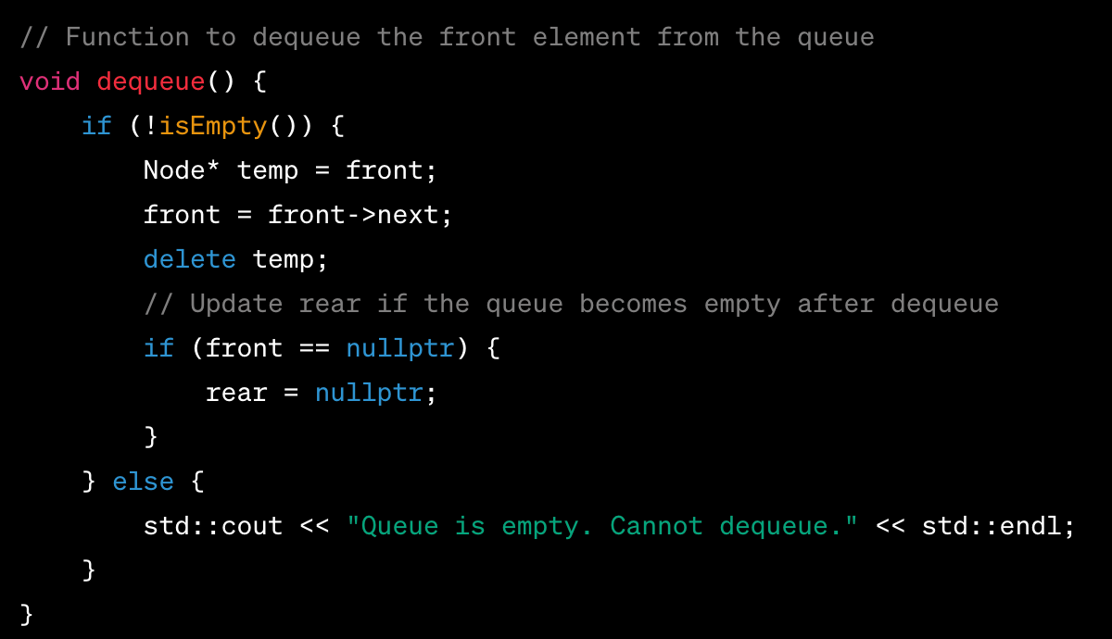

Slide 22
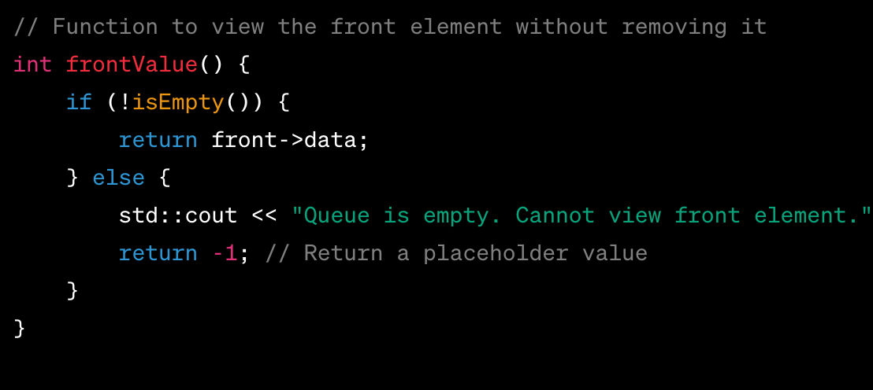

Slide 23
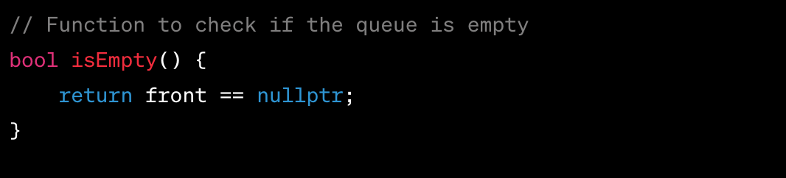

Slide 24
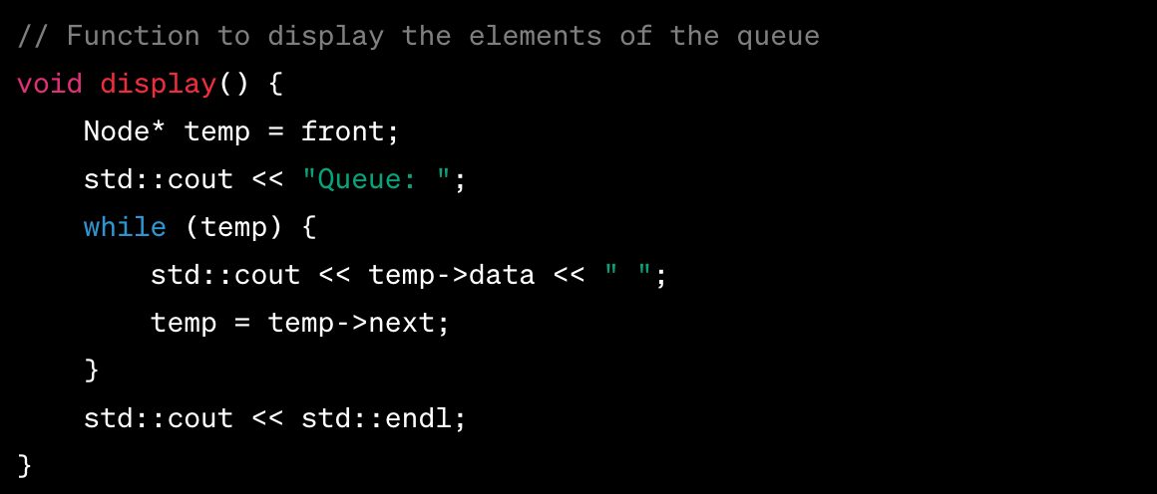
Same as stack

Slide 25
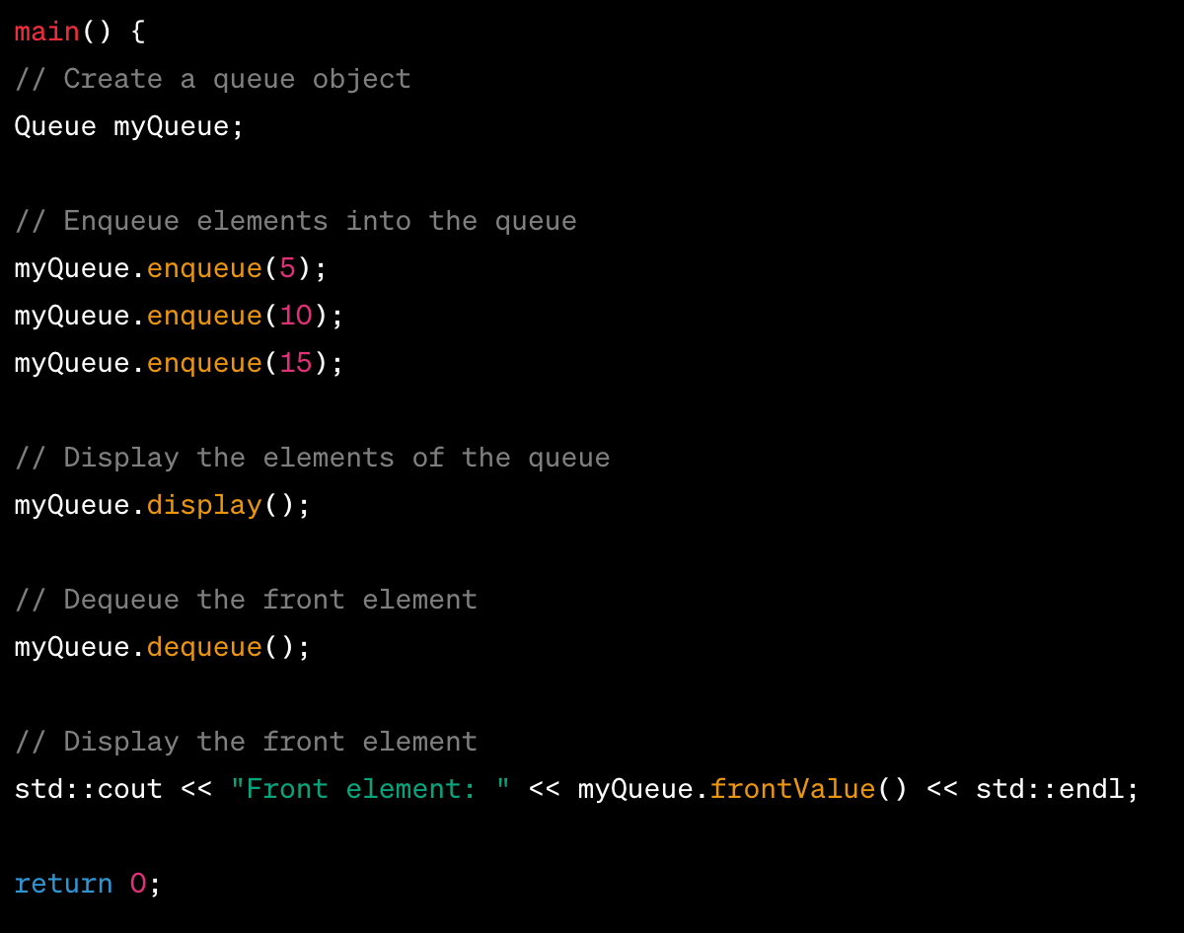

Slide 26
Queue use cases
Task Scheduling:
FIFO queues are commonly used in task scheduling algorithms where tasks are executed in the order they are received.
Breadth-First Search (BFS):
BFS traversal in graph algorithms often uses FIFO queues to explore vertices level by level.
Print Queue:
Print jobs are typically managed using FIFO queues to ensure that the first document sent to the printer is the first one printed.
Data Buffering:
FIFO queues are employed in scenarios where data needs to be buffered before processing, such as in communication systems.

Slide 27
Exercise
Swap two adjacent elements by adjusting only the links (and not the data) using Singly linked list

Slide 28
Let’s do one use case of Stack to conclude the class
Let’s evaluate a postfix expression with a stack
What is a postfix expression?
"2 3 4 * + 5 -"

Slide 29
Infix, postfix and prefix expressions
An infix expression is the standard mathematical notation in which operators are written between the operands.
Examples:
3 + 4 * 5
(a + b ) x d
In postfix notation, also known as Reverse Polish Notation (RPN), the operators come after their operands.
Examples
3 4 5 x + equivalent to 3 + 4 x 5
In prefix notation, the operators precede their operands.
Examples:
+ 3 x 4 5 is equivalent to 3 + 4 x 5

Slide 30
Algorithm
Initialize an Empty Stack:
Scan the Postfix Expression from Left to Right:
For Each Symbol:
If the symbol is an operand, push it onto the stack.
If the symbol is an operator, pop the required number of operands from the stack, perform the operation, and push the result back onto the stack.
Continue Scanning Until the End of the Expression:
Return the only element in the stack (result)

Slide 31
Example
Let's evaluate the postfix expression "2 3 4 * + 5 -":
Scan the expression from left to right:
"2": Push 2 onto the stack.
"3": Push 3 onto the stack.
"4": Push 4 onto the stack.
"*": Pop 3 and 4 (operands), calculate 3 * 4 = 12, and push 12 onto the stack.
"+": Pop 2 and 12 (operands), calculate 2 + 12 = 14, and push 14 onto the stack.
"5": Push 5 onto the stack.
"-": Pop 14 and 5 (operands), calculate 14 - 5 = 9, and push 9 onto the stack.
The final result is 9, which is the only element remaining on the stack.

Slide 32
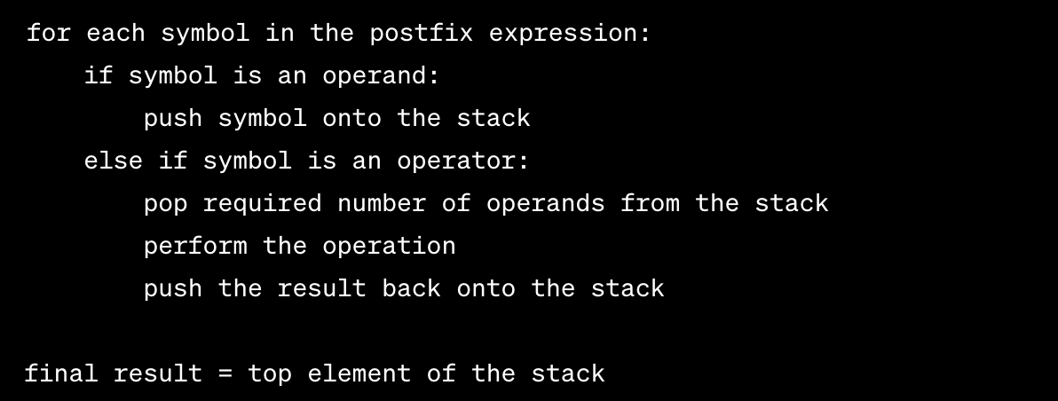
How to program - Pseudocode

Slide 33
Homework
Implement the evaluation of postfix expressions with STL stack.

Slide 34
Questions?

