Slide 1
Analysis of Algorithms Week 3

Slide 2


What we did so far?
List
Stack
Queue
Iterators
Analysis of algorithm

Slide 3

Today
Binary Trees
Terminology
Height
Traversals
Binary Search Trees
Definition
find
insert
delete
buildTree

Slide 4
Introduction
What is a tree?
In data structures, a tree is a hierarchical and widely used abstract data type that simulates a hierarchical tree structure with a root value and subtrees of children, represented as nodes.

Slide 5
Terminologies
Node: Each element in a tree is called a node. Nodes contain data and may have links to other nodes.
Root: The topmost node in a tree is called the root. It is the starting point for traversing the tree.
Parent and Child: Nodes in a tree are connected such that one node is the parent of another node (directly above it), and the connected node is a child of the parent.
Leaf: A node in a tree that has no children is called a leaf or a terminal node.

Slide 6
Terminologies – Cont’d
Subtree: A tree formed by a node and its descendants in the hierarchy is called a subtree.
Level: The level of a node is the distance from the root. The root is at level 0, and its children are at level 1, and so on.
Depth: The depth of a node is the length of the path from the root to that node.
Height: The height of a tree is the length of the longest path from the root to a leaf. It represents the depth of the deepest node.

Slide 7
Reminder: Tree terminology
Node
A
Root
B
C
Left subtree
Right subtree
D
E
F
G
Edges
H
I
Leaves
J
K
L
M
N

Slide 8
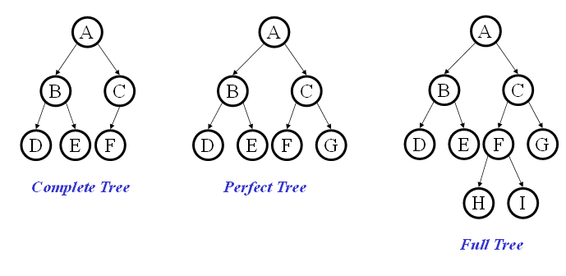
Binary Trees
Binary tree: Each node has at most 2 children
Binary tree is
A root (with data)
A left subtree (may be empty)
A right subtree (may be empty)
Special Cases:
Notes:
Complete tree
All levels, except possibly the last, are completely filled.
All nodes are as left as possible.
Perfect tree

Slide 9
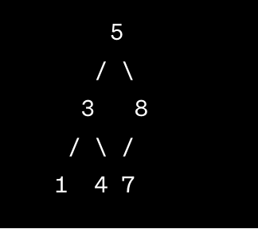

Complete tree
All levels, except possibly the last, are filled.
All nodes are as left as possible.
If we represent this tree in an array using a level-order traversal, it might look like:

Slide 10
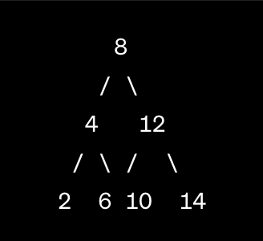
Complete Binary Tree
All interior nodes have exactly two children.
All leaf nodes are at the same level.
It is a complete binary tree.
challenging to maintain a perfectly balanced tree during dynamic operations

Slide 11
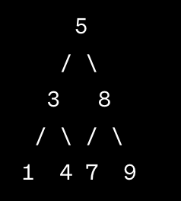
Full Tree
every node has either 0 or 2 children.
Perfect tree is a special case of full tree

Slide 12
Binary Trees: Some Numbers
Recall: height of a tree = longest path from root to leaf (count edges)
For binary tree of height h:
max # of leaves:
The maximum number of leaves in a binary tree of height h is 2^{ℎ-1}.
max # of nodes:
The maximum number of nodes in a binary tree of height ℎ is 2^{ℎ}−1.
min # of leaves:
The minimum number of leaves in a binary tree of height h is 1 if ℎ=0 (only the root node is a leaf). Otherwise, it is 0.
min # of nodes:
The minimum number of nodes in a binary tree of height h is ℎ+1
For n nodes, the min height (best-case) is ⌊log2​(n)⌋
the max height (worst-case) is n - 1

Slide 13
Tree Traversals
A traversal is an order for visiting all the nodes of a tree
Pre-order: root, left subtree, right subtree
In-order: left subtree, root, right subtree
Post-order: left subtree, right subtree, root
A
B
C
D
E
F
G

Slide 14
Binary Search Tree (BST) Data Structure
Structure property (binary tree)
Each node has ≤ 2 children
Result: keeps operations simple
Order property
Result: straight-forward to find any given value
8
5
11
2
6
10
12
4
7
9
14
A binary search tree is a type of binary tree
(but not all binary trees are binary search trees!)
13

Slide 15
Practice: are these BSTs?
5
8
4
8
5
11
1
7
11
2
7
6
10
18
All children must obey order
3
4
15
20
21

Slide 16
How do we find(value) in BST’s?
12
5
15
2
9
20
7
10
17
30

Slide 17
find in BST: Recursive Version
Data find(Data value, Node root){
if(root == null)
return null;
if(key < root.value)
return find(value, root.left);
if(key > root.value)
return find(value, root.right);
return root.value;
}
12
5
15
2
9
20
What is the running time?
7
10
17
30

Slide 18
find in BST: Iterative Version
12
Data find(Object value, Node root){
while(root != null
&& root.value != value) {
if (value < root.value)
root = root.left;
else (value > root.value)
root = root.right;
}
if(root == null)
return null;
return root.value;
}
5
15
2
9
20
7
10
17
30

Slide 19
Other BST “Finding” Operations
12
findMin: Find minimum node
findMax: Find maximum node
5
15
2
9
20
7
10
17
30

Slide 20
insert in BST
12
insert(13)
insert(8)
insert(31)
Worst-case running time:
5
15
2
9
20
7
10
17
30

Slide 21
Practice with insert, primer for delete
Start with an empty tree. Insert the following values, in the given order:
14, 2, 5, 20, 42, 1, 4, 16
Then, changing as few nodes as possible, delete the following in order:
42, 14
What would the root of the resulting tree be?
2
4
5
16

Slide 22
What does the following method do?
int height(Node root){
if (root == null),
return -1;
return 1 + max(height(root.left),
height(root.right);
}
It calculates the number of nodes in the tree.
It calculates the depth of the nodes.
It calculates the height of the tree.
It calculates the number of leaves in the tree.

Slide 23
delete in BST
Why might delete be harder than insert?
Basic idea:
Three potential cases to fix:

Slide 24
delete case: Leaf
delete(17)
12
5
15
2
9
20
7
10
17
30

Slide 25
delete case: One Child
delete(15)
12
5
15
2
9
20
7
10
30

Slide 26
delete case: Two Children
delete(5)
12
What can we replace 5 with?
5
2
9
20
7
10
30
Notes:
Ah, now the hard case. How do we delete a two child node?
We remove it and replace it with what?
It has all these left and right children that need to be greater and less than the new value (respectively).
Is there any value that is guaranteed to be between the two subtrees?
Two of them: the successor and predecessor!
So, let’s just replace the node’s value with it’s successor and then delete the succ.

Slide 27
delete case: Two Children
What can we replace the node with?
Options:
Notes:
Options:
successor minimum node from right subtree findMin(node.right)
predecessor maximum node from left subtree findMax(node.left)

Slide 28
delete case: Two Children (example #2)
delete(23)
12
5
23
2
9
18
30
7
10
15
19
25
32
Notes:
Ah, now the hard case. How do we delete a two child node?
We remove it and replace it with what?
It has all these left and right children that need to be greater and less than the new value (respectively).
Is there any value that is guaranteed to be between the two subtrees?
Two of them: the successor and predecessor!
So, let’s just replace the node’s value with it’s successor and then delete the succ.

Slide 29
Practice delete
Changing as few nodes as possible, delete the following in order:
42, 14
14
2
20
1
5
16
42
4

Slide 30
delete through Lazy Deletion
Lazy deletion can work well for a BST
Simpler
Can do “real deletions” later as a batch
Some inserts can just “undelete” a tree node
But
Can waste space and slow down find operations
Make some operations more complicated:
e.g., findMin and findMax?

Slide 31
Building the tree - BST
Let’s consider building (insert values starting from an empty tree)
Insert values 1, 2, 3, 4, 5, 6, 7, 8, 9 into an empty BST
If inserted in given order, what is the tree?
What big-O runtime for building a BST on this sorted input?
Is inserting in the reverse order any better?

Slide 32
Building a tree - BST
Insert values 1, 2, 3, 4, 5, 6, 7, 8, 9 into an empty BST
What we if could somehow re-arrange them
median first, then left median, right median, etc. 5, 3, 7, 2, 1, 4, 8, 6, 9
What tree does that give us?
What big-O runtime?

Slide 33
Implementation
struct TreeNode {
int data;
TreeNode* left;
TreeNode* right;
TreeNode(int value) : data(value), left(nullptr), right(nullptr) {}
};

Slide 34
Class – private methods
class BinaryTree {
private:
TreeNode* root;
// Private helper functions
void insertHelper(TreeNode*& node, int value);
TreeNode* deleteHelper(TreeNode* node, int value);
void inOrderTraversalHelper(TreeNode* node);
void preOrderTraversalHelper(TreeNode* node);
void postOrderTraversalHelper(TreeNode* node);

Slide 35
Public methods
public:
BinaryTree() : root(nullptr) {}
// Public functions
void insert(int value);
void remove(int value);
void inOrderTraversal();
void preOrderTraversal();
void postOrderTraversal();
};

Slide 36
Insert
void BinaryTree::insertHelper(TreeNode*& node, int value) {
if (node == nullptr) {
node = new TreeNode(value);
} else if (value < node->data) {
insertHelper(node->left, value);
} else {
insertHelper(node->right, value);
}
}

Slide 37
InOrder Traversal
void BinaryTree::inOrderTraversalHelper(TreeNode* node) {
if (node != nullptr) {
inOrderTraversalHelper(node->left);
std::cout << node->data << " ";
inOrderTraversalHelper(node->right);
}
}

Slide 38
PreOrder Traversal
void BinaryTree::preOrderTraversalHelper(TreeNode* node) {
if (node != nullptr) {
std::cout << node->data << " ";
preOrderTraversalHelper(node->left);
preOrderTraversalHelper(node->right);
}
}

Slide 39
PostOrder Traversal
void BinaryTree::postOrderTraversalHelper(TreeNode* node) {
if (node != nullptr) {
postOrderTraversalHelper(node->left);
postOrderTraversalHelper(node->right);
std::cout << node->data << " ";
}
}

Slide 40
Delete – bit complex
TreeNode* BinaryTree::deleteHelper(TreeNode* node, int value) {
if (node == nullptr) {
return nullptr;
}
if (value < node->data) {
node->left = deleteHelper(node->left, value);
} else if (value > node->data) {
node->right = deleteHelper(node->right, value);
} else {

Slide 41
// Node with only one child or no child
if (node->left == nullptr) {
TreeNode* temp = node->right;
delete node;
return temp;
} else if (node->right == nullptr) {
TreeNode* temp = node->left;
delete node;
return temp;
}

Slide 42
// Node with two children: Get the inorder successor (smallest
// in the right subtree)
TreeNode* temp = node->right;
while (temp->left != nullptr) {
temp = temp->left;
}
// Copy the inorder successor's data to this node
node->data = temp->data;
// Delete the inorder successor
node->right = deleteHelper(node->right, temp->data);
}
return node;
}

